Slide 1
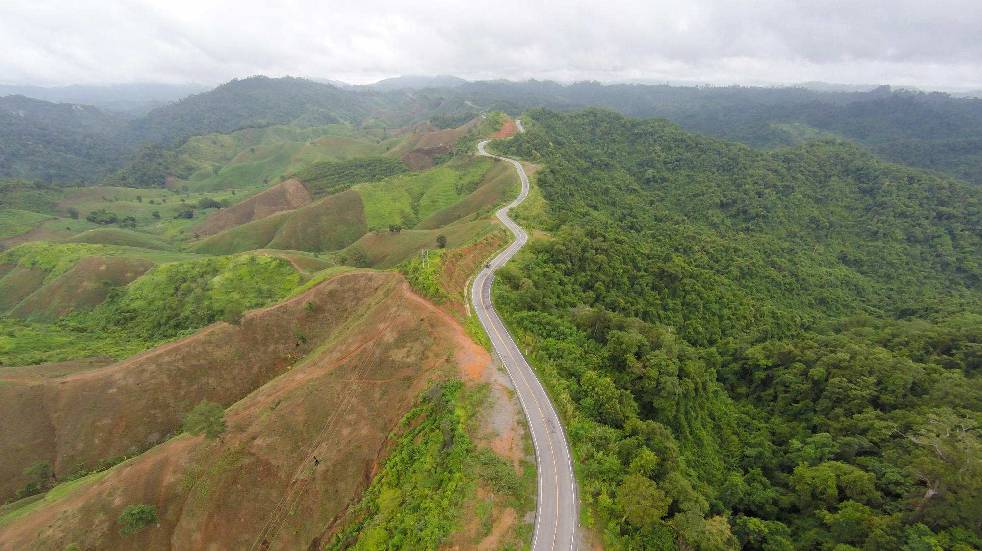

The Transport System and Transport Policy
Edited by Bert van Wee, Jan Anne Annema, David Banister and Baiba Pudãne
Chapter 10: Transport and the environment
Author: Natalia Barbour
Road though mountains - Free image on Pexels

Slide 2
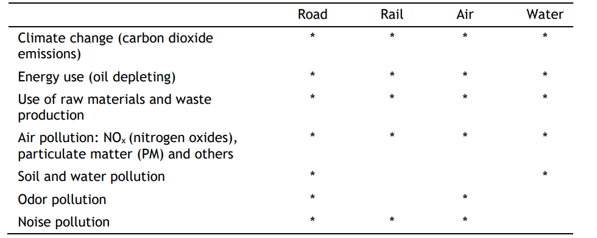
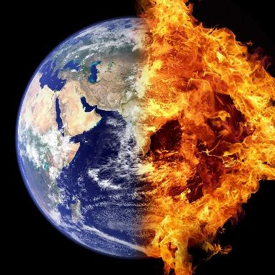
Introduction and scope
Transport has diverse environmental impacts, including harm to biodiversity, air quality, and public health.
The focus of this chapter
Table 10.1 Dominant environmental impacts per transport mode. (Taken from Chapter 10, page 253)

Slide 3
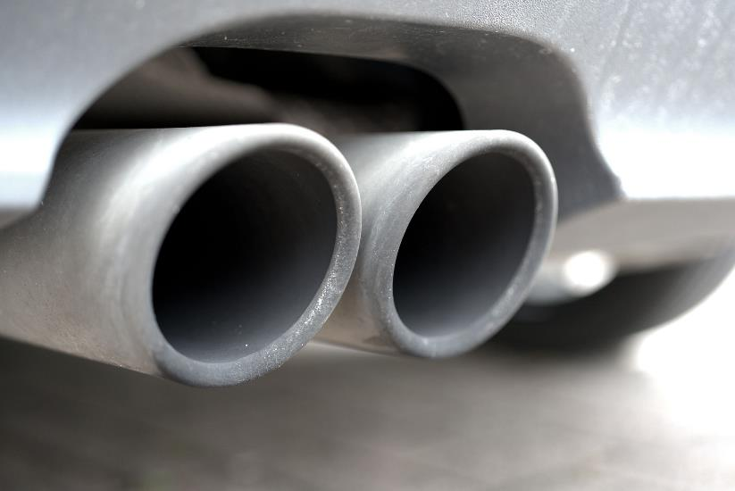
Introduction
CO₂ emission is the most important contributor to rising global temperatures.
The exponential growth of emissions since the 1950s is primarily due to the dependence on fossil fuel-driven transportation and industry.
Globally, the transportation sector accounts for 24% of direct CO₂ emissions from fuel combustion.
In developed economies, this value reaches 30% of national total, partly due to the contribution of road transport.
Exhaust car - Free image on Pixabay

Slide 4

Chapter overview
History of environmental concerns
Trends in CO₂ emissions from transport
Other types of pollution and their causes
CO₂-driven innovations in the transport sector
Environmental performance of transport modes
Policy instruments to reduce environmental impact
Criteria to evaluate environmental policy options
Conclusions

Slide 5

Chapter overview
History of environmental concerns
Trends in CO₂ emissions from transport
Other types of pollution and their causes
CO₂-driven innovations in the transport sector
Environmental performance of transport modes
Policy instruments to reduce environmental impact
Criteria to evaluate environmental policy options
Conclusions

Slide 6
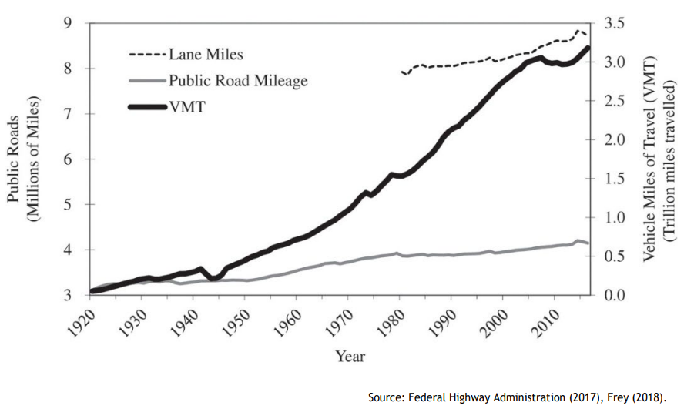
History of environmental concerns in transport
Rapid growth in population, industrialization, and consumption levels fuelled concerns over environmental problems in the late 1960s.
Growth in emissions from fuel combustion linked to increased travel.
Vehicle miles travelled (VMT) has been increasing in the United States (USA) since 1920. (see figure)
High ratio of vehicles to people, e.g., 816 vehicles to 1,000 people in USA and 681 to 1,000 inhabitants in Luxembourg
The process of oil extraction (drilling, fracking, mining) pollute water & affect health, degrade land and wildlife, and damage ecosystems.
Figure 10.2 Growth in vehicle miles travelled (VMT), public road mileage, and public road lane-miles in the United States from 1920 to 2016.
(Taken from Chapter 10, page 203)
Federal Highway Administration (2017), Highway statistics—2016, U.S. Department of Transportation. Washington DC.

Slide 7


History of environmental concerns in transport
The high reliance on automobile has impacted livability.
Car-centric designs, traffic, or exposure to pollution
Natural environment, transportation convenience and environmental health
Car-free/car-lite spaces for inclusive urban mobility
Accommodates a healthy life and easy mobility

Slide 8
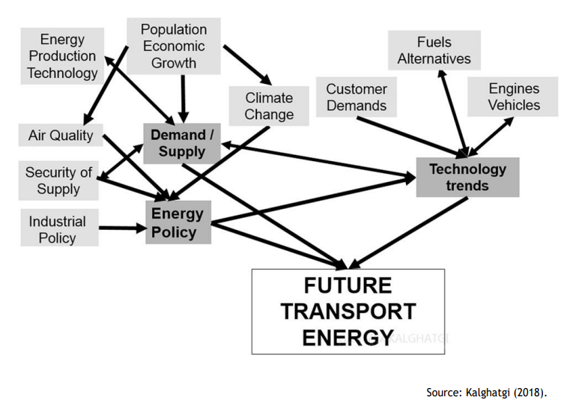
Addressing environmental concerns caused by road transport
There are various ways to address the environmental concerns caused by road transport:
Transport technology (Chapter 8)
Land-use and infrastructure (Chapter 5)
Driving behavior (Chapter 8)
Legislative measures increasing transport resistance (Chapter 6)
Energy system (see figure for factors influencing the future transport energy system)
Figure 10.4 Factors in future transport energy
(Taken from Chapter 10, page 204)
Kalghatgi, G. (2018), ‘Is it really the end of internal combustion engines and petroleum in transport?’, Applied Energy, 225, 965-974.

Slide 9
Overview chapter
History of environmental concerns
Trends in CO₂ emissions from transport
Other types of pollution and their causes
CO₂-driven innovations in the transport sector
Environmental performance of transport modes
Policy instruments to reduce environmental impact
Criteria to evaluate environmental policy options
Conclusions

Slide 10

Trends in CO₂ emissions from transport
(Fossil) fuel combustion
Fossil fuels are burned in the internal combustion engines of road vehicles, ships, and planes for propulsion. CO₂ is a byproduct.
A vehicle can cover large distances, with relatively low fuel volume on board, due to its high energy content.
Inexpensive fuel has led to its wide adoption in passenger cars and vans.
However, price can widely fluctuate, strongly influencing travel demand and adoption of alternative technologies.
CO₂
Propulsion

Slide 11
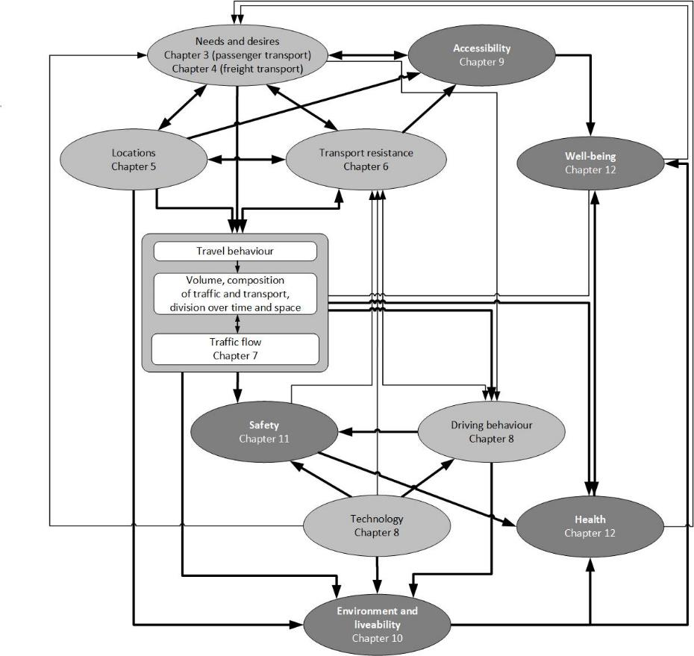
Factors in the transport system influencing CO₂ emission trends
CO₂ emissions are dependent on:
the number of vehicles on the road affected by affordability, consumer incomes and preference (Chapter 3),
distances driven affected by infrastructure characteristics (Chapter 5),
prices such as fuel price and tax policies such as car taxation tolls or congestion charge (Chapter 6),
land use (Chapter 5) ,
the level of fuel economy of the cars and vehicle size, as well as driving behaviour (Chapter 8).

Slide 12
Chapter overview
History of environmental concerns
Trends in CO₂ emissions from transport
Other types of pollution and their causes
CO₂-driven innovations in the transport sector
Environmental performance of transport modes
Policy instruments to reduce environmental impact
Criteria to evaluate environmental policy options
Conclusions

Slide 13

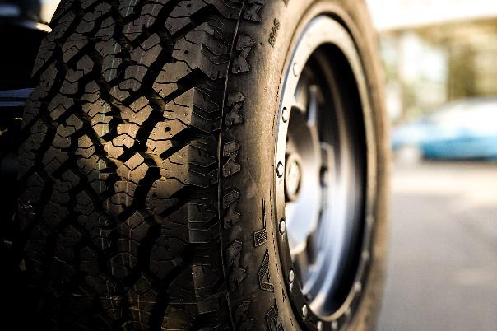
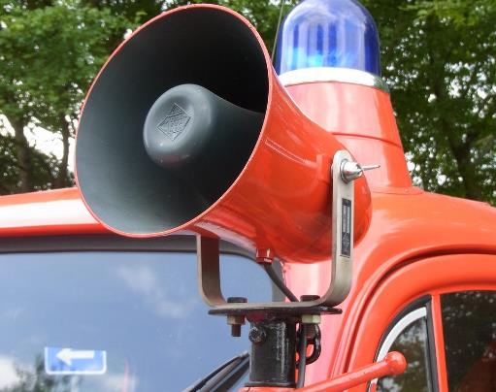
Other types of pollution and their causes: overview
Besides CO₂ emissions, the sector also faces environmental impacts from
Exhaust air pollution: particulate matter (PM), nitrogen oxide (NO_{x}), carbon monoxide (CO)
Non-exhaust air pollution: particulate matter from breaking and tire wear
Noise pollution: from engines, and by engines and tire-road contact at high speeds
Black car with silver car photo – Free Grey Image on Unsplash
Black and silver car wheel photo – Free Tire Image on Unsplash
Automobile Antique Car Fire - Free photo on Pixabay - Pixabay

Slide 14

Particulate Matter (PM): source and impacts
Traffic is a major contributor to high levels of particulate matter (PM) emissions
Exhaust and non-exhaust sources are tire wear, brake wear, and road dust resuspension
  Non-exhaust emissions contribute to the formation of secondary PM through atmospheric chemical reactions
The amount of PM is influenced by weight of vehicle
PM is associated with health impacts, primarily respiratory and cardiovascular problems, and even premature death.
Associated negative health effects are high due to the shorter distance between road traffic and the exposed individuals compared to other emission sources

Slide 15
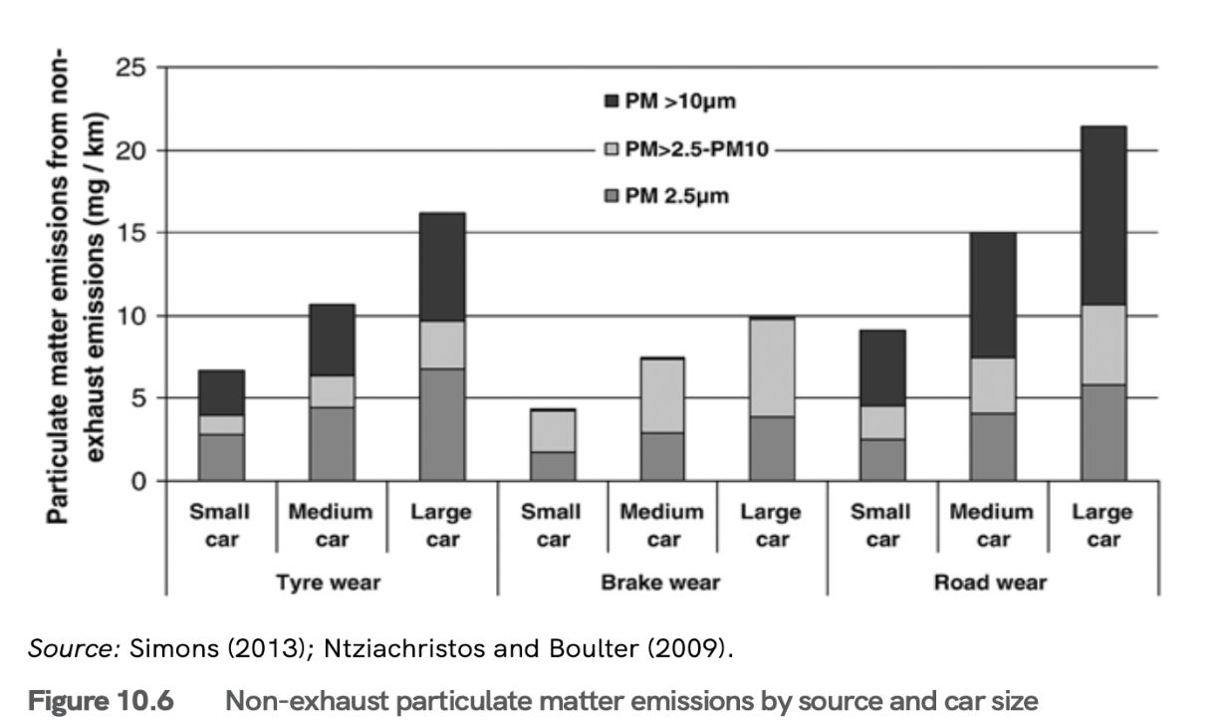
Particulate Matter (PM): source and impacts

Slide 16
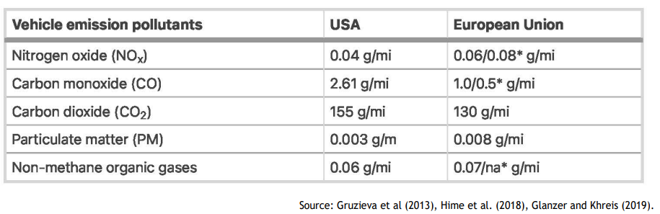

Other pollutants besides CO₂ and PM
The transportation sector also emits other pollutants like
nitrogen oxide (NO_{x}),
carbon monoxide (CO),
sulfur dioxide (SO₂),
ozone (O₃), and
non-methane gases.
The emissions are often unregulated and allowed amounts of pollutants can vary by region.
(See Figure 10.7 for comparison between the USA and European Union.)
Figure 10.7 Comparison of vehicle emission regulations per pollutant between USA and EU for light duty vehicles set to last until 2025. (Taken from Chapter 10, page 208)

Slide 17

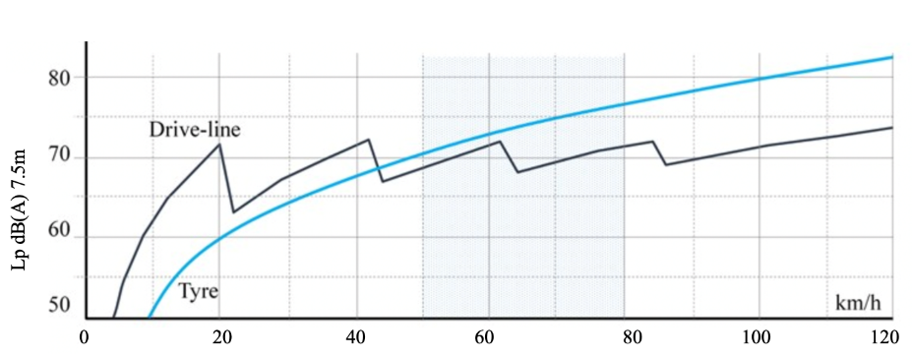
Noise pollution
Noise pollution is a consequence of
Running engines
Tires making contact with road surface at high speeds
Exposure to noise pollution in the US is linked to socioeconomic position, while the linkage in the EU is less clear.
Transport-related noise pollution are linked to adverse health outcomes.
Figure 10.8 Correlation between velocity and noise emitted by car. (Taken from Chapter 10, page 209)

Slide 18
Overview chapter
History of environmental concerns
Trends in CO₂ emissions from transport
Other types of pollution and their causes
CO₂-driven innovations in the transport sector
Environmental performance of transport modes
Policy instruments to reduce environmental impact
Criteria to evaluate environmental policy options
Conclusions

Slide 19

CO₂-driven innovations in the transport sector
Categories of innovations are:
  Technical innovations:
    Electrification: battery capacities and durability, charging infrastructure
    Use of hydrogen as an energy carrier
    Biofuels for freight, marine, and aviation
  Behavioural innovations:
    Mobility-as-a-Service (MaaS)
    Micromobility (e-scooters, bikesharing)
    Car-sharing and ridesharing
    Innovations in public transport

Slide 20
CO2-driven innovations in the transport sector
Categories of innovations are:
  Technical innovations:
    Electrification: battery capacities, durability, charging infrastructure
    Use of hydrogen as an energy carrier
    Biofuels for freight, marine, and aviation
  Behavioural innovations:
    Mobility-as-a-Service (MaaS)
    Micromobility (e-scooters, bikesharing)
    Car-sharing and ridesharing
    Innovations in public transport

Slide 21
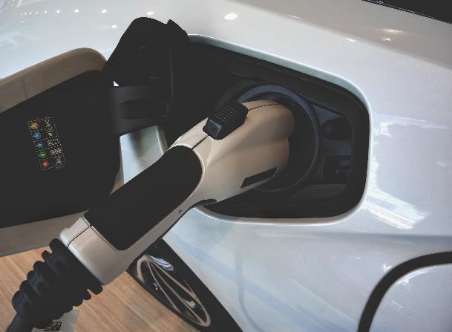
Technical innovations: Electrification
Electrification is a prominent strategy for mitigating climate change.
Reduction in emissions achieved, but with constraints:
Battery weight and its impact on vehicle weight and non-exhaust emissions
Sourcing of raw materials (e.g., Lithium and Cobalt)
EV adoption dependent on availability of charging infrastructure
Car charging - Free image on Unsplash

Slide 22
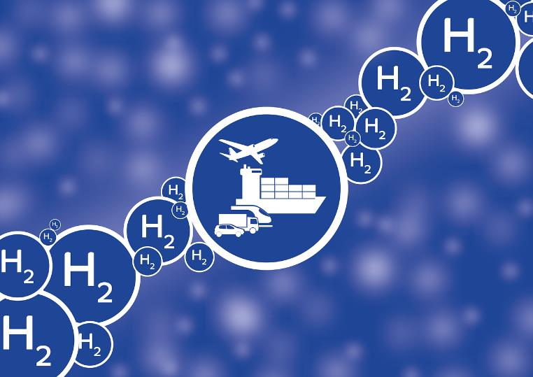
Technical innovations: Hydrogen
Hydrogen fuel cell technology could decarbonize the heavy and long-haul freight or marine shipping.
Barriers to its use:
Low energy lifecycle efficiency compared to direct electrification
Charging infrastructure, price, and technology maturity
Hydrogen transport - Free image on Pixabay
Transport and Environment (2020), Electrofuels? Yes, we can ... if we’re efficient. Retrieved from https://www.transportenvironment.org/wpcontent/uploads/2020/12/2020_12_Briefing_feasibility_study_renewables_decarbonisation.pdf (February 4th, 2022).

Slide 23

Technical innovations: Biofuels
Biofuels complement electrification in transportation, particularly in freight, marine, and aviation sectors Ethanol and biodiesel have achieved commercial scale and success.
Challenges in scaling up biofuels, particularly those derived from lignocellulosic feedstocks.
Biofuel - Free image on Pixabay
Jaramillo, P., S. Kahn Ribeiro, P. Newman, S. Dhar, O. Diemuodeke, T. Kajino, D. Lee, S. Nugroho, X. Ou, A. Hammer Strømman and J. Whitehead (2022), Transport. In IPCC, 2022: Climate change 2022: Mitigation of climate change. Contribution of Working Group III to the Sixth Assessment Report of the Intergovernmental Panel on Climate Change [P.R. Shukla, J. Skea, R. Slade, A. Al Khourdajie, R. van Diemen, D. McCollum, M. Pathak, S. Some, P. Vyas, R. Fradera, M. Belkacemi, A. Hasija, G. Lisboa, S. Luz, J. Malley, (eds.)]. Cambridge University Press, Cambridge, UK and New York, NY, USA. doi: 10.1017/9781009157926.012

Slide 24

CO₂-driven innovations in the transport sector
Categories of innovations are:
  Technical innovations:
    Electrification: battery capacities, durability, charging infrastructure
    Use of hydrogen as an energy carrier
    Biofuels for freight, marine, and aviation
  Behavioural innovations:
    Innovations in public transport
    Mobility-as-a-Service (MaaS)
    Advances in micromobility (e-scooters, bikesharing)
    Car-sharing and ridesharing

Slide 25

Reducing emissions through behavior change
Behavioral changes and incentives can contribute to emissions reduction alongside technological innovation
Mobility-as-a-service (Maas)
Public transport information
Advances in micromobility
Infrastructure information
Phone - Free image on Unsplash

Slide 26

Behavioural innovations: Sharing economy
Growth in shared mobility solutions stimulated by advancements in technology, a decrease in price of mobile devices and availability of internet connection.
Use of services depend on socio-demographic, residential location characteristics, time of day or weather conditions.
Adoption varies because users are not homogeneous.
Price plays a crucial role in the adoption of emerging services.

Slide 27
Chapter overview
History of environmental concerns
Trends in CO₂ emissions from transport
Other types of pollution and their causes
CO₂-driven innovations in the transport sector
Environmental performance of transport modes
Policy instruments to reduce environmental impact
Criteria to evaluate environmental policy options
Conclusions

Slide 28

A comparison of the environmental performance of transport modes
Comparing emissions performance of transport modes is challenging due to methodological differences:
Selection of emissions for comparison
Inclusion of indirect emissions from vehicle production, infrastructure, etc.
Consideration of emissions from electricity production and refineries
Comparison of emissions for different years and sub-segments
Differentiating between average emissions and marginal emissions
Factoring in time periods and real-world circumstances
Accounting for load factors or occupancy rates
van Wee, B., P. Janse and R. van den Brink (2005), ‘Comparing environmental performance of land transport modes', Transport Reviews, 25(1), 3–24.

Slide 29

A comparison of the environmental performance of transport modes
Lifecycle analysis provide a comprehensive evaluation of transport impacts including:
Vehicle production and scrapping,
Energy (fuel) extraction, and
Production and the full environmental impacts associated with infrastructure.
LCA used to calculate impacts of the full range of transport activities associated with the entire supply chain of a product.

Slide 30

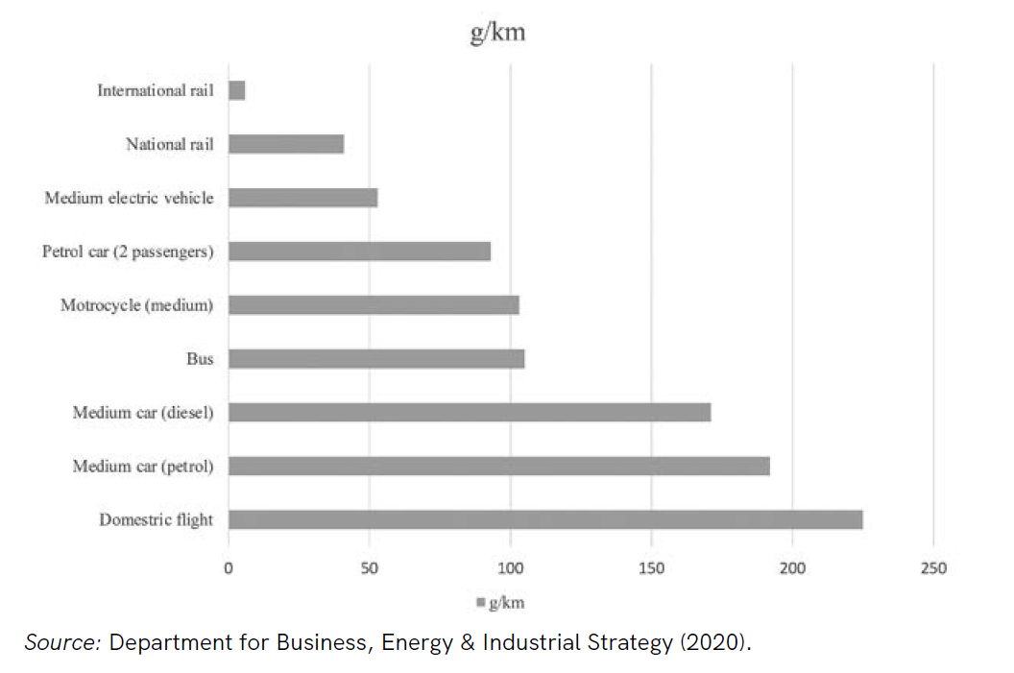
A comparison of the environmental performance of transport modes
Walking, cycling, and train travel are the most efficient and least pollution-intensive modes:
Substituting car trips with bicycles reduces travel emissions to negligible amounts of CO₂
Choosing a train over a car for medium-length distances can cut emissions by around 80%
Opting for a train instead of a domestic flight reduces emissions by approximately 84%
Figure 10.10 Carbon footprint of travel per kilometer in 2018. (Chapter 10, page 215)
Department for Business, Energy & Industrial Strategy (2020), Government greenhouse gas conversion factors for company reporting: Methodology paper for Conversion factors. Final Report. London, UK.

Slide 31
Chapter overview
History of environmental concerns
Trends in CO₂ emissions from transport
Other types of pollution and their causes
CO₂-driven innovations in the transport sector
Environmental performance of transport modes
Policy instruments to reduce environmental impact
Criteria to evaluate environmental policy options
Conclusions

Slide 32



Policy instruments to reduce the environmental impacts of transport
Policy measures can be categorized into physical, soft, and knowledge policies:
Physical policies
Soft policies
Knowledge policies
Building and maintaining infrastructure for public transport, walking, cycling, and freight transport
Non-tangible measures aimed at behavioural change, such as incentives, pricing, and regulations
They promote efficient vehicle use and behaviours like carsharing, carpooling, teleworking, teleshopping, and eco-driving
Investment in research and development for sustainable model of mobility

Slide 33

Policy instruments to reduce the environmental impact of transport
Types of policy measures:
Regulations
Pricing
Land-use planning
Infrastructure policies
Public transport policies
Policies to stimulate work-from-home

Slide 34

Policy instruments to reduce the environmental impact of transport: regulations
Types of policy measures:
Regulations
Pricing
Land-use planning
Infrastructure policies
Public transport policies
Policies to stimulate work-from-home

Slide 35
Policy instruments to reduce the environmental impact of transport: regulations
Emission regulations for road vehicles have successfully reduced transport emissions of pollutants in OECD countries:
  CO, VOC, and NO_{x} emissions per car and truck kilometer have decreased by a factor of 5 to 10 or more between 1980 and the 2020s (see Chapter 8).
Despite tightened noise emission standards, car fleets have not become quieter over time.
  Noise from fleets of lorries has only reduced by 3 dB(A) between 1980 and 1996.
Limiting speed limits can effectively reduce noise pollution, especially between 50 and 80 km/h.
  It can also impact safety by reducing the frequency and severity of vehicle crashes.
  Cost associated with travel time losses be significant.

Slide 36

Policy instruments to reduce the environmental impact of transport: pricing
Types of policy measures:
Regulations
Pricing
Land-use planning
Infrastructure policies
Public transport policies
Policies to stimulate work-from-home

Slide 37

Policy instruments to reduce the environmental impact of transport: pricing
Subsidies on public transport have several benefits:
  Reduced fares.
  Decreased transport resistance.
  Increased usage of public transit.
  Often motivated by environmental improvement, reduced congestion, and improved access for individuals without cars.
Free Rich Image on Unsplash

Slide 38




Policy instruments to reduce the environmental impact of transport: pricing
Taxes on fuels can change the share of different fuel types and address environmental concerns.
  Higher fuel prices lead to decreased car use in the longer term (fuel price elasticity estimated to be around -0.25).
Parking charges increase transport resistance, reducing car use and promoting alternative modes of transportation.
Road pricing schemes, like congestion pricing, Effectively reduce congestion, change travel patterns, and encourage cycling.
  Singapore reduced peak hour traffic by 65%.
  London decreased traffic volume entering the congestion zone by 18%.
  Stockholm resulted in decreased vehicle distance, traffic volume, and emissions.
Carbon pricing, such as carbon taxes, encourages travelers to use less polluting and more cost-effective vehicle fuel types.

Slide 39
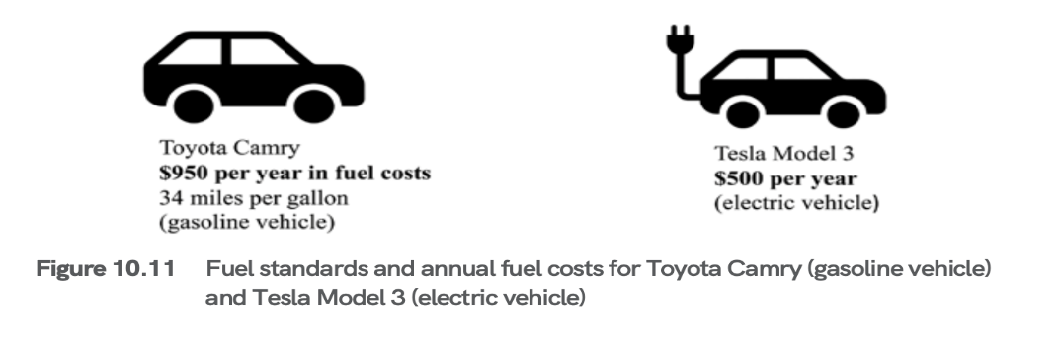
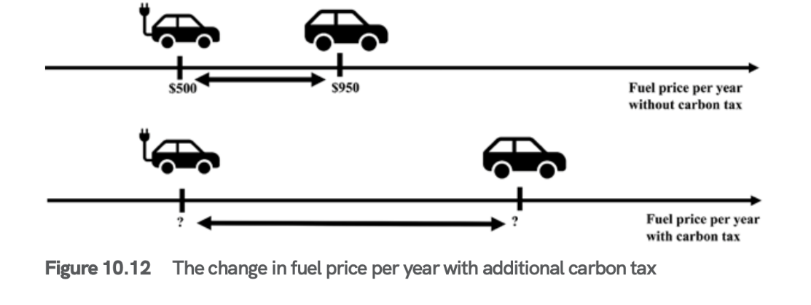
Policy instruments to reduce the environmental impact of transport: carbon pricing
The more carbon-intensive option is taxed, the price gap between refueling these two different models will widen.

Slide 40

Policy instruments to reduce the environmental impact of transport: land-use planning
Types of policy measures:
Regulations
Pricing
Land-use planning
Infrastructure policies
Public transport policies
Policies to stimulate work-from-home

Slide 41
Policy instruments to reduce the environmental impact of transport: land-use planning
High-density development can reduce travel distances by bringing destinations closer together
Locating offices and residential neighbourhoods near railway stations can increase the share of public transit
Attractive neighbourhood design can encourage the use of slow modes of transportation
Mixed land use, such as combining housing, shops, schools, and services, can reduce travel distances and promote the use of slow modes
Effects on the distribution of road types and its driving behaviours can reduce emissions, safety levels and emissions exposure.

Slide 42

Policy instruments to reduce the environmental impact of transport: infrastructure policies
Types of policy measures:
Regulations
Pricing
Land-use planning
Infrastructure policies
Public transport policies
Policies to stimulate work-from-home

Slide 43
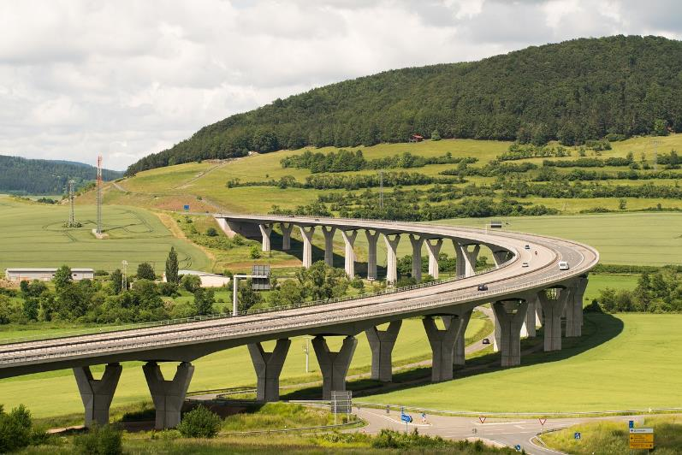
Policy instruments to reduce the environmental impact of transport: infrastructure policies
Infrastructure provision is typically a public matter, even in the case of toll roads:
  Governments determine the construction and location of motorways, and the institutional context.
The quality and quantity of road and rail networks significantly impact
  Transport volumes, modal split, traffic distribution, route choices.
  Driving behaviors, safety, emission levels and exposure.
Highway - Free image on Pixabay

Slide 44

Policy instruments to reduce the environmental impact of transport: infrastructure policies
Infrastructure supporting alternative modes such as cycling, bikesharing, e-cycling, and walking can effectively reduce emissions.
Public agencies invest in bicycle infrastructure networks to enhance connectivity and accessibility, including bike lanes and pavement maintenance.
Bike-friendly initiatives have seen global growth, resulting in improvements in cycling infrastructure.
  The installation of additional bike lanes in NYC led to a significant increase in bikesharing daily trips.
Bicycle - Free image on pixabay
Xu, S. and J. Chow (2020), ‘A longitudinal study of bike infrastructure impact on bikesharing system performance in New York City’, International Journal of Sustainable Transportation, 14(11).

Slide 45
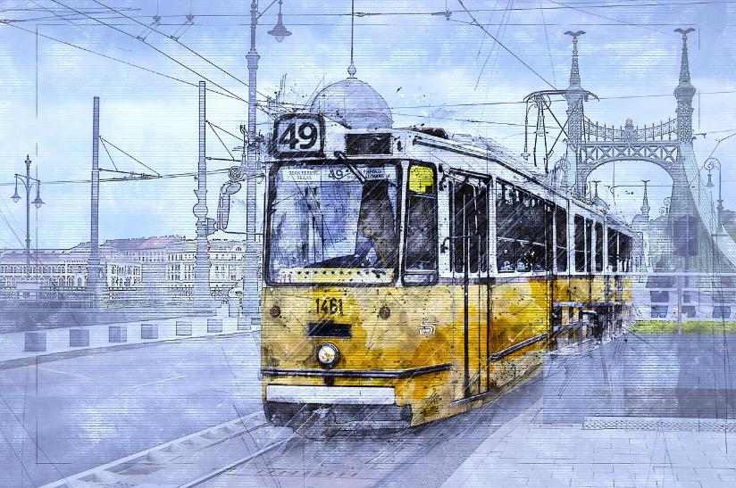
Policy instruments to reduce the environmental impact of transport: public transport policies
Types of policy measures:
Regulations
Pricing
Land-use planning
Infrastructure policies
Public transport policies
Policies to stimulate work-from-home

Slide 46
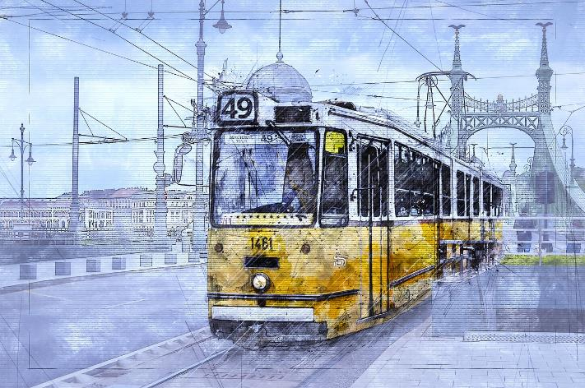
Policy instruments to reduce the environmental impact of transport: public transport policies
Public transport can be made more attractive through specific policies
Adjustments in bus routing and frequency and improvements in railway station facilities can enhance public transport
Transit-Oriented Developments (TODs) can make public transit more convenient and appealing

Slide 47

Policy instruments to reduce the environmental impact of transport: work-from-home
Types of policy measures:
Regulations
Pricing
Land-use planning
Infrastructure policies
Public transport policies
Policies to stimulate work-from-home

Slide 48
Policy instruments to reduce the environmental impact of transport: work-from-home
The COVID-19 pandemic caused a sudden change in commute patterns and the rapid adoption of work-from-home.
  This led to decreased pollution and traffic in most cities during the pandemic.
Work-from-home is being explored as a viable alternative to auto commutes to reduce transportation-related environmental impacts.
Work-from-home policies may be stimulated by various factors, including:
  Flexible work hours.
  Attractive tax deductions for home office maintenance.
  New legislations supporting telehealth and privacy-sensitive fields.
Work from home - Free image on Pixabay

Slide 49
Chapter overview
History of environmental concerns
Trends in CO₂ emissions from transport
Other types of pollution and their causes
CO₂-driven innovations in the transport sector
Environmental performance of transport modes
Policy instruments to reduce environmental impact
Criteria to evaluate environmental policy options
Conclusions

Slide 50
Criteria to evaluate candidate environmental policy options
Ex-ante and ex-post policy evaluation each compare two different scenarios
Multiple policies need to be implemented to meet emission reduction objectives.
Effectiveness of policies are to be continuously evaluated.
 | Scenario without intervention | Scenario with intervention
Ex-ante evaluation | What will happen if not introduced | What will happen if introduced
Ex-post evaluation | What would happen if not introduced | What happened when introduced

Slide 51
Criteria to evaluate candidate environmental policy options
As policies may be difficult to implement and may have side-effects, the evaluation criteria of available options become important to define.
The following criteria are typically included in the evaluation:
CO₂ emission reductions
Costs
Other environmental impacts
Risks or risk perceptions
Land-use and spatial impacts
Psychological factors
Legal, institutional, and political factors
Stakeholder positions
Transition feasibility, whether evolutionary changes or radical changes are required

Slide 52
Overview chapter
History of environmental concerns
Trends in CO₂ emissions from transport
Other types of pollution and their causes
CO₂-driven innovations in the transport sector
Environmental performance of transport modes
Policy instruments to reduce environmental impact
Criteria to evaluate environmental policy options
Conclusions

Slide 53

Conclusions
Road transportation due to its increased auto-dependency is a major contributor to emissions.
CO₂ and particulate matter (PM) are the most problematic pollutants in transport.
Many policy instruments are available to reduce the environmental impact of transport.
Effective implementation of measures is key.
Future environmental problems will likely include energy use, climate change, health, raw material use, and noise nuisance, as well as battery supply chain issues.
Mitigating CO₂ emissions, reducing oil dependency, and addressing unregulated non-exhaust emissions are the key challenges for the coming decades.
Pricing is a powerful tool to change behaviour.
Technology improvements should be supported by smart adoption, usage, and timely regulation.
Earth globe protection planet - Free image on Pixabay

Slide 54
The Transport System and Transport Policy
Edited by Bert van Wee, Jan Anne Annema, David Banister and Baiba Pudãne
Chapter 10: Transport and the environment
Author: Natalia Barbour
Road though mountains - Free image on Pexels

