Slide 1
The Transport System and Transport Policy
Edited by Bert van Wee, Jan Anne Annema, David Banister and Baiba Pudãne
Chapter 12: Travel behaviour and health
Authors: Bert van Wee and Dick Ettema
Bike holiday - Free image on Pexels

Slide 2
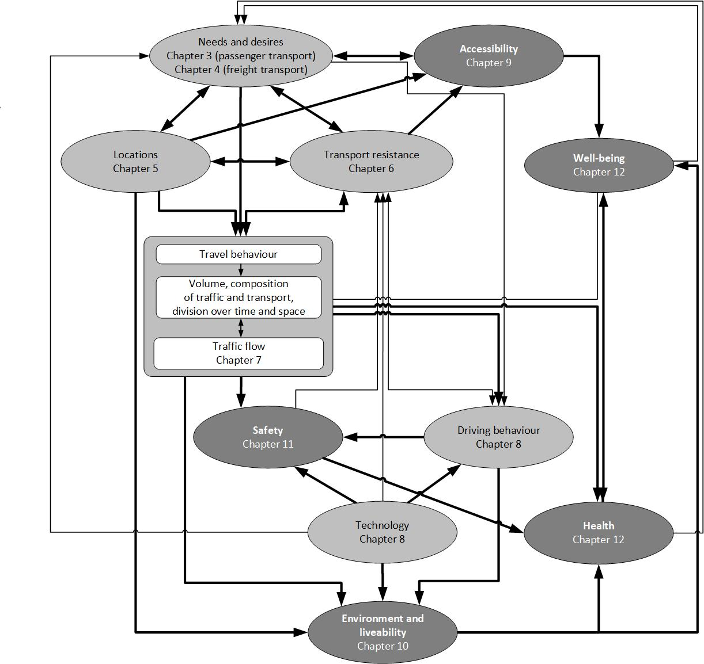
Introduction
The health impacts of the transport system are gaining significance in research and policy making
Travel behaviour affects the health of both travellers and non-travellers
Key influencing factors are travel behaviour (e.g., cycling and walking) and exposure to air pollution and safety risks. Accessibility levels impact well-being.
Health and well-being are strongly related

Slide 3
Overview chapter
Travel behaviour and the health of travellers
Travel behaviour and the health of non-travellers
Conclusions

Slide 4
Overview chapter
Travel behaviour and the health of travellers
Travel behaviour and the health of non-travellers
Conclusions

Slide 5
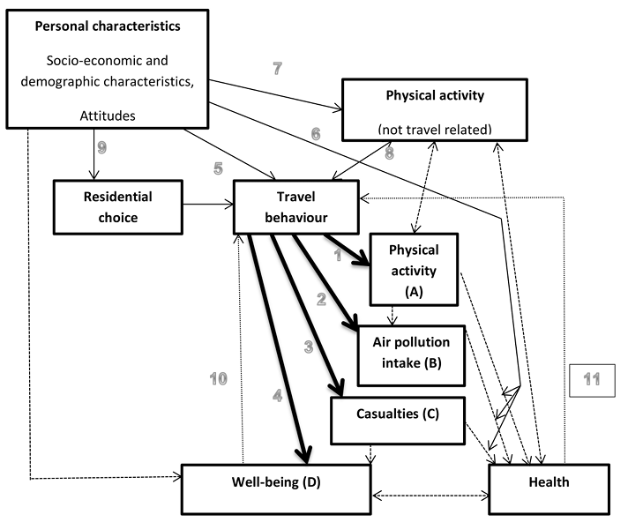
Health of travellers: A conceptual model
‘Health is a state of complete physical, mental and social well-being and not merely the absence of disease of infirmity.’ (WHO, 2020)
This chapter: excludes social dimension and distinguishes:
mental component of health = subjective well-being (this chapter)
physical component of health = health (this chapter)
Conceptual model for dominant links between travel behaviour and health of travellers →
Here:
 | Dominant first order relationships between travel behaviour and health
 | Second order relationships
 | Other relationships
1-4
5-11
Figure 12.1 Conceptual model for the relationship between travel behaviour and health
Source: adapted from van Wee and Ettema (2016) (Taken from Chapter 12, page 261)
This model focusses on the individual level.
The general conceptual framework (see earlier) focuses on aggregate relationships.
Van Wee, B. and D. Ettema (2016), ‘Travel behaviour and health: A conceptual model and research agenda’, Journal of Transport and Health, 3(3) 240-248.
WHO (2020) (World Health Organization), ‘Basis documents, forty-ninth edition. https:// apps .who .int/gb/ bd/ pdf files/ BD 49th -en .pdf, assessed 22-5-2023, page 1. (Accessed 23/05/2023)

Slide 6
Health of travellers: First order relationships
The dominant direct relationships are
From travel behaviour to physical activity (arrow 1)
From travel behaviour to pollution intake (arrow 2)
From travel behaviour to casualties (arrow 3)
From travel behaviour to subjective well-being (arrow 4)
These relationships are ‘first order’ relationships because travel behaviour influences health via these routes
All other relationships in figure (→) are called ‘second order’ relationships. There is much more research on first order effects than on the second order effects
Figure 12.1 Conceptual model for the relationship between travel behaviour and health
(Taken from Chapter 12, page 261)

Slide 7
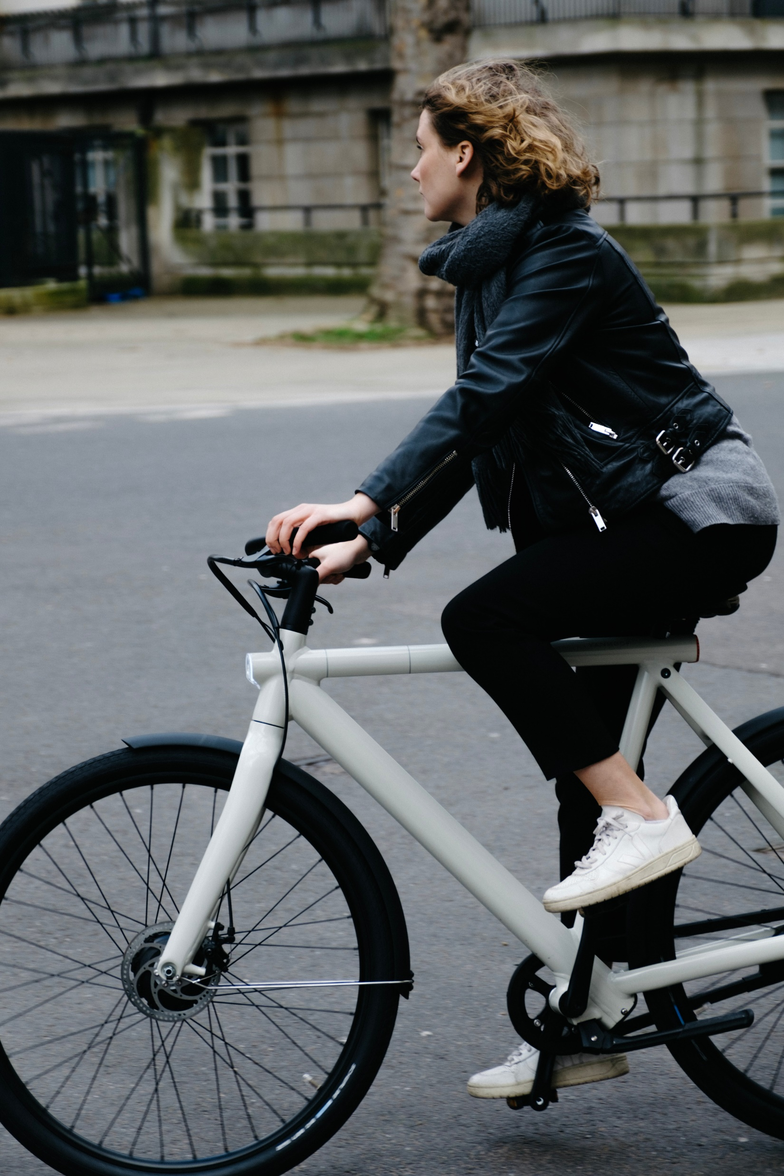
Health of travellers: Physical activity
Adults are recommended to engage in moderate physical activity for 150 minutes or vigorous physical activity for 75 minutes per week.
Walking and cycling can contribute to fulfilling these physical activity recommendations.
Figure 12.1 Conceptual model for the relationship between travel behaviour and health
(Taken from Chapter 12, page 261)
Person in black jacket riding on white bicycle during daytime photo – Free London Image on Unsplash

Slide 8
Health of travellers: Air pollution
Exposure to air pollution applies to all categories of travellers:
Drivers and passengers of cars and other motorized vehicles
People cycling and walking
People traveling by underground
Concentration of pollutants is the highest on the roads and decrease with distance from the road (Janssen et al., 2002)
Drivers and passengers of motorized vehicles are exposed to relatively high concentrations of pollutants
Concentration of pollutants in vehicles is between 1.5 and over 10 times higher than in the ambient air
Concentration depends on traffic density and vehicle characteristics
Figure 12.1 Conceptual model for the relationship between travel behaviour and health
(Taken from Chapter 12, page 261)
Janssen, N.A.H., B. Brunekreef, G. Hoek and P. Keuken (2002), Traffic-related air pollution and health. Utrecht / Apeldoorn: Utrecht University, Institute for Risk Assessment Sciences, Environmental and Occupational Health Division / TNO Milieu, Energie en Procesinnovatie.

Slide 9
Health of travellers: Air pollution
Cyclists
are exposed to lower air pollution concentrations than drivers due to larger distance
inhale more air than car drivers because they are physically active (Van Wee, 2007; see arrow Physical activity → Air pollution intake)
Exposure to pollutants of cyclists and pedestrians depends on travel speed:
Higher speed leads to higher breathing rates and higher pollution inhaled per unit of time (Nyhan et al., 2014)
However, higher speeds also imply shorter travel times, resulting in less overall exposure (McNabola et al., 2007)
Figure 12.1 Conceptual model for the relationship between travel behaviour and health
(Taken from Chapter 12, page 261)
Van Wee, B. (2007), Environmental effects of urban traffic, in: T. Garling and L. Steg (eds.), Threats from car traffic to the quality of urban life. Problems, causes, and solutions, Amsterdam: Elsevier. Nyhan, M., A. McNabola and B Misstear (2014), ‘Evaluating artificial neural networks for predicting minute ventilation and lung deposited dose in commuting cyclists’. Journal of Transport and Health, 1 (4), 305-315. McNabola, A., B. Broderick and L.W. Gill (2007), ’Optimal cycling and walking speed for minimum absorption of traffic emissions in the lungs’, Journal of Environmental Science and Health - Part A Toxic/Hazardous Substances and Environmental Engineering, 42(13), 1999- 2007.

Slide 10
Health of travellers: Air pollution
People traveling by underground are often exposed to high concentrations of particulate matter (PM) originating from mechanical friction processes (wheel on rail, brakes)
Figure 12.1 Conceptual model for the relationship between travel behaviour and health
(Taken from Chapter 12, page 261)
Man beside woman wearing black backpack photo – Free Urban Image on Unsplash

Slide 11
Health of travellers: Air pollution
Negative health effects of air pollution include (Handy, 2014):
Cardiovascular diseases
Eye and throat irritation
Respiratory health problems (asthma, lung damage)
High blood pressure
Neurological disorders and cancer
Brain and kidney damage, among others
Health effects depend on:
Duration and accumulation of exposure
Personal characteristics (infants, the elderly, pregnant women are more sensitive to certain pollutants)
Health status (smoking, obesity, diabetes)
Figure 12.1 Conceptual model for the relationship between travel behaviour and health
(Taken from Chapter 12, page 261)
Handy, S. (2014). Health and travel., in: T. Gärling, D. Ettema, M. Friman (eds.), Handbook of sustainable travel, Dordrecht/Heidelberg/New York/London: Springer

Slide 12
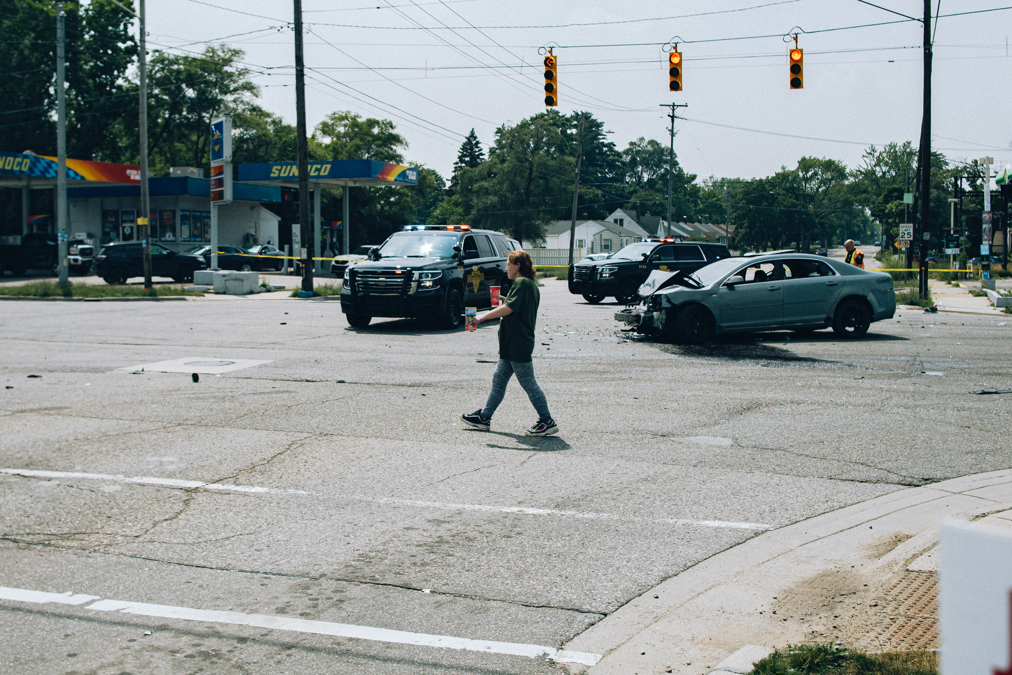
Health of travellers: Casualties
Travelling with any mode is associated with incident risk, including fatalities and injuries
Risk factors are mode-specific and vary between different road types (see chapter 11)
Figure 12.1 Conceptual model for the relationship between travel behaviour and health
(Taken from Chapter 12, page 261)
A man walking across a street next to a car photo – Free Flint Image on Unsplash

Slide 13
Health of travellers: Casualties
Estimating the risks for cycling (and walking) is complex:
Cycling infrastructure, cycling experience and driver behaviour around cyclists greatly varies across countries
Higher cycling levels result in lower risk factors (safety in numbers effect)
Comparisons should be based on competing trips rather than aggregate average risk factors; e.g., should consider urban (and not inter-urban) car trips as comparison for cycling trips
Data on cycling behaviour is often lacking in many countries
Cycling is poorly included in mainstream transport models
Risks are influenced by gender and age of users and their risk-taking behaviours
Figure 12.1 Conceptual model for the relationship between travel behaviour and health
(Taken from Chapter 12, page 261)

Slide 14
Health of travellers: Well-being
The effect of travel on subjective well-being:
The experience of travel itself and the interaction with the physical and social environment influences mood and well-being.
Positive effect of active modes on well-being is explained by physical activity, higher interaction with the environment, experience of autonomy and mastery, and social interactions in one's neighbourhood
Car travel (depending on duration, congestion, road characteristics)
Public transport (depending on PT modes and quality – delays, crowding, etc.)
Active modes (walking, cycling)
Higher
Lower
Satisfaction and well-being
Figure 12.1 Conceptual model for the relationship between travel behaviour and health
(Taken from Chapter 12, page 261)

Slide 15
Health of travellers: Well-being
The effect of travel on subjective well-being:
Access to travel enables participation in meaningful activities that foster subjective well-being
Access to important destinations and the potential to travel influence well-being
Lack of transport options may result in reduced participation in (social, cultural, economic) activities and lower subjective well-being
Well-being also depends on environmental characteristics such as attractiveness and noise levels
Figure 12.1 Conceptual model for the relationship between travel behaviour and health
(Taken from Chapter 12, page 261)

Slide 16
Health of travellers: Second order relationships
Several second order relationships exist:
Socio-economic and demographic characteristics and travel behaviour (arrows 5, 6, 7)
Physical activity: walking and cycling versus physical activity that is not related to travel (arrow 8)
Subjective well-being and the use of active modes (arrow 10)
Health and travel behaviour (arrow 11)
Self-selection effects (arrows 5 and 9)
Macro-micro effects and social influence (no specific arrow)
Figure 12.1 Conceptual model for the relationship between travel behaviour and health
(Taken from Chapter 12, page 261)

Slide 17
Health of travellers: Socio-economics & demographics
Socio-economic and demographic variables (e.g., age, education, gender, household characteristics) influence travel behaviour (arrow 5)
Health impacts of physical activity, pollution intake and crashes/falls are moderated by personal characteristics (arrow 6)
E.g., an 85-year-old would be more affected by a fall from bicycle than a 14-year-old
Age and gender impact the non-travel related physical activity (arrow 7)
The effects of socio-demographic characteristics on travel-related health outcomes can be contradictory
E.g., the elderly may benefit more from physical activities but are more vulnerable to crashes/falls and sensitive to pollution
Figure 12.1 Conceptual model for the relationship between travel behaviour and health
(Taken from Chapter 12, page 261)

Slide 18
Health of travellers: Non-travel physical activity
People may substitute other physical activities, such as going to the gym, with walking or cycling
Or: individuals who walk or cycle may engage more in other forms of physical activity due to feeling fitter
Both effects probably occur; varying evidence.
Important for policy: to what extent cycling and walking have additional health benefits?
Figure 12.1 Conceptual model for the relationship between travel behaviour and health
(Taken from Chapter 12, page 261)
Women taking exercise on black stationary bikes in front of gray concrete wall photo – Free Fitness Image on Unsplash

Slide 19
Health of travellers: Well-being → Travel
Previously: active travel (walking, cycling) leads to higher travel satisfaction and subjective well-being
However, individuals with higher subjective well-being may be more likely to use active modes
Ignoring the bi-directionality can lead to an overestimation of the well-being effects of active travel
Figure 12.1 Conceptual model for the relationship between travel behaviour and health
(Taken from Chapter 12, page 261)

Slide 20
Health of travellers: Health → Travel
Previously: travel behaviour influences health through various routes (arrows 1-4)
However, health also influences travel behaviour:
Individuals with lower health levels may engage in more walking and cycling to improve their health.
However, it is also possible that their lower health level results in lower levels of walking and cycling
De Haas et al. (2021): individuals with a higher Body Mass Index (BMI) cycle less than the average
Figure 12.1 Conceptual model for the relationship between travel behaviour and health
(Taken from Chapter 12, page 261)
De Haas, M., M. Kroesen, C. Chorus, S. Hoogendoorn-Lanser and S. Hoogendoorn (2021), ‘Causal relations between body-mass index, self-rated health and active travel: An empirical study based on longitudinal data’, Journal of Transport and Health, 2021, 22, 101113.

Slide 21
Health of travellers: Self-selection effects
Personal characteristics (socio-economics, demographics & attitudes) influence their travel behaviour via two routes:
Directly (arrow 5). People’s characteristics and preferences for car travel, public transport, biking, or walking influence their mode choices and usage patterns
Indirectly via residential self-selection (arrow 9). Individuals choose to live in areas that align with their preferred modes of transportation:
People who like travelling by active modes may choose to live in areas that support their use
A person with lung disease may choose to live in an area that is not exposed to high concentrations of pollutants or traffic
Figure 12.1 Conceptual model for the relationship between travel behaviour and health
(Taken from Chapter 12, page 261)
Built environment also directly influences travel behaviour. I.e., neighbourhood walkability increases walking trips (see also ch. 5).

Slide 22
Overview chapter
Travel behaviour and the health of travellers
Travel behaviour and the health of non-travellers
Conclusions

Slide 23
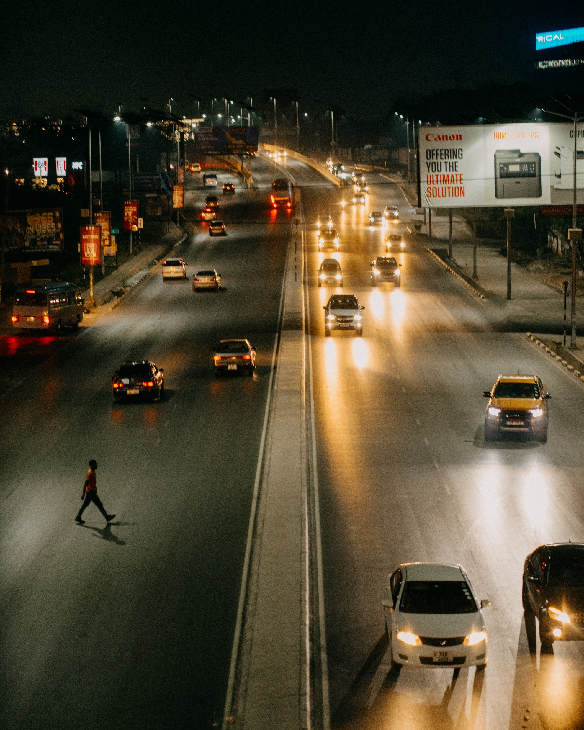
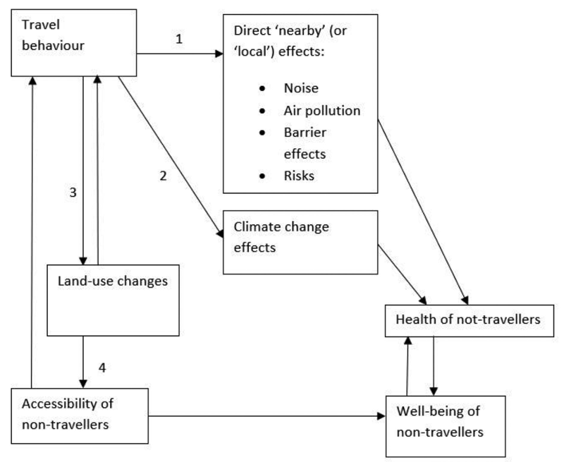
Health of non-travellers: A conceptual model
Travel behaviour not only affects the health of travellers but also has health impacts on non-travellers: called ‘external effects’ or ‘externalities’ in economic literature (see ch. 13)
Travel behaviour of people has an impact on the health of others first via nearby or ‘local’ effects →
*
Figure 12.2 A conceptual model for the dominant relationships between travel behaviour and health of non-travellers (Taken from Chapter 12, page 267)
* Barrier effects describe the ability to cross streets and other infrastructure objects
Traffic at Night · Free Stock Photo (pexels.com)

Slide 24
Health of non-travellers: Climate change effects
Transport contributes to climate change, mainly due to CO2 emissions (see Chapter 10).
Climate change will have a range of health-related effects (e.g. Patz et al., 2005), such as extremely hot temperatures, exposure to flood risks, and the spread of diseases
Figure 12.2 A conceptual model for the dominant relationships between travel behaviour and health of non-travellers (Taken from Chapter 12, page 267)
Patz, J.A.., Campbell-Lendrum, D., Holloway, T., Foley , J. A. (2005), Impact of regional climate change on human health. Nature, 438, 310–317.

Slide 25
Health of non-travellers: Land-use and accessibility
Travel behaviour in the long run induces land-use changes:
If more people travel by car (as opposed to other modes), then shops, companies, and services may prefer to be located at locations that are accessible by car (arrow 3)
Shift of activities to locations accessible by car (and not other modes) may result in social exclusion (arrow 4) with impacts on well-being
Land-use changes also influence the proximity of green space and can reduce the potential health benefits from being close to green space (arrow 4)
Figure 12.2 A conceptual model for the dominant relationships between travel behaviour and health of non-travellers (Taken from Chapter 12, page 267)
Wegener, M., Furst, F., 1999. Land-Use Transport Interaction: State of the Art. Transland. Integration of Transport and Land Use Planning. Work Package 2, Deliverable D2a. Institute of Spatial Planning, University of Dortmund , Dortmund.

Slide 26
Overview chapter
Travel behaviour and the health of travellers
Travel behaviour and the health of non-travellers
Conclusions

Slide 27
Conclusions
Health is a topic of growing importance in transport research and in policy making
The impact of travel behaviour on health is not straightforward. In addition to diverse impacts on physical activity, air pollution, casualties, and well-being, travel behaviour affects health through various direct and indirect routes, with feedbacks and self-selection effects at play. Also non-travellers are affected
Recommendations for future research:
Empirical research should make the conceptual structure of variables explicit and discuss any excluded relationships
Due to the difficulty in quantifying the effects of travel behaviour on health, including health impacts in cost-benefit analyses and multi-criteria analyses is problematic
Many relationships should be further studied: e.g., interactions between travel behaviour and other physical activity, the complex relationship between cycling and health, and self-selection effects
Literature stack of books - Free image on Pixabay

Slide 28
The Transport System and Transport Policy
Edited by Bert van Wee, Jan Anne Annema, David Banister and Baiba Pudãne
Chapter 12: Travel behaviour and health
Authors: Bert van Wee and Dick Ettema
Bike holiday - Free image on Pexels

