Slide 1
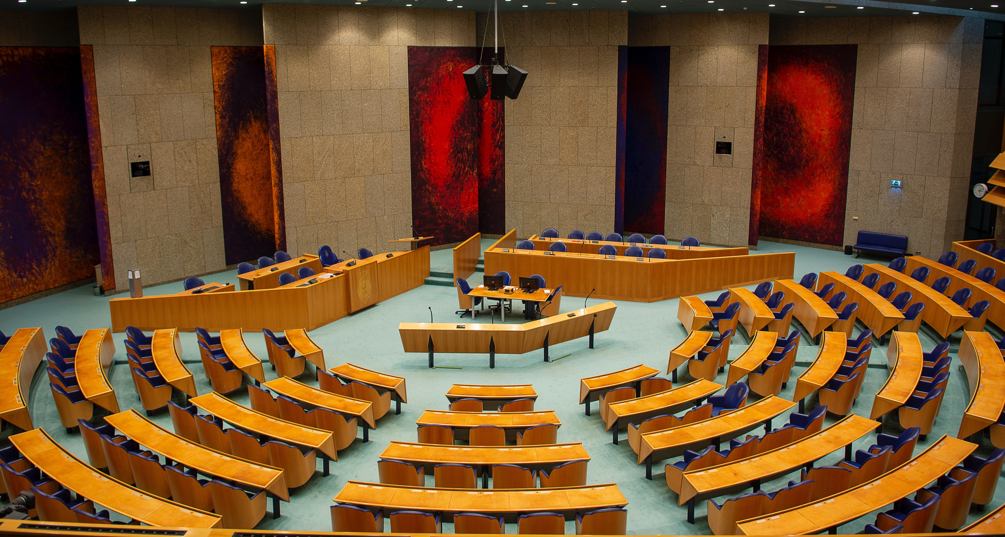
The Transport System and Transport Policy
Edited by Bert van Wee, Jan Anne Annema, David Banister and Baiba Pudãne
Chapter 13: Transport policy
Author: Jan Anne Annema
House of representatives Netherlands - Free image on Pexels

Slide 2
Introduction
The aims of this chapter:
To explain the main reasons why governments intervene in the transport market
To give a concise overview of the dominant transport policies

Slide 3
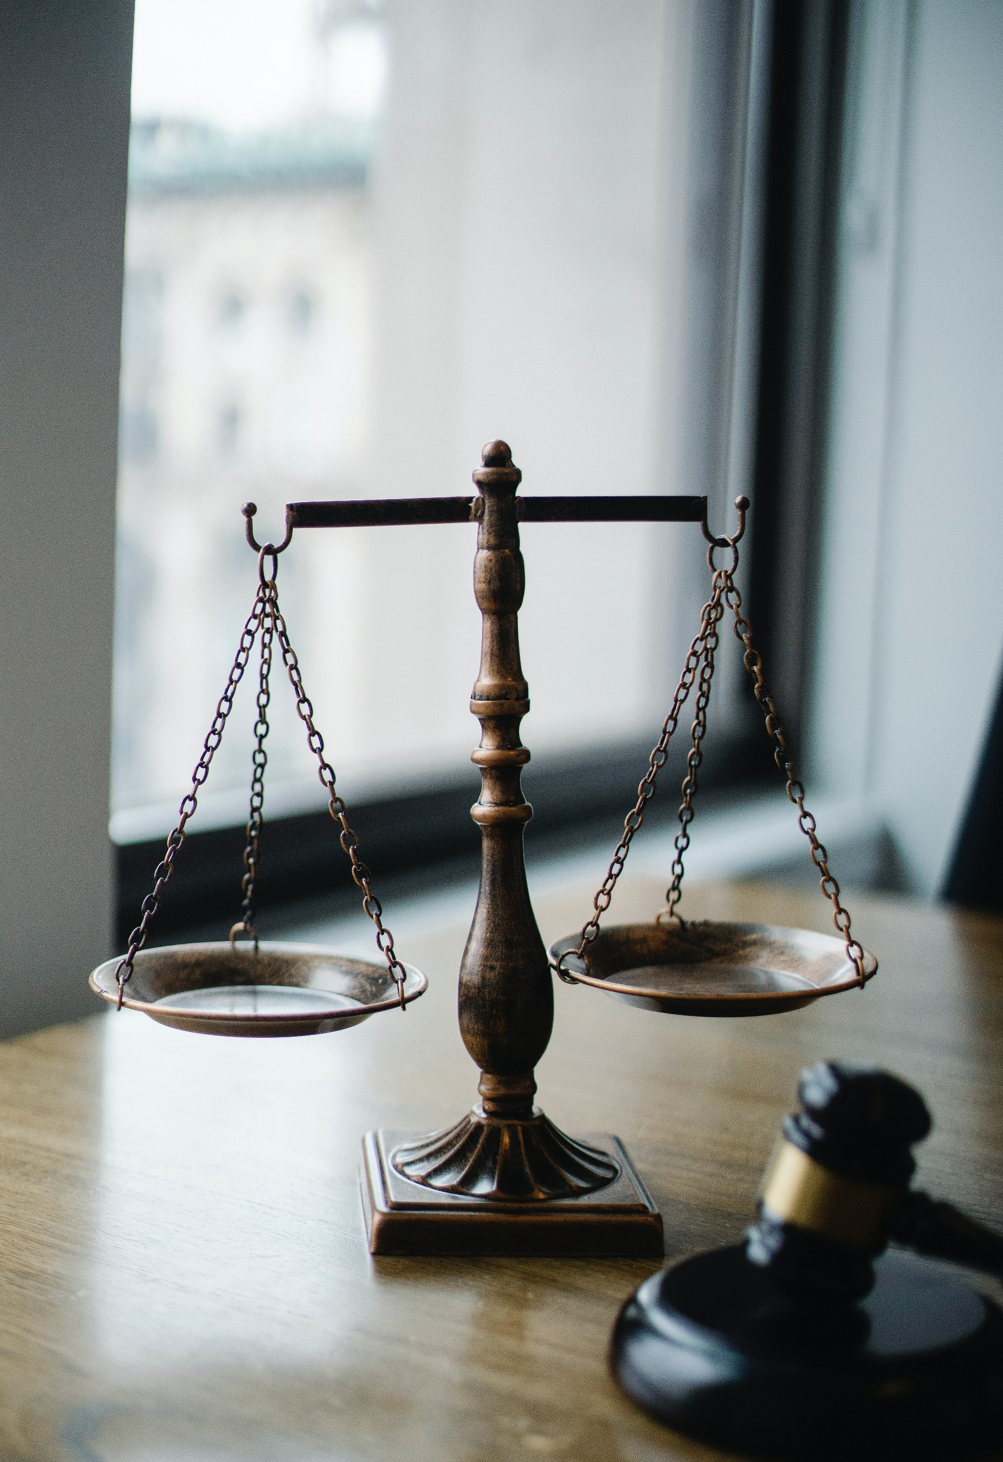
Introduction
Transport is still one of the most regulated sectors in any economy (Button and Gillingwater 1986)
Governments:
provide and own transport infrastructure,
tax car owners,
subsidize public transport,
decide by implementing traffic rules who has right of way,
implement emission standards to make vehicles cleaner and safer,
and so forth…
Button, K.J. and D. Gillingwater (1986), Future Transport Policy, London: Routledge.
Law - Free image on Pexels

Slide 4
Introduction
Generally speaking, all over the world three main reasons can be found for government interference in the transport market:
Market failure Scarce goods like e.g., road capacity, cars, aircraft seating capacity, clean air etc. are not efficiently allocated
Equity reasons E.g., many governments subsidize public transport because they think it is desirable that all people in a country have nearby public transport at their disposal; even in very low population density areas where running a profitable public transport service is impossible
To generate revenues E.g., the total car tax revenue in the Netherlands was around 17 billion Euro in 2018 consisting of vehicle purchase tax, fixed annual car tax, fuel levies, and the addition of the private use of company cars in the payroll and income tax (Algemene Rekenkamer, 2019)
Algemene Rekenkamer (2019), Autobelastingen als beleidsinstrument [Car taxation as a policy instrument], The Hague: Algemene Rekenkamer (www .rekenkamer .nl) (In Dutch).

Slide 5
Overview chapter
External effects of transport
External benefits
Maximizing welfare
Equity
Public choice theory
‘Healthy’ transport policies
Current transport policy
Conclusions

Slide 6
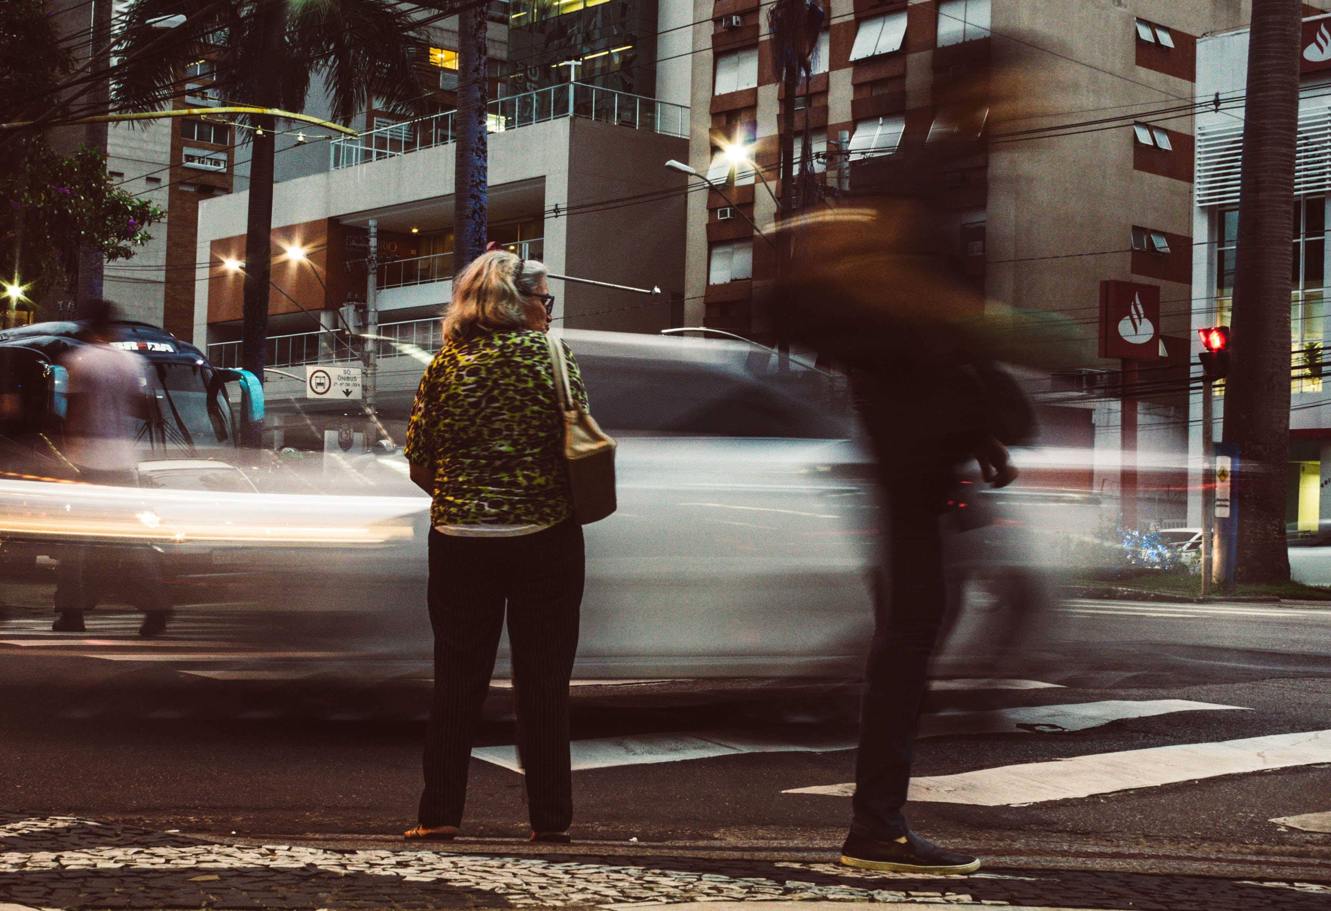
External effects of transport
An important reason for government intervention in transportation is market failure due to external effects.
Individuals and shippers typically account for costs (the resistance factors, Chapter 6) for themselves (internal costs) such as their travel time, fuel costs, and effort.
External effects in transportation mostly refer to costs that trip makers produce to third parties which they do not have to compensate for.
External costs are mostly related to environment, safety and accessibility.
Unable to cross over - Free image on Pexels

Slide 7
External costs
Verhoef (1996) distinguishes three kinds of external transport costs:
Costs due to the use of transport means such as road vehicles, ships or airplanes
Costs due to vehicle ownership and availability
Costs due to infrastructure
Verhoef, E.T. (1996), Economic Efficiency and Social Feasibility in the Regulation of Road Transport Externalities, Tinbergen Research Series 108, Amsterdam: Thesis Publishers.

Slide 8
External costs: use of transport means
Direct external costs:
Accidents. Cars in Europe alone accounted for over 200 billion euros in external accident costs in 2016 (Van Essen et al., 2019)
Congestion. Car drivers during peak hours unintentionally cause delays for other road users without compensating for the resulting time loss.
Indirect external cost:
Avoidance costs associated with the risks of accidents or delays, which can influence people's decision not to travel are also external costs
Methods that measure people's willingness to pay (WTP) to avoid external costs or their willingness to accept (WTA) compensation for these costs can be used estimate external costs in monetary units.
Costs due to the use of transport means such as road vehicles, ships or airplanes
Essen, H. L. van, Wijngaarden van, A. Schroten, D. Sutter, C. Bieler, M. Silvia Maffii, M. Brambilla, D. Fiorello, F. Fermi, R. Parolin and K. El Beyrouty (2019), Handbook on the external costs of transport Version 2019 – 1.1, Luxembourg: Publications Office of the European Union, 2020.

Slide 9
External costs: vehicle ownership/availability
Examples include:
Costs related to vehicle parking in the public domain, where the owner either does not have to pay or the payment is insufficient
Environmental effects associated with the production and disposal of vehicles, aircraft, or ships.
Life Cycle Analysis (LCA) is relevant in understanding the environmental impacts throughout the entire life cycle of a product, such as a car.
External costs that arise during the non-use phase of products.
Costs due to vehicle ownership and availability

Slide 10
External costs: Infrastructure
External costs arise due to the construction and presence of transport infrastructure, such as roads and railways:
The existence of infrastructure can impact the physical environment, including noise, visual quality, light pollution, and people's perception of their environment and quality of life (Geurs et al., 2009)
New or existing transport schemes can have negative social impacts on communities, such as severance (Geurs et al., 2009)
Infrastructure act as physical and biological barriers to wildlife species, affecting their habitat availability and causing fragmentation (Kreling et al., 2019)
The production, maintenance, and disposal of infrastructure, such as road asphalt, can have environmental and health impacts, not accounted for in the wages of workers
Costs due to infrastructure
Geurs, K.T., W. Boon and B. van Wee (2009), ‘Social impacts of transport: literature review and the state of the practice of transport appraisal in the Netherlands and the United Kingdom’, Transport Reviews, 29 (1), 69–90. Kreling, S.E.S., K.M. Gaynor and C.A.C. Coon (2019), ‘Roadkill distribution at the wildland-urban interface’, Journal of Wildlife Management, 83(6), 1427–36.

Slide 11
Overview chapter
External effects of transport
External benefits
Maximizing welfare
Equity
Public choice theory
‘Healthy’ transport policies
Current transport policy
Conclusions

Slide 12
External benefits
External benefits refer to positive external effects of mobility.
Governments may intervene to promote these benefits, similar to their intervention to reduce external costs.
External benefits occur outside the normal market, as people or shippers participating in transport activities do not consider these positive impacts when making travel decisions.
Lower production costs, consumer prices, or enhanced family relations are not external benefits, since they are often monetized impacts that are already considered in the decision-making process.
External benefits of transport are limited to classic examples, such as airplane or train spotting.
Aeroplane spotting - Free image on Pexels

Slide 13
Overview chapter
External effects of transport
External benefits
Maximizing welfare
Equity
Public choice theory
‘Healthy’ transport policies
Current transport policy
Conclusions

Slide 14
Maximizing welfare: Pareto efficiency
The economic welfare theory states that we should strive in policy-making for Pareto optimal welfare, or Pareto efficiency. Pareto efficiency is said to exist when no other improvements can be made in the allocation of resources to one individual without it causing a loss to others.
Pareto efficiency does not ensure fair distribution of resources.
Example:
Lowering the fuel levy
Leads to
Car travel ↑ Road Noise ↑
If fuel levy continues to decrease, eventually it will lead to
Discomfort for residents along the road
When this happens, policy is not Pareto efficient as some individuals are worse off due to the increased noise.

Slide 15
Maximizing welfare: Kaldor-Hicks efficiency
The Kaldor-Hicks efficiency criterion (Hicks, 1939; Kaldor, 1939) means that an outcome of a policy is efficient if those that are made better off could in theory compensate those that are made worse off.
The compensation criterion is the most used criterion in a cost-benefit analysis.
With Kaldor–Hicks it is not required that the compensation is actually being paid, merely that the possibility for compensation exists.
Following the previous example, the Kaldor-Hicks optimum is not reached until the benefits to the people who can drive more than outweigh the costs of the people who suffer from the extra noise load.
In contrast, using Pareto efficiency ensures that no one becomes worse off.
Hicks, J.R (1939), ‘The foundations of welfare economics’, Economic Journal, 49 (196), 696–712.
Kaldor, N. (1939), ‘Welfare propositions of economics and interpersonal comparisons of utility’, Economic Journal, 49 (195), 549–52.

Slide 16
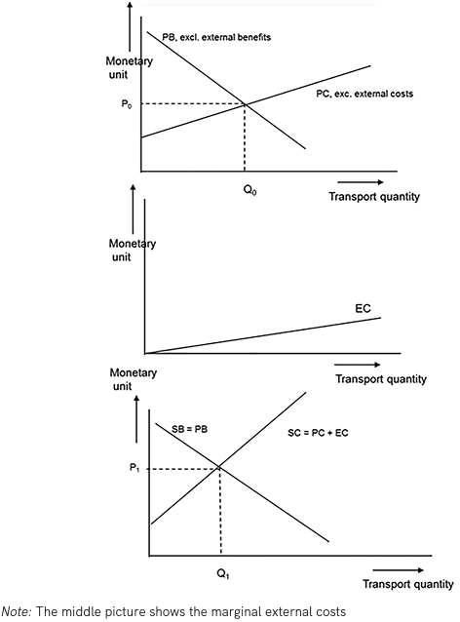
Maximizing welfare: marginal costs and benefits
(a)
Figure 13.2 illustrates welfare theory in transportation.
The figure depicts marginal costs and benefits per unit of transport:
The top figure (13.2a) represents the transport market without considering external costs
The middle picture (13.2b) shows the marginal external costs
In the bottom figure (13.2c) it is depicted what would happen if marginal external costs are taken into account in the transport price
(b)
(c)
Figure 13.2 Transport prices and quantities in two equilibrium situations: without external benefits and costs (top) and with external benefits and costs (Taken from Chapter 13, page 280)

Slide 17
Maximizing welfare: marginal costs and benefits
(a)
Marginal private benefits (PB) decrease as the amount of transport increases, reflecting how people value different trips.
Marginal private costs (PC) are assumed to increase with transport quantity in the figure.
The equilibrium at quantity Q₀ and price P₀ represents the private optimum, where marginal private costs equal marginal private benefits.
(b)
(c)
Figure 13.2 Transport prices and quantities in two equilibrium situations: without external benefits and costs (top) and with external benefits and costs (Taken from Chapter 13, page 280)

Slide 18
Maximizing welfare: marginal costs and benefits
(a)
If marginal external costs are considered (depicted in Figure 13.2c), the marginal social cost line becomes steeper than the marginal private cost line (SC = PC + EC).
The new equilibrium at price P₁ and quantity Q₁ represents the social optimum, achieved by internalizing external costs.
(b)
(c)
Figure 13.2 Transport prices and quantities in two equilibrium situations: without external benefits and costs (top) and with external benefits and costs (Taken from Chapter 13, page 280)

Slide 19
Maximizing welfare: marginal costs and benefits
(a)
To internalize the external cost, governments should increase the private transport price by the difference between P₁ and P₀.
The social optimum will arise leading to less transport (Q₁) compared to the situation where external costs are not internalized (Q₀).
(b)
(c)
Figure 13.2 Transport prices and quantities in two equilibrium situations: without external benefits and costs (top) and with external benefits and costs (Taken from Chapter 13, page 280)

Slide 20
Maximizing welfare: societal cost–benefit analysis (CBA)
(a)
Societal CBA is based on welfare theory and is used to evaluate transport policies and infrastructure projects
CBA quantifies marginal impacts and assigns monetary values to them to determine if the benefits outweigh the costs.
Travel time gains and construction costs are often significant factors in CBA assessments.
The goal of CBA is to increase total welfare by ensuring that the marginal benefits of new infrastructure exceed the marginal costs.
(b)
(c)
Figure 13.2 Transport prices and quantities in two equilibrium situations: without external benefits and costs (top) and with external benefits and costs (Taken from Chapter 13, page 280)

Slide 21
Maximizing welfare: the practice
(a)
Implementing welfare theory in practice is challenging: Monetizing external costs is complicated.
Determining the charge level (P₁ minus P₀) or conducting a proper cost-benefit analysis (CBA) requires knowledge of people's willingness to pay (WTP) to avoid various external impacts.
Impacts are external, therefore outside the realm of supply and demand markets, where prices are determined.
(b)
(c)
Figure 13.2 Transport prices and quantities in two equilibrium situations: without external benefits and costs (top) and with external benefits and costs (Taken from Chapter 13, page 280)

Slide 22
Maximizing welfare: the practice
(a)
Contingent valuation methods (CVM) are common in trying to find people’s WTPs or WTAs for goods that are not traded, such as external effects.
CVM are survey-based methods where people can state their preferences or where via choice experiments people’s valuations for non-tradable goods can be estimated.
The results of valuation studies are uncertain and can be subject to debates.
(b)
(c)
Figure 13.2 Transport prices and quantities in two equilibrium situations: without external benefits and costs (top) and with external benefits and costs (Taken from Chapter 13, page 280)

Slide 23
Overview chapter
External effects of transport
External benefits
Maximizing welfare
Equity
Public choice theory
‘Healthy’ transport policies
Current transport policy
Conclusions

Slide 24
Equity
Equity in transport refers to the fair or just distribution of transport benefits and costs.
Determining what is fair and just, and whether policy intervention is needed depends on a moral judgment.
Ethical theories that are often referenced in the transport literature are:
Utilitarianism:
relates to cost-benefit analysis (CBA) and considers policies just if they result in a net welfare gain for the majority.
Egalitarianism:
focuses on reducing inequalities and considers a policy just if it maximizes the minimum level of primary goods for the worst-off individuals
Sufficientarianism:
aims to ensure that everyone has an adequate level of well-being, rather than focusing on reducing inequalities.

Slide 25
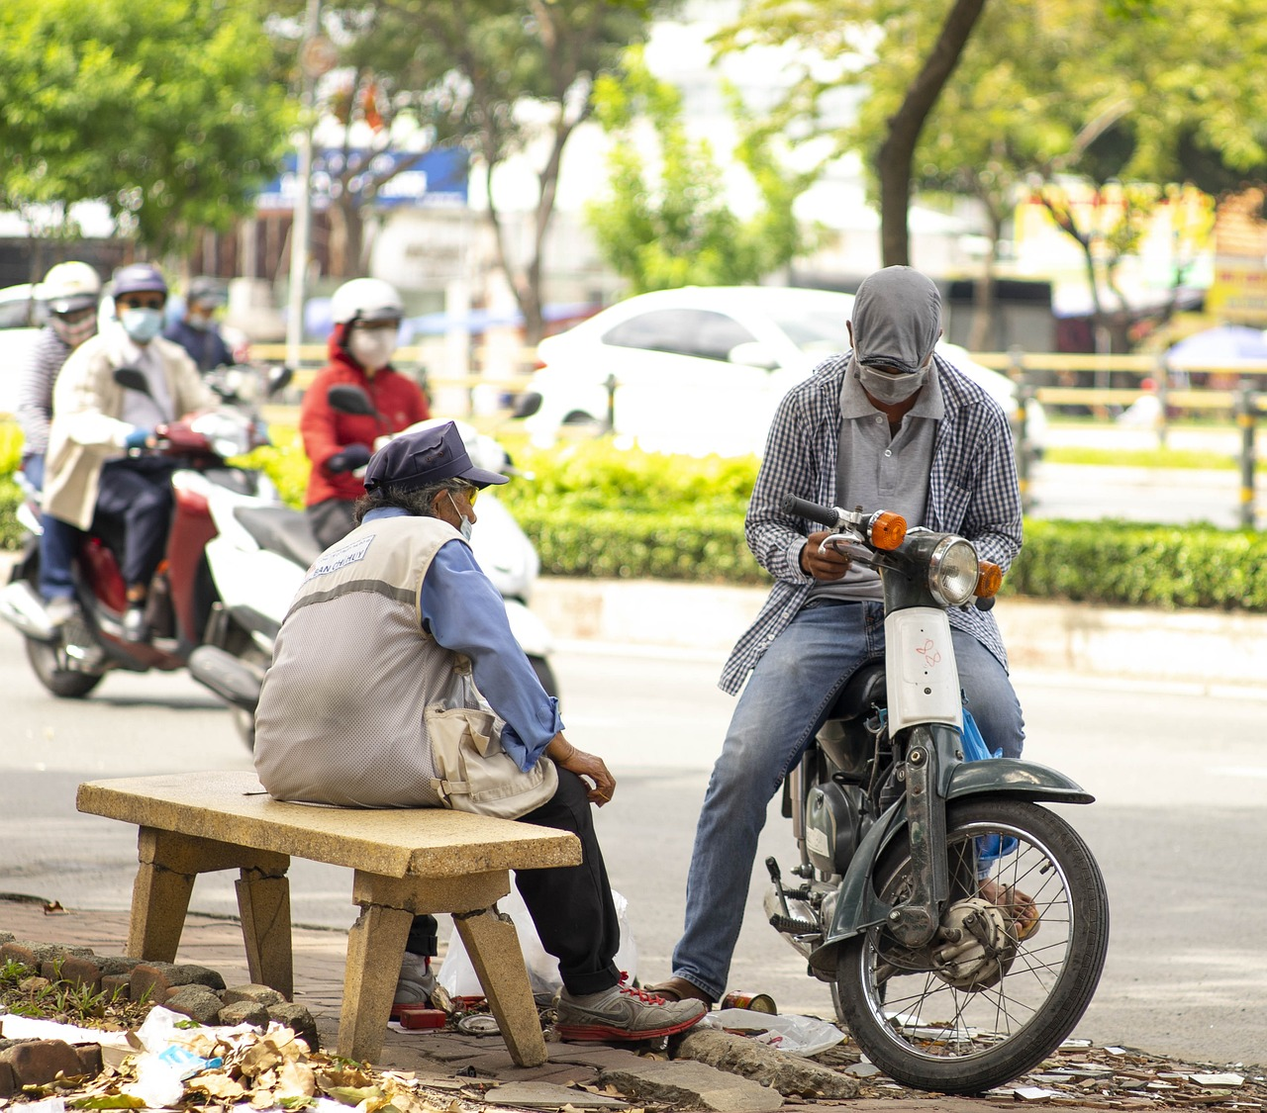
Equity
Egalitarianism and sufficientarianism are applied to some extent to government provided public transport and public transport subsidies.
Transport-related social exclusion occurs when limited mobility options leads to restricted access to jobs, services, and social opportunities (Lucas, 2018)
Providing public transport and subsidies is a common approach to address equity concerns and prevent social exclusion
However, the distribution of transport subsidies may not always be equitable, with wealthier households often benefiting more than the poorest.
Street - Free image on Pixabay
Lucas, K. (2018) ‘A new evolution for transport-related social exclusion research?’, Journal of Transport Geography, 81:102529 https://doi.org/10.1016/j.jtrangeo.2019.102529.

Slide 26
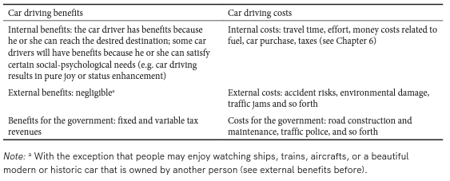
Equity
Governments can find it fair that certain transport mode users (e.g., all car users) pay for their total social costs even if this means that in this way of pricing, the marginal social costs outweigh the marginal social benefits.
Example (see →)
Total internal benefits are equal to total internal costs in the cost-benefit balance.
Total social balance: the external costs caused by car driving and government expenditures for roads and policies are equal to the tax revenues paid by the car drivers.
In other words, government revenue from fixed and variable car taxes equals the external car costs and government expenditures on car driving.
Table 13.1 Balance of costs and benefits of car driving – an example (Taken from Chapter 13, page 284)

Slide 27
Equity
Governments may aim to charge transport modes their total social costs, but this can lead to inefficiencies in the system.
Cost-benefit analysis (CBA) is frequently used in transport policy evaluation but is criticized for neglecting equity concerns and distribution effects (see also Chapter 15).
Criticisms related primarily to the practice, not fundamental to the method, include the disproportionate influence of the rich, and discounting future generations.
Tragic choices, where some may suffer severe consequences, are a limitation of CBA from an ethical perspective.
Other appraisal methods like Multi-Criteria Analysis (MCA), Environmental Impact Assessment, and Social Impact Assessment help overcome problems of tragic choices and provide a broader evaluation of policies from an equity perspective (see further in ch. 15).

Slide 28
Overview chapter
External effects of transport
External benefits
Maximizing welfare
Equity
Public choice theory
‘Healthy’ transport policies
Current transport policy
Conclusions

Slide 29
Public choice theory
The behaviour of politicians and bureaucrats in transport policy-making can be influenced by psychological factors and self-interest. Public choice theory suggests that individuals in the political marketplace act primarily in their own self-interest (Buchanan and Tullock, 1962)
Politician - Free image on Pixabay
Buchanan, J. M. and G. Tullock (1962), The Calculus of Consent, Ann Arbor: University of Michigan Press.

Slide 30
Public choice theory
Flyvbjerg et al. (2003a) have built a database of 258 transport infrastructure projects all over the world.
Of these projects 86% showed cost overruns, with an average overrun of 28% of the estimated costs
‘Cost overruns’ means that the costs of building the new infrastructure is higher compared to the cost estimation used for making the political decision
Four different types of explanations (Flyvbjerg, 2005, Cantarelli et al., 2010)
Technical: Explains failure in terms of honest mistakes, related to difficulties in predicting the future (Flyvbjerg, 2005).
Psychological: Humans tend to overemphasize their own abilities and to be overly optimistic about the future, rather than rationally weighing gains, losses, and probabilities (Lovallo and Kahneman, 2003).
Economic: Project funds are scarce, and projects that look good on paper can more easily be financed than projects that do not.
Political: Politicians, planners and forecasters are said to deliberately underestimate costs while overestimating benefits in order to gain approval and funding for their ‘own’ (sometimes much loved) project.
Flyvbjerg, B., N. Bruzelius and W. Rothengatter (2003a), Megaprojects and Risk: An Anatomy of Ambition, Cambridge: Cambridge University Press. Flyvbjerg, B. (2005), ‘Policy and planning for large infrastructure projects: problems, causes, cures’, Policy Research Working Paper, World Bank, Washington, DC. Cantarelli, C.C., B. Flyvbjerg, E.J.E. Molin and B. van Wee (2010), ‘Cost overruns in large-scale transportation infrastructure projects: explanations and their theoretical embeddedness’, European Journal of Transport Infrastructure Research, 10 (1), 5–18. Lovallo, D. and D. Kahneman (2003), ‘Delusions of success: how optimism undermines execu- tives’ decisions’, Harvard Business Review, 81 (7), 56–63.

Slide 31
Public choice theory
The root causes of inaccuracies in cost-benefit analysis (CBA) outcomes are not purely technical but are influenced by factors like overconfidence bias, planning fallacy, and strategic misrepresentation (Flyvbjerg and Bester, 2021)
Despite the well-known phenomena affecting estimation accuracy, there has been little improvement in estimation methods over time, indicating a lack of feedback loop and learning process in place.
Flyvbjerg, B. and D.W. Bester (2021), ‘The cost-benefit fallacy: Why cost-benefit analysis is broken and how to fix it’, Journal of Benefit-Cost Analysis, 12(3), 395–419.
Financial analysis - Free image on Pixabay

Slide 32
Overview chapter
External effects of transport
External benefits
Maximizing welfare
Equity
Public choice theory
‘Healthy’ transport policies
Current transport policy
Conclusions

Slide 33
‘Healthy’ transport policies
Six general criteria for ‘healthy’ transport policy interventions (van Wee, 2009)
Effectiveness: Does the policy achieve its intended goals? Consider the level of effects
Efficiency: Assess cost-effectiveness or cost-to-benefit ratio, particularly in complex policy options with multiple effects or non-monetary costs
Equity: Address the distribution of benefits and costs. Clearly define the target group and the meaning of improved accessibility for that group
Ease of implementation: While not the sole determinant of a healthy policy, policies that are easy to implement are advantageous. Identify barriers and learn from successful implementations elsewhere
Flexibility: Evaluate the adaptability of the policy to foresee changes. Some policies, like levies on fuels and cars, are relatively easy to change
Long-term robustness: Consider whether the policy is 'no regret' under uncertain long-term developments. Assess its resilience to major societal changes, especially in expensive land-use or transport infrastructure policies
Van Wee, B. (2009), Transport Policy: What Can It and What Can’t It Do?, European Transport Conference 2009, http://etcproceedings.org/paper/ transport-policy-what-it-can-and-what-it-can-t-do.

Slide 34
Overview chapter
External effects of transport
External benefits
Maximizing welfare
Equity
Public choice theory
‘Healthy’ transport policies
Current transport policy
Conclusions

Slide 35
Current transport policy
There are different ways to classify transport policies:
According to policy goal. For example, policies to improve accessibility or policies to improve transport safety
According to the kind of instrument. For example, pricing policies or policies providing new infrastructure.
According to the policy body responsible for implementing the policy.
national and regional governments (federal states or provinces), city councils,
supranational bodies (such as the International Civil Aviation Organization (ICAO) and the International Maritime Organization (IMO) of the United Nations) and
international economic and political blocks (e.g., the European Union, EU)

Slide 36
Current transport policy
Various transport policy instruments are used to achieve different goals (from Table 13.2, page 289):
Improving accessibility | National governments primarily implement policies such as infrastructure provision, public transport subsidies, road pricing, traffic management, and land-use policies
Enhancing the environment liveability and health | National governments set vehicle emission and noise standards, fuel standards, and provide infrastructure improvements like noise barriers and cycling/walking facilities. International bodies like the EU, ICAO, and IMO also play a role in setting standards for aviation and shipping
Ensuring transport safety | National governments establish safety standards for vehicles, enforce rules like seat-belt and helmet requirements, and modify infrastructure for safer traffic conditions
Promoting equity | Public transport fare subsidies and infrastructure provision in underserved areas are implemented by national, regional, and local governments. International economic blocks, like the EU, may also subsidize infrastructure in poorer regions or countries. The World Bank offers low-interest loans to support transport infrastructure development in impoverished countries
Generating government revenues | National and regional governments primarily implement taxes on vehicles and fuels

Slide 37
Overview chapter
External effects of transport
External benefits
Maximizing welfare
Equity
Public choice theory
‘Healthy’ transport policies
Current transport policy
Conclusions

Slide 38
Conclusions
The main conclusions are as follows:
Governments implement transport policies with a societal perspective, considering social costs and benefits, including external effects.
External effects of transport, including negative costs like congestion, pollution, climate change, and accidents, drive many policies aimed at decreasing these costs.
Governments implement policies to improve efficiency and increase overall welfare. Fairness and equity considerations also motivate policy implementation.
Psychological factors and politicians' self-interest can influence policy implementation.
The goal of improving accessibility is mainly achieved through infrastructure provision, while equity improvement is also fulfilled through infrastructure and public transport subsidies. Policies targeting the environment, liveability, and transport safety focus on vehicle and fuel standards and regulations to enhance the technical characteristics of vehicles and fuels.

Slide 39
The Transport System and Transport Policy
Edited by Bert van Wee, Jan Anne Annema, David Banister and Baiba Pudãne
Chapter 13: Transport policy
Author: Jan Anne Annema
House of representatives Netherlands - Free image on Pexels

