Slide 1
The Transport System and Transport Policy
Edited by Bert van Wee, Jan Anne Annema, David Banister and Baiba Pudãne
Chapter 15: Appraisal methods for transport policy
Authors: Niek Mouter and Piet Rietveld
Road - Free image on Unsplash

Slide 2
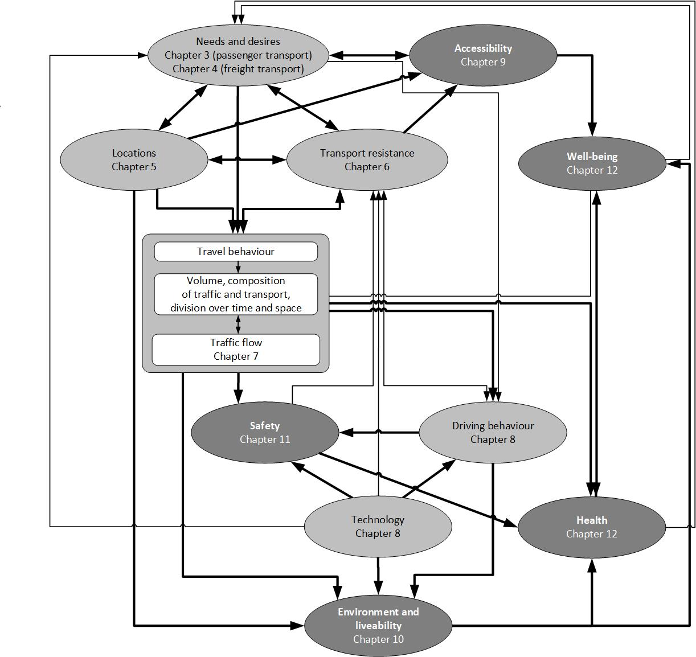
Introduction
Transportation networks provide an array of benefits: goods delivery, access to services and personal mobility
However, transport can also result in several adverse effects such as damage to the environment (see Chapter 10) and crashes (see Chapter 11), and varied impacts on health and well-being (see Chapter 12)
Governments are in many ways involved in transport policy and planning (see Chapter 13):
They determine regulations such as speed limits
They can decide to invest public budget in the extension and/or maintenance of transport infrastructure

Slide 3
Introduction
Policy makers typically want to make decisions informed by the expected positive and negative impacts of a transport policy option
Ex-ante evaluation methods can be used to provide such information:
Social Cost-Benefit Analysis (SCBA)
Participatory Value Evaluation (PVE)
Multi-Criteria Analysis (MCA)
Environmental Impact Assessment (EIA)
Social Impact Assessment (SIA)
This chapter introduces and compares these methods
Measure - Free image on Pixabay

Slide 4
Overview chapter
Social Cost-Benefit Analysis (SCBA)
Participatory Value Evaluation (PVE)
Multi-Criteria Analysis (MCA)
Environmental Impact Assessment (EIA)
Social Impact Assessment (SIA)
Comparing the five appraisal methods
Conclusions
Measure - Free image on Pixabay

Slide 5
Overview chapter
Social Cost-Benefit Analysis (SCBA)
Participatory Value Evaluation (PVE)
Multi-Criteria Analysis (MCA)
Environmental Impact Assessment (EIA)
Social Impact Assessment (SIA)
Comparing the five appraisal methods
Conclusions
Measure - Free image on Pixabay

Slide 6
Social Cost-Benefit Analysis (SCBA)
In virtually all western countries Social Cost–Benefit Analysis (SCBA) is mandatory when national funding is considered for large transport projects (Mackie et al., 2014)
A SCBA is an overview of all the positive effects (benefits) and negative effects (costs) of a project or policy option (e.g., van Wee, 2012)
Welfare economics forms the theoretical basis of SCBA
Mackie, P., T. Worsley and J. Eliasson (2014), ‘Transport appraisal revisited’, Research in Transportation Economics, 47, 3–18. Van Wee, B. (2012), ‘How suitable is CBA for the ex-ante evaluation of transport projects and policies? A discussion from the perspective of ethics’, Transport Policy, 19(1), 1–7.
Audit Auditor Analysis - Free photo on Pixabay - Pixabay

Slide 7
SCBA: Underlying principles
When is the social welfare effect of a policy positive?
Pareto criterion: it is positive if a project benefits someone without making anyone worse off (Nyborg, 2014)
Kaldor-Hicks efficiency criterion: when those who benefit can theoretically compensate those who suffer from it creating Pareto improvement after the compensation (Hicks, 1939; Kaldor, 1939):
In practice:
Government policies can hardly ever meet the strict Pareto criterion
Example: Transport infrastructure projects are funded by taxpayers and may have negative external effects like noise and CO2 emissions
Standard SCBA assesses whether a project meets Kaldor-Hicks efficiency criterion
Nyborg, K. (2014), ‘Project evaluation with democratic decision-making: what does cost-benefit analysis really measure?’, Ecological Economics, 105, 124–31.
Hicks, J. (1939), ‘The Foundations of Welfare Economics’, Economic Journal, 49 (196), 696–712. Kaldor, N. (1939), ‘Welfare Propositions of Economics and Interpersonal Comparisons of Utility’, Economic Journal, 49 (195), 549–52.

Slide 8
SCBA: Underlying principles
Two further principles from welfare economics used in SCBA:
Individualism: Preferences of individual citizens are the basis for SCBA
Non-paternalism: Individuals are the best judges of their own welfare
This thereby excludes:
Preferences of experts, stakeholders and policy makers
Citizens’ preferences for how benefits and burdens of a policy are distributed
Public support for a policy option
SCBA uses individuals’ willingness to pay (WTP) from their private income:
For a positive effect, the WTP is the maximum amount which a person is willing to pay for it
For a negative effect, the WTP is the minimum amount which a person needs to accept it (then often called willingness-to-accept: WTA)
Example: to find individuals’ WTP for travel time and accident risk reduction, they are asked to choose among hypothetical routes that differ in travel time, accident risk and travel costs

Slide 9
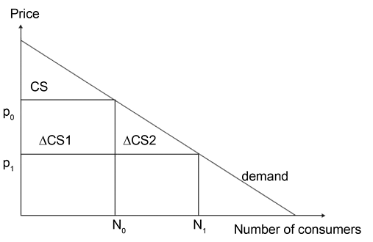
SCBA: Link with demand function
The consumers’ preferences can be described by means of a demand function ↓
How much a group of consumers is prepared to pay for a certain product or service?
In transport, service may be a bus trip A→B or use of road C→D
Example:
When p₀ is the price, N₀ consumers will use the service provided
When the price decreases to p₁, the number of consumers increases to N₁
Note: willingness to pay is at least p₀ for N₀ users: most of them are prepared to pay more than just p₀
Figure 15.2 Illustration of the consumer surplus concept
(Taken from Chapter 15, page 317)

Slide 10
SCBA: Link with demand function
Consumer surplus (CS) is the difference between what consumers pay and what they are willing to pay for the product or service
Example:
When p₀ is the price, N₀ consumers will use the service provided
When the price decreases to p₁, the number of consumers increases to N₁
Consumer surplus for the present users of the service when the price is p0 is represented by the triangle CS
Figure 15.2 Illustration of the consumer surplus concept
(Taken from Chapter 15, page 317)

Slide 11
SCBA: Link with demand function
Improvement in the (transport) service can be seen as a reduction in costs $p_{0}→p_{1}$
Equivalently: worsening in the (transport) service can be seen as an increase in costs
Example:
When p₀ is the price, N₀ consumers will use the service provided
When the price decreases to p₁, the number of consumers increases to N₁
Consumer surplus for the present users of the service when the price is p0 is represented by the triangle CS
A consequence of price reduction $p_{0}$→$p_{1}$ for the present users is a welfare gain $ΔCS1$
The price reduction also attracts new users $N_{1}−N_{0}$
For these new users, the welfare gain is $ΔCS1=(N_{1}−N_{0})(p_{0}−p_{1})/2$
Figure 15.2 Illustration of the consumer surplus concept
(Taken from Chapter 15, page 317)

Slide 12
SCBA: Link with demand function
The old users benefit ‘in full’ from the price reduction
The new users benefit ‘half’ form the price reduction (‘the rule of half’)
Consequence according to the model: people who do not change their behaviour are hit harder than those who change
Example:
When p₀ is the price, N₀ consumers will use the service provided
When the price decreases to p₁, the number of consumers increases to N₁
Consumer surplus for the present users of the service when the price is p0 is represented by the triangle CS
A consequence of price reduction $p_{0}$→$p_{1}$ for the present users is a welfare gain $ΔCS1$
The price reduction also attracts new users $N_{1}−N_{0}$
For these new users, the welfare gain is $ΔCS1=(N_{1}−N_{0})(p_{0}−p_{1})/2$
Opposite to political economy perspective: consumers who change their behaviour are affected more
Figure 15.2 Illustration of the consumer surplus concept
(Taken from Chapter 15, page 317)

Slide 13
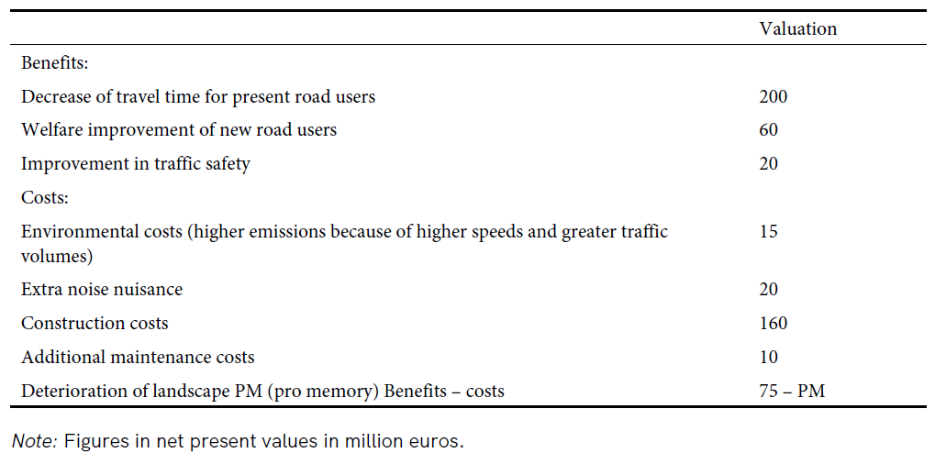
SCBA: Final steps
Make a projection on how economy and the transport system will look in the future
Without the policy = reference alternative
With the policy
Determine changes in costs and benefits for all actors and all alternatives (compared to the reference alternative)
Future benefits and costs are ‘discounted’:
Discount rate $d$ means that the benefit/cost that will be encountered in year $n$ should be multiplied with $1/{\left(1+d\right)}^{n}$
The alternative with the highest positive net balance or benefit-cost ratio is the best candidate to be implemented
Sensitivity analysis is recommended
Table 15.1 Example of an SCBA table for a road upgrade involving separation of motorized and non-motorized transport
(Taken from Chapter 15, page 316)

Slide 14
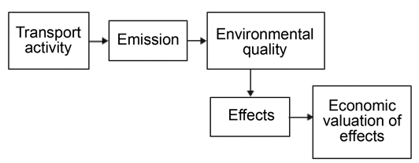
SCBA: Valuation methods
Crucial step in SCBA: obtaining monetary values for all impacts of the policies, such as
Travel time savings
Traffic safety impacts
Environmental impacts – particularly challenging →
Noise impacting sleep, causing stress and and heart diseases
CO₂ impacting health and ecosystems
Several valuation methods are used for the task
Figure 15.1 Chain from transport to economic valuation of emissions
(Taken from Chapter 15, page 314)

Slide 15
SCBA: Valuation methods
Valuation via observed behaviour in markets
Hedonic price analysis: Isolating the effect of an aspect (e.g., noise) by comparing value of houses that are exposed to different levels of it (e.g., houses in areas with different noise exposure) and controlling for other differences
Hedonic price analysis used to analyse values of landscape, nature, and proximity of highways/light rail transit
Self-selection leads to underestimation of the effect: People who prioritize quiet environments will avoid living in noisy areas, whereas people who do not mind noise will bid higher prices for houses in such areas
Travel cost method: incur value through people’s willingness to visit (nature) areas with different characteristics (e.g., landscape)
Valuation via surveys
Contingent Valuation Method: Surveys ask participants for direct monetary values they attach to experienced effects. E.g., how much are you willing to pay to reduce the number of animals killed by transport in acertain area?
Stated choice experiments: Respondents choose between options to derive average values of effects (see route choice example before)
Valuation via prevention cost method:
Estimates the cost to prevent a specific target from being exceeded (e.g., reducing CO2 emissions). Does not estimate the costs of a damage.
Breaches the principle of individualism because the method is based on preferences of politicians

Slide 16
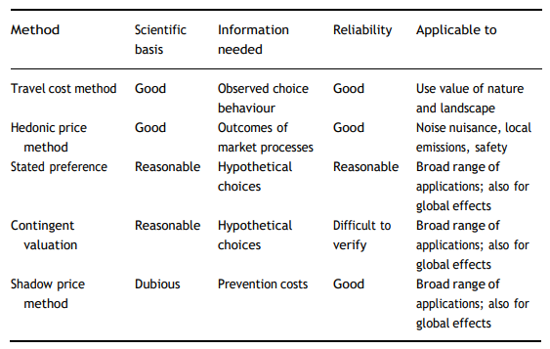
SCBA: Valuation methods
Table 15.2 Assessment of evaluation methods for environmental damage (Taken from Chapter 15, page 319)
Confused Muddled Illogical - Free photo on Pixabay - Pixabay

Slide 17
SCBA: Issues
Uneven distribution of benefits and costs
Due to Hicks-Kaldor principle (see before): hypothetical compensation does not guarantee actual compensation
Result: concerns about equity. SCBA is criticised for placing too much value on increasing mobility overall, rather than ensuring equitable access to transport
No distinction between private and public preferences:
SCBA monetizes impacts based on private willingness-to-pay (see before)
People may be unwilling to contribute privately but would accept a new law or a tax increase when the whole community is involved
People value the same effect differently in private sphere (the real estate market) and the public sphere (ballot box): distribution of costs and benefit is more relevant in the latter
Values that are not traded in a real-life setting (e.g., biodiversity ad landscape) are likely incorrectly valued

Slide 18
Overview chapter
Social Cost-Benefit Analysis (SCBA)
Participatory Value Evaluation (PVE)
Multi-Criteria Analysis (MCA)
Environmental Impact Assessment (EIA)
Social Impact Assessment (SIA)
Comparing the five appraisal methods
Conclusions
Measure - Free image on Pixabay

Slide 19
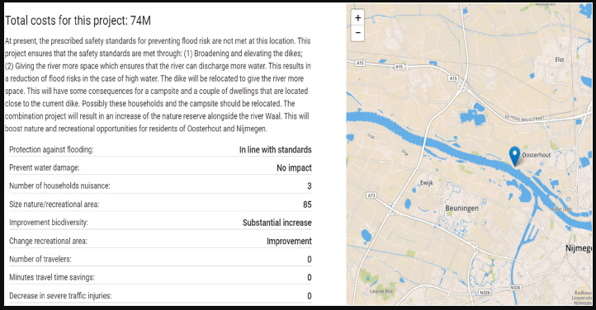
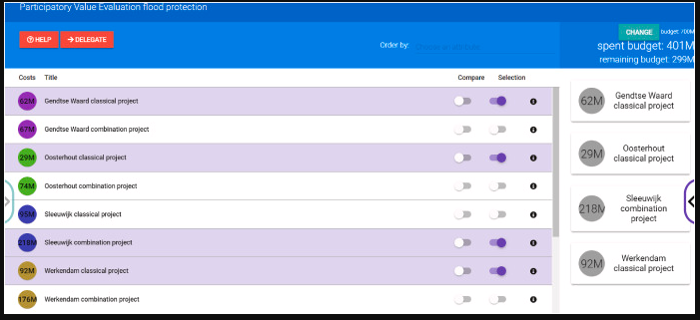
Participatory Value Evaluation
In Participatory Value Evaluation (PVE) experiments, participants directly express their preferences for government projects:
They choose (several) of presented public projects, given information about their impacts, such as effect on flood protection (see →), changes in nature and travel time
They need to respect the public budget constraint
Figures from Mouter, N., Koster, P., & Dekker, T. (2021). Participatory value evaluation for the evaluation of flood protection schemes. Water Resources and Economics, 36, 100188.

Slide 20
Participatory Value Evaluation
The trade-offs made in selecting their preferred portfolio can be used to establish individuals’ preferences for (the impacts of) the public projects
PVE addresses limitations of the SCBA (see before):
Limitations of private willingness-to-pay paradigm
Equity concerns. It allows a more inclusive and participatory decision-making process
Feedback group communication - Free image on Pixabay
1) Dekker, T., P.R. Koster and N. Mouter (2020), ‘The economics of participatory value evaluation experiments’, Working Paper, Tinbergen Institute. 2) Mouter N, P.R. Koster and T. Dekker (2021b), ‘Participatory Value Evaluation for the evaluation of flood protection schemes’, Water Resources and Economics, 36, 100188.

Slide 21
Overview chapter
Social Cost-Benefit Analysis (SCBA)
Participatory Value Evaluation (PVE)
Multi-Criteria Analysis (MCA)
Environmental Impact Assessment (EIA)
Social Impact Assessment (SIA)
Comparing the five appraisal methods
Conclusions
Measure - Free image on Pixabay

Slide 22
Multi-Criteria Analysis
The multi-criteria analysis (MCA), (equivalently, multiple-criteria decision-making, MCDM, or multiple-criteria decision analysis, MCDA) has the following stages:
Identification of criteria against which to test transport policy options
Weighting and/or scoring the different criteria to arrive at a ranking of options
Feedback - Free image on Pixabay

Slide 23
Multi-Criteria Analysis
A distinction can be made between ‘sophisticated MCA methods’ and ‘simple MCA methods’:
Simple MCA methods:
Use rough procedures for scoring or may abstain from ranking options
Example: UK Appraisal Summary Table, not intended for final ranking
Simplicity makes these methods popular
Sophisticated MCA methods:
Utilize advanced mathematical principles and procedures
Examples: analytic hierarchical process (AHP) (Saaty, 1990) and best-worst method (BWM) (Rezaei, 2015)
AHP uses pairwise comparisons to determine importance of criteria
BWM involves selecting the best and worst (i.e., most and least important) criteria for preference computation
Saaty, T.L. (1990), ‘How to make a decision: The Analytic Hierarchy Process’, European Journal of Operational Research, 48, 9–26. Rezaei, J. (2015), ‘Best-Worst Multi-Criteria Decision-Making Method’, Omega, 53, 49–57.

Slide 24
Multi-Criteria Analysis
Non-participatory MCA
Analysis carried out autonomously by one or more experts
vs
Participatory MCA
Involvement of different interested and affected parties (i.e., problem stakeholders)
applications
Argument: scientists and trained experts are better suited to make complex decisions
Popular in research, but not clear whether it has (many) real-world applications
People Sitting in Front of the Projector Screen · Free Stock Photo (pexels.com)

Slide 25
Overview chapter
Social Cost-Benefit Analysis (SCBA)
Participatory Value Evaluation (PVE)
Multi-Criteria Analysis (MCA)
Environmental Impact Assessment (EIA)
Social Impact Assessment (SIA)
Comparing the five appraisal methods
Conclusions
Measure - Free image on Pixabay

Slide 26
Environmental Impact Assessment
Environmental Impact Assessment (EIA) is a comprehensive evaluation of significant transport projects, providing information to decision-makers on environmental impacts and mitigation options
Initiators of transport projects (e.g., governmental agencies or private companies) are responsible for conducting EIA. The assessment is used to give consent to the project by an authority.
Information in an EIA report:
Description of project alternatives and baseline description of the environment at project location
Prediction of significant project effects on environment
Measures envisaged to avoid, prevent or reduce the effects
Description of alternatives and the main reasons for the chosen alternative
Non-technical summary
Point 2 ↑ is a crucial part of EIA Concept of significance postulates that impact depends on both the magnitude (degree of environmental change caused) and the scale of the environmental impact

Slide 27
Environmental Impact Assessment
Strategic Environmental Assessment (SEA) assesses policies and plans at a strategic level.
Example:
Should a specific new highway be built? → EIA assessment
Should highways or railways be built or other measures taken to improve accessibility? → SEA assessment
Characteristic of SEA: combinations of specific plans become clear. E.g., next to building the new highway, plans may be presented to expand the cities with new residential areas
Forest - Free image on Pixabay

Slide 28
Overview chapter
Social Cost-Benefit Analysis (SCBA)
Participatory Value Evaluation (PVE)
Multi-Criteria Analysis (MCA)
Environmental Impact Assessment (EIA)
Social Impact Assessment (SIA)
Comparing the five appraisal methods
Conclusions
Measure - Free image on Pixabay

Slide 29
Social Impact Assessment
Social Impact Assessment (SIA)
Introduced in late 1970s in the US to complement the (perceived) biophysical focus of EIA with a social assessment
Utilises participatory processes to analyse the concerns of interested and affected parties (i.e., stakeholders)
Special focus: enhance the lives of vulnerable and disadvantaged members of the society
Typical SIA steps:
identify interested/affected people,
assess social impacts,
develop mitigation measures,
develop strategies to deal with residual or non-mitigatable impacts
Discussion - Free image on Pixabay

Slide 30
Social Impact Assessment
Challenges in fully integrating SIA into planning processes:
Despite international guidelines, SIA is not consistently mandated or fully integrated into infrastructure planning processes in many jurisdictions
SIA is sometimes limited to an EIA 'add-on' technical study, reducing its potential to improve social outcomes
Current SIA practice in some areas may fall short of good practices proposed in academic and professional literature

Slide 31
Overview chapter
Social Cost-Benefit Analysis (SCBA)
Participatory Value Evaluation (PVE)
Multi-Criteria Analysis (MCA)
Environmental Impact Assessment (EIA)
Social Impact Assessment (SIA)
Comparing the five appraisal methods
Conclusions
Measure - Free image on Pixabay

Slide 32
Comparing the five appraisal methods
Multi-Criteria Analysis (MCA)
Participatory Value Evaluation (PVE)
The flexibility of MCA can be a strength for capturing intangibles (better than SCBA) but can also lead to subjectivity and double counting
SCBA, PVE and MCA are in a decreasing order strict / allow increasing freedom in selecting impacts and valuing criteria.
Environmental Impact Assessment (EIA)
SCBA & PVE are grounded in welfare economics, but not MCA.
SCBA, PVE & MCA Inform policy makers about desirability of a transport policy option and rely on transport model results
EIA and SIA provide recommendations for mitigation.
EIA focuses on environmental effects while SIA considers social impacts
Social Cost-Benefit Analysis (SCBA)
Social Impact Assessment (SIA)

Slide 33
Overview chapter
Social Cost-Benefit Analysis (SCBA)
Participatory Value Evaluation (PVE)
Multi-Criteria Analysis (MCA)
Environmental Impact Assessment (EIA)
Social Impact Assessment (SIA)
Comparing the five appraisal methods
Conclusions
Measure - Free image on Pixabay

Slide 34
Conclusions
SCBA is the most used method for evaluating transport projects. It monetises societal impacts based on individuals' willingness to pay from their private income.
SCBA is criticised for not considering the distribution of benefits/costs and for equalising private and public choices
PVE evaluates government projects through an experiment where individuals select their preferred portfolio of projects within a constrained public budget.
MCA comprises diverse methods that consider multiple objectives and criteria in decision-making
MCA allowing analysts more freedom in selecting criteria and determining weights than SCBA and PVE. It can measure intangibles better than SCBA but is criticized for subjective weighting
EIA is a comprehensive evaluation of likely environmental effects of a transport project and includes recommendations for mitigating impacts
SIA aims to bring about a more sustainable and equitable biophysical and human environment by analysing and monitoring social consequences of planned transport interventions
Each method has its strengths and limitations, and their applications depend on the specific objectives and contexts of transport policy evaluation. Combination of methods is recommended in many cases.
Discussion - Free image on Pixabay

Slide 35
The Transport System and Transport Policy
Edited by Bert van Wee, Jan Anne Annema, David Banister and Baiba Pudãne
Chapter 15: Appraisal methods for transport policy
Authors: Niek Mouter and Piet Rietveld
Road - Free image on Unsplash

