Slide 1
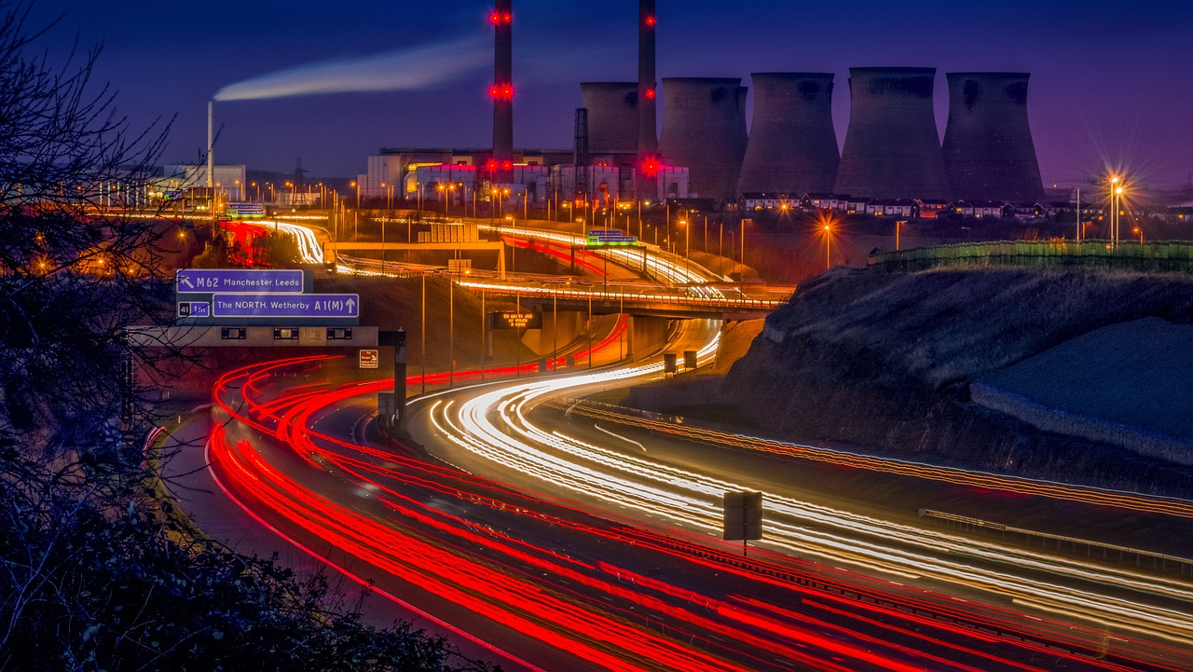
The Transport System and Transport Policy
Edited by Bert van Wee, Jan Anne Annema, David Banister and Baiba Pudãne
Chapter 16: Transportation models and their applications
Authors: Gonçalo Homem de Almeida Correia and Bert van Wee
Ferrybridge - Free image on Pixabay

Slide 2
Introduction
Definition:
Model is a simplified representation of part of reality
Use of models:
Gain insight into the behaviour of the system in a do-nothing scenario
Understand the effects of proposed policies on transport, accessibility, environment, safety, land-use, etc.
Park - Free image on Pixabay

Slide 3
Introduction
This chapter focusses on ‘strategic models’:
Strategic models aggregate volumes of travellers for faster representation of mobility patterns in a city, region, or country
Typical output: number of passenger kilometres in a country, region or city
Different from real-time traffic management models that require modelling each vehicle (see Chapter 7)
Park - Free image on Pixabay

Slide 4
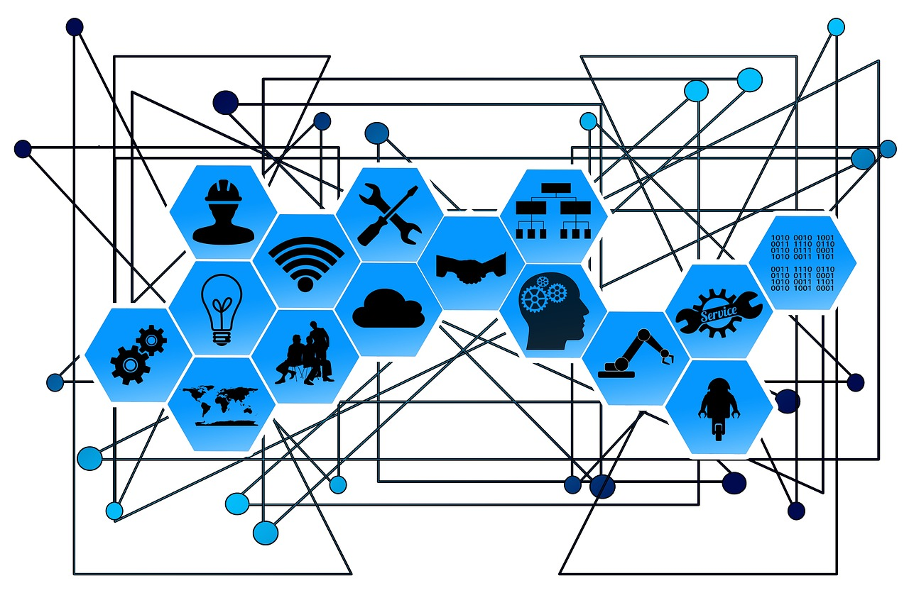
Overview chapter
Types of transport models
Elasticities
The 4-step model
Human behaviour modelling
Validation of models
Some examples of models
What can a transport model be used for?
Conclusions
Web Network Points - Free photo on Pixabay - Pixabay

Slide 5
Overview chapter
Types of transport models
Elasticities
The 4-step model
Human behaviour modelling
Validation of models
Some examples of models
What can a transport model be used for?
Conclusions
Web Network Points - Free photo on Pixabay - Pixabay

Slide 6
Types of transport models
Transport models describe human behaviour based on a theory of how humans behave in their daily mobility choices
The theory establishes causal connections between exogenous and endogenous variables:
Exogenous variables (determined outside the model): GDP growth assumptions, capacity of road links, public transport fares, etc.
Endogenous variables (determined within the model): car ownership, travel choices
Causal connection can be established given that the following is true (see details in Chambliss & Schutt, 2019):
Empirical association
Temporal priority of the independent variable
Non-spuriousness
Known causal mechanism
Known context in which the effect occurs
Chambliss F. and R. Schutt (2019), ‘Causation and experimental design’, in Daniel F. Chambliss, Russel K. Schutt (Eds.), Making Sense of the Social World: Methods of Investigation, London: SAGE, 130–61.

Slide 7
Types of transport models
Technically, models contain mathematical formulas and coefficients:
Coefficients indicate how exogenous variables affect endogenous ones
E.g., if 1% increase in income leads to a 0.4% increase in car ownership then 0.4 is the (elasticity) coefficient here
Determining coefficients is known as model estimation
Goal of model estimation: Make model results as similar as possible to the collected empirical data (see ‘Human behaviour modelling’ and ‘Validation of models’ later)

Slide 8
Types of transport models
Overview of strategic models:
Descriptive | Versus | Explanatory
Spatial | Versus | Non-Spatial
Aggregated | Versus | Disaggregated
Static | Versus | Dynamic
Based on revealed preference | Versus | Based on stated preference
Consider land-use changes | Versus | Not consider land-use changes
Passenger transport | Versus | Freight transport
Agent-Based Models

Slide 9
Types of transport models: Descriptive vs explanatory
Descriptive – showing correlations | Explanatory – showing causation
Represent correlations between variables without explicitly considering causality Limited a priori insight in the reasons behind correlations Valuable starting point for developing explanatory models | Map out causes and consequences of relationships between variables Known underlying mechanisms (see criteria for causality before)
Examples: Stork-birth correlation: Statistical model shows a relationship between stork numbers and birth rates ‘Big data’ model linking accident frequencies and road, regional characteristics. Can be a good starting point for theory building. | Example: Investigating the impact of an airport on economic growth in a region Can differentiate if the airport causes extra economic growth or is situated in regions with strong economic development

Slide 10
Types of transport models: Spatial vs non-spatial
Spatial |  | Non-spatial
Include physical space as an explicit component in the model Spatial Models divide the research area into zones/regions/areas specify networks for cars and other transport modes, often with many nodes and links |  | Physical space is not considered in the model
Example: used to estimate the origin-destination (OD) matrices used for statistical analysis of relations between car usage and public transport accessibility |  | Example: Model of car use based on population age groups, GDP, fuel prices, road capacity, and price per km for road transport
 | Between spatial and non-spatial: Spatial statistical explanatory models recognize the influence zones have on each other, accounting for spatial autocorrelation. E.g.: model for metro use in a city that considers the zones of the metro stations and their neighbouring zones

Slide 11
Types of transport models: Aggregated vs disaggregated
Aggregated | Disaggregated
Unit of generation and attraction of trips: zones, areas or regions Trips are aggregated per time interval Origin and destination information is not specific to individual travellers Developed in 1950s to support the ‘predict and provide’ transport planning policy | Model individual travellers with specific origin and destination locations Focus on individual mobility rather than zone averages Developed in 1970s and can be estimated more efficiently at present. Can support more diverse transport planning policies (e.g., traffic containing measures, regulations, promotion of car alternatives, etc.)
Aggregating Disaggregated Models: Although disaggregated models focus on individual mobility, their results need to be aggregated for policymaking

Slide 12
Types of transport models: Static vs dynamic
Static | Dynamic
Changes in behaviour occur instantly Estimated on cross-sectional data (data collected at a snapshot of time) | Time is a crucial factor in measuring the state of the system. Changes in behaviour occur over a certain period The area of interest (e.g., region) never reaches a final equilibrium Exogenous and endogenous factors continuously change the system Estimation requires time-series or panel (as opposed to cross-sectional) data
 | Example: A rise in fuel price has a ‘lagged’ impact on car use due to limited alternatives Over time, travellers may adjust their routines, reduce car use, relocate, …
A close up of a silver watch face photo – Free Time Image on Unsplash

Slide 13
Types of transport models: Revealed vs stated preference
Based on revealed preference (RP) | Based on stated preference (SP)
RP involves observing actual choices made by individuals in real situations Data can be collected through travel diaries or using Information and Communications Technologies (ICT) (e.g., big data from cellphones) | SP involves presenting hypothetical choice situations to respondents in surveys Respondents choose preferred alternatives from given choice sets (e.g., two trip alternatives) Often less expensive than RP data collection Can study non-existing alternatives, such as automated vehicles Social desirability can bias the results: e.g., studying electric vehicle adoption
Combining RP and SP data - possible and advisable RP data provides realistic preferences between existing alternatives, while SP data compares existing alternatives with new ones to be introduced (e.g., new vehicles in the market)

Slide 14
Types of transport models: Trip-based vs activity-based
Trip-based | Activity-based
Early and many currently used transport models consider travel behaviour in isolation Origin-destination (OD) matrices are ‘generated’ only by regional land use Little connection between demand over different time periods Early models used zones as units of analysis, not individuals or households | Activity-based models emerged later, making travel dependent on individual and household activity patterns Individual and household characteristics (income, life-cycle stage, time budgets) significantly influence travel behaviour in these models Offer better estimations of aggregate behaviour under a wider range of policies and measures Activity-based models can become highly complex, requiring many resources for estimation and use

Slide 15
Types of transport models: Considering land-use changes?
Consider land-use changes |  | Not consider land-use changes
Land Use and Transportation Interaction (LUTI) models consider the bi-directional interaction between land use and transport E.g.: building a new road can lead to businesses settling in its vicinity Validation is difficult since land use changes over a long time and is influenced by factors beyond infrastructure changes |  | Traditional models describe transportation as a derivative of spatial planning
Lowry model (Lowry, 1964): The Lowry model is the first operational LUTI static model: it used road accessibility to explain where people live and work in a city
Traditional models
Land-use
Transport
Additional feedback considered in LUTI models

Slide 16
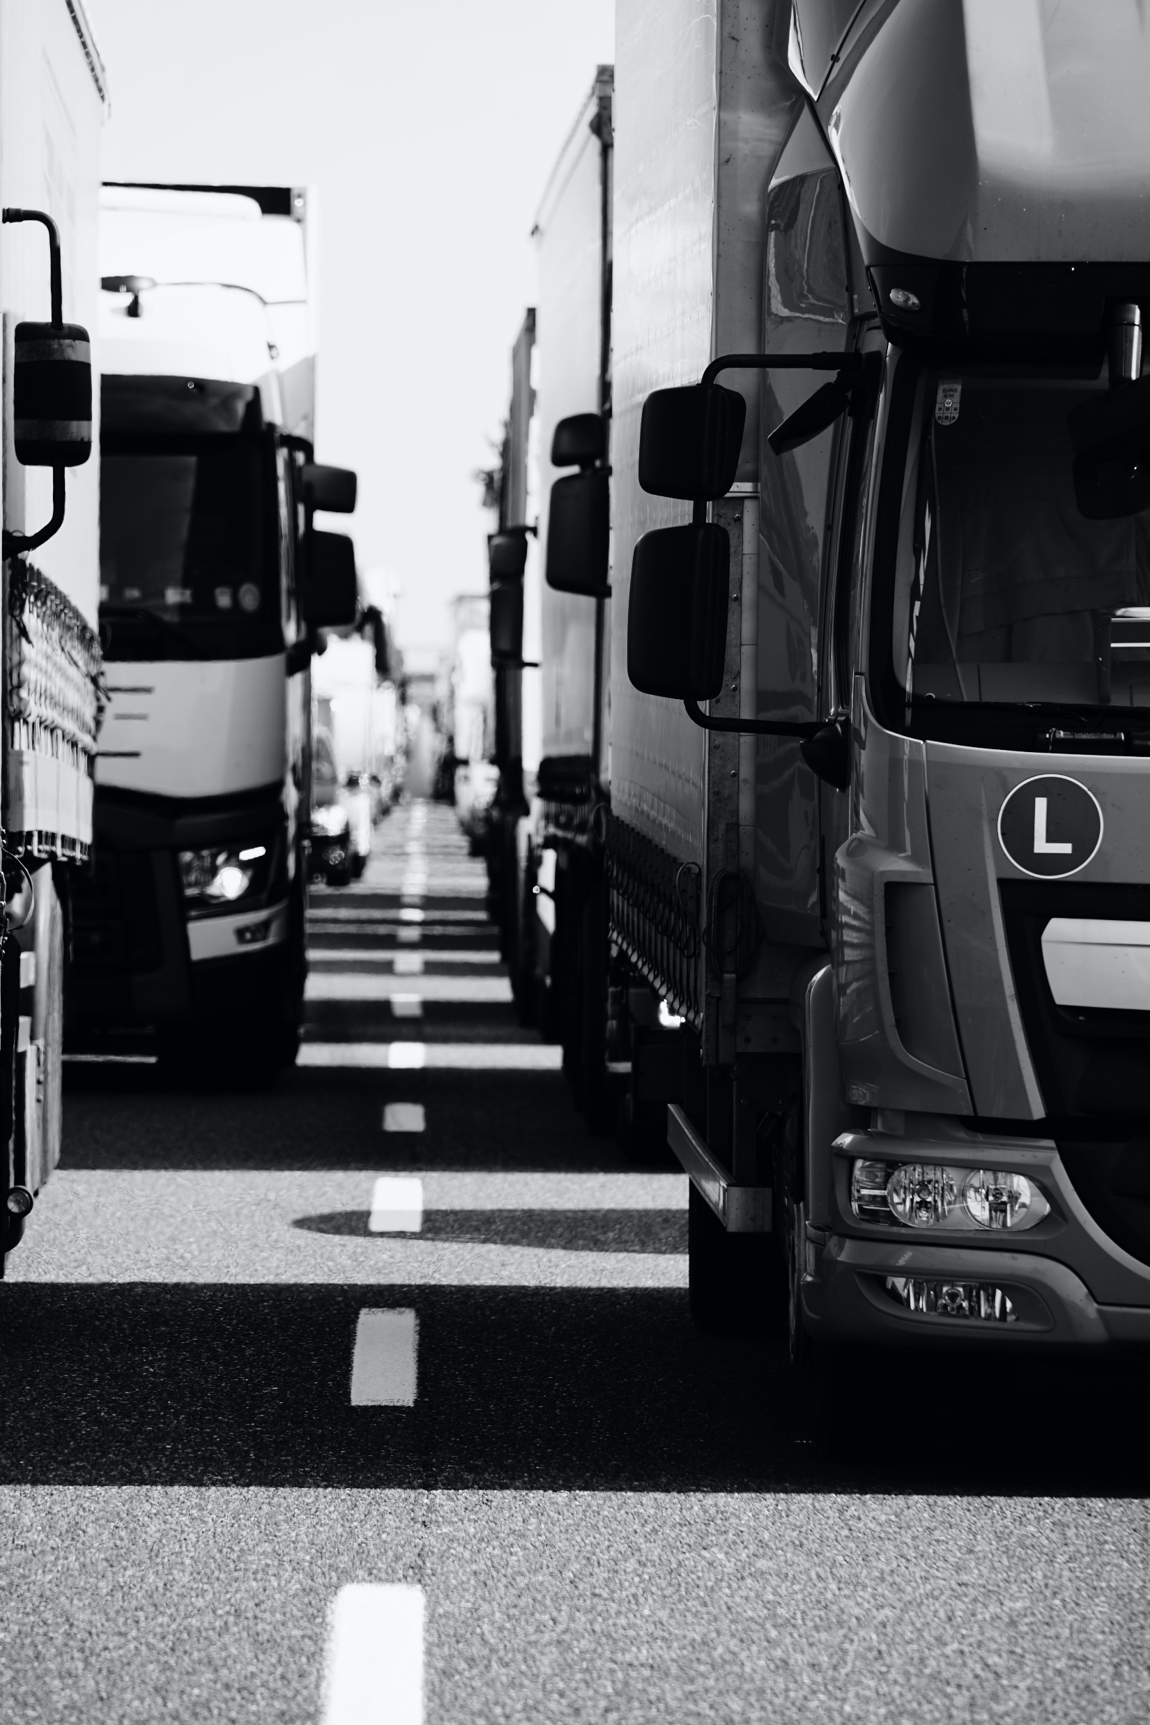
Types of transport models: Passenger vs freight transport
Passenger transport | Freight transport
Most transport modelling studies focus on passenger transport and overlook the freight component | Freight transport modelling has gained importance due to the significant and ongoing growth of freight transport high environmental footprint of trucks (CO₂, road surface damage, contribution to traffic jams) Challenge in developing freight transport models: lack of suitable data Aggregated economic statistics often use coarse classifications of economic sectors, limiting accuracy Disaggregated data depends on voluntary cooperation of businesses Data may be scattered over multiple departments: management, administration, production, logistics, and transportation departments
Grayscale photo of cars on road photo – Free Truck Image on Unsplash

Slide 17
Types of transport models: Agent-based models
Agent-Based Models (ABMs) can represent complex systems, including transport
ABMs focus on the emergence of behaviour: a bottom-up approach modelling individual agents and their interactions
ABMs often combine many model advancements discussed before:
Disaggregated,
Dynamic,
Spatial
Activity-based
May include LUTI component
Main agents are typically citizens who make decisions on activities, modes of transport, and routes
It is possible to model one synthetic agent for each real citizen

Slide 18
Overview chapter
Types of transport models
Elasticities
The 4-step model
Human behaviour modelling
Validation of models
Some examples of models
What can a transport model be used for?
Conclusions
Web Network Points - Free photo on Pixabay - Pixabay

Slide 19
Elasticities (see also ch. 3 and 6)
Simplest answer to the question: ‘to what extent is a change in one variable associated with a change in another variable?’
$$x−elasticity of y:E=\frac{∂y/y}{∂x/x}$$
Example: If the fuel price ($x$) elasticity of car use in km ($y$) is -0,4, then car use will decline by 4% when fuel prices increase by 10%.
Direct price elasticities are usually negative (demand decreases as price goes up), whereas cross price elasticities may be positive (in case the products are substitutes) or zero (if they are independent)
Caution points when using elasticities:
The elasticity can differ at different values of the independent variable – it is point-specific
The elasticity can differ when the variable is decreasing or increasing – it is direction-specific
Transport system is complex with multiple feedback loops. E.g., in response to fuel price increase, there may be reduction of car travel demand. This would however decrease travel times leading to increased demand, perhaps by different car users.
→ Use of elasticities as a single method is not recommended

Slide 20
Overview chapter
Types of transport models
Elasticities
The 4-step model
Human behaviour modelling
Validation of models
Some examples of models
What can a transport model be used for?
Conclusions
Web Network Points - Free photo on Pixabay - Pixabay

Slide 21
The 4-step model
The 4-Step is the most traditional aggregate modelling approach, having originated in 1950s in the US.
Having divided the study area into zones, the model proceeds through 4 steps using a sub-model to answer a question in each step:
1st step: Generation (production) and attraction – how many trips depart and arrive at each zone?
Trip-generation models provide the total number of trips departing from each zone based on land-use variables (e.g., population, retail area, employment)
Trip-attraction models provide the total number of trips arriving at each zone based on similar variables.
2nd step: Distribution – from the trips that depart from each zone what are their destination zones?
The distribution model determines the number of trips between each OD pair. The sum of trips departing from each origin / arriving at each destination zone equals the outputs from the corresponding models in step 1. This is called a ‘doubly-constrained model’.
The classic distribution model is derived from Newton’s gravity theory, considering generalised travel costs as distance
3rd step: Modal split – how many trips identified in step 2 are performed using each travel mode?
Modal split (or mode choice) models divide the trips among different modes of transport available in the region
Typically, car, public transport and active modes are distinguished, as well as possibly their combinations
Discrete choice models are typically used at this step
4th step: Assignment – which route is taken to get from an origin to the destination zone in the existing networks?
Simplest assignment method is ‘all or nothing’ – assumption that everyone takes the shortest route
Alternatively, and more realistically, discrete choice models are used
The most used methodology is user equilibrium traffic assignment. This method considers the relationships between travel demand, road capacities, congestion and travel times in car travel – see ch. 7.
The most recent class of models is dynamic traffic assignment methods – these consider also the departure time choices of drivers

Slide 22
The 4-step model
Do the 4 steps correspond to travellers’ sequential decisions?
They may
However, the decisions are likely interconnected and there are feedback loops – e.g., traffic congestion likely influences travel mode choice (potentially making car less attractive)
4-step models often consider such loops and simultaneous decisions, e.g., simultaneous destination and mode choice (steps 2 & 3)
The 4-step model remains a widely used approach in transport modelling in many large cities, even as disaggregated models are being developed and are gaining popularity with the advent of big data
Pumpkin steps - Free image on Pixabay

Slide 23
Overview chapter
Types of transport models
Elasticities
The 4-step model
Human behaviour modelling
Validation of models
Some examples of models
What can a transport model be used for?
Conclusions
Web Network Points - Free photo on Pixabay - Pixabay

Slide 24
Human behaviour modelling
Behind each of the 4 steps in the 4-step model are decisions on an individual level:
To make a certain trip or not?
What destination to choose?
What travel mode to choose?
Which route to choose?
What time of day to choose for the trip? (sometimes added as 5th step in 4-step model)
These decisions can be modelled using human behaviour models, based in microeconomics (see also ch. 3).
Car transportation travel road trip - Free image on Pixabay

Slide 25
Human behaviour modelling: The microeconomic approach
The microeconomic human behaviour models consider the following:
There is a set of alternatives available for a decision
A rational individual will choose the alternative that yields the highest utility
Utility cannot be directly measured, but it is inferred from the popularity of all the alternatives
The utility is composed of deterministic (and observable) and stochastic (and unobservable) component
Random Utility Maximisation: principle that postulates that the alternative with the largest total utility for the individual is chosen
Definition. Utility reflects the satisfaction or benefit that individuals gain from choosing a certain alternative.

Slide 26
Human behaviour modelling: The microeconomic approach
The simplest and most used choice model is the multinomial logit (MNL).
In this model, the choice probabilities have a simple closed form: $$P_{i}=\frac{e^{V_{i}}}{\sum_{j∈M}{e^{V_{j}}}}$$
Where: $P_{i}$ - probability that individual will choose alternative $i$ $V_{i}$ - deterministic (or observed) utility of alternative $i$ $M$ - the set of all alternatives
The deterministic part of utility for public transport (PT) could be, e.g., as follows:
$$V_{PT}=β_{0}+β_{1}TT_{PT}+β_{2}TC_{PT}+β_{3}WT_{PT}+β_{4}TrT_{PT}+β_{5}CO$$
(3)
(4)
Alternative-specific constant
PT travel time
PT waiting time
Dummy indicating whether a person owns a car or not
PT travel costs
PT transfer time

Slide 27
Human behaviour modelling: The microeconomic approach
The $β$ coefficients in the previous model indicate the importance of each variable in relation to others
Negative $β$ indicate that the corresponding variable decreases the utility of the transport mode.
E.g., all travel time and travel costs are expected to be negative – with longer travel times or higher costs, the PT alternative becomes less attractive.
Coefficient $β_{0}$ is called alternative-specific constant. It captures the mean utility effect of all variables that are not explicitly part of the utility function – e.g., a positive or negative attitude towards PT
The $β$ coefficients are estimated having collected choice data (revealed or stated preference, see before) and using statistical estimation techniques.

Slide 28
Human behaviour modelling: Applications to travel decisions
Each of the 5 individual travel decisions (see before) can be modelled using this microeconomic approach. There is much research in specifying and applying various models to these decisions. Some examples:
Joint choice of travel mode and destination can be modelled using nested logit
When modelling destination choices, the denominator of eq. (3), see before, expresses the level of accessibility (see also utility-based accessibility measure, ch. 9)
It is possible to model random individual differences in $β$ coefficients using a mixed logit model
Recommended reading:
Train, K.E., 2003. Discrete Choice Methods with Simulation, Discrete Choice Methods with Simulation. Cambridge University Press, Cambridge. https://doi.org/10.1017/CBO9780511753930
Ben-Akiva, M.E., Lerman, S.R., 1985. Discrete choice analysis: theory and application to travel demand, MIT Press series in transportation studies ; 9. MIT Press, Cambridge.
Library Books Bookshelves - Free photo on Pixabay - Pixabay

Slide 29
Overview chapter
Types of transport models
Elasticities
The 4-step model
Human behaviour modelling
Validation of models
Some examples of models
What can a transport model be used for?
Conclusions
Web Network Points - Free photo on Pixabay - Pixabay

Slide 30
Validation of models
Validation is defined as the assessment of whether the model describes reality correctly or not
The question is phrased simply, but the answer is usually complicated (Cambridge Systematics, 2010)
For validation purposes, designers use independent data not used during the construction of the model to assess the reliability of the model for a wide range of situations
Button red green icon - Free image on Pixabay
Cambridge Systematics, Inc. (2010), Travel Model Validation and Reasonability Checking Manual Second Edition. Federal Highway Administration.

Slide 31
Validation of models
Aspects that must be taken care of during validation of a transport model may be:
Application scope E.g.: when using a peak model designed for working days, model users cannot expect the model to perform well for peak travel during holidays.
Qualitative criteria E.g.: for which policy measures should the model be suitable in general?
The level of validation E.g.: on which road links should the model be able to calculate delays due to congestion?
Analysis of the discrepancies between the independent data and model outcomes should give clues about needed improvements:
Additional model parameters?
Calculation with smaller digits or taking smaller steps (in dynamic models)?
Reducing step size or increasing the number of iterations in iterative algorithms?
Adjusting the mathematical model to fit the conceptual model?
Adjusting the conceptual model to better represent some dependencies or amend the theories?

Slide 32
Overview chapter
Types of transport models
Elasticities
The 4-step model
Human behaviour modelling
Validation of models
Some examples of models
What can a transport model be used for?
Conclusions
Web Network Points - Free photo on Pixabay - Pixabay

Slide 33
Some examples of models
The examples described are:
The LMS, the national Dutch model system, being an example of a state-of-the-art mainstream transport model.
ILUTE, a state-of-the-art agent-based LUTI model
DYNAMO, an example of an impact model, in this case a model for car ownership, energy use and emissions
LMS
ILUTE
DYNAMO

Slide 34
Some examples of models: LMS
LMS
The Dutch National Model System (in Dutch: Landelijk Model Systeem - LMS) is a renowned and unique transportation policy design instrument used by Rijkswaterstaat, the public works department of the Dutch Ministry of Infrastructure and the Environment, since 1986.
It is a disaggregated model system that estimates future traffic flows for both trunk-road networks and public transport in the Netherlands
Zoning and data:
The Netherlands and small parts of bordering countries is divided into ~1500 zones
Socio-economic and employment data for each zone in the base year and forecasting year are used
Road and public transport network data
Trip diaries (RP data) and surveys (SP data) to create models of individual / household choice behaviour
Data on parking costs, driving licence and car ownership
Data on passenger mobility and freight transport in the base year

Slide 35
Some examples of models: LMS
LMS
Here are the key steps and components of the LMS:
Step 1: Choice behaviour for each type of household
Individuals and households make choices, including car ownership (by households) and mode choice (by individuals)
Step 2: Type of travellers in the base year
LMS establishes traveller types based on individual characteristics such as age, gender, car availability, etc.
Classification is done for each zone in the base and forecasting years
If, e.g., the number of people over 50 years of age grows in the future, then so does the number of trips made especially by this group
Step 3: Applying the choice models
Choice models are estimated for driving license and car ownership, trip-making decisions, travel destination, mode, time of day, station, and access/egress mode for car drivers
Route choice for car drivers and public transport assignment is done using commercial software

Slide 36
Some examples of models: LMS
LMS
Step 4: Types of travellers in the forecasting year
The model determines the size and composition of the future traveller population for each location using demographic, socio-economic, and spatial data
Step 5: Changed circumstances – i.e., considered policy options
Planned policy options are implemented in the model
Examples: increasing railway connections, changing parking costs, or widening roads
Step 6: Forecast: New travelling behaviour
The model computes short-term and long-term changes in choice behaviour, such as route shifts or mode changes due to changed circumstances
It forecasts the number of travellers for each transport mode and the number of kilometres travelled
The model also computes transport flows within and between zones and allocates trips to the trunk-road network and public transport

Slide 37
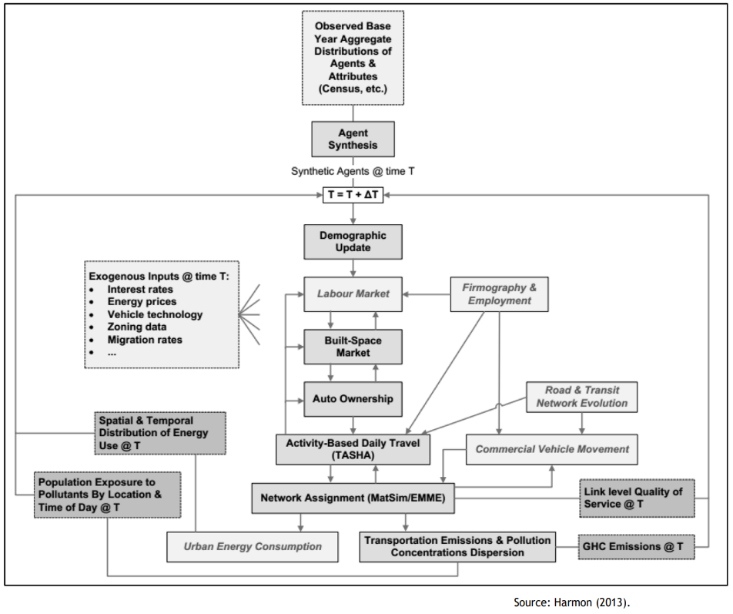
Some examples of models: ILUTE
ILUTE
The ILUTE model is a state-of-the-art agent-based Land Use and Transport Interaction (LUTI) model for the Toronto-Hamilton region in Canada (Salvini and Miller, 2005)
The model changes the system state from an initial base case to a future end state in discrete time steps
The model considers individual agents such as persons, households, housing units, and firms collectively defining the urban region state
Figure 16.3 The ILUTE model structure (Taken from Chapter 16, page 352)
Salvini, P. and E.J. Miller (2005), ‘ILUTE: An Operational Prototype of a Comprehensive Microsimulation Model of Urban Systems’, Networks and Spatial Economics, 5, 217–34. https://doi.org/10.1007/ s11067–005–2630–5

Slide 38
Some examples of models: ILUTE
ILUTE
The main modules of the ILUTE model are
Demographics Module:
Models population and household evolution over time, including births, deaths, migration, marriages, and divorces
Housing Market Component:
Endogenously explains the supply of housing by type and location, along with corresponding prices
Household Automobile Ownership:
Dynamically updated using models of household vehicle transactions
Travel Activity Scheduler for Household Agents (TASHA):
An activity generator for agents that schedules the activities of the synthetic population in the region
Trip Assignment:
Assigns trips resulting from agents' movements to modes of transport (public transport and car) and paths in the networks
This process can use traditional aggregated traffic assignment methods or an agent-based dynamic traffic simulation model like MATSim

Slide 39
Some examples of models: ILUTE
ILUTE
On-going work on ILUTE:
addition of a labour market
implementing firms' characteristics and location choices to explain population dynamics and mobility choices
ILUTE uses random utility maximization principles for simulating choices and employs specific procedures to enhance the realism of those choices.
E.g.: it implements search process for house selection as opposed to assuming that decision makers consider all homes on the market at once
ILUTE allows tracking each agent over time, monitoring the changes in their workplace, household composition, modes of transport, chosen paths, etc.:
This allows to study how policies may affect different populations differently
E.g.: ILUTE has been used to model population exposure to pollution in the Toronto region

Slide 40
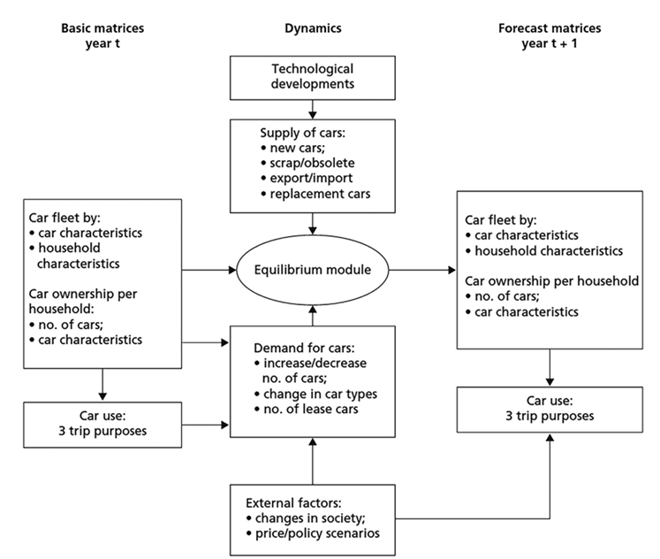
Some examples of models: DYNAMO
DYNAMO
DYNAMO (Meurs and Haaijer, 2006) is a dynamic model for forecasting the size, composition, and use of the Dutch passenger car fleet from 2003 to 2040, along with the resulting emissions
The model's core is an equilibrium module where prices for second-hand cars emerge to balance the demand and supply for second-hand cars each year
It needs the following input:
Number of cars per household
For each car in the household: type of fuel and fuel consumption, car age and weight category
Type of ownership: private / lease / company-owned cars
Car use: number of kilometres driven by cars
Types of households: household size, number of working people, age of the oldest individual, and real disposable household income
The model considers
how household income affects car use and car choices within each household group
how fleet composition and usage impacts government income through taxes
Figure 16.4 Structure of the DYNAMO model (Taken from Chapter 16, page 354)
Meurs, H. and R. Haaijer (2006), DYNAMO: a new dynamic model for the Dutch passenger car market, in: Colloquium Vervoersplanologisch Speurwerk. Amsterdam.

Slide 41
Overview chapter
Types of transport models
Elasticities
The 4-step model
Human behaviour modelling
Validation of models
Some examples of models
What can a transport model be used for?
Conclusions
Web Network Points - Free photo on Pixabay - Pixabay

Slide 42
What can a transport model be used for?
Transport models provide insights into the magnitude of effects of developments and policy measures.
Various effects: Transport models can inform about effects on pollutant emissions, congestion levels, and long-term suburbanization
Incorporating developments: Models can show the impact of demographic, economic, spatial, and infrastructural changes on transport
Should a model be used for a particular research question?
Cannot be answered in general
The decision depends on the question's complexity, available time, budget, the desired level of precision and the expected impact on the system
Using models not only provides a result, but also force researchers to make research questions explicit, facilitating better study design and thereby outcomes

Slide 43
What can a transport model be used for?
Caution point in using models:
Matching real-world structure:
E.g.: adoption of more fuel-efficient cars do not only lead to less emissions directly, but can also induce more car travel that counters that effect
Handling small vs. major changes: Models are better suited to study the effects of relatively small changes which are within the scope of agents’ behaviour and data used to develop the models
Limitations of model use:
It is not important whether certain package of policy measures only just, or only just not, lead to achieving a goal in 2040
Instead: considering the uncertainties in the model, the conclusion should be that the package will lead to changes in the magnitude of the set aim
Interpreting model results: Researchers should not ‘hide behind the model’, but should take responsibility for model use, interpretation, and implications
Woman Standing Near the White Board · Free Stock Photo (pexels.com)

Slide 44
Overview chapter
Types of transport models
Elasticities
The 4-step model
Human behaviour modelling
Validation of models
Some examples of models
What can a transport model be used for?
Conclusions
Web Network Points - Free photo on Pixabay - Pixabay

Slide 45
Conclusions
A model is a simplified representation of a part of a real system
Transportation models are first and foremost a means to gain insights into the effects of various developments (like policy developments) on transportation
Models can be classified by the transport mode they focus on, the period of time they focus on, and their technical characteristics – e.g., dynamic versus static, spatial or not
Aggregated models such as the 4-step method have been used extensively for the past decades to support transport policy decisions in urban areas. With the need to study more complex measures and advances in computational speed, disaggregated models have been developed more recently.
Whether or not to answer a certain research or policy question by using a model requires adequately weighing the available alternatives as well as the pros and cons of model simulations and the relevant alternatives

Slide 46
The Transport System and Transport Policy
Edited by Bert van Wee, Jan Anne Annema, David Banister and Baiba Pudãne
Chapter 16: Transportation models and their applications
Authors: Gonçalo Homem de Almeida Correia and Bert van Wee
Ferrybridge - Free image on Pixabay

