Slide 1


The Transport System and Transport Policy
Edited by Bert van Wee, Jan Anne Annema, David Banister and Baiba Pudãne
Chapter 3: Individual needs, opportunities and travel behaviour: a multidisciplinary perspective based on psychology, economics and geography
Authors: Martin Dijst, Piet Rietveld, Linda Steg, Janet Veldstra and Erik Verhoef
Road from the air - Free image from Pexels

Slide 2
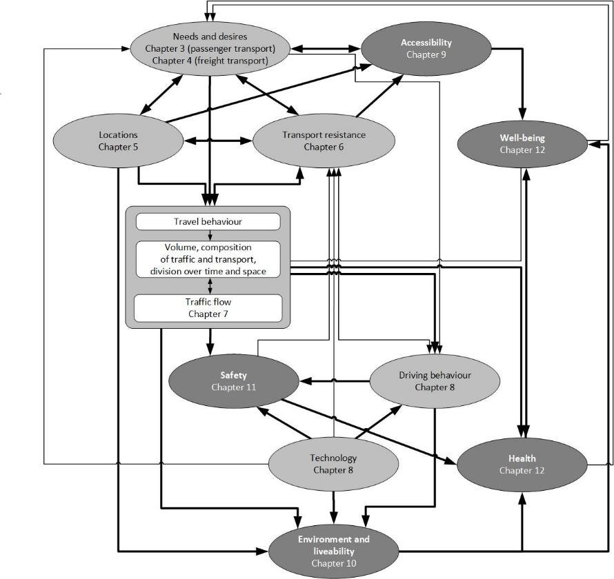
Motivation of this chapter

Slide 3
Understand needs and desires in passenger transport
Pas (1980): Travel typically not aim in itself, but a means to reach activities and locations
Banister (2008): Travel is not only derived demand, but has also an intrinsic value
Therefore (recap from Chapter 2):
Definition
We consider needs and desires for
  (spatially separated) activities
  ways of travel – e.g., car as a status symbol
Banister, D. (2008), ‘The sustainable mobility paradigm’, Transport Policy, 15, 73–80
Pas, E.I. (1980), Toward the Understanding of Urban Travel Behavior through the Classification of Daily Urban Travel/Activity Patterns, Ph.D. thesis, Evanston, IL: Northwestern University.

Slide 4



Understand travel behaviour
Several disciplines have something to say about travel behaviour:
- Psychology
- Economics
- Geography
The differences between these disciplines are in their conceptualizations, and emphasis put on different determinants and behavioural mechanisms.
The chapter is structured according to these disciplines
Psychology brain - Free icon from Freeicons , Shaking hands - Free icon from Freeicons , Earth globe - Free icon from Freeicons

Slide 5

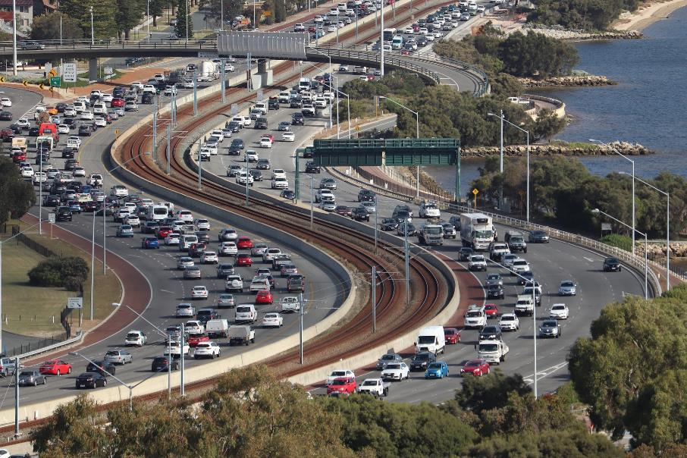
Design better transport policies
Congestion, reliance on car – still on the policy agendas of Western countries:
Expect delays sign - Free image on Unsplash
Congestion - Free image on Pixabay

Slide 6
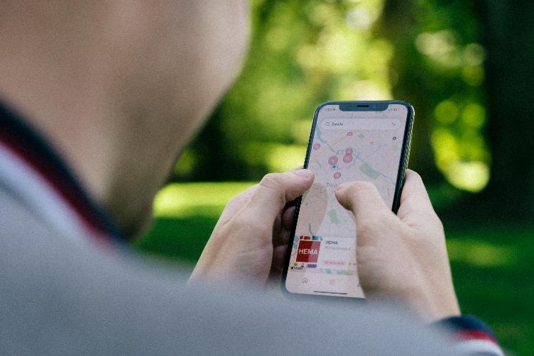
Design better transport policies
New transport innovations create new items on policy agenda’s
Example: MaaS
= Mobility-as-a-Service, to integrate transport modes and mobility services into one mobility service accessible on demand
Challenge: how to stimulate the adoption of innovations, such as MaaS?
Mobility on phone - Free image on Unsplash
Motivations to use new travel modes
Strategies to promote MaaS

Slide 7
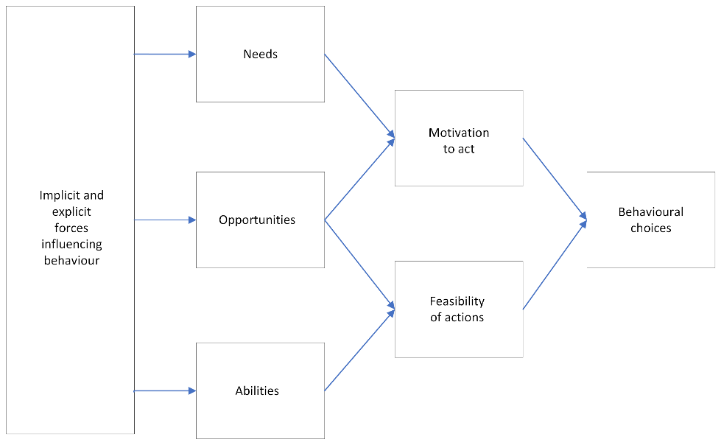
Needs-Opportunities-Abilities model
The Needs-Opportunities-Abilities model is a general conceptual framework to explain travel behaviour
Needs: e.g., to travel safely, to buy food
Opportunities: e.g., supply of transport alternatives
Abilities: e.g., available time, money, skills
Inter-dependent: a lack of motivation to engage in a behaviour might lead to a denial of opportunities or abilities to use it
Individual factors influencing travel behaviour: the NOA model
(Taken from Chapter 3)

Slide 8

The Psychological Perspective
Overview of subjects:
- Behavioural choices
  Motivational factors
    Perceived cost and benefit
    Moral and normative concerns
    Affective and symbolic motives
  Contextual factors
Habitual behaviour

Slide 9
The Psychological Perspective
Overview of subjects:
- Behavioural choices
  Motivational factors
    Perceived cost and benefit
    Moral and normative concerns
    Affective and symbolic motives
  Contextual factors
Habitual behaviour

Slide 10


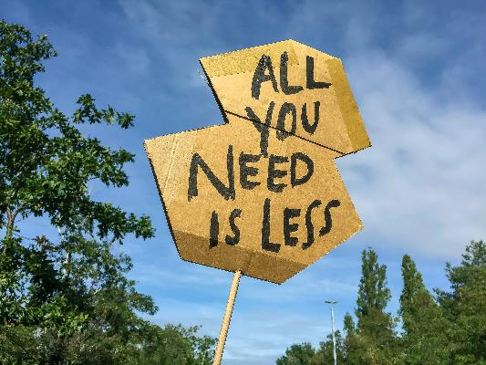
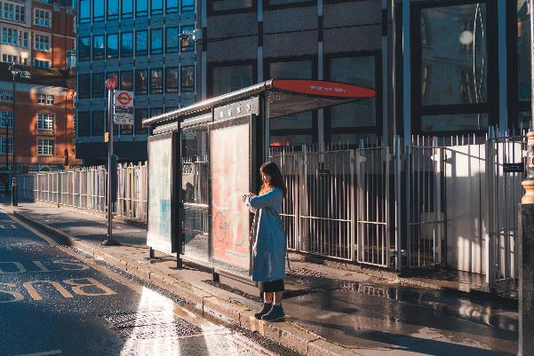
Motivational factors: three lines of research
1. Perceived cost and benefit 2. Moral and normative concerns 3. Affect and symbolic factors
Costs of travel - Free image on pixabay
Bus is too late - Free image on Unsplash
All you need is less sign - Free image on Unsplash

Slide 11
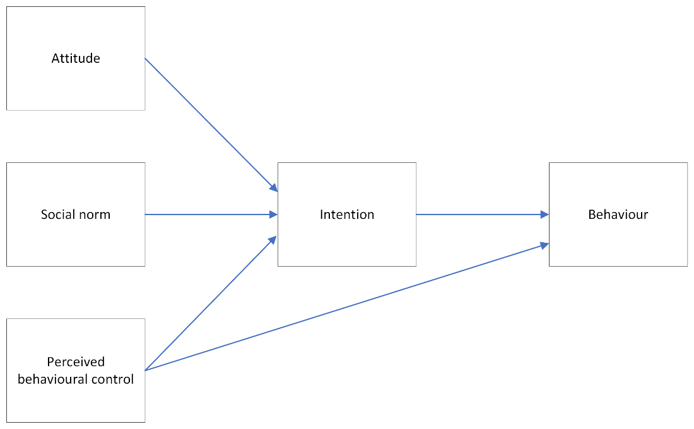
Perceived cost and benefit: Theory of planned behaviour
Definition
Car mode choice example
To which extent do people think that a behaviour will result in particular outcomes and thus will yield different costs and benefits
E.g., driving a car is expensive, saves time, provides freedom or enhances one’s status
To which extent do people believe that important others approve or disapprove the behaviour
Expectations from e.g., friends, family or colleagues
To which extent do people think they are capable of engaging in relevant behaviour
E.g., the extent to which they feel capable of using the bus due to knowing the timetable and having the money
The theory of planned behaviour
(Taken from Chapter 3)

Slide 12
Perceived cost and benefit: Theory of planned behaviour
Other factors, such as demographics and personal values, affect behaviour indirectly For example:
“Men travel more by car because they like driving”
“People with strong environmental values may drive less because of the negative environmental consequences”
“Low-income groups may drive less because they have a lower perceived behaviour control”
The theory of planned behaviour
(Taken from Chapter 3)

Slide 13
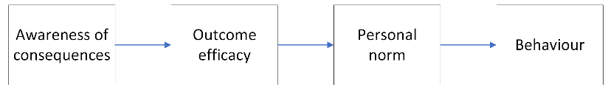
Moral and normative concerns
Environmental values can act as a motivational source to trigger sustainable mobility decisions and behaviours
Several studies examined the role of moral and normative considerations underlying travel behaviour:
Norm Activation Model (NAM):
Personal norms determine people’s behavioural choices
Example: If a person feels a moral obligation to reduce CO2 emissions (problem awareness), then they would be more likely to engage in sustainable behaviour and feel that they can help reduce these impacts (outcome efficacy)
Value-Belief-Norm Theory (VBN):
Problem awareness is rooted in personal values
Example: If a person has self-transcendence values, then the person has greater problem awareness, outcome efficacy, and stronger personal norms. They also more favourably evaluate interventions that aim to reduce car use, and they themselves are more willing to reduce their use of cars
The norm activation model
(Taken from Chapter 3)

Slide 14

Motives of travel behaviour
Three types of motives may underlie travel behaviour: instrumental, symbolic and affective motives
1. Instrumental: e.g.
“if I drive to work I shall get there faster than if I take the train.”
3. Affective: e.g.
“Driving to work is more fun than taking the bus.”
2. Symbolic: e.g.
“If I take the bus to work my colleagues will think I am a loser.”
Fitting in - Free image on unsplash

Slide 15
The Psychological Perspective
Overview of subjects:
- Behavioural choices
  Motivational factors
    Perceived cost and benefit
    Moral and normative concerns
    Affective and symbolic motives
  Contextual factors
Habitual behaviour

Slide 16
Contextual factors
The three theories of the motivational factors focus on individual motivations for travel behaviour, but contextual factors also play a role in travel behaviour through opportunities and constraints
The NOA model reflects the mutual influence of motivation and contextual factors
Four ways in which contextual factors affect travel behaviour:
  Directly, by enabling or disabling certain modes of transportation
  Indirectly, by influencing attitudes and personal norms
  Moderating the relationship between motivation and behaviour
  Determining which type of motivation (goal-framing theory) affects behaviour

Slide 17
The Psychological Perspective
Overview of subjects:
- Behavioural choices
  Motivational factors
    Perceived cost and benefit
    Moral and normative concerns
    Affective and symbolic motives
  Contextual factors
Habitual behaviour

Slide 18

Habitual behaviour
Choices are not always based on careful deliberation, but are also guided by automatic cognitive processes.
Habits emerge when:
- outcomes of choices have generally been satisfactory
- the choice is mentally associated with the relevant goal-directed behaviour
Behaviour can be habitual even if it is not frequently repeated
Smoking - Free image on Pexels

Slide 19

The Economics’ Perspective
Overview of subjects:
Classical economics’ view on behaviour & behavioural economics
- Utility functions
Useful variables in economic analysis of transport:
- Value of travel time (VOT)
- Price elasticity
- Time elasticity
- Income elasticity

Slide 20
The Economics’ Perspective
Overview of subjects:
Classical economics’ view on behaviour & behavioural economics
- Utility functions
Useful variables in economic analysis of transport:
- Value of travel time (VOT)
- Price elasticity
- Time elasticity
- Income elasticity

Slide 21


Classical perspective in economics
The preferences of consumers is the starting point of the economic analysis
The classical assumptions of the economic theory are:
Consumers base their choice on rational considerations
Consumers are able to arrive at a complete and consistent ranking between options.
An example of a complete and consistent ranking:
Individual chooses among A, B and C
Say, she/he ranks the options as B > A (i.e., ‘B is better than A’) and A > C . Then, B > C will make the ranking consistent for that individual
Money - Free image on Unsplash

Slide 22
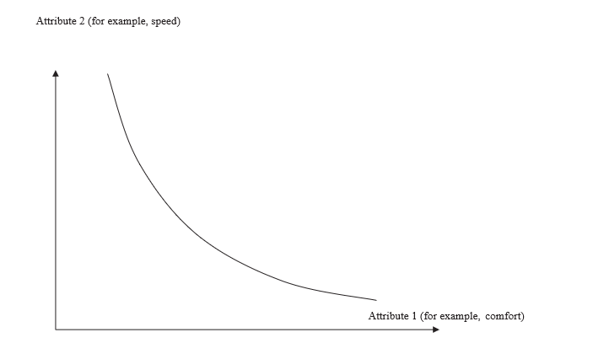
Utility functions
Definition:
Utility function gives a quantitative representation of a consumer's preference ordering
- The consumer’s behaviour can be (imperfectly) characterized as if she maximized such a function
Definition:
Indifference curve is the curve that contains the set of all combinations of attributes that is valued equally by the consumer
- It is another representation of the preference orderings that are described by the utility function
Illustration of an indifference curve with two attributes
(Taken from Chapter 3)

Slide 23
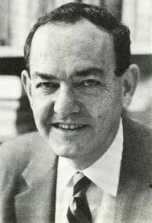
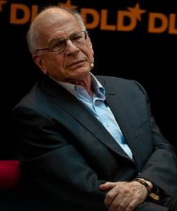

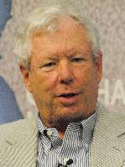
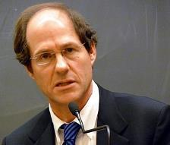
Behavioural economics
Behavioural economics was started and formed by several Nobel Prize laureates
- Bounded rationality (Simon, 1955) is the idea that we make decisions that are rational, but within the limits of the information and time available to us to make that decision
- Prospect Theory (Kahneman and Tversky, 1979) is the general concept that individuals make decisions based on perceived gains instead of perceived losses
- Motives and consumer mistakes (e.g. Becker and Murphy, 1988) is about models that exlain seemingly irrational behaviour from economic modelling of behaviour
- Nudge Theory (Thaler and Sunstein, 2021) assesses how nudges in choice architecture steers behaviour
In this literature, elements from other behavioural sciences, including psychology, are integrated to improve the understanding and modelling of human behaviour
H. Simon
A. Tversky
D. Kahneman
R. Thaler
C. Sunstein

Slide 24
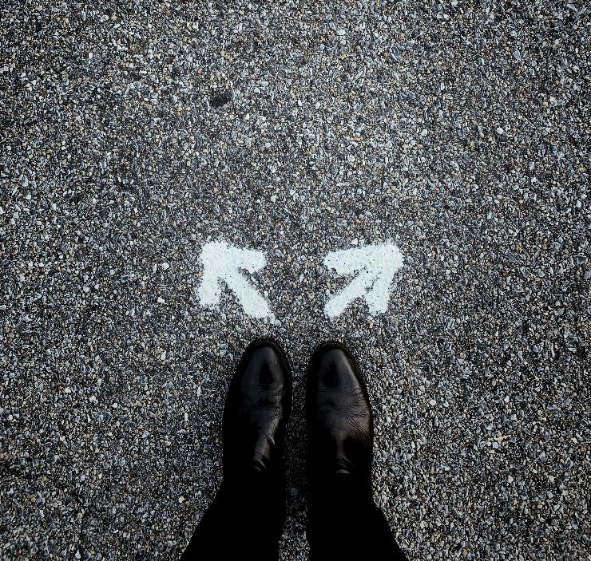
Behavioural choices in transport
In addition to mode choice, transport behaviour includes choices of:
Trip making
Route
Time of day
Vehicle ownership
Destination
Speed
Choose - Free image on Unsplash

Slide 25
The Economics’ Perspective
Overview of subjects:
Classical economics’ view on behaviour & behavioural economics
- Utility functions
Useful variables in economic analysis of transport:
- Value of travel time (VOT)
- Price elasticity
- Time elasticity
- Income elasticity

Slide 26
Value of travel time (VOT)
VOT is the core of the trade-off consumers make between price and speed (or monetary price and travel time) when they compare various travel alternatives
Example: Imagine that a traveller has VOT of 25 euros per hour. She needs to choose between a 6-hour train and 3-hour plane travel and she only cares about travel time and monetary costs and no other aspect of travelling by plane or train. Then she will choose the plane, if the plane ticket costs up to 75 euros more than the train ticket. If the plane ticket exceeds the train ticket by more than 75 euros, she will choose the train
→ comfort, access and perceived sustainability will also play a role in this trade-off

Slide 27

Value of travel time (VOT)
The VOT also depends on:
The opportunities to use the saved travel time
The trip purpose
The urgency of arriving on time
The time already used for travel
money growth time - Free image on Pixabay

Slide 28
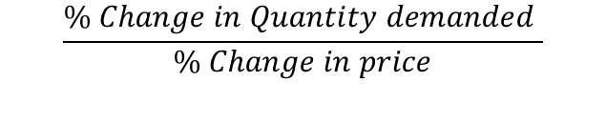
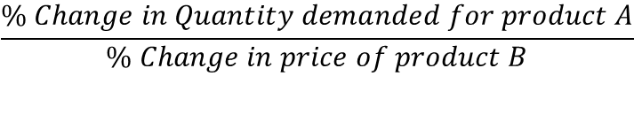
Price elasticity
Definition:
The price elasticity of demand for kilometres is the percentage change in demand (Q) when the price per kilometre (P) increased by 1 percent
Example: fuel price elasticity = -0.2
When the fuel price increases by 10 % the number of kilometres driven will decrease by 2 %
Definition:
The cross price elasticity of demand for kilometres is the percentage change in demand (Q) for one good (A) when the price per kilometre (P) for another good (B) increased by 1 percent
Example: Price of railway tickets decreases
Demand for car use will decrease (substitution)
Demand for bus rides to the station will increase (complementarity)
$$\frac{\% Change in Quantity demanded }{\% Change in price}$$
$$\frac{\% Change in Quantity demanded for product A}{\% Change in price of product B}$$

Slide 29
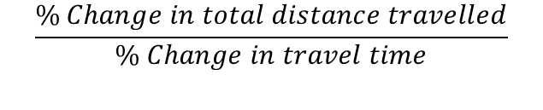
Travel time elasticity
Travel behaviour depends on the duration – and hence the speed – of trips
Travel time elasticity =
The long-term travel time elasticity of the demand for transport is close to −1
A decrease in travel time by a certain percentage will lead to a similar percentage increase in the total distance travelled
An example of a cross-travel time elasticity:
Consider a multimodal trip chain with train as main transport mode. Because access modes bringing passengers to the railway station are often slow, the demand for rail transport may well be rather sensitive to the speed of access modes
$$\frac{\% Change in total distance travelled}{\% Change in travel time}$$

Slide 30

Income elasticity
The impact of income on the demand of transport
Income elasticity of demand = $\frac{\% change in quantity demand(\frac{∆D}{D})}{\% change in income (\frac{∆I}{I})}$
When increase in income:
1. Inferior Good
Fall in demand
e.g. public transport
2. Income inelastic
Small rise in demand
e.g. cycling and walking
3. Luxury goods
Bigger % rise in demand
e.g. Aviation

Slide 31

The Geographical Perspective
Overview of subjects:
Classical time geography
  Time-geographic space-time prism
Beyond classical time geography:
  GIS
  Measurement theory
  Probabilistic approach
  Relational time geography

Slide 32
The Geographical Perspective
Overview of subjects:
Classical time geography
  Time-geographic space-time prism
Beyond classical time geography:
  GIS
  Measurement theory
  Probabilistic approach
  Relational time geography

Slide 33

Classical time geography
Development of time geography by Hägerstrand was parallel to and inspired the transition from trip-based to activity-based approaches in transport modelling:
Until 1960s: Trip-based approach
Hägerstrand (1970): Activity-based approach
The life of an individual, but also of other organisms and material objects, describes an uninterrupted ‘path’ through time and across space
Society: large number of webs composed of uninterrupted paths by people, other organisms and non-living elements through life and space
Various time scales, e.g. a day or a whole life span
Every organism or thing is constantly in movement
Hägerstrand, T. (1970), ‘What about people in regional science?’, Papers of the Regional Science Association, 24, 7–21.

Slide 34
Classical time geography
Participation in activities is not a matter of choice, but subject to three types of constraints:
1. Capability constraints: biological, mental and instrumental limitations, e.g. sleeping
2. Coupling constrains: people need to meet or access equipment and other materials at certain times and locations, e.g. attending a lecture
3. Authority constraints: regulation of the access of individuals to activity places,
e.g. laws
‘Base’ locations are fixed in time and space, e.g. work or home

Slide 35
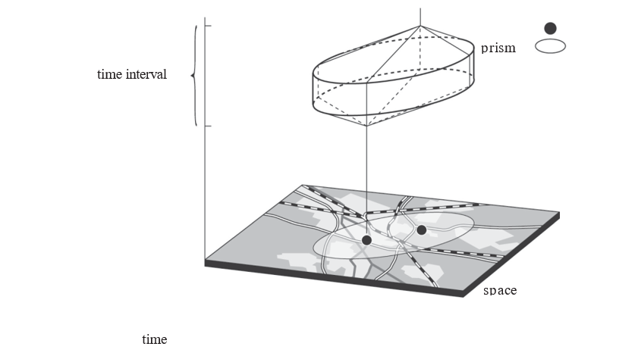
Time-geographic space-time prism
Capability, coupling and authority constraints define a three-dimensional ‘prism’
Prism and potential action space
(Taken from Chapter 3)

Slide 36
Time-geographic space-time prism
Capability, coupling and authority constraints define a three-dimensional ‘prism’
‘potential action space’, contains all the activity places that can be visited within a certain time window
Prism and potential action space
(Taken from Chapter 3)

Slide 37
The Geographical Perspective
Overview of subjects:
Classical time geography
  Time-geographic space-time prism
Beyond classical time geography:
  GIS
  Measurement theory
  Probabilistic approach
  Relational time geography

Slide 38
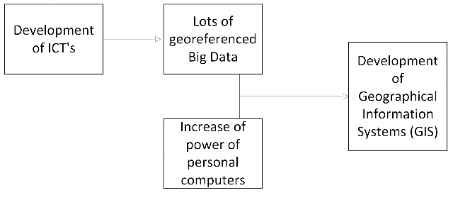
Beyond classical time geography
Classical time geography has been enriched and transformed due to the supply and use of ICT’s in daily life:
GIS: Geovisualisation of human activity patterns using 3-D GIS (Kwan, 2000). In the GIS, the three-dimensional figures offer realistic representations of urban environments, showing individual time-space paths and the location of activity places (see: http://meipokwan.org/Gallery/STPaths.htm )
The conceptual and geometric time geographic framework is supplemented by Harvey Miller’s measurement theory (Miller, 2005a). This is about an analytical framework to infer time geographic entities and relationships from high resolution measurement of mobile objects in time and space
Probabilistic approach in time geography developed to determine chances of finding a person in a specific area or the likelihood of two people meeting. It relies on knowledge of people's behaviours in time and space, which leads to different probability distributions (Winter and Yin, 2011)
Kwan, M.-P. (2000), ‘Interactive geovisualization of activity-travel patterns using threedimensional geographical information systems: a methodological exploration with a large data set’, Transportation ResearchC, 8, 185–203.
Miller, H.J. (2005a), ‘A measurement theory for time geography’, Geographical Analysis, 37, 17–45.
Winter, S. and Z-C. Yin (2011), ‘The elements of probabilistic time geography’, GeoInformatica, 15, 417–434.

Slide 39
Relational time geography
In classical time geography, time and space are pre-given dimensions of a container. However, in a relational perspective time and space are constructed within relational networks of humans and non-humans
It emphasizes the relevance of embodied experiences, intentions and meanings
It allows studying existential feelings and relational needs of people in daily interaction in geographical environment → this increases the understanding of health and health-related behaviours and social issues, such as social integration and cohesion (Dijst, 2018)
Reinterpret the concept of ‘Authority constraint’: also individual herself can act as an authority → this means that a person could avoid specific places and disapproving gazes (McQuoid and Dijst, 2012)
Dijst, M., (2018), ‘A relational interpretation of time geography’, in K. Ellegård (eds), TimeGeography in the Global Context: An Anthology, London: Routledge, pp. 113–134.
McQuoid, J. and M.J. Dijst, (2012), ‘Bringing emotions to time geography: the case of mobilities of poverty’, Journal of Transport Geography, 23, 26–34.

Slide 40

Main differences between perspectives
+ +
Psychology describes a wider range of behavioural aspects than economics including emotions, morality and habits
Economics has a stronger focus on quantitive analyses than the psychological and the geographical approach
The geographical approach is complementary to psychological and economics’ approaches

Slide 41

Conclusion
+ +
The same phenomena is studied from different angles and with different emphases
The combination of the disciplinary perspectives can lead to a more comprehensive understanding of travel behaviour
→ Use that to increase the effectiveness of integral transport policies
Growth - Free image on Pixabay

Slide 42
The Transport System and Transport Policy
Edited by Bert van Wee, Jan Anne Annema, David Banister and Baiba Pudãne
Chapter 3: Individual needs, opportunities and travel behaviour: a multidisciplinary perspective based on psychology, economics and geography
Authors: Martin Dijst, Piet Rietveld, Linda Steg, Janet Veldstra and Erik Verhoef
Road from the air - Free image from Pexels

