Slide 1
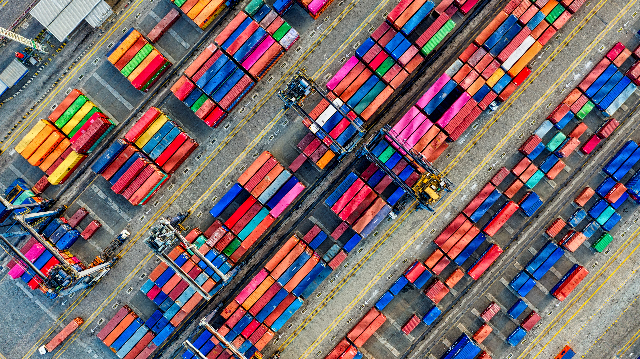

The Transport System and Transport Policy
Edited by Bert van Wee, Jan Anne Annema, David Banister and Baiba Pudãne
Chapter 4: Freight transport: indicators, determinants and drivers of change
Authors: Lóri Tavasszy, Kees Ruijgrok
Containers from the air - Free image on Pexels

Slide 2
Freight transport
Freight transport flows result from an interplay between economic activities (production/consumption) and supply of logistics and transport services
Freight transport in this chapter is examined from three angles:
Indicators for the description of freight transport flows: measures related to volumes moved, transport and traffic performance as well as the impact on the environment from these activities
Determinants of freight transport: the primary decisions (e.g. mode of transport) of actors within the logistics system that create the need for freight movements
Drivers of change in freight transport, i.e. external forces that influence demand: economic growth, globalisation, technology, consumer preferences and pressures to keep the system sustainable

Slide 3
Structure of the chapter
1
2
3
4.2 Indicators of Freight Transport
Weight lifted Ton kilometers Vehicle kilometers Emissions from Transport
4.3 Determinants of Freight Transport
Production Inventories Transport
4.4 Drivers of Change in Freight Transport
Economic Growth Globalisation (Information) Technology & Mass Individualisation Sustainability
Legend:
1/2/3 | Numbers represent order of treatment in chapter
 | Colours represent the parts of the slides that correspond to sections in the chapter
 | Blue arrows indicate how change occurs in the freight system

Slide 4
Indicators of freight transport
1
4.2 Indicators of Freight Transport
Weight lifted Ton kilometers Vehicle kilometers Emissions from Transport
4.3 Determinants of Freight Transport
Production Inventories Transport
4.4 Drivers of Change in Freight Transport
Economic Growth Globalisation (Information) Technology & Mass Individualisation Sustainability

Slide 5
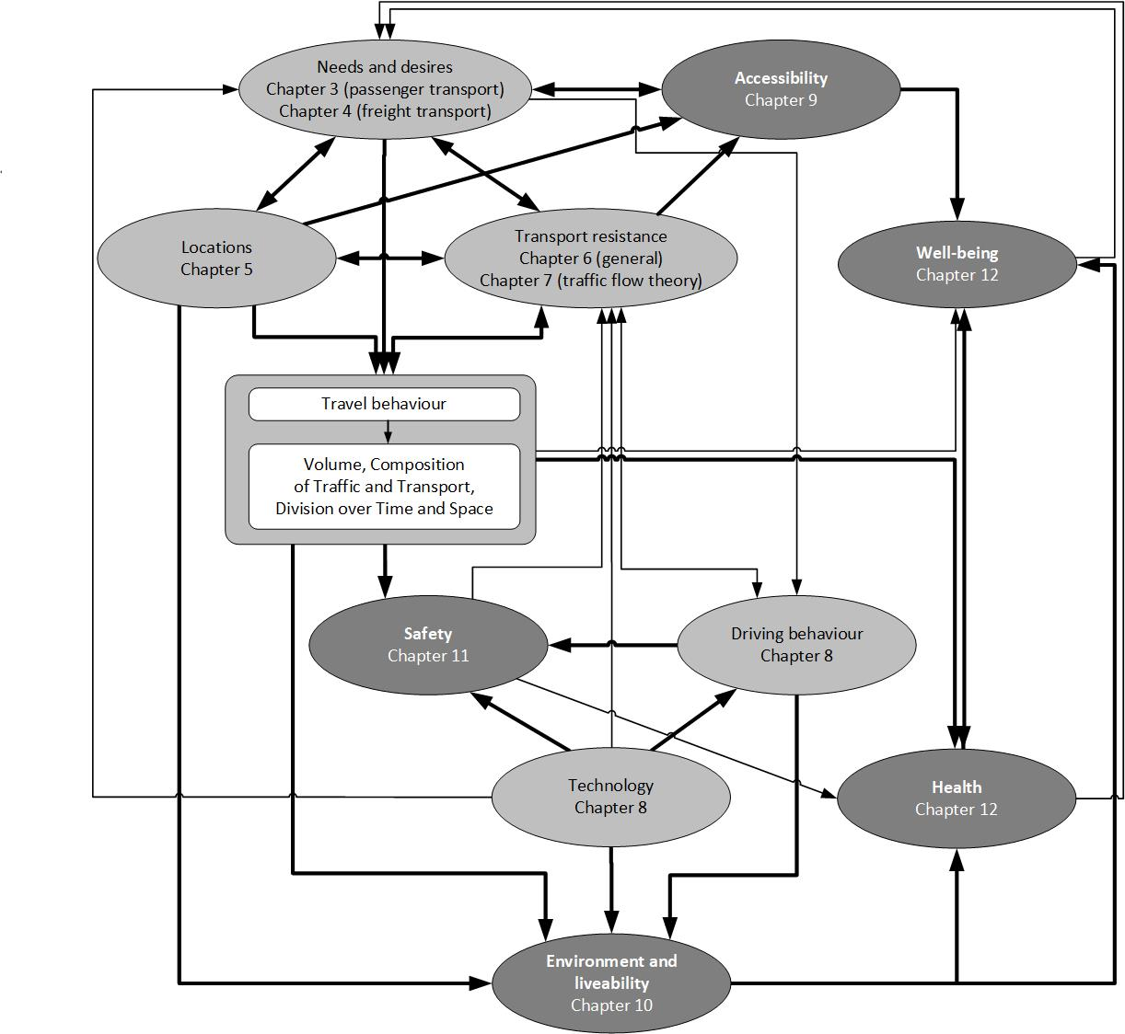
Indicators of freight transport
Four key indicators to describe the volumes and patterns of freight transport:
Transport volume
Mass of the goods lifted for transport, expressed in metric tonnes
Transport performance:
Distance times mass moved of freight (tonnes-kilometres)
Traffic performance
Distance times number of vehicles (vehicle kilometres)
Emissions
Harmful gasses and particulates that freight transport creates

Slide 6
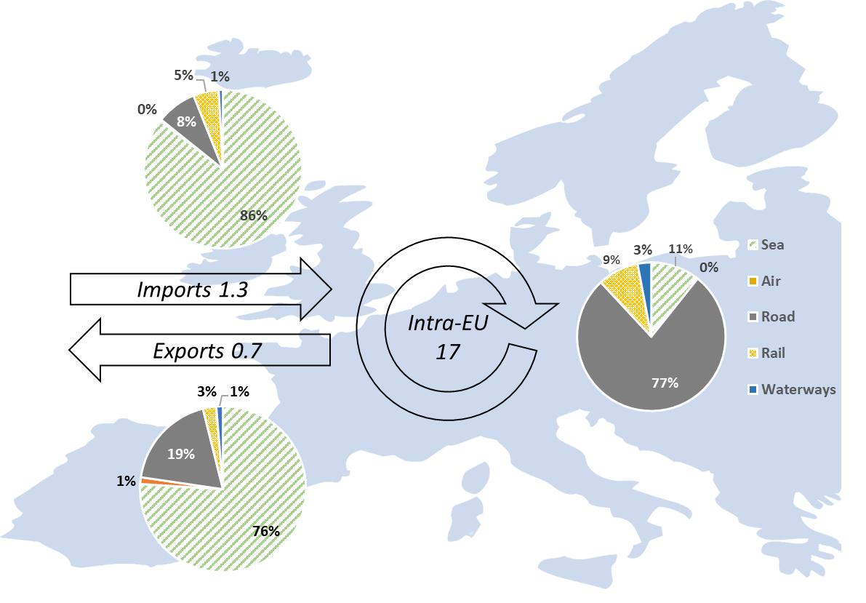
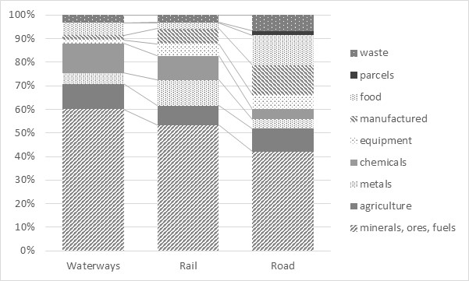
Transport volume (tonnes)
Definition:
Transport volume is the total weight lifted of the goods (tonnes)
The total weight lifted depends on:
Transport mode used
Majority of moves is by intercontinental flows is by sea, of domestic flows by road. Rail and waterways play a small role in all freight transport.
2. Heterogeneity of its commodities
All modes move many different commodities. Rail and waterways focus on heavy freight.
Freight transport flows by mode within and to/from Europe (2020) (Eurostat Transport Dataexplorer 2021). Flow totals in arrows in billion tonnes
(Taken from Chapter 4 , page 2)
Share of commodities for 3 modes of transport in the EU 2020 (Eurostat)
(Taken from Chapter 4, page 3)

Slide 7
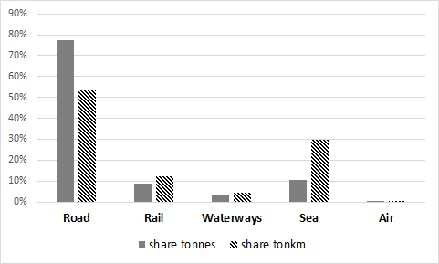
Transport performance (tonne-km)
The transport volume alone is not a sufficient indicator for freight transport flows, because:
  The number of tonnes will depend on structure of the transport chain and the transport technology used (intermodal or door-to-door unimodal transport).
  Every time goods are unloaded and loaded onto a next mode of transport; they are counted a second time as registration occurs on a transport mode basis
  It does not reveal much about the economic importance or societal impacts of transport
    Energy used, costs of carriers and prices of transport will depend on both distance and volume
An additional indicator is needed:
Transport performance (tonne-kilometres)
Definition:
Transport performance (in tonne-kilometres) is the amount of weight moved multiplied by the distance that it is moved across.
Freight Modal split in the EU27: measured by tonnes lifted and tonne kilometres, (Eurostat) Year 2020, tonnes based modal split estimated based on time series 2006-2019 (Taken from Chapter 4, page 4)

Slide 8
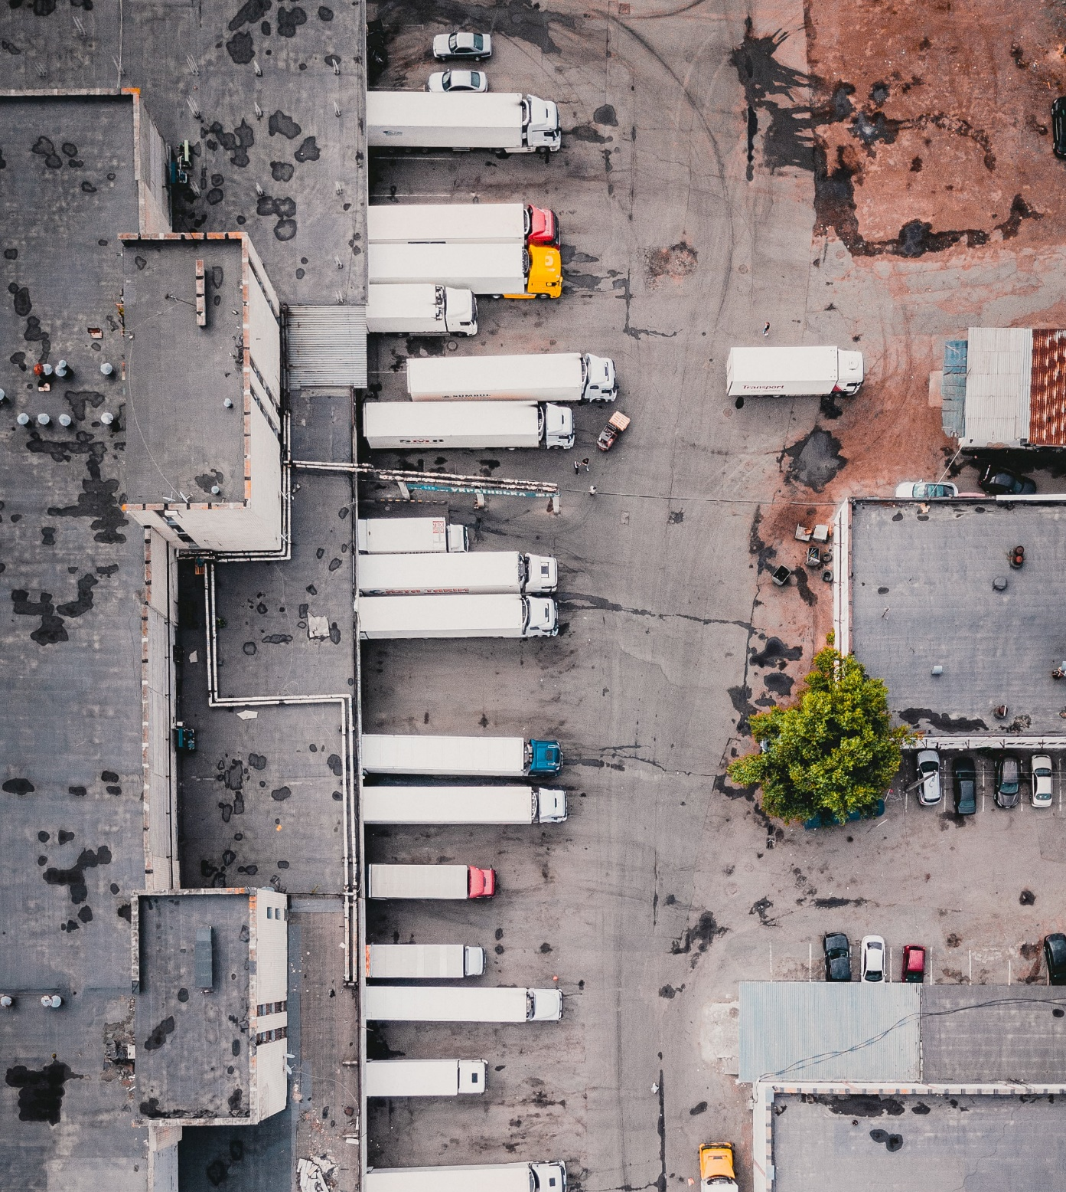
Traffic performance (veh-km)
Transport performance is not homogeneous and should be treated with care
E.g., taking one ton of freight over 1000 kilometres will involve a different usage of resources than 1000 tonnes over 1 kilometre. This is because of the economies of scale and density, the technology available for that size of shipment and distance
Addition of indicator is needed: traffic performance
Definition:
Traffic performance is the number of vehicles needed to move freight
The conversion from tonne kilometres to vehicle kilometres is difficult: Average load factors vary by country, typically between 40% and 60%, while 20% of trucks drive entirely empty!
This load factor is measured in truck capacity weight and not vehicle size → the real efficiency of the system is probably higher
aerial view of trucks – Free Image on Unsplash
Table overview units indicators
Indicator | Measurement in:
Transport volume | Tonnes
Transport performance | Tonne-kilometres
Traffic performance | Vehicle-kilometres

Slide 9
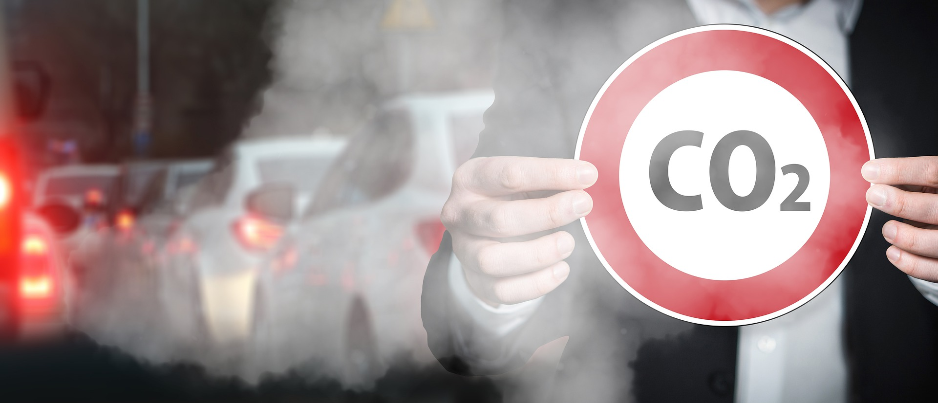
Emissions
The freight transport sector is responsible for a large share of emissions, dependent on the size of the vehicles it uses and the type of fuel it consumes
More in Chapter 10
Figure highlights direct transport emissions: emissions from fuel production, refining, and distribution are included in the other sectors’ total.
Co2 Exhaust Traffic Signs - Free image on Pixabay
Share of EU-27 wide GHG emission 2018 by transport subsector (land use, land use change and forestry included in Other sectors; total 3.8 Gt CO₂e ) (EEA, 2021)
(Taken from Chapter 4, page 5)

Slide 10
Determinants of freight transport
2
4.2 Indicators of Freight Transport
Weight lifted Ton kilometers Vehicle kilometers Emissions from Transport
4.3 Determinants of Freight Transport
Production Inventories Transport
4.4 Drivers of Change in Freight Transport
Economic Growth Globalisation (Information) Technology & Mass Individualisation Sustainability

Slide 11
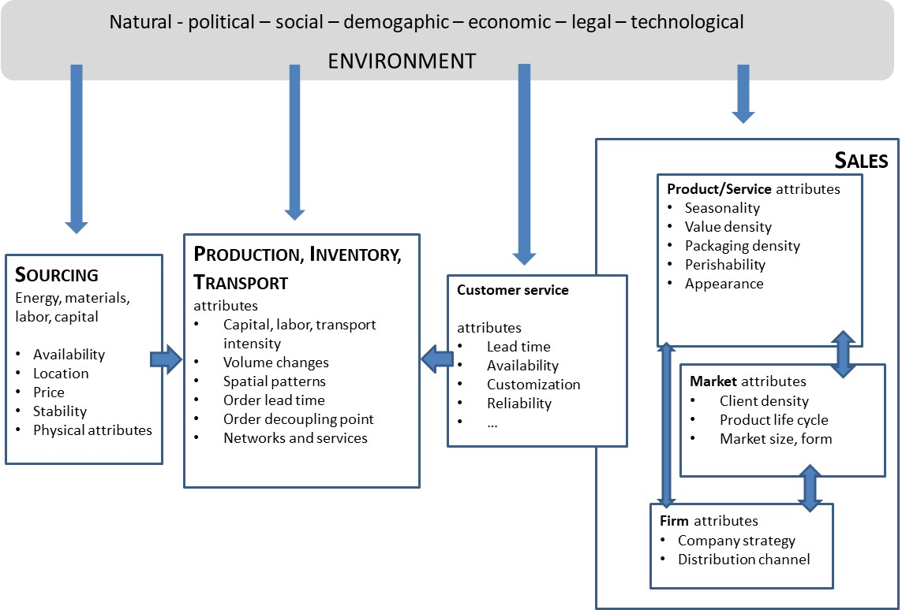
Determinants of freight transport
SPITS-model (Kuipers et al., 1995):
Characterization of the supply chain system that determines the demand for transport as one consisting of 5 elements: Sources, Production, Inventories, Transport and Sales (SPITS).
Figure 4-7 SPITS Model (Kuipers et al., 1995)
(Taken from Chapter 4, page 7)
Kuipers, B., H. van Rooden, A.D.M. van de Ven and A.A.C.M. WierikX (1995), ‘De logistieke wereld bezien door de bril van de overheid’, Tijdschrift voor Vervoerwetenschap, 1, 55–76.

Slide 12
Determinants of freight transport
The components P(roduction), I(nventories) and T(ransport) (PIT) are central in this system and interact with each other to connect source and sales, by optimization of the supply chain, given the service requirements of the customers (scale economies), which is highlighted in green in the figure
Optimization function:
Min GLC | Service (1)
GLC = T + I + H (2)
  Where:
  GLC = Generalized Logistics Cost
  T = Transport
  I = Inventory
  H = Handling
  Service = The service requirements (e.g., pick-up and delivery time)
Figure 4-7 SPITS Model (Kuipers et al., 1995)
(Taken from Chapter 4, page 7)

Slide 13
Determinants: Production
20th century:
Change from high degree of economic protection and isolation to free trade and high degree of specialization
Production moved for the West towards Eastern Europe, Eurasia and the Far East because of differences in factor costs and availability of natural resources together with reduced trade barriers.
Scale economies and specialization result in an increasing number of production steps in a supply chain
Location of production plants evaluated more frequently, assembly plants are more footloose
Figure 4-7 SPITS Model (Kuipers et al., 1995)
(Taken from Chapter 4, page 7)

Slide 14
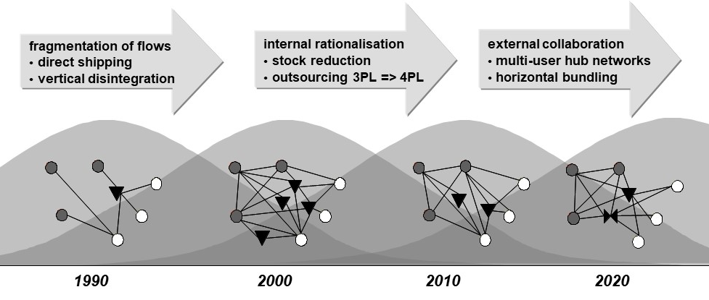
Determinants: Inventory
Inventories can build up in warehouses at the site of producers, at consumer households or at intermediate storage points (distribution centers)
Distribution structure designs have changed over time and new supply chain management techniques emerged: e.g. quick response, lead-time management, lean logistics, agile logistics, pipeline mapping etc.
Now: Increased transparency but also lack of cooperation and standardization
Figure 4-7 SPITS Model (Kuipers et al., 1995)
(Taken from Chapter 4, page 7)
Figure 4.8 Evolution of logistics networks through time (Tavasszy et al., 2012)
Dark dots: suppliers, bright dots: consumers, triangle: warehouses and cross-docking facilities
(Taken from Chapter 4, page 9 )

Slide 15
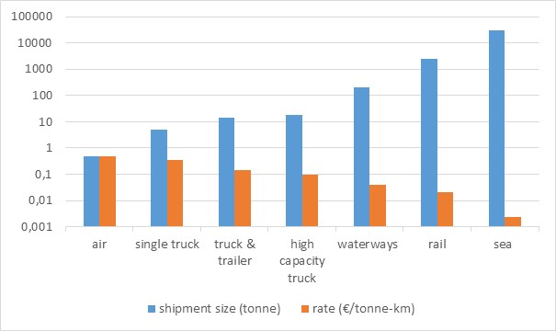
Determinants: Transport
Transport logistics limited here to the strategic level decision of mode choice, i.e., the choice between different networks used by the modes of transport
Differences in shipment size and transport charges for different modes of transport, Data from Dutch cost survey after Panteia (2021)
(Taken from Chapter 4, page 11)
Figure 4-7 SPITS Model (Kuipers et al., 1995)
(Taken from Chapter 4, page 7)
95% of the mode choices can be related to transport distances and basic product characteristics
Shipment size is a key variable determining the mode of transport, with impacts on total logistics costs

Slide 16
Determinants: Transport
Definition:
Volatility refers to the statistical measure for the demand uncertainty
the higher the volatility, the more uncertain the demand.
Definition:
Pipeline inventory costs refers to the costs of stock that is currently in transit between locations and has not yet been purchased by the consumer, e.g., warehouse costs to store goods temporarily in between locations
→ When value density is low, pipeline costs will be negligible
Figure 4-7 SPITS Model (Kuipers et al., 1995)
(Taken from Chapter 4, page 7)

Slide 17
Determinants: Transport
Example: trade-off value density vs. pipeline costs for laptops
A container with 1000 laptops must be moved across the ocean from Asia to Europe. Which mode to choose: air or sea? A quick & dirty calculation:
Production value is $500 per laptop. For sea, the trip takes 36 days. By air it takes 3,5 days. Assume a yearly interest rate of 10%. Shipping rates are $1500 for sea and $6000 for air (3kgs per laptop at $2 per kg).
Results:
By sea, each container will have a pipeline inventory cost of $5000 (= 500*1000*0.1*36/365). These will exceed the sea fare by more than a factor of 3!
For air, with an assumed total travel time of half a week, the pipeline costs would be less than $500.
The generalized logistics costs would be roughly the same for air and sea: $6500. It would depend on slight changes in the inputs which would be preferred.
Figure 4-7 SPITS Model (Kuipers et al., 1995)
(Taken from Chapter 4, page 7)

Slide 18
Determinants: Transport
Lessons: trade-off value density vs. pipeline costs for laptops
The example shows that, although transport costs differ substantially by mode of transport, generalized costs show less variation, taking into account other logistic cost factors
When the volatility is high, retailers and distributors do need safety stocks in order to avoid empty shelves if the demand for a product is higher than the stock and the demand during the reorder period
Safety stocks can be avoided for a great deal if fast and reliable transport options exist that can guarantee the delivery of products within the customer service requirements
→ trade-offs exist between inventory costs and transport costs and the generalized cost concept takes these trade-offs into account
Figure 4-7 SPITS Model (Kuipers et al., 1995)
(Taken from Chapter 4, page 7)

Slide 19
Drivers of change of freight transport
3
4.2 Indicators of Freight Transport
Weight lifted Ton kilometers Vehicle kilometers Emissions from Transport
4.3 Determinants of Freight Transport
Production Inventories Transport
4.4 Drivers of Change in Freight Transport
Economic Growth Globalisation (Information) Technology & Mass Individualisation Sustainability

Slide 20
Economic growth
Definition:
Gross domestic product (GDP) is the total monetary or market value of all the finished goods and services produced within a country’s borders in a specific time period
→ Roughly, freight transport grows 1-on-1 with the national GDP
Current development: domestic transport growth is becoming less dependent of national GDP, due to dematerialization of flows, changes in logistics and internationalization of trade. Domestic flows may decouple negatively, while international flows may grow faster than GDP.

Slide 21
Economic growth and freight transport
Relationship between GDP and freight transport in the Netherlands (KiM, 2006, on the right) shows that the net increase in transport performance can largely be explained by relatively strong growth in international flows on top of modest growth in the domestic economy:
Development of the GDP
Growth of:
  The building sector
  The service industry
Decline of the agricultural sector
Although the numbers have changed since then, this pattern that can be seen on the figure has remained largely the same for the Netherlands (KiM, 2019)
Causal analysis of changes in yearly transport performance (KiM, 2006)
(Taken from Chapter 4, page 15)
KiM, (2006), Mobiliteitsbalans (in Dutch), Netherlands Institute for Transport Policy Analysis, Ministry of Infrastructure & Environment, The Hague.

Slide 22

Globalisation and trade
Removing constraints on cross-border movement and reducing related barrier costs has provided great stimulus to the development of global trade.
Complex global trading networks have been developed to exploit:
  labour cost differences;
  regional production specialization;
  global product differentiation opportunities;
  availability of raw materials in particular countries.
Trade deal - Free image on Pixabay

Slide 23

Globalisation
Globalisation supports changes in supply chain architectures, which include:
  Vertical re-organisation, to serve more diverse consumer needs (see next)
  Horizonal rationalisation, to reduce pressure on product costs (see next)
International network - Free image on Pixabay

Slide 24
Vertical re-organisation
Due to mass-individualisation, a vertical re-organisation has taken place in the supply chain
Vertical re-organisation:
Mass-individualisation in logistics has 2 main dimensions:
  Product/service customisation
  Increased responsiveness of services
increase in the number of steps to produce and distribute products to final market
increase in the demand for freight transport
Chain configurations in four demand segments (adapted from Vermunt at al., 2000)
(Taken from Chapter 4, page 16)
• Top right: standard products with a long order lead time (e.g. smartphones, chips)
• Top left: customised products with long order lead time (e.g. cars, machines)
• Bottom right: standard products with a short lead time (e.g. spare parts, medicines)
• Bottom left: customised products with a short lead time (e.g. fresh pizzas, flowers)

Slide 25
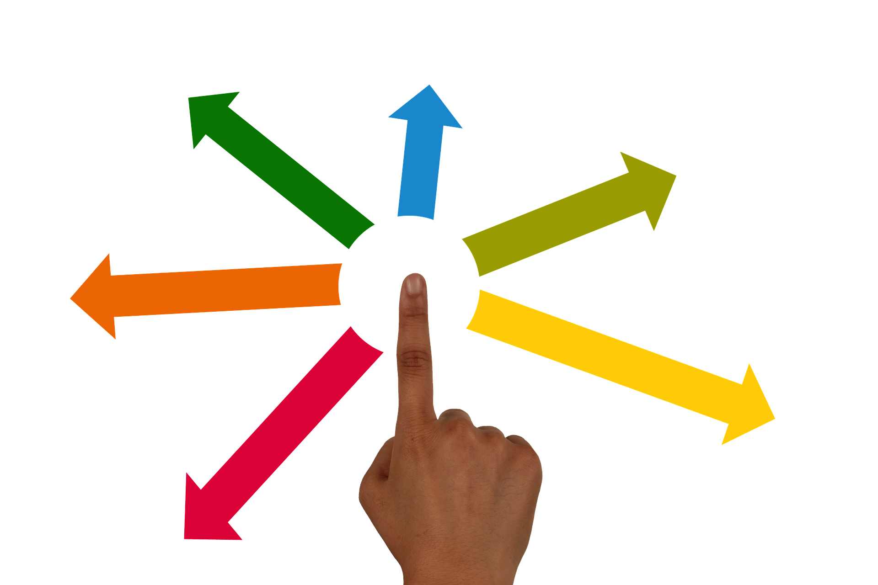
Vertical re-organisation: Examples
Rapid fulfilment depots for low demand but urgent products like spare parts
The move from continental distribution centres towards production to order at a global scale, where delivery takes place directly or with an intermediate step of value added logistics
Flexible order production, allowing fast switching in batch size and end-product specifications, close to the consumer market
Centralized international distribution (supplemented by regional distribution centres), introduced to reduce inventory and building on the decrease of trade barriers
delegate-finger-hand-arrows-touch - Free image on Pixabay

Slide 26

Horizontal rationalisation
Definition:
Rationalisation is the reorganisation of a company in order to increase its operating efficiency
Example:
Horizontal collaboration or consolidation and cooperation between firms at the same level of a chain
reorganising - Free image on Pixabay
Larger vehicles can be used
Lower cost per unit of freight
Note: Rationalisation creates cost reductions necessary to finance mass-individualisation. However, when implemented too far, it will reduce responsiveness of supply chains.

Slide 27
(Information) technology: the Physical Internet
Logistics service providers have several innovative tools at their disposal, technologically and organisationally:
  Digitalisation of information exchange, away from paper-based communication
  Automation of all processes, from transport and transhipment to communication, planning and even decision-making
  New organisational approaches for the coordination of supply and service networks
The Physical Internet is a strategic vision of the logistics system of the future that binds these innovations together. Around the turn of the century, a global movement was created by logistics industry leaders (Montreuil, 2011).
Montreuil, B. (2011), ‘Toward a Physical Internet: meeting the global logistics sustainability grand challenge’, Logistics Research, 3(2), 71-87

Slide 28
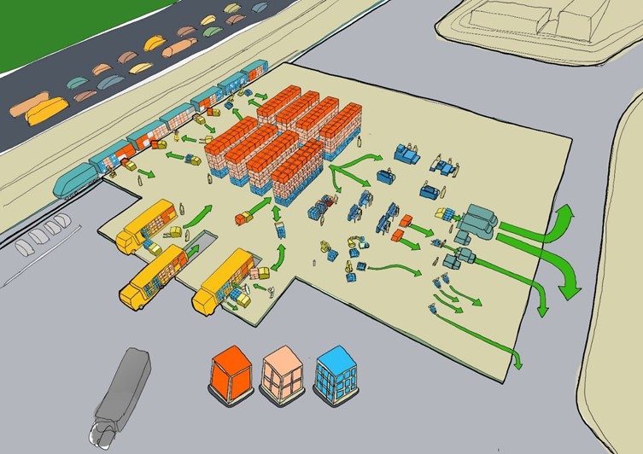
(Information) technology: the Physical Internet
In Europe a roadmap was created for the Physical Internet (ALICE, 2020). It identifies concrete innovation steps for the next 2 decades:
  Routing algorithms and service protocols to connect shippers and carriers
  Global network designs that allow system-optimal allocation of capacity
  Information systems that allow nodes to help decide the routing of shipments
  Specialized equipment to allow managing shipments below container level at transshipment points
  Protocols for vertical and horizontal collaboration of multi-modal carriers
  A new standardized hierarchy of container sizes and shapes
The roadmap builds on major steps currently being undertaken and mentions important requirements for the full PI vision to become reality
Figure: Automated transshipment processes of PI-containers in an open network
Source: SENSE consortium (2019), SENSE Project Deliverable 2.3. Brussels: ALICE
ALICE (2020), ‘Physical Internet Roadmap’, accessed January 2022 at https://www.etplogistics.eu

Slide 29
Sustainability
Continued growth of the transport sector:
World trade is expected to continue to grow for decades ahead, even after occasional global economic recessions and pandemics.
As a result, the growth of transport will also continue, spurring new demand for transport services and infrastructure.
These developments will clash with the increased urgency to adapt to climate change and to internalize the external costs of transport.
Strategies for decarbonizing logistics are broadly known (McKinnon, 2018) and discussed in international communities such as ALICE.
Demand
Reducing demand
Re-organizing demand
Modes
Modal shift
Modal alignment
Assets
Sharing of assets
Load optimization
Efficiency
Energy
Vehicle technology
Operations
Sustainable energy
Reporting
Figure: Summary of main decarbonization measures.
Adapted from ALICE-ETP (2019), Roadmap towards zero emissions logistics 2050, Brussels: ALICE
McKinnon, A. (2018). Decarbonizing logistics: Distributing goods in a low carbon world. Kogan Page Publishers.

Slide 30
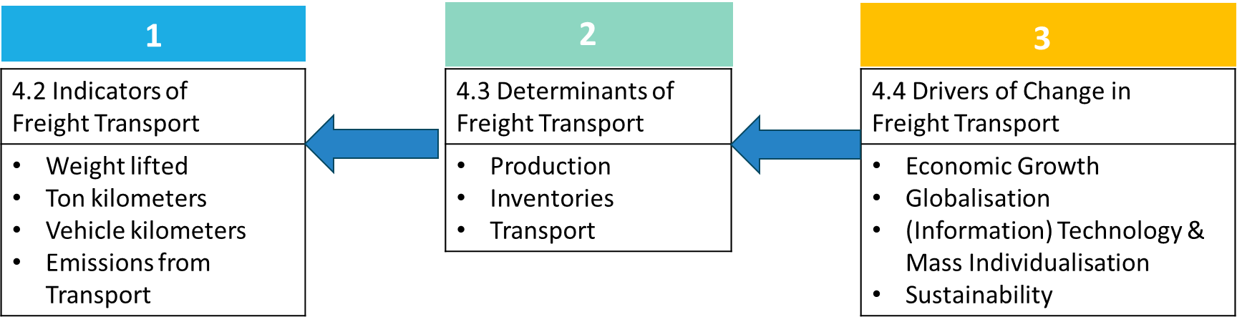
Summary
Four basic indicators of freight transport activity: weight lifted (tonnes), transport performance (tonne kilometres), traffic performance (vehicle kilometres) and emissions.
Freight transport growth is uneven across modes, with sea and road transport taking the major share of increase in demand.
Logistics service improvements and cost minimization have run in parallel with liberalization of trade and improvements in transport and information technologies.
The Physical Internet vision combines many seemingly unrelated developments into an overarching storyline of logistics innovation.
Transport growth is decoupling from GDP, due to dematerialization of flows, changes in logistics and internationalization of trade. Overall, these effects largely balance out.
Recent roadmaps for the decarbonisation of logistics and also the Physical Internet are instrumental to reduce external costs (sustainability).

Slide 31
The Transport System and Transport Policy
Edited by Bert van Wee, Jan Anne Annema, David Banister and Baiba Pudãne
Chapter 4: Freight transport: indicators, determinants and drivers of change
Authors: Lóri Tavasszy, Kees Ruijgrok
Containers from the air - Free image on Pexels

