Slide 1
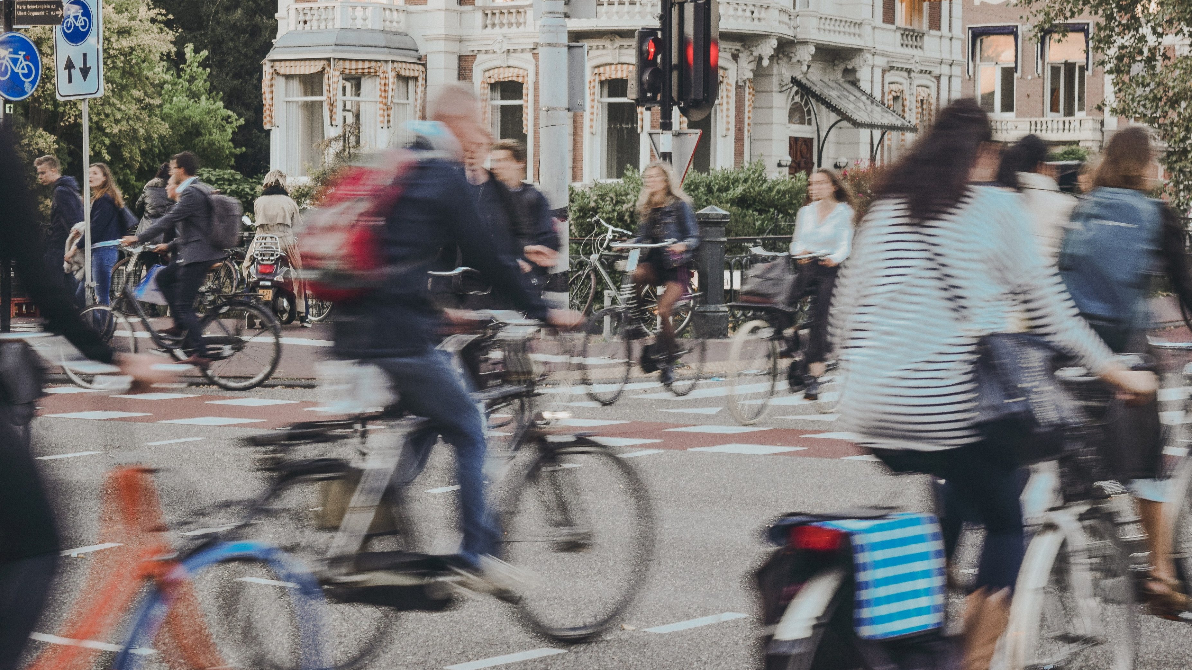
The Transport System and Transport Policy
Edited by Bert van Wee, Jan Anne Annema, David Banister and Baiba Pudãne
Chapter 5: Land use and transport
Author: Bert van Wee
Biking in Amsterdam - Free image on Unsplash

Slide 2
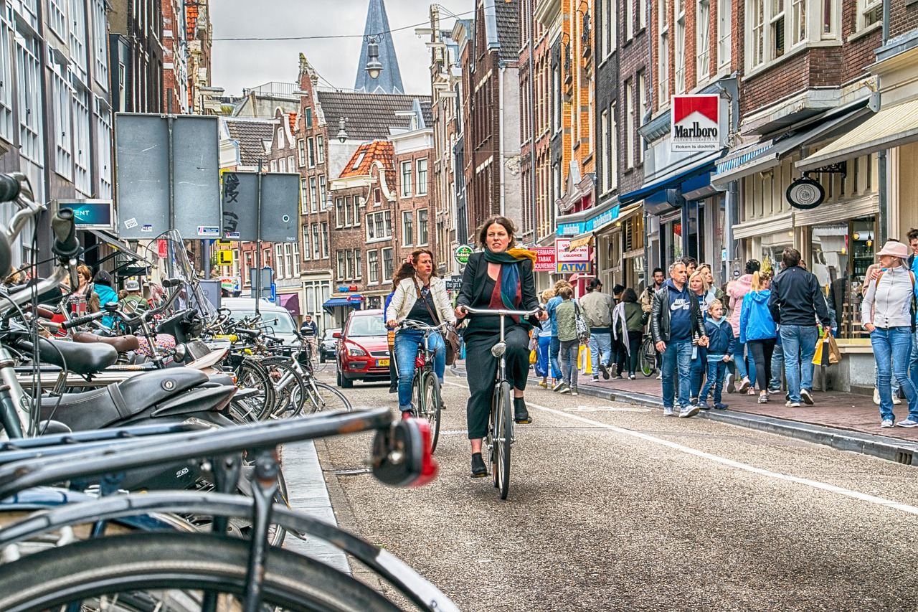
Introduction
Wat is the impact of land use on travel behaviour?
The question is important because:
once a residential area is designed and built, it is hard to change
opportunity to increase the effectiveness of land-use policies
This chapter is limited to passenger transport only, because there is a lot more research on this topic, unlike goods transport.
bikes-bicycle-busy-street-with-cars - Free image on Pixabay

Slide 3
Overview chapter
Conceptual perspective from Chapter 2
Theoretical perspective: The theory of utilitarian travel demand
The impact of the 5 key land-use variables on travel behaviour
Key land-use variables: Density, Diversity, Design, Destination accessibility, Distance to transit (5D's)
Interaction between the 5D’s
Impact of land-use variables on travel behaviour
The impact of land use (5Ds) on transport – empirical results
Why are empirical conclusions different?
Evaluating the impact of land use on travel behaviour
Indicators
Methods
Environment vs Accessibility
Conclusions

Slide 4
Conceptual and theoretical perspective
Conceptual perspective from Chapter 2
Theoretical perspective: The theory of utilitarian travel demand
The impact of the 5 key land-use variables on travel behaviour
Key land-use variables: Density, Diversity, Design, Destination accessibility, Distance to transit (5D's)
Interaction between the 5D’s
Impact of land-use variables on travel behaviour
The impact of land use (5Ds) on transport – empirical results
Why are empirical conclusions different?
Evaluating the impact of land use on travel behaviour
Indicators
Methods
Environment vs Accessibility
Conclusions

Slide 5
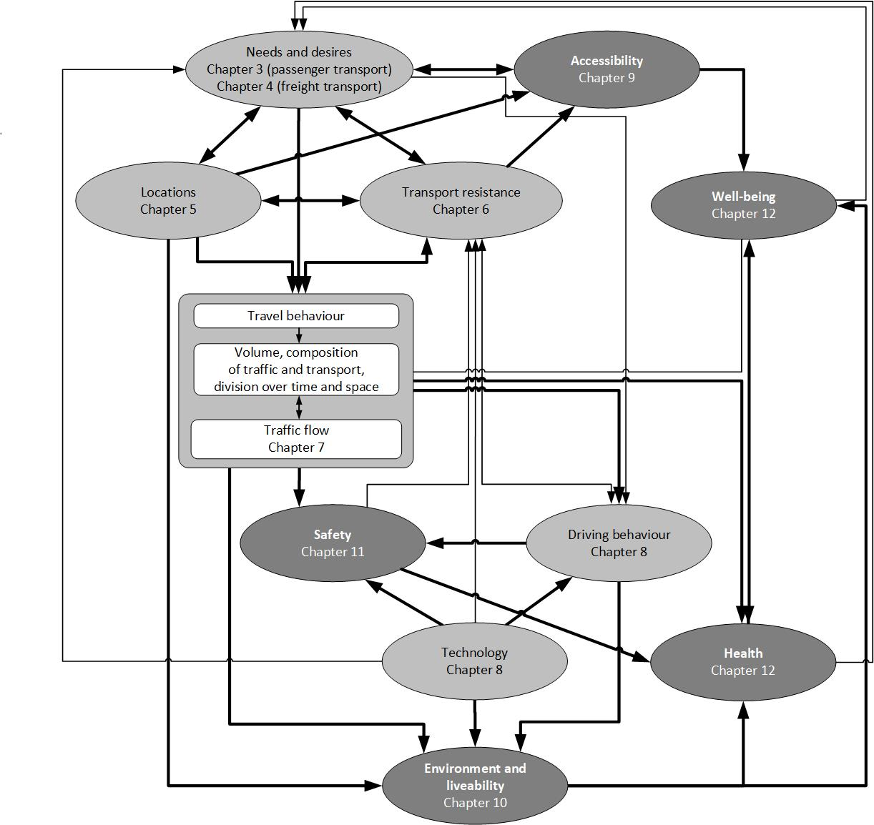
Conceptual perspective from Chapter 2
People travel because they want to carry out activities such as living, working, shopping and visiting friends and relatives at different locations
Passenger transport volume and mode split depend on:
Locations of human activities (living, working, shopping, etc.)
Needs, wants, desires, and preferences of people (Chapter 3)
Transport resistance (generalized transport costs)
→ These elements are in a continuously changing equilibrium or "disequilibrium" as new changes occur before long-term equilibrium is reached

Slide 6
Theoretical perspective
The theory of utilitarian travel demand is the theoretical foundation for the impact of land use on travel behaviour.
According to this theory, travel is ‘derived demand’.
The demand of travel depends on
The utility of the activity, which depends on
Characteristics of the activity
Characteristics of the location of the activity
The aggregate costs to reach the location of the activity = GTC (see chapter 6)

Slide 7
The impact of the 5 key land-use variables on travel behaviour
Conceptual perspective from Chapter 2
Theoretical perspective: The theory of utilitarian travel demand
The impact of the 5 key land-use variables on travel behaviour
Key land-use variables: Density, Diversity, Design, Destination accessibility, Distance to transit (5D's)
Interaction between the 5D’s
Impact of land-use variables on travel behaviour
The impact of land use (5Ds) on transport – empirical results
Why are empirical conclusions different?
Evaluating the impact of land use on travel behaviour
Indicators
Methods
Environment vs Accessibility
Conclusions

Slide 8
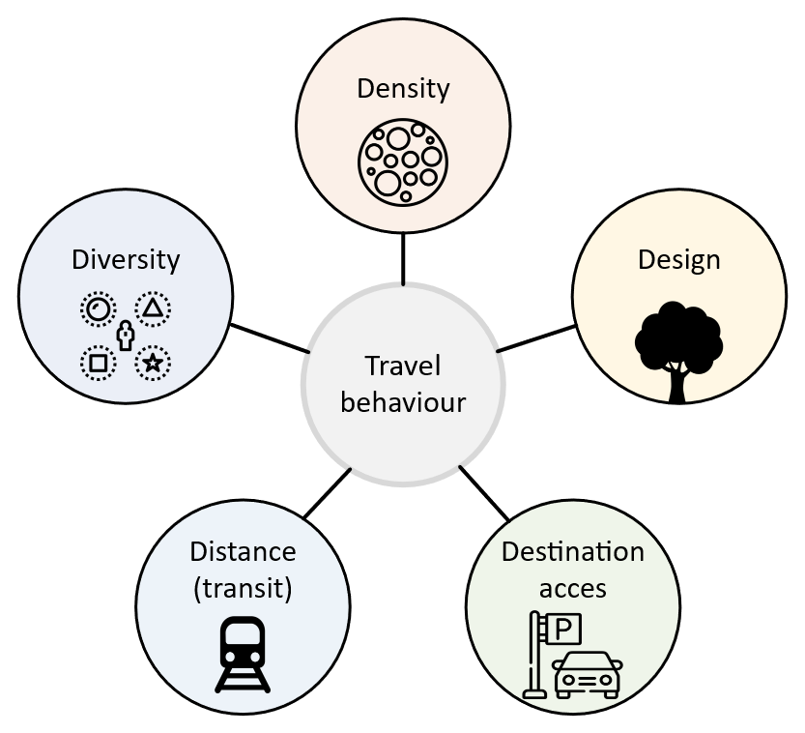
The 5 D’s
The key land-use variables influencing travel behaviour are often labelled by 5D’s
Diversity refers to the idea of mixed land use: to what extent are dwellings, workplaces, schools, shops, etc. located near to each other, or ‘mixed’? Mixed land use means that people need to travel less to reach various destinations
If destinations are closer to each other, then travellers are more likely to walk or bike
If the local street system has more connections, less circuitous paths, and fewer cul-de-sacs, it will be easier for more people to walk, bike, reach transit, and take short drives
If more dwellings and opportunities (e.g., jobs) are located near railway stations, access and egress times are shorter for a larger number of trips, resulting in a higher share for the train as compared to the car
s
If there is parking near the destination then people are more likely to drive to it compared to areas (such as inner city) with limited parking

Slide 9
Interaction between the 5D’s
Mixed land use including public spaces and parks also makes the places more attractive
Building with focus on cyclists (e.g., an attractive bicycle stand near shops) will result in a better destination access for cyclists to those shops
Building in higher densities may impact mode choice if the areas are located near railway stations
s

Slide 10
The impact of the 5 key land-use variables on travel behaviour
Conceptual perspective from Chapter 2
Theoretical perspective: The theory of utilitarian travel demand
The impact of the 5 key land-use variables on travel behaviour
Key land-use variables: Density, Diversity, Design, Destination accessibility, Distance to transit (5D's)
Interaction between the 5D’s
Impact of land-use variables on travel behaviour
The impact of land use (5Ds) on transport – empirical results
Why are empirical conclusions different?
Evaluating the impact of land use on travel behaviour
Indicators
Methods
Environment vs Accessibility
Conclusions

Slide 11
Impact of land-use variables on travel behaviour
Very old studies (until late 1980s) sometimes directly investigated correlations between land-use variables and travel behaviour variables:
(Taken from Chapter 5, page 80)

Slide 12
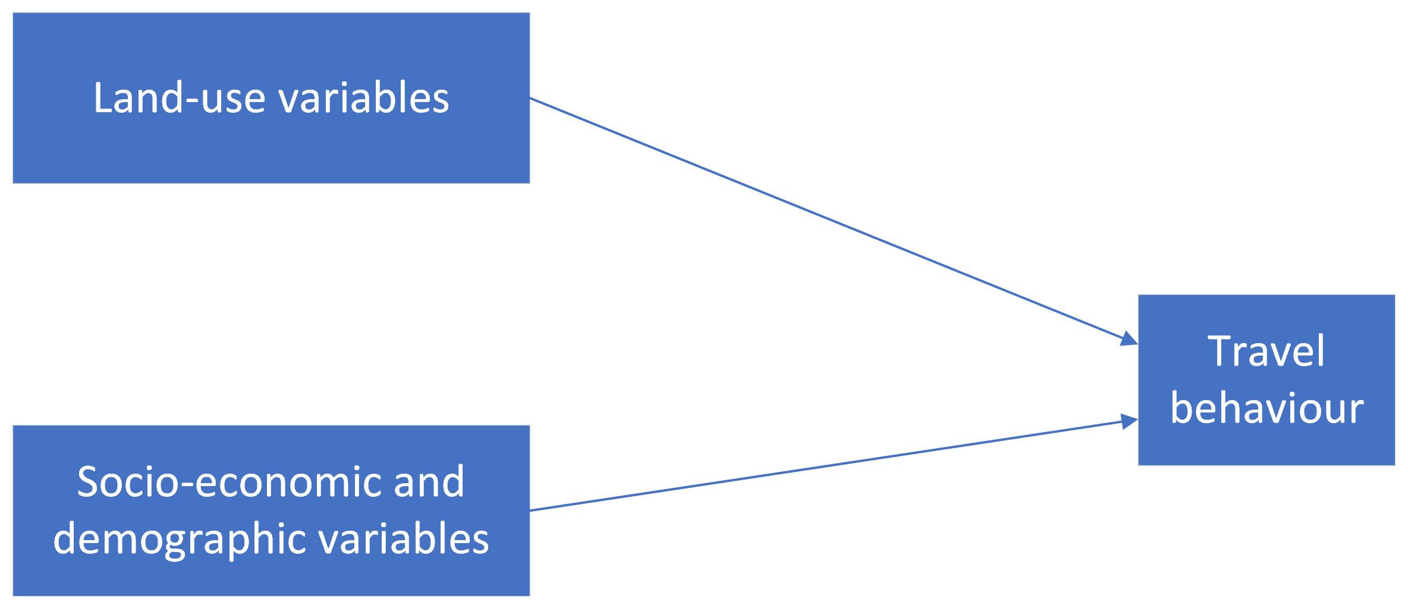
Impact of land-use variables on travel behaviour
Later studies added socio-economic and demographic variables, finding lower impacts of land-use variables.
→ Example: people with higher income can afford to live in relatively expensive houses in lower-density residential areas. They may also choose to use private car more often (travel behaviour). The impact of density on travel behaviour is overestimated if the difference in income levels is ignored.
(Taken from Chapter 5, page 80)

Slide 13
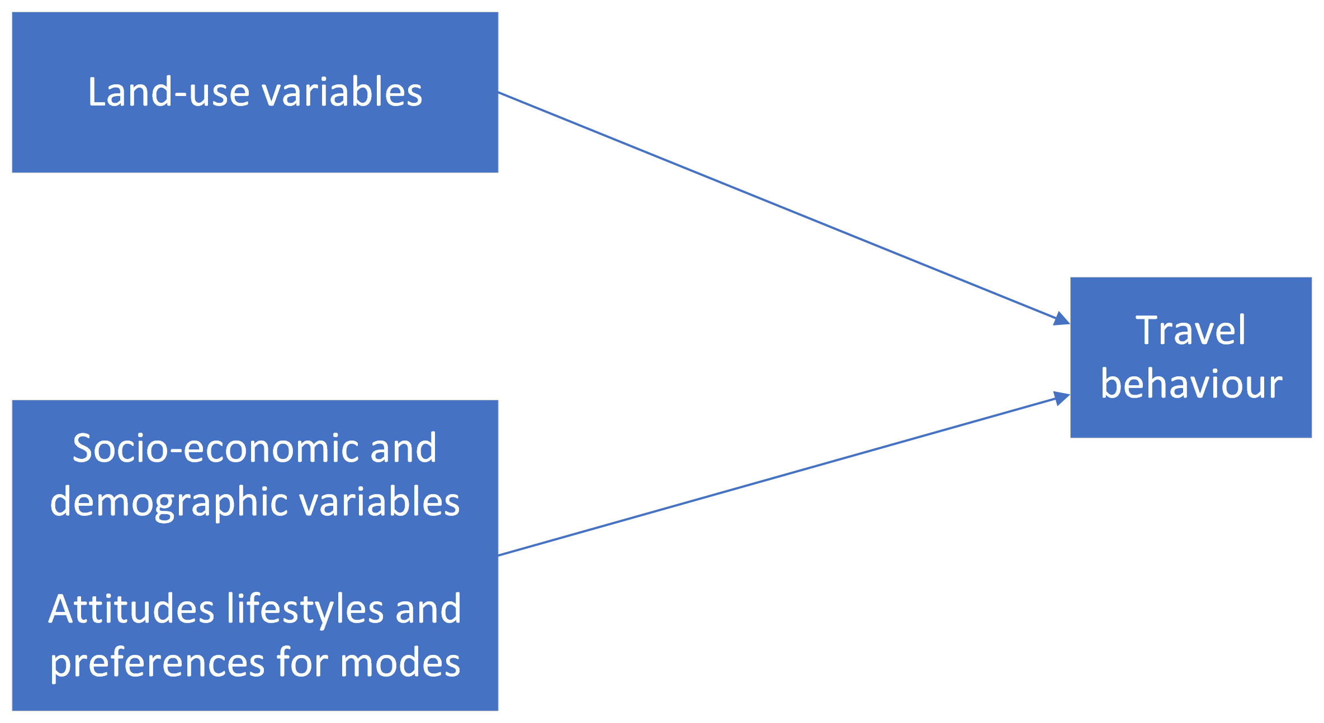
Impact of land-use variables on travel behaviour
Later studies add attitudes, lifestyles and preferences for modes as explanatory factors
→ Example: people with pro-environmental attitude, culture-oriented lifestyle, or (most directly) specific preferences for modes (‘car lovers’) travel differently

Slide 14
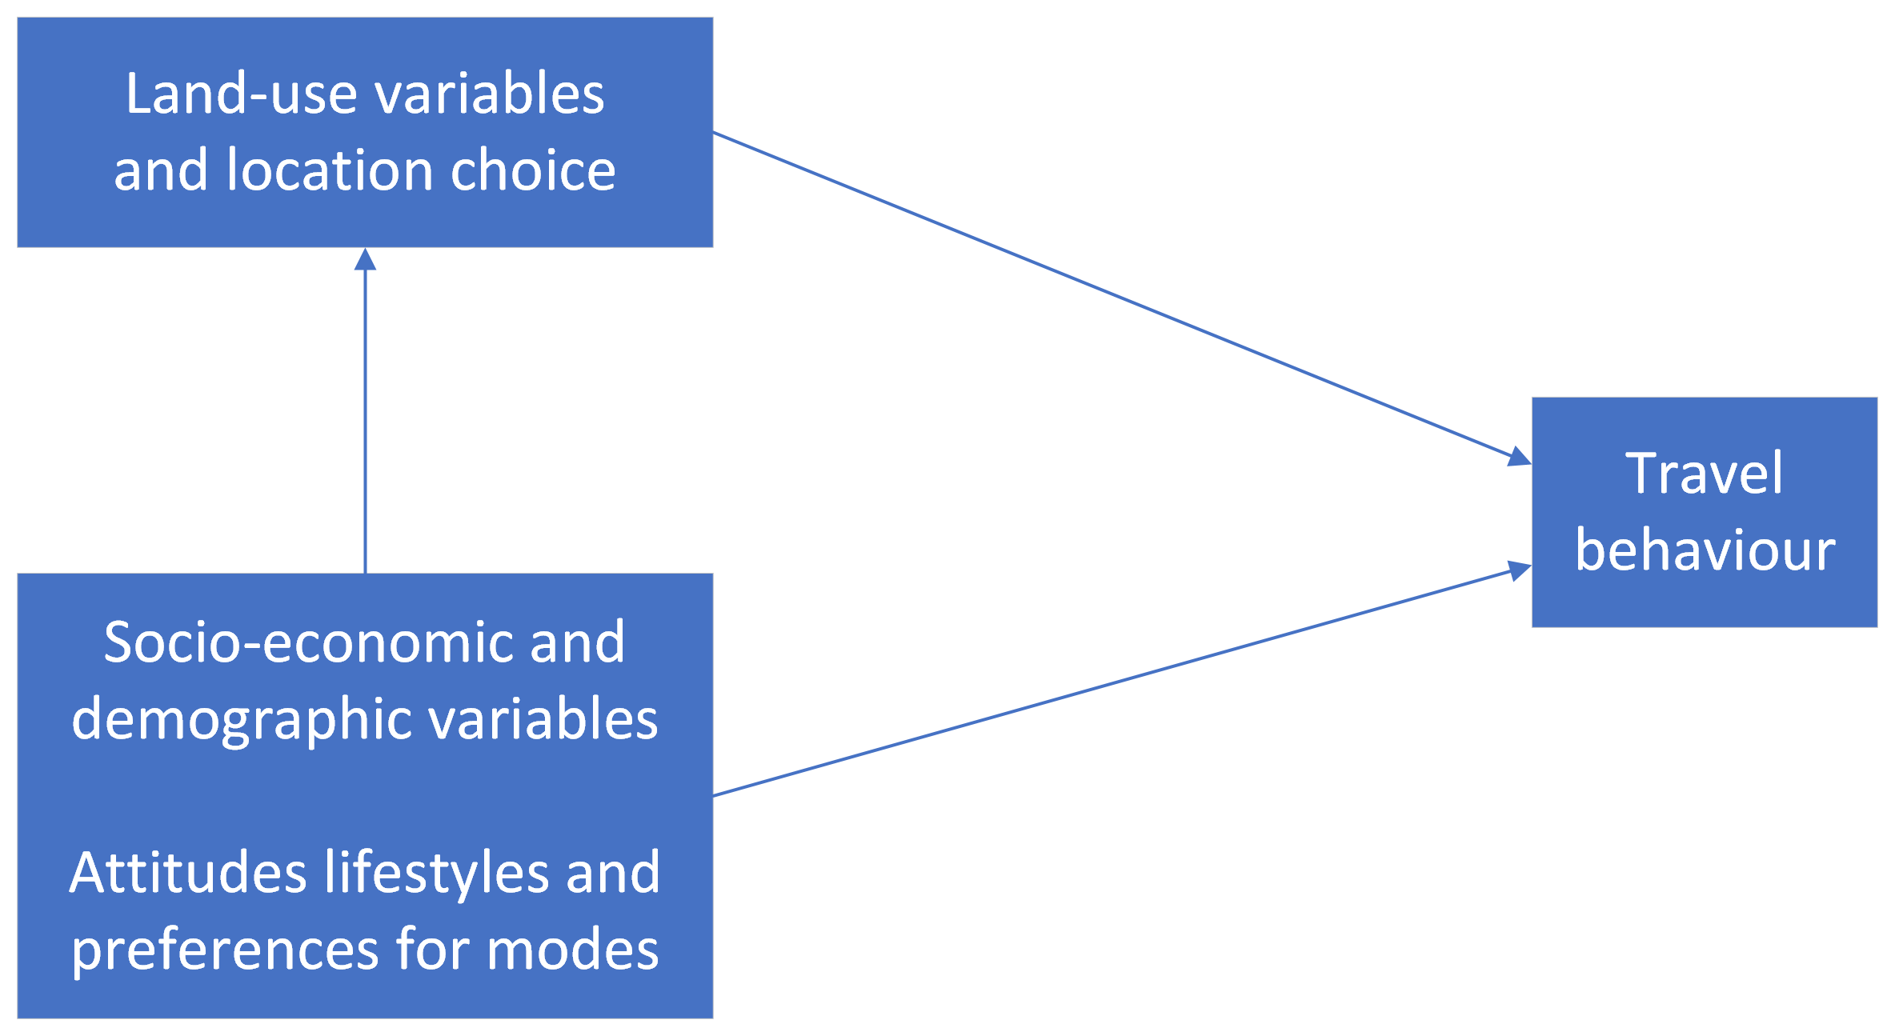
Impact of land-use variables on travel behaviour
Finally, studies discovered the ‘(residential) self-selection’ phenomenon
People choose (residential) locations based on their travel abilities, needs and preferences.
(residential) self-selection
Cao et al. (2009) provide an overview of empirical studies in the area of residential self-selection.
(Taken from Chapter 5, page 81)
Cao, X., P.L. Mokhtarian and S. Handy (2009), ‘Examining the impact of residential self-selection on travel behavior: a focus on empirical findings’, Transport Reviews, 29 (3), 359–395.

Slide 15
Impact of land-use variables on travel behaviour
Debates about the causal structure are ongoing (as of 2022). For example:
Van Wee (2009): Self selection is not limited to residential self-selection but may also occur with respect to work location choice or the choice of other destinations
Kroesen et al. (2017): Travel behaviour influences attitudes and travel related reasons
Næss (2014) argues that people will only act according to their preferences if their residential area allows them to do so, and car ownership and transport attitudes are influenced by residential locations
Schwanen and Mokhtarian (2005) argue that reducing the lack of congruence between physical neighbourhood structure and preferences matters for quality-of-life reasons
(residential) self-selection
1) Van Wee, B., J. De Vos and K. Maat (2019), 'Impacts of the built environment and travel behaviour on attitudes: Theories underpinning the reverse causality hypothesis', Journal of Transport Geography, 80,102540.
2) Kroesen, M., S. Handy, S. and C. Chorus, C. (2017), 'Do attitudes cause behavior or vice versa? An alternative conceptualization of the attitude-behavior relationship in travel behavior modeling', Transportation Research Part , 101, 190-202. 3) Næss, P. (2014). Tempest in a teapot: The exaggerated problem of transport-related residential self-selection as a source of error in empirical studies, Journal of Transport and Land Use 7(3), 57–79. 4) Schwanen, T. and P.L. Mokhtarian (2005), ‘What if you live in the wrong neighborhood? The impact of residential neighborhood type dissonance on distance travelled’, Transportation Research Part D, 10 (2), 127–151.

Slide 16
The impact of land use (5Ds) on transport – empirical results
Conceptual perspective from Chapter 2
Theoretical perspective: The theory of utilitarian travel demand
The impact of the 5 key land-use variables on travel behaviour
Key land-use variables: Density, Diversity, Design, Destination accessibility, Distance to transit (5D's)
Interaction between the 5D’s
Impact of land-use variables on travel behaviour
The impact of land use (5Ds) on transport – empirical results
Why are empirical conclusions different?
Evaluating the impact of land use on travel behaviour
Indicators
Methods
Environment vs Accessibility
Conclusions

Slide 17
The impact of land use (5Ds) on transport
Ewing and Cervero (2010):
1 percent increase in local density results in a 0.05 percent decrease in vehicle miles travelled and vehicle trips.
1 percent in-crease in diversity (mixing uses) results in a decrease of -0.03 percent in vehicle trips, and a 0.05% decrease in vehicle miles travelled
s
Ewing, R. and R. Cervero (2010), Travel and the built environment. Journal of the American Planning Association, 76(3), 265–294.

Slide 18
The impact of land use (5Ds) on transport
Manaugh and El--Geneidy (2011): in neighbourhoods with high walkability in Montreal, people make significantly more walking trips for most non-work purposes Pan et al. (2009): in the pedestrian- and cyclist-friendly neighborhoods in Shanghai, residents travel shorter distances than in other neighborhoods, making non-motorized modes feasible options Shaer et al. (2021): local bike sharing infrastructure influences cycling levels in Tehran
s
1) Manaugh, K. and A. El-Geneidy (2011), ‘Validating walkability indices: how do different households respond to the walkability of their neighbourhood?’, Transportation Research Part D, 16, 309–315.
2) Pan, H., Q. Shen and M. Zhang (2009), ‘Influence of urban form on travel behaviour in four neighbourhoods of Shanghai’, Urban Studies, 46 (2), 275–294.
3) Shaer, A., M. Rezaei, M., B. Moghani Rahimi and F. Shaer (2021), 'Examining the associations between perceived built environment and active travel, before and after the COVID-19 outbreak in Shiraz city, Iran', Cities, 115,103255.

Slide 19
The impact of land use (5Ds) on transport
Brons et al. (2009): access to railway stations contributes to travel by train, and expanding access services to railway stations can increase the mode share of rail Cervero and Duncan (2006: 53): emphasize the importance of both ends of a trip, both ends need to be similarly convenient to increase the use of a transport mode
s
1) Brons, M., M. Givoni and P. Rietveld (2009), ‘Access to railway stations and its potential in increasing rail use’, Transportation Research Part A, 43 (2), 136–149.
2) Cervero, R. and M. Duncan (2006), ‘Which reduces vehicle travel more: jobs–housing balance or retail–housing mixing?’, Journal of the American Planning Association, 74 (4), 475– 490.

Slide 20
Why are empirical conclusions different?
Conceptual perspective from Chapter 2
Theoretical perspective: The theory of utilitarian travel demand
The impact of the 5 key land-use variables on travel behaviour
Key land-use variables: Density, Diversity, Design, Destination accessibility, Distance to transit (5D's)
Interaction between the 5D’s
Impact of land-use variables on travel behaviour
The impact of land use (5Ds) on transport – empirical results
Why are empirical conclusions different?
Evaluating the impact of land use on travel behaviour
Indicators
Methods
Environment vs Accessibility
Conclusions

Slide 21
Why are empirical conclusions different?
Why do researchers find different or even contradicting results on the possible impact of land use on transport? Reasons for this are:
Research methods: Handy (1996): studies that use more advanced methods tend to find smaller and less significant effects of land use on travel behaviour
Level of difference in crucial factors: if the study areas do not really differ with respect to the most important land-use factors that influence transport, such as densities and the level of mixed land use, small differences in travel behaviour may be found
Geographical scale: the size of the area at which forms of mixed use or densities occur matters, and the scale of research may affect the results
Contradiction - Free image on Pixabay
Handy, S. (1996), ‘Methodologies for exploring the link between urban form and travel behaviour’, Transportation Research D, 1 (2), 151–165.

Slide 22
Why are empirical conclusions different?
Time horizon: people will not change their behaviour instantaneously after changes in determinants for travel behaviour, and the relevance of how much time has passed since changes took place and when the empirical research is undertaken has implications for the findings
Differences between countries: differences in concepts, the role of different modes in the transport system, and cultural differences make the translation of land use effects from one country to another risky
Indirect effects: land use may have a direct impact on passenger travel, but it also shows the existence of several indirect effects that may be very complex
The impact of policy: policy can also affect land-use patterns, and this may strongly influence the travel behaviour of people living in a certain area
Contradiction - Free image on Pixabay

Slide 23
Evaluating the impact of land use on travel behaviour
Conceptual perspective from Chapter 2
Theoretical perspective: The theory of utilitarian travel demand
The impact of the 5 key land-use variables on travel behaviour
Key land-use variables: Density, Diversity, Design, Destination accessibility, Distance to transit (5D's)
Interaction between the 5D’s
Impact of land-use variables on travel behaviour
The impact of land use (5Ds) on transport – empirical results
Why are empirical conclusions different?
Evaluating the impact of land use on travel behaviour
Indicators
Methods
Environment vs Accessibility
Conclusions

Slide 24
Evaluating the impact of land use on travel behaviour: indicators
Given that land use impacts travel behaviour, how to evaluate land-use policies that aim to change it?
In any given context, should policy makers:
Increase density
Use mixed land-use practices
…?
Indicators
Environmental
Fairness
Accessibility
Most studies analyse the impact on
Km (of vehicles or passengers)
Number of trips / trip distances
These indicators are motivated by environmental considerations, although do not directly capture the environmental impact.
Other categories of indicators should be considered as well →
Option value
Robustness
Consumer surplus
Financial
Safety and health

Slide 25
Evaluating the impact of land use on travel behaviour: indicators
Environmental impacts
Small share of studies provide direct environmental indicators, such as CO₂ and NO_{X} emissions.
If these indicators are used, they usually do not account for the exposure: e.g., air pollution and noise emissions in residential and agricultural areas have different impacts.
There is not enough attention to wider liveability effects, such as the impacts resulting from moving and parked vehicles, regardless of their exhaust and noise emissions.
Indicators
Environmental
Fairness
Accessibility
Option value
Robustness
Consumer surplus
Financial
Safety and health

Slide 26
Evaluating the impact of land use on travel behaviour: indicators
Accessibility impacts
Not considered in most studies.
Accessibility describes the extent the system enables people to travel between locations they want to visit and thereby participate in the activities desired
Examples of indicators (see also ch. 9):
From geography: potential accessibility, time–space related accessibility indicators
Utility-based indicators (see Geurs and van Wee, 2004, for a literature review of accessibility indicators)
Travel time indicators (e.g. Schwanen et al., 2002)
Indicators
Environmental
Fairness
Accessibility
Option value
Robustness
Consumer surplus
Financial
1) Geurs, K. T., & Van Wee, B. (2004). Accessibility evaluation of land-use and transport strategies: review and research directions. Journal of Transport geography, 12(2), 127-140. 2) Schwanen, T., Dijst, M., & Dieleman, F. M. (2002). A microlevel analysis of residential context and travel time. Environment and Planning A, 34(8), 1487-1507..
Safety and health

Slide 27
Evaluating the impact of land use on travel behaviour: indicators
The option value captures non-user benefits
The option value is the individual’s valuation of the opportunity to be able to use a particular transport mode or piece of infrastructure in the future that is not being used in the present, or the option to have access to a specific destination that is currently not visited.
E.g., car user may value access to PT, if their car breaks down.
Current evaluations focus on user benefits only, but, if non-user benefits are relevant, then the option value may be important.
Indicators
Environmental
Fairness
Accessibility
Option value
Robustness
Consumer surplus
Financial
Safety and health

Slide 28
Evaluating the impact of land use on travel behaviour: indicators
The consumers’ surplus
The consumers’ surplus is the difference between the market price of a product or service and the value for a consumer
The consumer surplus plays an important role in evaluations (including cost–benefit analyses – CBAs) of infrastructure projects
Valuation by people
Building in low densities results in more spacious homes and land plots, but also less accessibility to opportunities and less green space between cities and towns.
How do people value such trade-offs?
What type of job locations do people prefer?
Indicators
Environmental
Fairness
Accessibility
Option value
Robustness
Consumer surplus &
Financial
Valuation by people
Safety and health

Slide 29
Evaluating the impact of land use on travel behaviour: indicators
Health and safety impacts
If people travelled more by active modes, this would have not only environmental and safety advantages but also health advantages (see Chapter 12)
Safety impacts of land-use and transport alternatives may differ (see Chapter 11)
Such impacts should be included in the ex-ante evaluation of these alternatives
Indicators
Environmental
Fairness
Accessibility
Option value
Robustness
Consumer surplus
Financial
Safety and health

Slide 30
Evaluating the impact of land use on travel behaviour: indicators
Financial aspects
Relevant factors include the costs of construction, maintenance and exploitation of land-use and transport alternatives
The indirect effects of land-use and transport alternatives (e.g., effects on the labour and housing market) are more difficult to estimate than the direct effects
Indicators
Environmental
Fairness
Accessibility
Option value
Robustness
Consumer surplus
Financial
Safety and health

Slide 31
Evaluating the impact of land use on travel behaviour: indicators
Long-term robustness of the land use and transport system
Other related terms are: ‘flexibility’, ‘reliability’, ‘resilience’, ‘vulnerability’ and ‘substitutability’
Robustness plays a role
In the short term (within a day): being able to change routes while travelling, e.g., due to a road block,
In the long term (over decades): energy limitations
Land-use transport strategies that are positively valued with respect to travel behaviour impacts will be robust.
Such strategies include compact building, mixed land use and availability of good-quality public transport.
Indicators
Environmental
Fairness
Accessibility
Option value
Robustness
Consumer surplus
Financial
Safety and health

Slide 32
Evaluating the impact of land use on travel behaviour: indicators
Fairness
In addition to the scores of candidate policies on the criteria discussed above, fairness is an upcoming topic in both research and policy making
Distribution effects play an important role in fairness discussions, dominant examples being distributions across population groups by income or region
More in Chapter 15
Indicators
Environmental
Fairness
Accessibility
Option value
Robustness
Consumer surplus
Financial
Safety and health

Slide 33
Evaluating the impact of land use on travel behaviour: methods
If most effects of land-use concepts can be quantified and expressed in monetary terms, a CBA could be an attractive method to evaluate such concepts ex ante.
If important effects are difficult to quantify or express in monetary terms, combining a CBA and an MCA provides an interesting basis for such evaluation
For a further discussion on evaluation methods, see Chapter 15

Slide 34
Evaluating the impact of land use on travel behaviour: environment vs accessibility
If the potential (theoretically possible) impact of land use on travel behaviour does not occur in practice, there must be accessibility benefits for travellers that they value at least as highly as those of potential decreases in generalized transport costs.
Van Wee (2011)
Higher density / mixed land-use ➔ less travel and lower GTC (theoretically possible)
Higher density / mixed land-use ➔ if no impact on travel volumes, despite lower GTC, then induced travel due to accessibility benefits
Van Wee, B. (2011). Evaluating the impact of land use on travel behaviour: the environment versus accessibility. Journal of Transport Geography, 19(6), 1530-1533.

Slide 35
Evaluating the impact of land use on travel behaviour
Conceptual perspective from Chapter 2
Theoretical perspective: The theory of utilitarian travel demand
The impact of the 5 key land-use variables on travel behaviour
Key land-use variables: Density, Diversity, Design, Destination accessibility, Distance to transit (5D's)
Interaction between the 5D’s
Impact of land-use variables on travel behaviour
The impact of land use (5Ds) on transport – empirical results
Why are empirical conclusions different?
Evaluating the impact of land use on travel behaviour
Indicators
Methods
Environment vs Accessibility
Conclusions

Slide 36
Conclusions
The theoretical foundation for the impact of land use on travel behaviour can be found in the theory of utilitarian travel demand.
The 5 land-use related determinants that have an impact on travel behaviour (and have been traditionally considered) are density, mixed land use, neighbourhood design, distance of origins and destinations to public transport nodes.
Empirical studies into the impact of land use on travel behaviour often find different and even contradicting results, methodological reasons probably being the most important cause of these differences
Travel behaviour results from a complex interplay of land-use variables, socio-economic and demographic variables, variables related to attitudes, lifestyles and preferences for modes, and residential self-selection. The impact of land-use variables on travel behaviour can easily be overestimated if such complex relationships are overlooked
Land-use concepts are often promoted because of policy reasons, environmental reasons being the most mentioned. To make such studies more relevant for policy, they should include other indicators, such as (more direct) environmental impacts, accessibility impacts, the option value, the consumers’ surplus, safety and health impacts, the valuation of land-use concepts by people, financial aspects, robustness and fairness
If most effects of land-use concepts can be quantified and expressed in monetary terms, a CBA could be an attractive method to evaluate such concepts ex ante. If important effects are difficult to quantify or express in monetary terms, combining a CBA and an MCA provides an interesting basis for such evaluation

Slide 37
The Transport System and Transport Policy
Edited by Bert van Wee, Jan Anne Annema, David Banister and Baiba Pudãne
Chapter 5: Land use and transport
Author: Bert van Wee
Biking in Amsterdam - Free image on Unsplash

