Slide 1
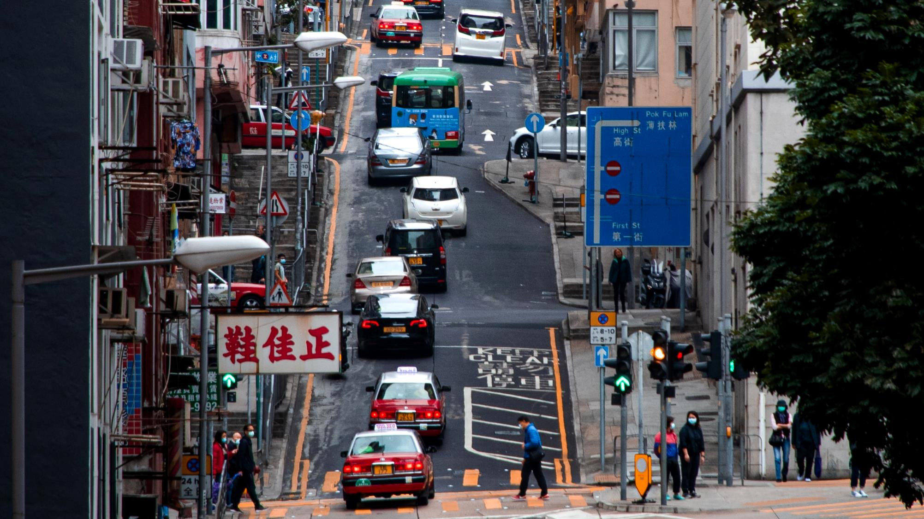
The Transport System and Transport Policy
Edited by Bert van Wee, Jan Anne Annema, David Banister and Baiba Pudãne
Chapter 6: Transport resistance factors: time, money and effort
Author: Jan Anne Annema
Very steep road - Free image on Unsplash

Slide 2
Introduction
This chapter describes the transport resistance factors and their impact on passenger and freight transport demand
In physics: resistance is what stops or obstructs a force
Locations and need of transport are the ‘forces’, resulting in transport
These ‘forces’ are obstructed by travel time, monetary costs and effort: the so-called resistance factors
In economics: resistance are the costs of a trip
Utility theory (Chapter 3): A trip will be made only if the benefits outweigh the costs
Resistance factors influence the amount of transport and the modal choice
→ The lower the resistance factors, the higher the amount of transport

Slide 3
Overview chapter
Transport resistance consists of three factors, that together make up the generalized travel/transport cost unit. These factors are relevant in both passenger (discussed next) as well as goods transport (discussed after).
Travel time
Monetary costs
Effort/Transport services
Generalized travel/transport costs
Passenger
Passenger
Passenger
Passenger
Goods
Goods
Goods
Goods

Slide 4
Travel time
Travel time
Monetary costs
Effort resistance
Generalized travel/transport costs
Passenger
Passenger
Passenger
Passenger

Slide 5
Components of travel time
Hidden waiting time
In-vehicle travel time
Biking time
Time to find parking lot
Travel time
Congestion time
Walking time
Time to get to final destination
Free flow time

Slide 6
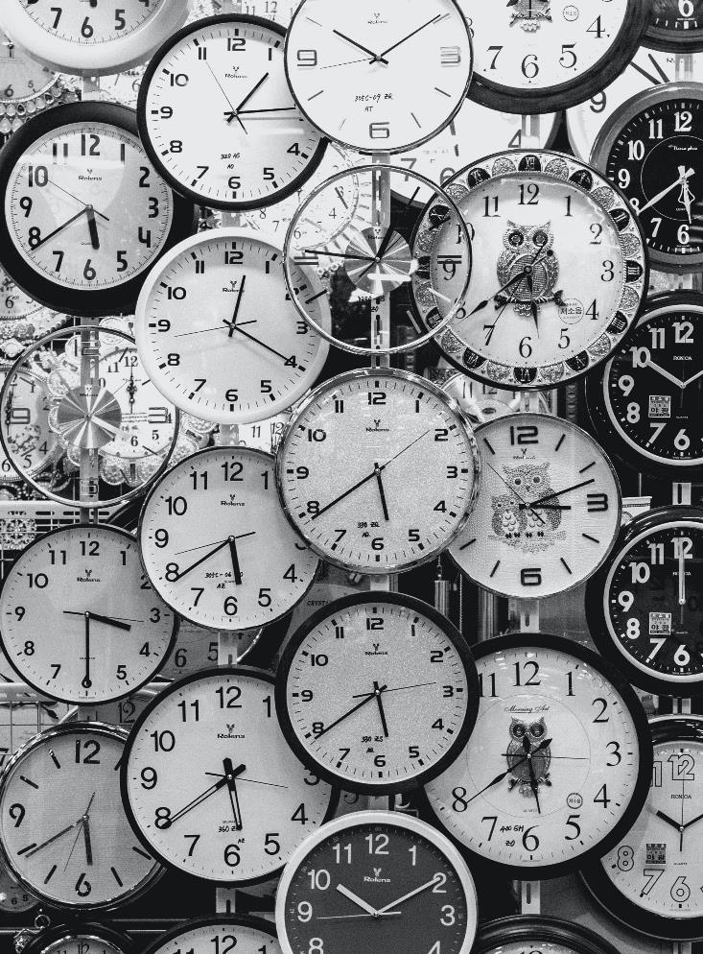
Value of time
Definition
Value of Travel Time (VOTT)* is the amount of money consumers or shippers are willing to pay to save a unit of travel time.
* Sometimes, MVTTS (Marginal Value of Travel Time Savings) is used. Both terms are equivalent.
There are differences in VOTT between countries. Income differences is one of the main explanations:
Country Short distance (urban) Long distance (inter-urban)
Commuting – business Personal Commuting – business Personal
Austria 16.9 7.8 19.8 7.8
Belgium 15.6 7.2 21.2 7.2
Bulgaria 6.5 3.0 8.5 3.0
Cyprus 11.0 5.1 12.5 5.1
Croatia 8.0 3.7 9.6 3.7
Czech Republic 11.6 5.4 14.0 5.4
Denmark 16.4 7.6 20.7 7.6
Estonia 10.0 4.6 12.1 4.6
Finland 14.5 6.7 20.6 6.7
France 13.8 6.4 15.7 6.4
Germany 16.4 7.6 20.0 7.6
Clocks - Free image on Pexels

Slide 7
Constant time budgets
The average that people spend on travelling per day has almost not changed since 1970: around 1.1 hour per day
Significant difference per person per day at a disaggregate level, but at the most aggregated level travel time budgets fairly constant →If people keep their time budgets constant, they will travel longer distances when travel time decreases instead of choosing smaller travel time budgets
This is because of :
basic instinct of humankind to expand its territory
more opportunities (for activities, etc.) in a larger area

Slide 8
Travel time elasticities
Definition:
Travel time elasticity is the responsiveness of people to travel time changes: % increase in travel demand (vehicle kilometres travelled) to the % increase in travel times.
This responsiveness means that expanding road infrastructure leads to more travel ➔ Induced demand. (See also chapter 3.)
Long term elasticities are typically higher (by absolute value) than short term elasticities, because travellers have more opportunities to change their behaviour – e.g., acquire or relinquish a vehicle, change their residential location.
Travel time elasticity = -1 means that the travellers have a constant travel time budget (see before).

Slide 9
Monetary costs
Travel time
Monetary costs
Effort resistance
Generalized travel/transport costs
Passenger
Passenger
Passenger
Passenger

Slide 10
Components of monetary costs
Definition:
The monetary costs in passenger transport is the amount money people have to spend for the trip.
Fuel costs
Fares
Monetary costs
Parking costs
Tolls
Insurance costs
Depreciation costs
Repair costs
Taxes
Maintenance costs

Slide 11
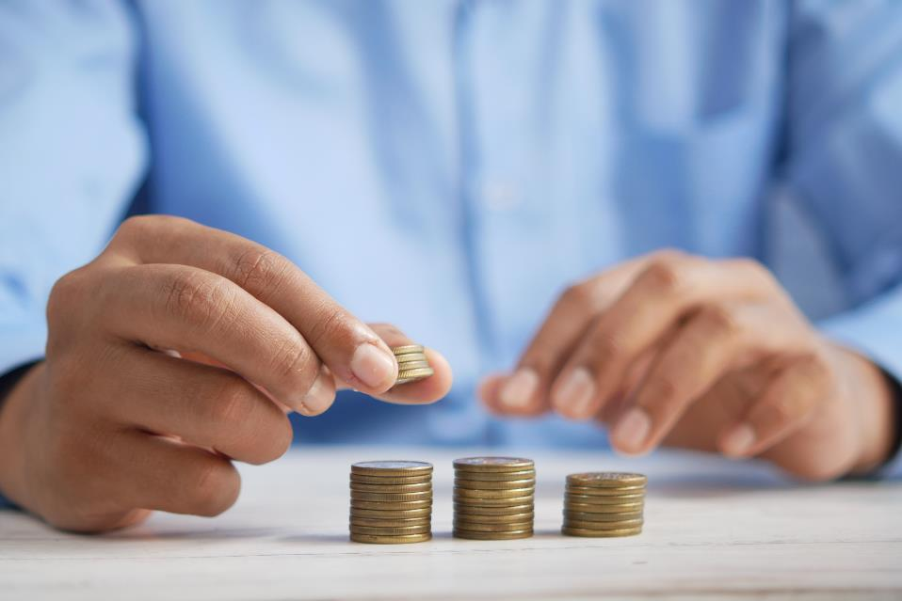
Constant money cost budgets
On average, people per class of income tend to spend a constant share (10 to 15%) of their income on transportation (Schafer, 1998)
Interpretation: if travel becomes more expensive, then people tend to travel less and vice versa.
Budgeting - Free image on Unsplash
Schafer, A. (1998), ‘The global demand for motorized mobility’, Transportation Research A, 32 (6), 455–477.

Slide 12
Price and monetary costs elasticities
The responsiveness to monetary changes can be expressed in elasticities:
Price and fare elasticities relate to the responsiveness to changes in prices such as fuel price
Travel or transport costs elasticities relate to behavioural changes dependent on actual costs changes
Empiric research worldwide shows that:
Transport consumers are indeed price and cost sensitive
The extent of their responsiveness is dependent on many factors like culture, income and time
The responsiveness to price changes is fairly modest in most cases (elasticities are in most cases between 0 and 1)

Slide 13
Price and monetary costs elasticities
The long-term fuel price elasticity for car use and car fuel are higher compared to the short-term elasticities →
Interpretation: it is relatively more difficult for people to make changes on the short-term then on the long-term. On the long term, people also acquire more fuel-efficient cars and can thereby continue travelling by car (counteracting the reduction in car use).
Consumers show a stronger response to price increases compared to price decreases.
Aligns with the prospect theory of Kahneman and Tversky (1979): people value losses (e.g., air fare increase) more than gains (e.g., air fare decrease).
Indicative fuel price elasticities
Short term (one year)
Long term (five to ten years)
Car ownership
-
0.05 to
-
0.2
-
0.1 to
-
0.65
Car use
-
0.1 to
-
0.2
-
0.25 to
-
0.5
Car fuel efficiency
0.1 to 0.15
0.3 to 0.4
Car fuel use
-
0.25 to
-
0.35
-
0.6 to
-
0.8
Indicative fare elasticities
Short term (one year
)
Long term (five to ten years)
Bus
-
0.2 to
-
0.5
-
0.6 to
-
1.0
Train
-
0.3 to
-
0.7
-
0.6 to
-
1.1
Metro
-
0.1 to
-
0.3
-
0.3 to
-
0.7
Geilenkirchen et al. (2009); Chapter 6 (page 106)
Geilenkirchen, G.P., K.T. Geurs, H.P. van Essen, A. Schroten and B. Boon (2009), Effecten van prijsbeleid in verkeer en vervoer, Bilthoven, Planbureau voor de Leefomgeving/Delft: CE Delft
. Kahneman, D., & Tversky, A. (2013). Prospect theory: An analysis of decision under risk. In Handbook of the fundamentals of financial decision making: Part I (pp. 99-127).

Slide 14
Effort resistance
Travel time
Monetary costs
Effort resistance
Generalized travel/transport costs
Insurances costs
Passenger
Passenger
Passenger
Passenger

Slide 15
Components of effort resistance
Reliability
Mental effort
Travellers (esp. women’s) feelings of insecurity
Effort resistance
Discomfort
Physical effort
(Mental) strain
Availability of information
Stress
Accident risk

Slide 16
Components of effort resistance: Discomfort
Reliability
Mental effort
Travellers (esp. women’s) feelings of insecurity
Effort resistance
Discomfort
Physical effort
(Mental) strain
Availability of information
Stress
Accident risk

Slide 17
Components of effort resistance: Discomfort
In public transport, discomfort can be caused by
the waiting environment quality,
the vehicle and rolling stock quality,
the quality of the front-line staff to customers,
crowding,
seat place availability,
the quality of on-board facilities,
cleanliness and the interchange quality between modes
When cycling, discomfort can be cause by
the hilliness of the landscape
the temperature outside
the weather outside
the state of the bicycle parking facility,
the quality of the cycling paths

Slide 18
Components of effort resistance: Reliability
Reliability
Mental effort
Travellers (esp. women’s) feelings of insecurity
Effort resistance
Discomfort
Physical effort
(Mental) strain
Availability of information
Stress
Accident risk

Slide 19
Components of effort resistance: Reliability
A reliable transportation system means that travellers and hauliers can make trips according to their expectations, especially related to expected travel time
The USA Department of Transportation defines travel time reliability as a measure of the consistency, timeliness, predictability and dependability of a trip (FHWA/DoT, 2021)
So, if a trip of 10 minutes suddenly is 1 hour and the next day it is 30 minutes and the day after that it is 15 minutes, a trip is highly unreliable
Definition:
The Value of Reliability (VOR) is people’s willingness-to-pay to make their trips more reliable. It can be measured in eur/h of standard deviation of travel times.
hands response - Free image on Pixabay
https://ops.fhwa.dot.gov/publications/tt_reliability/TTR_Report.htm

Slide 20
Components of effort resistance: Information
Reliability
Mental effort
Travellers (esp. women’s) feelings of insecurity
Effort resistance
Discomfort
Physical effort
(Mental) strain
Availability of information
Stress
Accident risk

Slide 21
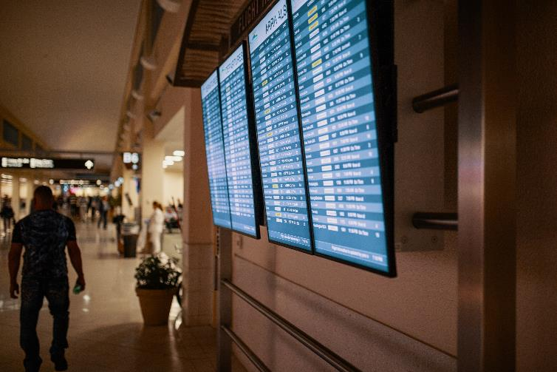
Components of effort resistance: Information
Traveller information relates to route information (en-route and beforehand) and mode information (e.g., fares and travel times to be expected, waiting and bicycle storing facilities and so forth)
The availability of high-quality traveller information can improve travelling comfort, trip reliability and decrease travel stress
Digital inequality
Travel information and transport services increasingly become more digitalized ➔
Higher accessibility for most people
Lower accessibility for people who do not have access to digital technologies or who do not have the capabilities to understand digital tools
Flight scheme - Free image on Pexels

Slide 22
Components of effort resistance: Insecurity
Reliability
Mental effort
Travellers (esp. women’s) feelings of insecurity
Effort resistance
Discomfort
Physical effort
(Mental) strain
Availability of information
Stress
Accident risk

Slide 23
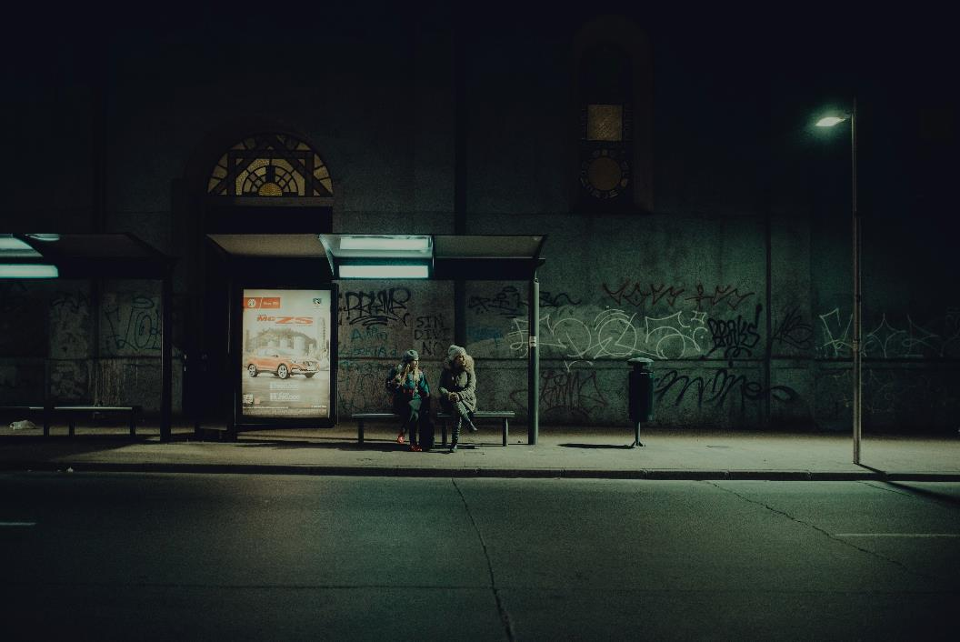
Components of effort resistance: Insecurity
Travellers feelings of insecurity is a resistance factor for public transport and the slow modes (biking and walking)
The factor relates to feelings of uneasiness when people travel, have to wait or transfer on stations or bus stops.
Women especially experience these high levels of perceived insecurity, because they experience more superficial incidents such as stalking, sexual slur, groping and other events with sexual undertones.
This results in mobility constraints for women in many places.
Bus stop at night - Free image on Unsplash

Slide 24
Components of effort resistance: Accident risk
Reliability
Mental effort
Travellers (esp. women’s) feelings of insecurity
Effort resistance
Discomfort
Physical effort
(Mental) strain
Availability of information
Stress
Accident risk

Slide 25
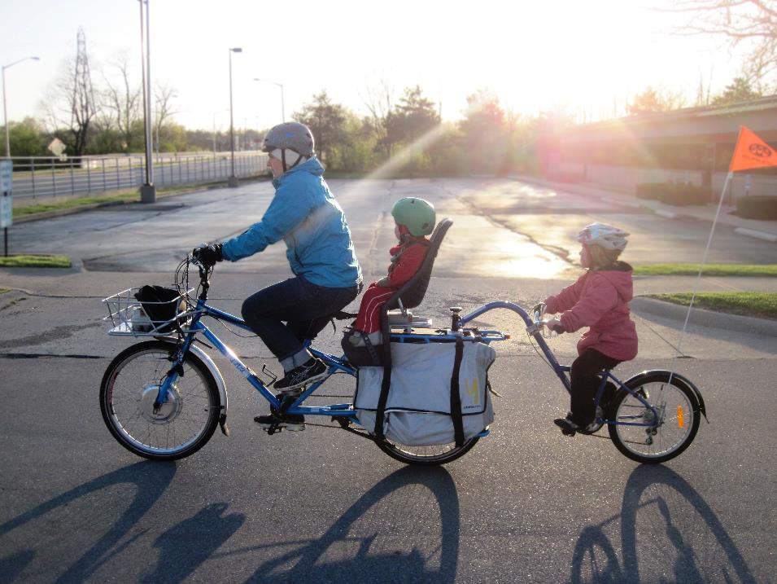
Components of effort resistance: Accident risk
People might fear that they or their children get involved in traffic accidents when they choose a certain transport mode → This fear might influence their mode choice
E.g., when children go to school by themselves, the parents may prefer them to go to school by bus because it may be more dangerous by bike due to inattentiveness by the children or the other road users

Slide 26
Components of effort resistance: Strain & stress
Reliability
Mental effort
Travellers (esp. women’s) feelings of insecurity
Effort resistance
Discomfort
Physical effort
(Mental) strain
Availability of information
Stress
Accident risk

Slide 27
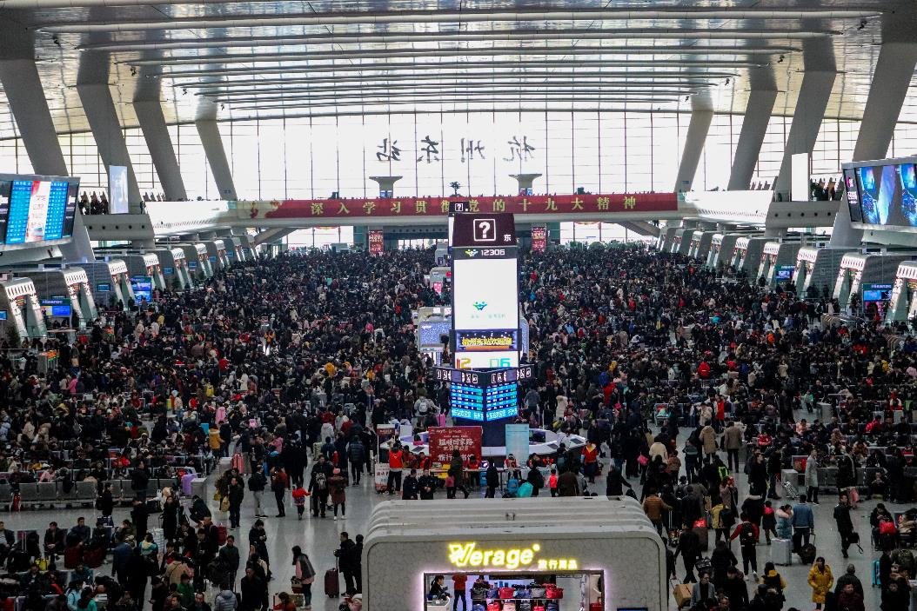
Components of effort resistance: Strain & stress
Travel effort factors can be related to stress such as crowded trains, discomfort from poor design, feelings of no control, unpredictability
Wener and Evans (2011) found that car commuters showed significantly higher levels of reported stress compared to train commuters
Crowded airport - Free image on Unsplash
Wener, R.E. and G.W. Evans (2011), ‘Comparing stress of car and train commuters’, Transportation Research Part F, 14, 111–116.

Slide 28
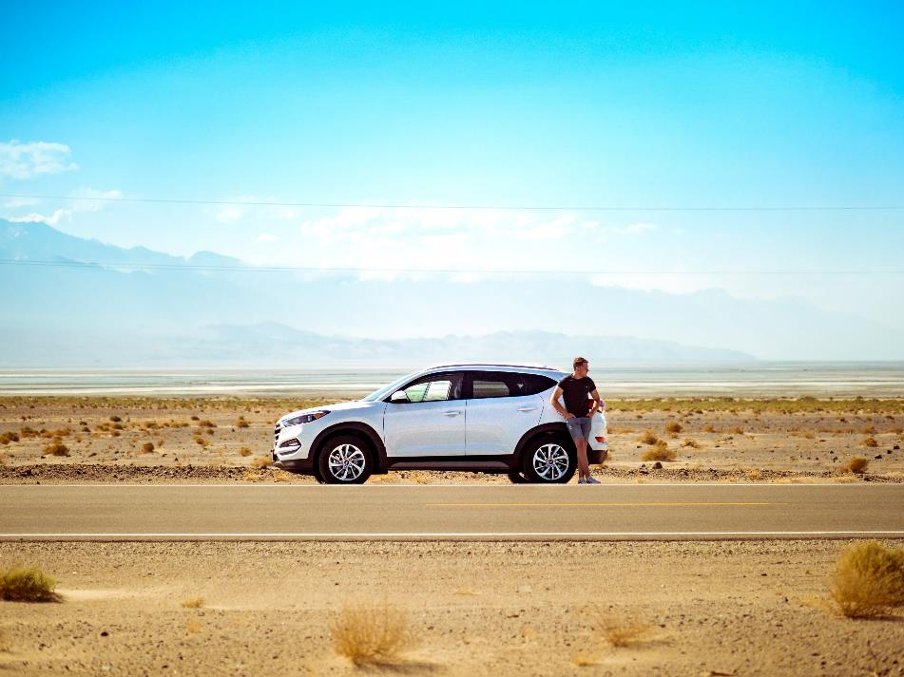
How to measure effort resistance?
It is more difficult to include the effort resistance factors in the total resistance factor, so specific weighting factors for the different parts of the trip are used in order to include all kinds of effort components. E.g., penalties for waiting time or unexpectedly arriving too early or late.
More in Chapter 16
Car broke down - Free image on Unsplash

Slide 29
Goods transport
Similar factors play a role in goods/freight transport choices by shippers and hauliers. Effort components are replaced with quality and reliability of transport services.
Transport time
Monetary costs
Transport services and reliability
Generalized travel/transport costs
Goods
Goods
Goods
Goods

Slide 30
Transport time of goods transport
Transport time
Monetary costs
Transport services and reliability
Generalized travel/transport costs
Goods
Goods
Goods
Goods

Slide 31
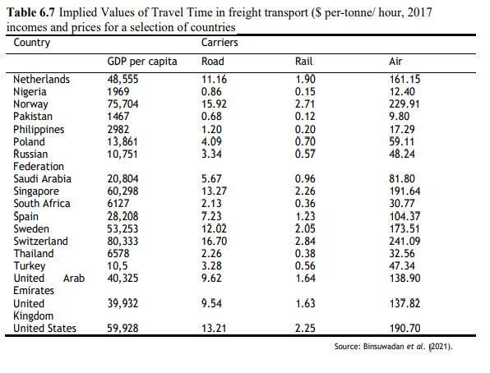
Transport time of goods transport
Binsuwadan et al. (2021) performed a large meta-analysis to explain variations in the value of freight travel time savings (VFTTS) →
Both carriers who transport goods and shippers who supply or own the goods (see also Chapter 4) value transport time savings
The average income (GDP per capita) in a country has an important influence on the willingness to pay for freight travel times savings
The different transport modes have very different VFTTS: the faster modes, especially air and to some extent road transport, have relatively high VFTTS
The VFTTS is dependent on who is the decisionmaker: a carrier is more willing to trade-off money against transport time savings because these time savings can increase his profits
(Taken from Chapter 6, page 112)
Binsuwadan, J., De Jong, G., Batley, R., & Wheat, P. (2021). The value of travel time savings in freight transport: a meta-analysis. Transportation, 1-27.

Slide 32
Monetary costs of goods transport
Transport time
Monetary costs
Transport services and reliability
Generalized travel/transport costs
Goods
Goods
Goods
Goods

Slide 33
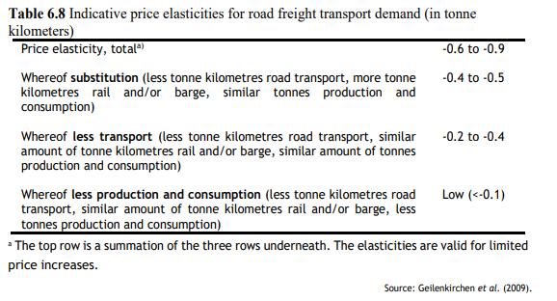
Monetary costs for goods transport
Responsiveness of road freight transport in the Netherlands for price increases →
An increase of road freight costs by, e.g., new taxes, tolls or oil price rises, may entice shippers to switch to other modes such as rail
An increase of road freight costs may make carriers increase efficiency by, e.g., using larger vehicles, reducing the number of empty runs
An increase of road freight costs may lead to lower production, since shippers may increase the final product price leading to lower demand
(Taken from Chapter 6, page 150)

Slide 34
Transport services and reliability
Transport time
Monetary costs
Transport services and reliability
Generalized travel/transport costs
Goods
Goods
Goods
Goods

Slide 35
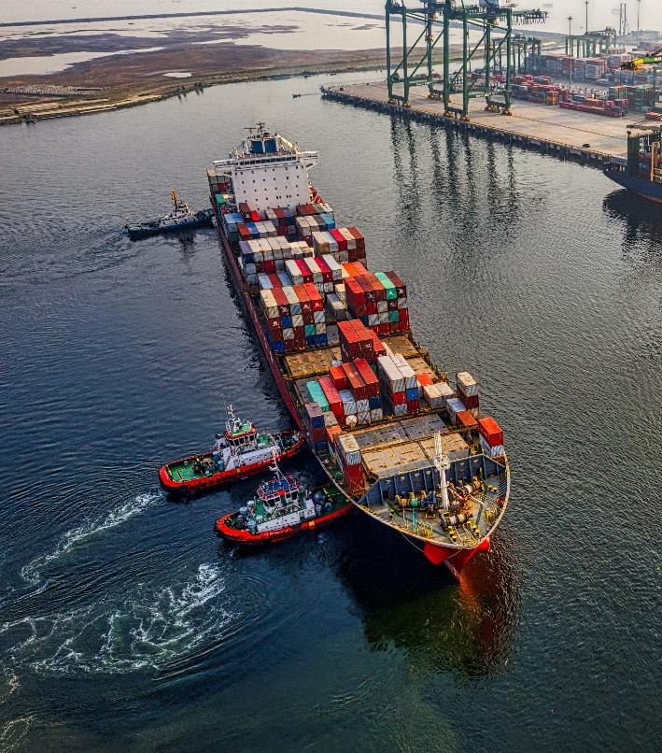
Transport services and reliability
Shippers also take transport service quality and reliability into account when deciding to use a particular transport freight mode.
Kim et al., (2017) shows that shippers (in New Zealand) value
Cargo arriving within a given time
More frequent services
Risk for damaged goods
Freight ship - Free image on Pexels
Kim, H., A. Nicholson and D. Kusumastuti, D. (2017), ‘Analysing freight shippers’ mode choice preference heterogeneity using latent class modelling’, Transportation Research Procedia, 25, 1109-1125.

Slide 36
Conclusion
The most important conclusions of this chapter are:
Important transport resistance factors for passenger transport are travel time, monetary costs and effort. Passengers are responsive to changes in these resistance factors
Important resistance factors for freight transport are transport time, monetary costs and transport services. Shippers and freight forwarders are responsive to changes in these resistance factors
People tend to keep their travel time budget constant on an aggregated scale, exchanging shorter travel times for more distance instead of spending saved time on other activities

Slide 37
Conclusion
Long-term travel time and price elasticities are higher than short-term elasticities because people have more options, such as moving or finding a new job
Higher transportation costs lead to less transport and mode shifts, but higher fuel prices also lead to the purchase of more fuel-efficient cars, allowing people to continue traveling by car while avoiding the full price increase

Slide 38
The Transport System and Transport Policy
Edited by Bert van Wee, Jan Anne Annema, David Banister and Baiba Pudãne
Chapter 6: Transport resistance factors: time, money and effort
Author: Jan Anne Annema
Very steep road - Free image on Unsplash

