Slide 1
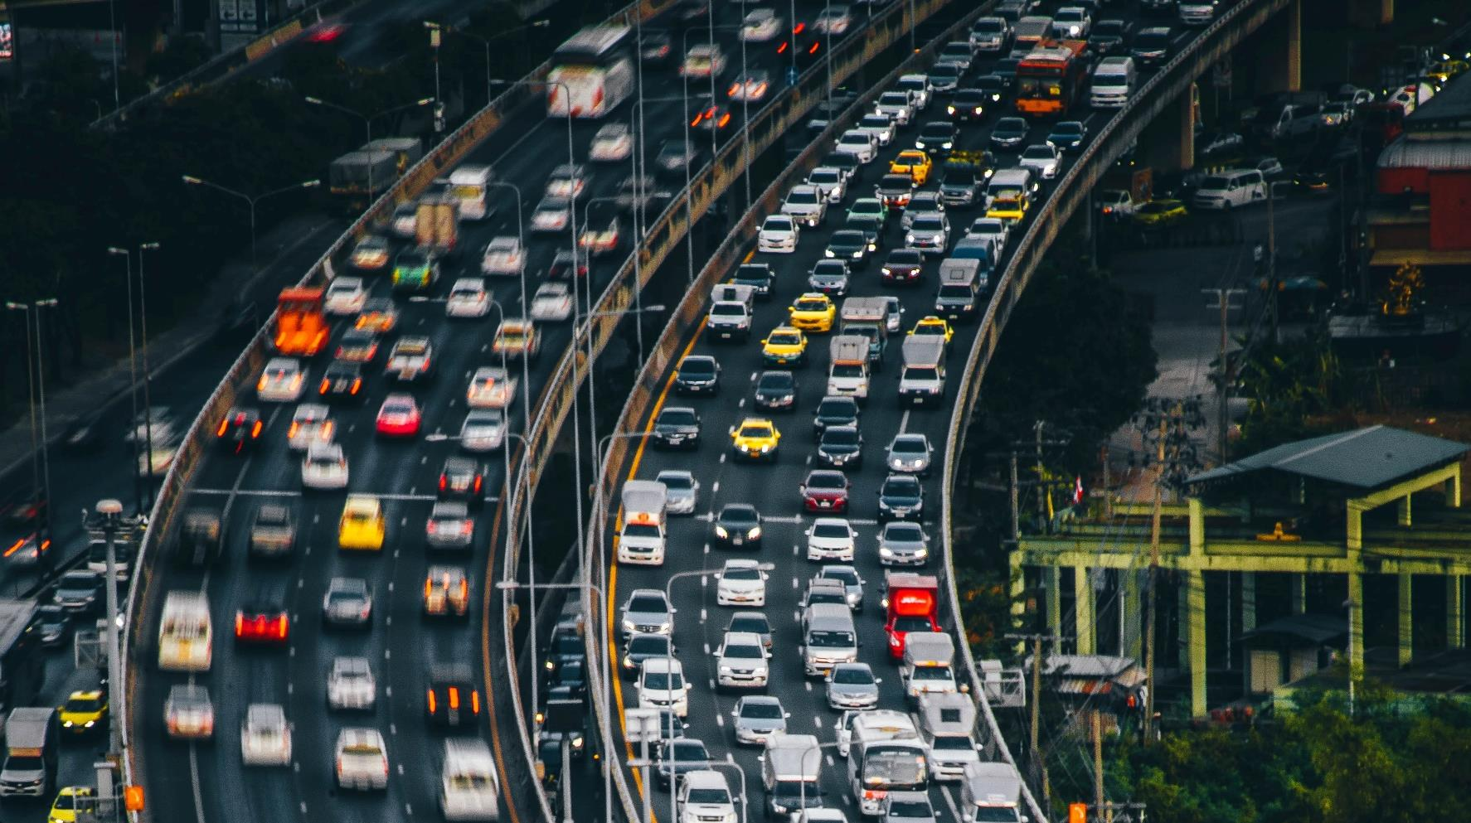

The Transport System and Transport Policy
Edited by Bert van Wee, Jan Anne Annema, David Banister and Baiba Pudãne
Chapter 7: Traffic flow theory and modelling
Authors: Victor Knoop and Serge Hoogendoorn
Traffic jam - Free image on Unsplash

Slide 2
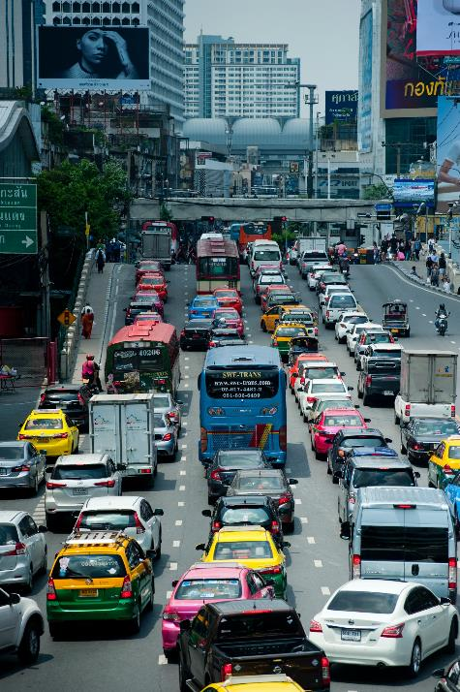
Introduction
Can we predict how long the queues will be?
There are a lot of questions about traffic flows:
Can we predict how long it will take for the congestion to resolve?
Can we predict when queuing will occur?
When do traffic jams emerge?
Why does an overloaded traffic network underperform?
Traffic jam - Free image on Pexels

Slide 3
Introduction
Can we predict how long the queues will be?
There are a lot of questions about traffic flows:
Can we predict how long it will take for the congestion to resolve?
Can we predict when queuing will occur?
These questions are relevant for traffic management measures and policies such as road expansions
When do traffic jams emerge?
Why does an overloaded traffic network underperform?
Traffic jam - Free image on Pexels

Slide 4
Introduction
Can we predict how long the queues will be?
There are a lot of questions about traffic flows:
Can we predict how long it will take for the congestion to resolve?
Can we predict when queuing will occur?
These questions are relevant for traffic management measures and policies such as road expansions
When do traffic jams emerge?
Why does an overloaded traffic network underperform?
Traffic flow theory can help answer these questions
Traffic jam - Free image on Pexels

Slide 5
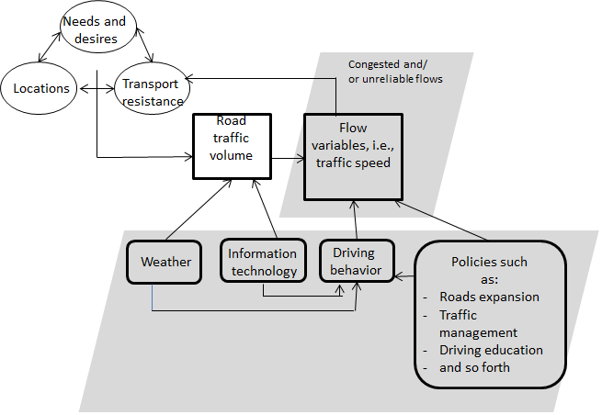
What this chapter covers…
Road traffic volume results from the interplay between needs and desires of people’s and shippers’, locations of activities and the transport resistance factors (see Chapter 2 for the full conceptual model)
Road traffic flows on certain road stretches during certain time periods can either be free or congested and/or the flows can be unreliable → transport resistance (Chapter 6) will be relatively high in the latter two cases
Flow variables (e.g., speed and density) describe the road traffic.
This chapter introduces these variables and their relationships with external variables, such as driving behaviour and weather.
Figure 7.1 The connection of this chapter (grey area) with the simplified conceptual framework (top left) as described in Chapter 2
(Taken from Chapter 7, page 119)

Slide 6
What this chapter covers…
This chapter considers traffic flow operations on simple infrastructure elements, although an important sidestep is made to network dynamics.
It takes both a microscopic and a macroscopic perspective:
Microscopic perspective: reflects the behaviour of individual drivers interacting with surrounding vehicles
Macroscopic perspective: reflects the average state of traffic
Figure 7.1 The connection of this chapter (grey area) with the simplified conceptual framework (top left) as described in Chapter 2
(Taken from Chapter 7, page 1)

Slide 7
Overview chapter
Vehicle trajectories and microscopic flow variables
Macroscopic flow variables
Microscopic and macroscopic flow characteristics
Developments for the future: connected and automated vehicles
Traffic flow dynamics and self-organisation
Multi-lane traffic flow facilities (motorways)
Microscopic and macroscopic traffic flow models
Network dynamics
Bicycle traffic

Slide 8
Overview chapter
Vehicle trajectories and microscopic flow variables
Macroscopic flow variables
Microscopic and macroscopic flow characteristics
Developments for the future: connected and automated vehicles
Traffic flow dynamics and self-organisation
Multi-lane traffic flow facilities (motorways)
Microscopic and macroscopic traffic flow models
Network dynamics
Bicycle traffic

Slide 9
Vehicle trajectories
Definition
The vehicle trajectory (often denoted as xi(t)) of vehicle (i) describes the position of the vehicle over time (t) along the roadway
The trajectory is the core variable in traffic flow theory which allows us to determine all relevant microscopic and macroscopic traffic flow quantities
Note that the lateral component of the trajectory is not considered here
Figure 7.2 Vehicle trajectories and key microscopic flow characteristics
(Taken from Chapter 7, page 121)

Slide 10
Vehicle trajectories
Figure (←) allows to determine:
the distance headway S_{i}
the time headway h_{i}
overtaking events (crossing trajectories)
the speed v_{i} = dx_{i}/dt
the size of the acceleration (see top left where one vehicle accelerates to overtake another vehicle)
the travel time T
Figure 7.2 Vehicle trajectories and key microscopic flow characteristics
(Taken from Chapter 7, page 121)

Slide 11
Vehicle trajectories
To illustrate the versatility of trajectories, figure 7.2 shows several vehicle trajectories
From figure 7.2, it is easy to determine:
the distance headway S_{i}
the time headway h_{i}
overtaking events (crossing trajectories)
the speed v_{i} = dx_{i}/dt,
the size of the acceleration (see top left where one vehicle accelerates to overtake another vehicle)
the travel time T
Figure 7.2 Vehicle trajectories and key microscopic flow characteristics
(Taken from Chapter 7, page 121)

Slide 12
Vehicle trajectories
To illustrate the versatility of trajectories, figure 7.2 shows several vehicle trajectories
From figure 7.2, it is easy to determine:
the distance headway S_{i}
the time headway h_{i}
overtaking events (crossing trajectories)
the speed v_{i} = dx_{i}/dt
the size of the acceleration (see top left where one vehicle accelerates to overtake another vehicle)
the travel time T
Figure 7.2 Vehicle trajectories and key microscopic flow characteristics
(Taken from Chapter 7, page 121)

Slide 13
Vehicle trajectories
To illustrate the versatility of trajectories, figure 7.2 shows several vehicle trajectories
From figure 7.2, it is easy to determine:
the distance headway S_{i}
the time headway h_{i}
overtaking events (crossing trajectories)
the speed v_{i} = dx_{i}/dt
the size of the acceleration (see top left where one vehicle accelerates to overtake another vehicle)
the travel time T
Figure 7.2 Vehicle trajectories and key microscopic flow characteristics
(Taken from Chapter 7, page 121)

Slide 14
Vehicle trajectories
To illustrate the versatility of trajectories, figure 7.2 shows several vehicle trajectories
From figure 7.2, it is easy to determine:
the distance headway S_{i}
the time headway h_{i}
overtaking events (crossing trajectories)
the speed v_{i} = dx_{i}/dt
the size of the acceleration (see top left where one vehicle accelerates to overtake another vehicle)
the travel time T
Figure 7.2 Vehicle trajectories and key microscopic flow characteristics
(Taken from Chapter 7, page 121)

Slide 15
Vehicle trajectories
To illustrate the versatility of trajectories, figure 7.2 shows several vehicle trajectories
From figure 7.2, it is easy to determine:
the distance headway S_{i}
the time headway h_{i}
overtaking events (crossing trajectories)
the speed v_{i} = dx_{i}/dt
the size of the acceleration (see top left where one vehicle accelerates to overtake another vehicle)
the travel time T
The two main microscopic flow variables
Figure 7.2 Vehicle trajectories and key microscopic flow characteristics
(Taken from Chapter 7, page 121)

Slide 16
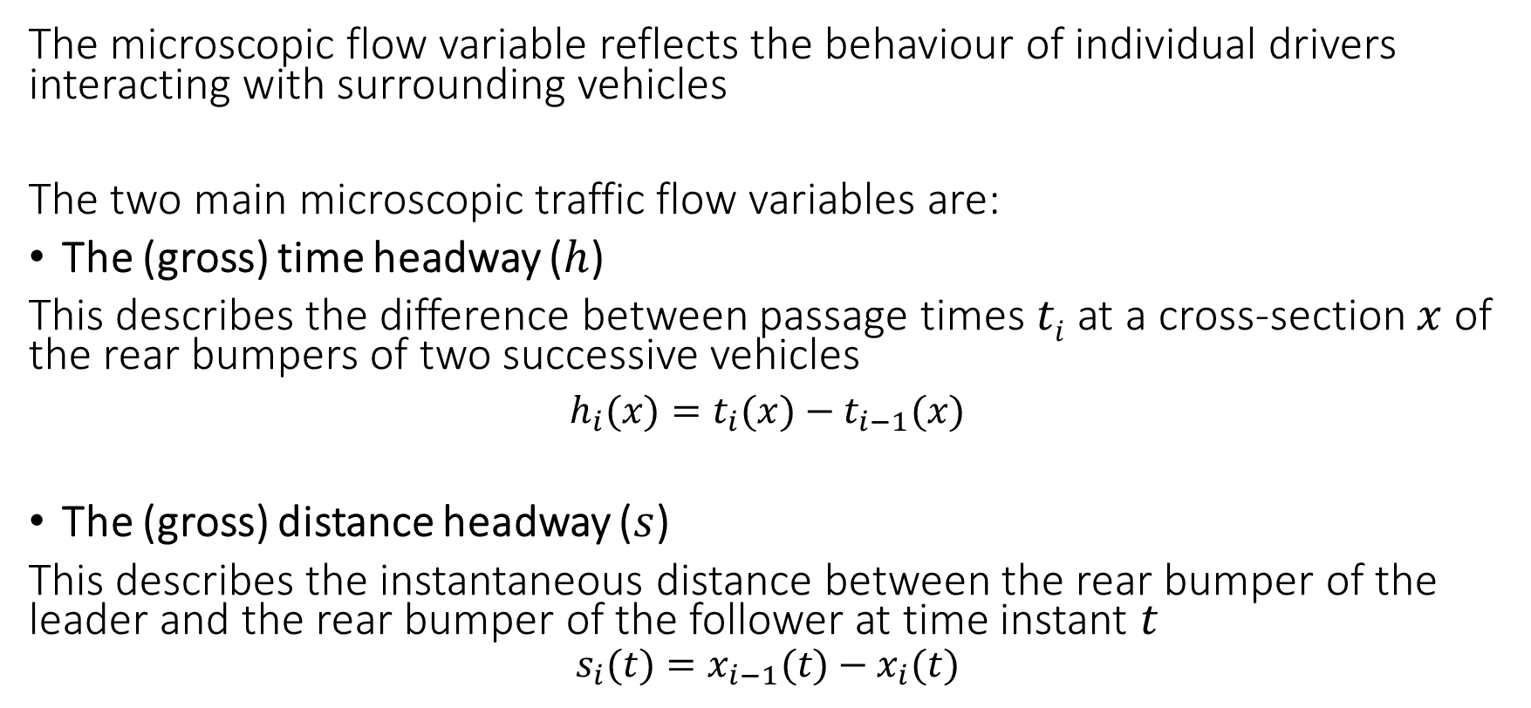
Microscopic flow variables
The microscopic flow variable reflects the behaviour of individual drivers interacting with surrounding vehicles
The two main microscopic traffic flow variables are:
The (gross) time headway ($h$)
This describes the difference between passage times $ti$ at a cross-section $x$ of the rear bumpers of two successive vehicles
$h_{i}(x)=t_{i}(x)−t_{i−1}(x)$
The (gross) distance headway ($s$)
This describes the instantaneous distance between the rear bumper of the leader and the rear bumper of the follower at time instant $t$
$$s_{i}(t)=x_{i−1}(t)−x_{i}(t)$$
(1)
(2)

Slide 17
Overview chapter
Vehicle trajectories and microscopic flow variables
Macroscopic flow variables
Microscopic and macroscopic flow characteristics
Developments for the future: connected and automated vehicles
Traffic flow dynamics and self-organisation
Multi-lane traffic flow facilities (motorways)
Microscopic and macroscopic traffic flow models
Network dynamics
Bicycle traffic

Slide 18
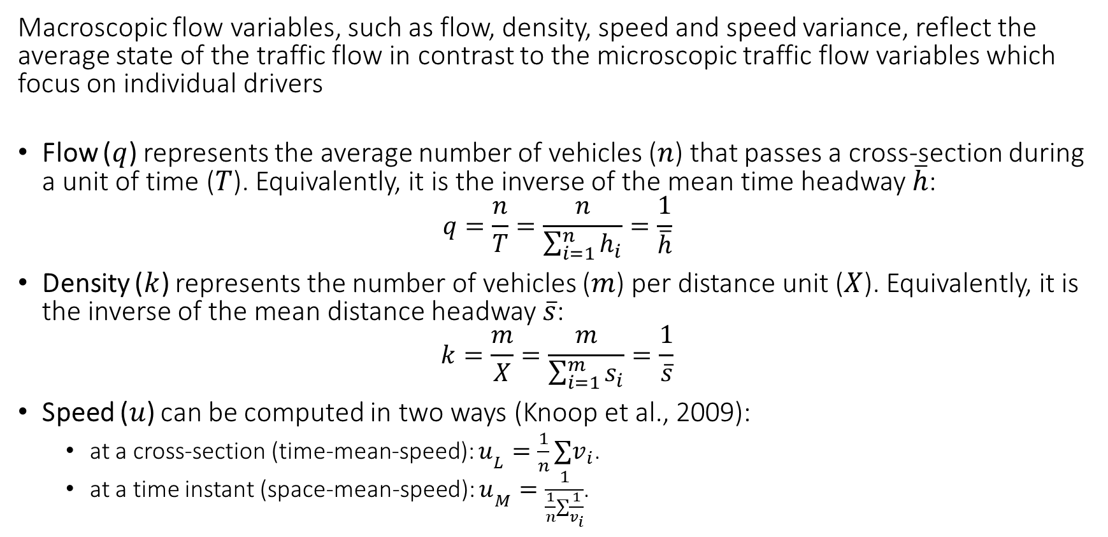
Traditional definitions of flow, density and speed
Macroscopic flow variables, such as flow, density, speed and speed variance, reflect the average state of the traffic flow in contrast to the microscopic traffic flow variables which focus on individual drivers
Flow ($q$) represents the average number of vehicles ($n$) that passes a cross-section during a unit of time ($T$). Equivalently, it is the inverse of the mean time headway $\overline{h}$:
$$q=\frac{n}{T}=\frac{n}{\sum_{i=1}^{n}{h_{i}}}=\frac{1}{\overline{h}}$$
Density ($k$) represents the number of vehicles ($m$) per distance unit ($X$). Equivalently, it is the inverse of the mean distance headway $\overline{s}$:
$$k=\frac{m}{X}=\frac{m}{\sum_{i=1}^{m}{s_{i}}}=\frac{1}{\overline{s}}$$
Speed ($u$) can be computed in two ways (Knoop et al., 2009):
  at a cross-section (time-mean-speed): $u­_{L}=\frac{1}{n}∑v_{i}$.
  at a time instant (space-mean-speed): $u­_{M}=\frac{1}{\frac{1}{n}∑\frac{1}{v_{i}}}$.
(4)
(5)
Knoop, V., Hoogendoorn, S. P., & van Zuylen, H. (2009). Empirical differences between time mean speed and space mean speed. In Traffic and Granular Flow’07 (pp. 351-356). Springer Berlin Heidelberg.

Slide 19


Continuity equation
The continuity equation is a fundamental relation in traffic flow theory
  It states that flow ($q$) equals density ($k$) times speed ($u$): $q=k∗u$
The derivation of the equation follows from expressing the total number of travellers using the capacity and flow variables.
The space mean speed (u­_{M}, see before)
should be used as $u$.
$$kX=qT ⇔ q=k\frac{X}{T}=ku$$
(6)
Figure 7.3 Derivation of the continuity equation
(Taken from Chapter 7, page 124)

Slide 20
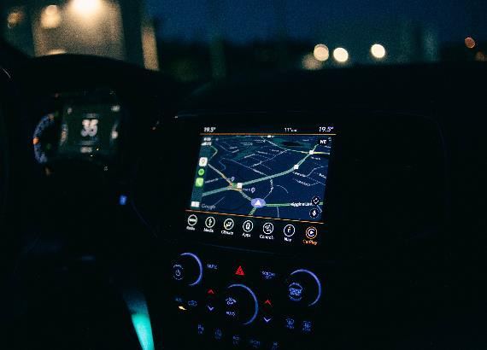
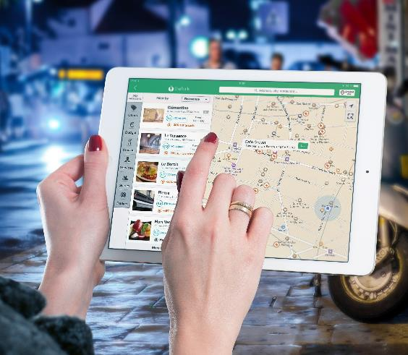
Generalized traffic flow variables
Automatic vehicle identification (AVI), radar, and floating-car measurements offer new ways to determine flow variables in traffic analysis
These methods provide information about both temporal and spatial aspects of traffic flow, allowing for direct observation of density in a region, as opposed to relying solely on local observations
Edie (1965) introduced generalized definitions of flow, density, and speed to establish the relation between instantaneous and local variables
Van Erp (2019) demonstrates how to merge new types of data, including findings on overtaking, to estimate flow, density and speed.
GPS car - Free image on Pexels
Edie, L. (1965), ‘Discussion of traffic stream measurements and definitions’, in 2nd Int. Symp. On the Theory of Traffic Flow, Paris: OECD, 139-154.
Van Erp, P. B., V.L. Knoop and S.P. Hoogendoorn (2019), ‘On the value of relative flow data’, Transportation Research Part C: Emerging Technologies, 113, 74-90.
Routing app - Free image on Pexels
Routing app - Free image on Pexels

Slide 21
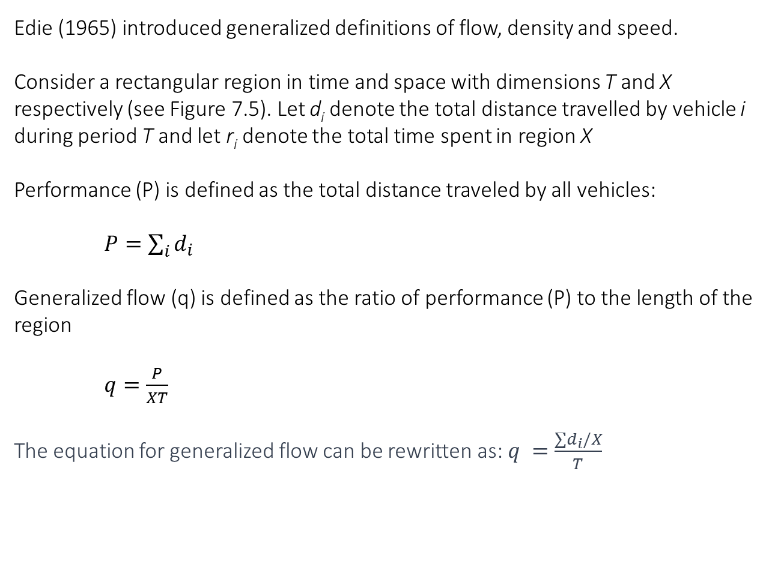
Generalized traffic flow variables
Edie (1965) introduced generalized definitions of flow, density and speed.
Consider a rectangular region in time and space with dimensions T and X respectively (see Figure 7.5). Let d_{i} denote the total distance travelled by vehicle i during period T and let r_{i} denote the total time spent in region X
Performance (P) is defined as the total distance traveled by all vehicles:
$P=\sum_{i}{d_{i}}$
Generalized flow (q) is defined as the ratio of performance (P) to the length of the region
$q=\frac{P}{XT}$
The equation for generalized flow can be rewritten as: $q =\frac{∑d_{i}/X}{T}$
(8)
(9)
Figure 7.5 Generalization according to Edie (1965)
(Taken from Chapter 7)
Edie, L. (1965), ‘Discussion of traffic stream measurements and definitions’, in 2nd Int. Symp. On the Theory of Traffic Flow, Paris: OECD, 139-154.

Slide 22
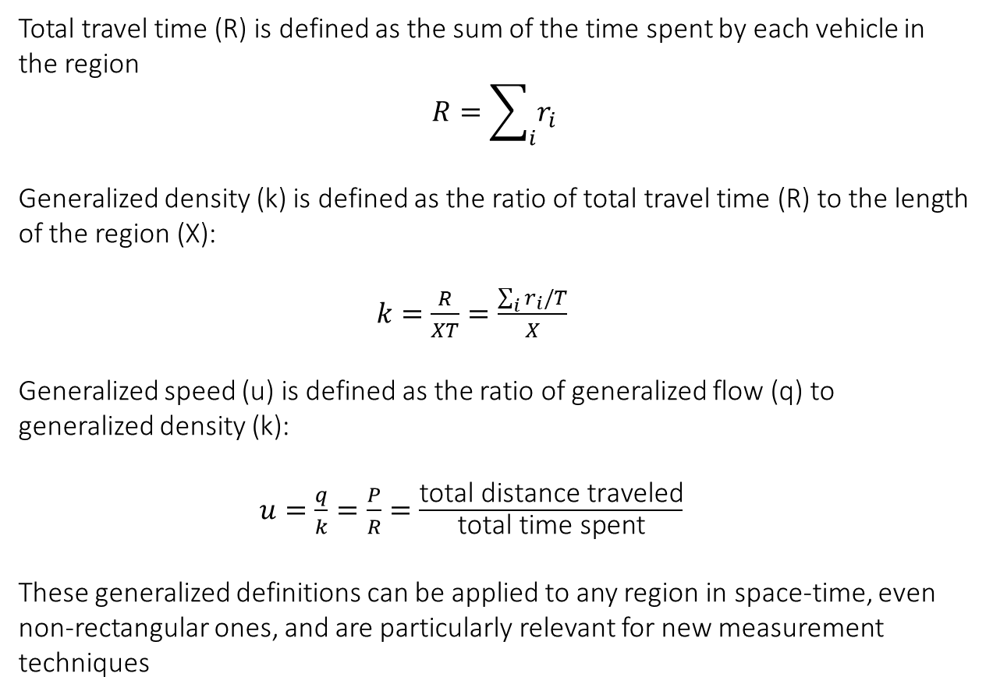
Generalized traffic flow variables
Total travel time (R) is defined as the sum of the time spent by each vehicle in the region
$$R=\sum_{i}{r_{i}}$$
Generalized density (k) is defined as the ratio of total travel time (R) to the length of the region (X):
$k=\frac{R}{XT}=\frac{\sum_{i}{r_{i}/T}}{X}$
Generalized speed (u) is defined as the ratio of generalized flow (q) to generalized density (k):
$u=\frac{q}{k}=\frac{P}{R}=\frac{\text{total} \text{distance} \text{traveled}}{\text{total} \text{time} \text{spent}}$
These generalized definitions can be applied to any region in space-time, even non-rectangular ones, and are particularly relevant for new measurement techniques
(11)
(12)
(13)
Figure 7.5 Generalization according to Edie (1965)
(Taken from Chapter 7)

Slide 23
Overview chapter
Vehicle trajectories and microscopic flow variables
Macroscopic flow variables
Microscopic and macroscopic flow characteristics
Developments for the future: connected and automated vehicles
Traffic flow dynamics and self-organisation
Multi-lane traffic flow facilities (motorways)
Microscopic and macroscopic traffic flow models
Network dynamics
Bicycle traffic
Necessary to understand the traffic flow dynamics

Slide 24
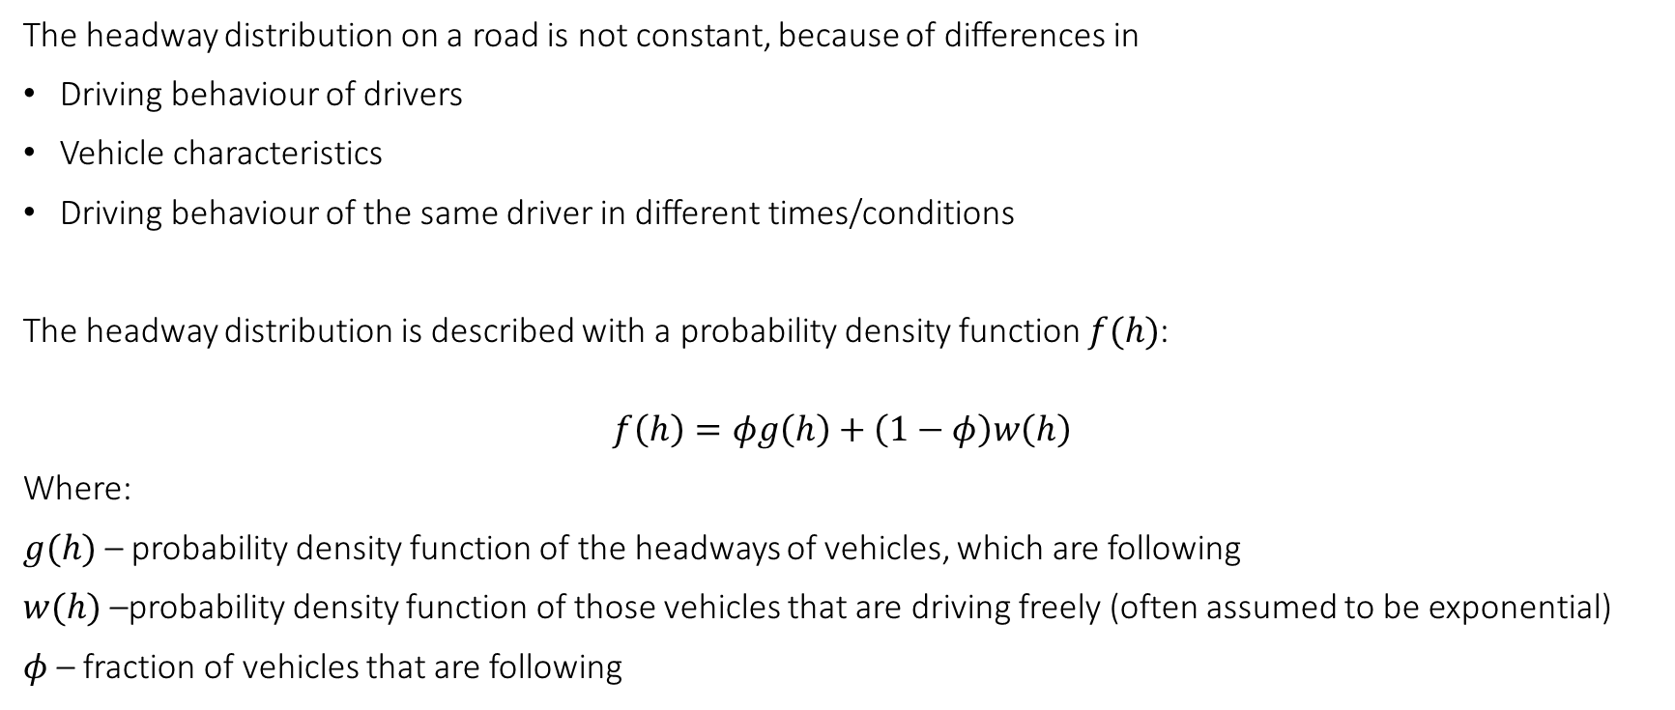
Microscopic and macroscopic flow characteristics: Headway distributions
The headway distribution on a road is not constant, because of differences in
Driving behaviour of drivers
Vehicle characteristics
Driving behaviour of the same driver in different times/conditions
The headway distribution is described with a probability density function $f(h)$:
$$f\left(h\right)=φg\left(h\right)+\left(1−φ\right)w\left(h\right)$$
Where:
$g(h)$ – probability density function of the headways of vehicles, which are following
$w(h)$ –probability density function of those vehicles that are driving freely (often assumed to be exponential)
$φ$ – fraction of vehicles that are following
(14)

Slide 25

Microscopic and macroscopic flow characteristics: Headway distributions
The consequence of non-constant headway distribution is that the capacity is also not a constant, but a stochastic variable.
$C=3600/E\left(H\right)$
Where:
$E(H)$ – expected value of the headway distribution
Example:
Expected value of headway distribution: $E\left(H\right)=1.69$ seconds
Capacity: $C=3600/1.69=2134$ vehicles per hour
(15)

Slide 26
Microscopic and macroscopic flow characteristics: Desired speed distributions
Definition:
The free speed or desired speed of a driver-vehicle combination (or simply: driver or vehicle) is defined by the speed driven when other road users do not influence the driver.
Knowledge of free speeds on a road under given conditions is relevant
For traffic flow models
For road design – e.g., determining suitable traffic rules for a certain facility
As a characteristic of the driver population – also relevant for the road design
The free speed is influenced by the characteristics of the vehicle, the driver, the road, and (road) conditions such as weather and traffic rules (speed limits)

Slide 27
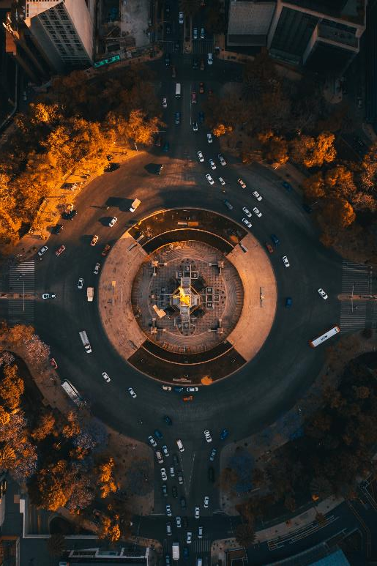
Microscopic and macroscopic flow characteristics: Gap-acceptance and critical gaps
Gap acceptance is a process that occurs in different traffic situations, such as crossing a road, entering a roundabout or performing an overtaking manoeuvre on a bi-directional road
The gap acceptance process can be described as follows: traffic participants that want to make a manoeuvre estimate the space they need and estimate the available space. Based on the comparison between required and available space, they decide to start the manoeuvre or postpone it.
  The minimum gap that a driver will accept is generally called the critical gap
  The required space is dependent on characteristics of the traffic participant, the vehicle and the road
Busy roundabout - Free image on Pexels

Slide 28
Microscopic and macroscopic flow characteristics: Gap-acceptance and critical gaps
Example:
a driver rejects gaps of 3, 9, 12 and 7 s and accepts a gap of 19 s. The only thing one can conclude from these observations is that this driver has a critical gap between 12 and 19 s
Note: Only the maximum of the rejected gaps is informative for the critical gap (assuming that driver behaviour is consistent); the smaller gaps are rejected by definition.
Busy roundabout - Free image on Pexels

Slide 29
Microscopic and macroscopic flow characteristics: Capacity
Definition:
Capacity is the maximum hourly rate at which persons or vehicles can reasonably be expected to traverse a point or uniform section of a lane or roadway during a given time period (usually 15 minutes) under prevailing roadway, traffic, and control conditions
Capacity (or maximum free flow, or queue discharge rate) is not constant values and varies with
the composition of the vehicle fleet,
the composition of traffic with respect to trip purpose,
weather-, road- and ambient conditions
Similar like headway distributions, capacities follow a distribution.
In most cases, a normal distribution can be used to describe the capacity.

Slide 30
Microscopic and macroscopic flow characteristics: Capacity
There are two maximum flow rates (or capacities):
Definition:
The pre-queue maximum flow is the maximum flow rate observed at the downstream location just before the on-set of congestion (a queue) upstream.
High speed
Instable
Large variance in flow
Definition:
The queue discharge flow is the maximum flow rate observed at the downstream location as long as congestion exists.
Lower speed and density
Constant outflow with small variance

Slide 31
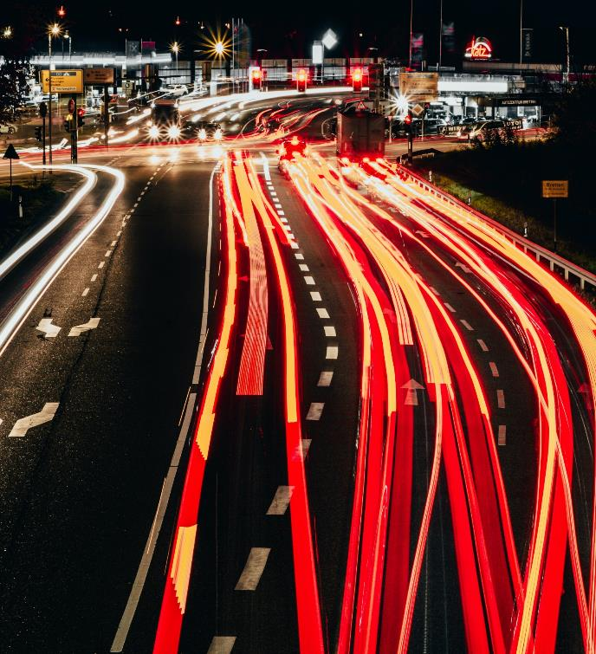
Microscopic and macroscopic flow characteristics: Capacity estimation
There are many approaches that can be applied to compute the capacity of a specific piece of infrastructure. The suitability of the approach depends on several factors, such as:
type of the infrastructure (e.g., motorway without off- or on-ramps, onramp, roundabout, unsignalized intersection, etc.)
type of data (individual vehicle data, aggregate data) and time aggregation
location of data collection (upstream of, in or downstream of the bottleneck)
traffic conditions for which data are available (congestion, no congestion)
Road traffic flow - Free image on Pexels

Slide 32
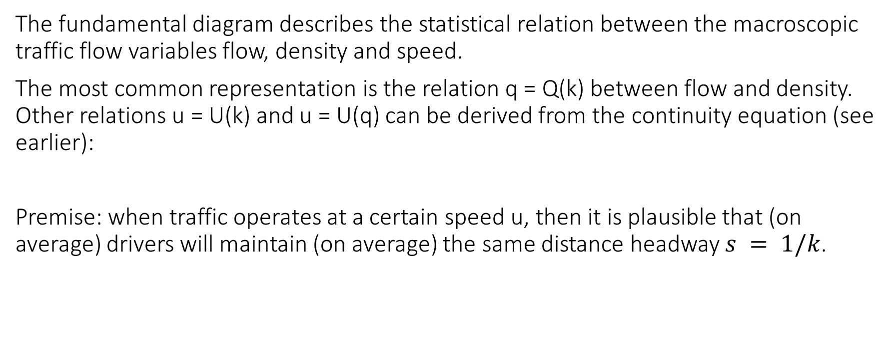
Microscopic and macroscopic flow characteristics: Fundamental diagrams
The fundamental diagram describes the statistical relation between the macroscopic traffic flow variables flow, density and speed.
The most common representation is the relation q = Q(k) between flow and density. Other relations u = U(k) and u = U(q) can be derived from the continuity equation (see earlier):
Premise: when traffic operates at a certain speed u, then it is plausible that (on average) drivers will maintain (on average) the same distance headway $s = 1/k$.
$$q=ku$$
(6)

Slide 33
Microscopic and macroscopic flow characteristics: Fundamental diagrams
Figure 7.7 Example of fundamental diagram
(Taken from Chapter 7, page 133)
The figure shows the roadway capacity C, the critical density k_{c} and the critical speed u_{c} (the density and speed occurring at capacity operations), the jam density k_{jam} (density occurring at zero speed), and the free speed u₀ can easily be derived from the figure
Large difference between the free conditions (k < k_{c}) and the congested conditions (k > k_{c}).

Slide 34
Overview chapter
Vehicle trajectories and microscopic flow variables
Macroscopic flow variables
Microscopic and macroscopic flow characteristics
Developments for the future: connected and automated vehicles
Traffic flow dynamics and self-organisation
Multi-lane traffic flow facilities (motorways)
Microscopic and macroscopic traffic flow models
Network dynamics
Bicycle traffic

Slide 35

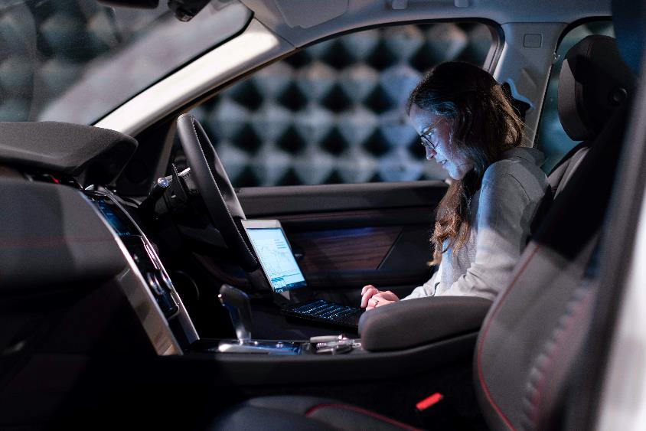
Developments for the future: connected and automated vehicles
Self driving car - Free image on Unsplash
Source: https://www.sae.org/blog/sae-j3016-update

Slide 36
Developments for the future: connected and automated vehicles
Early studies: automated vehicles were expected to strongly increase road capacity by driving closer to each other.
Recent studies: without communication, automation does not increase road capacity, because the adaptive cruise control systems keep longer time headways and break stronger than human drivers, making the traffic stream unstable.
Automated vehicles = autonomous connected vehicles may increase capacity → If a vehicle is certain that it will get a timely message before it needs to brake, it can drive closer to its predecessor.
Self driving car - Free image on Unsplash

Slide 37
Overview chapter
Vehicle trajectories and microscopic flow variables
Macroscopic flow variables
Microscopic and macroscopic flow characteristics
Developments for the future: connected and automated vehicles
Traffic flow dynamics and self-organisation
Multi-lane traffic flow facilities (motorways)
Microscopic and macroscopic traffic flow models
Network dynamics
Bicycle traffic

Slide 38
Traffic flow dynamics and self-organisation
Capacity drop: once congestion has formed, drivers are not maintaining a headway as close as before the speed breakdown → Road capacity can reduce up to 30%
Traffic hysteresis: drivers keep a different headway speed during acceleration (congestion → free flow) then during deceleration (free flow → congestion)
Figure 7.8 The capacity drop in the flow density diagram
(Taken from Chapter 7, page 136)
Figure 7.9 Average platoon length before and after disturbance
(Taken from Chapter 7, page 137)
Three phase traffic flows: there are different phases in traffic flows, with different phase transitions (e.g., from a jam with moving traffic to a stop-and-go wave)
Figure 7.10 Traffic patterns on the A4 motorway in the Netherlands
(Taken from Chapter 7, page 138)

Slide 39
Overview chapter
Vehicle trajectories and microscopic flow variables
Macroscopic flow variables
Microscopic and macroscopic flow characteristics
Developments for the future: connected and automated vehicles
Traffic flow dynamics and self-organisation
Multi-lane traffic flow facilities (motorways)
Microscopic and macroscopic traffic flow models
Network dynamics
Bicycle traffic

Slide 40

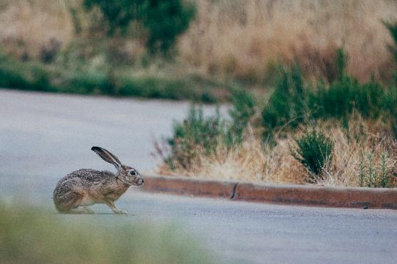
Multi-lane traffic flow (i.e., motorways)
There are differences between traffic flow on the lines of the motorway.
Daganzo (2002a, 2002b): defines the drivers as slugs, defined by their low desired speed, and rabbits, defined by their higher desired flow speed
As the speed in the right lane will go under a threshold, rabbits will move to faster lanes at the left (in right-hand driving)
Even if the density in the right lane is lower than in the left lane, the rabbits will not change towards the right lane if the speeds in the left lane are higher
This results in a ‘two-pipe regime’, with different speeds at the two different lanes
Only once increasing density in the left lane equalises the speed between with the right lane, rabbits move to the right lane.
Unbalanced lane flows are inefficient; by actively influencing land choice and lane changes, road capacity can be increased → active research field.
Brown slug on dirt field photo – Free Animal Image on Unsplash
Selective focus photo of brown and black rabbit on grey road near green grass photo – Free Hare Image on Unsplash
1) Daganzo, C. F. (2002a), ‘A behavioral theory of multi-lane traffic flow. Part I: Long homogeneous freeway sections’, Transportation Research Part B: Methodological, 36 (2), 131 – 158.
2) Daganzo, C. F. (2002b), ‘A behavioral theory of multi-lane traffic flow. Part II: Merges and the onset of congestion’, Transportation Research Part B: Methodological, 36 (2), 159 – 169.

Slide 41
Overview chapter
Vehicle trajectories and microscopic flow variables
Macroscopic flow variables
Microscopic and macroscopic flow characteristics
Developments for the future: connected and automated vehicles
Traffic flow dynamics and self-organisation
Multi-lane traffic flow facilities (motorways)
Microscopic and macroscopic traffic flow models
Network dynamics
Bicycle traffic

Slide 42
Traffic flow models
Traffic flow models are used to simulate traffic, e.g., to ex-ante evaluate the use of new infrastructure
Traffic flow models are categorized based on the following aspects (see Table below):
1. Representation of the traffic flow in terms of flows (macroscopic), groups of drivers (macroscopic), or individual drivers (microscopic)
2. Underlying behavioural theory, which can be based on characteristics of the flow (macroscopic), or individual drivers (microscopic behaviour)
Gas-kinetic and Particle models can be classified as hybrid models (neither microscopic nor macroscopic)
Table 7.1 Overview of traffic flow model classification
(Taken from Chapter 7, page 181)
Representation | Behavioural rules
 | Microscopic | Macroscopic
Vehicle-based | Microscopic flow models | Particle models
Flow-based | Gas-kinetic models | Macroscopic models

Slide 43
Microscopic traffic flow models – example 1/3
Car-following models
Pipes (1953): Safe-distance models (first car-following models)
A good rule for following vehicle i-1 at a safe distance s_{i} is to allow at least the length S₀ of a car between vehicle i and a part which is linear with the speed v_{i} at which i is travelling:
Where:
S₀ denotes the effective length of a stopped vehicle (+ some distance in front)
T_{r} denotes a parameter (comparable to the reaction time)
→ Good agreement with real-life observations
(16)
Pipes, L. (1953), ‘Car following models and the fundamental diagram of road traffic’, Transportation Research, 1, 21–29.

Slide 44

Microscopic traffic flow models – example 2/3
Car-following models
Chandler et al. (1958): Stimulus-Response models
Stimulus-response models are dynamic models that describe the acceleration of drivers as a function of changes in distance, speeds, etc., relative to the vehicle in front.
The Stimulus-Response models are based on the intuitive hypothesis that a driver’s acceleration is proportional to the relative speed v_{i–1} – v_{i}:
Where:
T_{r} denotes the overall reaction time
α denotes the sensitivity
v_{i} denotes the relative speed
$$a_{i}\left(t\right)=\frac{d}{dt}v_{i}(t)=α(v_{i−1}\left(t−T_{r}\right)−v_{i}({t−T}_{r}))$$
(17)
Chandler, R. E., R. Herman and E.W. Montroll (1958), ‘Traffic dynamics: studies in car following’, Operations Research, 6, 165-184.

Slide 45
Microscopic traffic flow models – example 3/3
Car-following models
Michaels (1963), cf. Leutzbach and Wiedemann(1986): Psycho-spacing models
In addition to finite reaction time T_{r} , considered in previous 2 models, these models consider that drivers are not able to:
Observe a stimulus lower than the given values (perception threshold)
Evaluate a situation and determine the required response precisely
Manipulate the gas a brake pedal precisely
Due to the need to distribute his attention to different tasks, a driver will generally not be permanently occupied with the car-following task
Michaels, R. (1963), ‘Perceptual factors in car following’, in Proceedings of the Second International Symposium on the Theory of Road Traffic Flow, Paris: OECD, 44-59.

Slide 46
Macroscopic traffic flow models
Now, some examples of macroscopic traffic flow models will be discussed:
Deterministic and stochastic queuing theory
Shockwave theory
Continuum traffic flow models
Table 7.1 Overview of traffic flow model classification
(Taken from Chapter 7, page 181)
Representation | Behavioural rules
 | Microscopic | Macroscopic
Vehicle-based | Microscopic flow models | Particle models
Flow-based | Gas-kinetic models | Macroscopic models

Slide 47
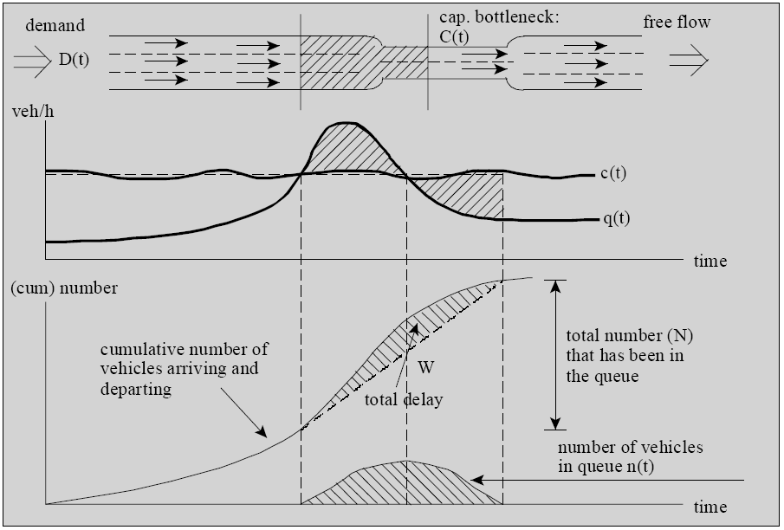
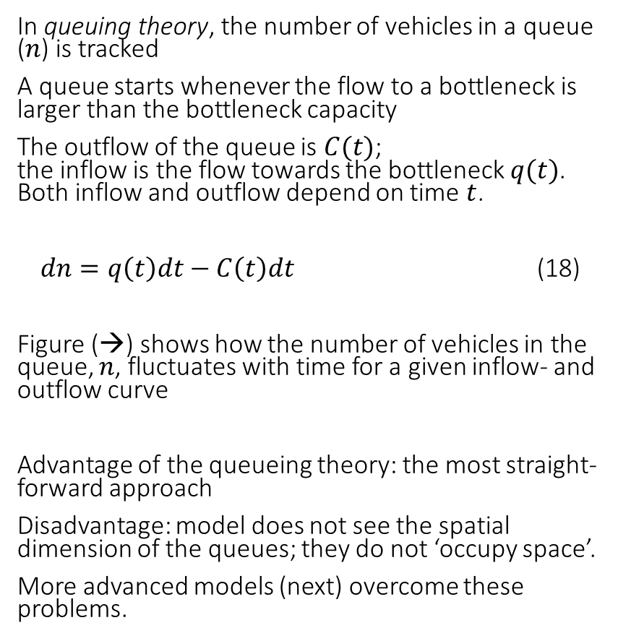
Macroscopic traffic flow models – example 1/3
Deterministic and stochastic queuing theory
In queuing theory, the number of vehicles in a queue ($n$) is tracked
A queue starts whenever the flow to a bottleneck is larger than the bottleneck capacity
The outflow of the queue is $C(t)$;
the inflow is the flow towards the bottleneck $q(t)$.
Both inflow and outflow depend on time $t$.
$dn=q\left(t\right)dt−C\left(t\right)dt$ (18)
Figure (→) shows how the number of vehicles in the queue, $n$, fluctuates with time for a given inflow- and outflow curve
Advantage of the queueing theory: the most straight-forward approach
Disadvantage: model does not see the spatial dimension of the queues; they do not ‘occupy space’.
More advanced models (next) overcome these problems.
Figure 7.11 Functioning of queuing theory
(Taken from Chapter 7, page 143)

Slide 48
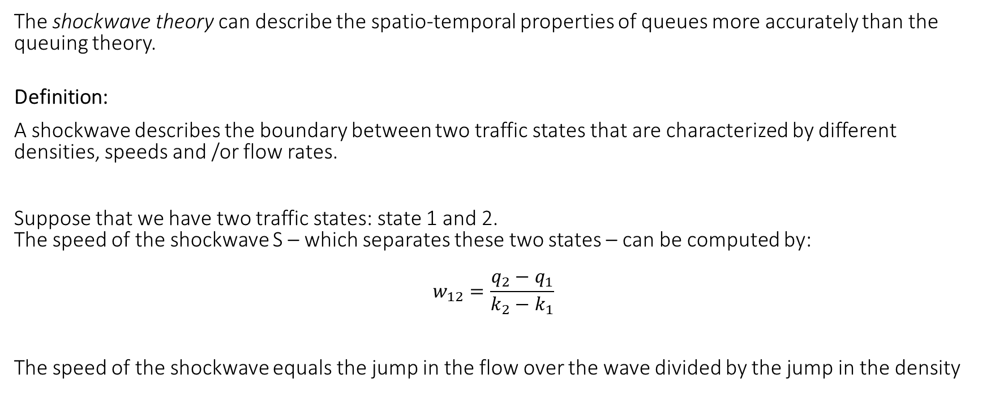
Macroscopic traffic flow models – example 2/3
Shockwave theory
The shockwave theory can describe the spatio-temporal properties of queues more accurately than the queuing theory.
Definition:
A shockwave describes the boundary between two traffic states that are characterized by different densities, speeds and /or flow rates.
Suppose that we have two traffic states: state 1 and 2.
The speed of the shockwave S – which separates these two states – can be computed by:
$$w_{12}=\frac{q_{2}−q_{1}}{k_{2}−k_{1}}$$
The speed of the shockwave equals the jump in the flow over the wave divided by the jump in the density
(19)

Slide 49
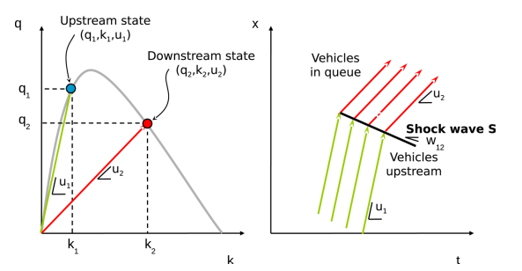
Macroscopic traffic flow models – example 2/3
Shockwave theory
Consider the line that connects the two traffic states 1 and 2 in the fundamental diagram (left side of figure →).
The slope of this line is the same as the speed of the shock in the time-space plane (right side of figure →).
Limitations of the shockwave theory:
The traffic driving away from congestion does not smoothly accelerate towards the free speed but keeps driving at the critical speed
Transition from the one state to the other occurs jump-wise, not considering the bounded acceleration characteristics of real traffic
There is no consideration of hysteresis
There is no spontaneous transitions from the one state to the other
The location of congestion occurrence is not in line with reality
Figure 7.12 Graphical interpretation of shockwave speed
(Taken from Chapter 7, page 144)

Slide 50
Macroscopic traffic flow models – example 3/3
Continuum traffic flow models
Continuum traffic flow deal with traffic flow in terms of aggregate variables, such as flow, densities and mean speeds (like in the continuity equation, see before):
The density k = k(x,t) describes the expected number of vehicles per unit length at instant t
The flow q = q(x,t) equals the expected number of vehicles flowing past cross-section x during per time unit
The speed u = u(x,t) equals the mean instantaneous speed of vehicle defined according to q=ku
Continuum flow models generally have a limited number of equations that are relatively easy to handle.

Slide 51
Overview chapter
Vehicle trajectories and microscopic flow variables
Macroscopic flow variables
Microscopic and macroscopic flow characteristics
Developments for the future: connected and automated vehicles
Traffic flow dynamics and self-organisation
Multi-lane traffic flow facilities (motorways)
Microscopic and macroscopic traffic flow models
Network dynamics
Bicycle traffic

Slide 52
Network dynamics
Analogous to the link fundamental diagram (see before), the overall dynamics of a traffic network can be described with the macroscopic or network fundamental diagram (NFD).
This diagram relates the vehicle accumulation, or average vehicle density, to the network performance.
Definition:
The network performance is the flow, weighted by the number of lanes, and the length of the roadway segment for which the measured flow is representative

Slide 53
Network dynamics
NFD (see →) contains 3 states:
Few vehicles use the network, free flow condition, low outflow
More vehicles use the network, reaching the maximum outflow (or production) – called ‘sweet spot’. This corresponds to the critical accumulation of vehicles
More vehicles (than critical accumulation) use the network, travellers experience delay. Network becomes congested.
Figure 7.13 Example Network Fundamental Diagram
(Taken from Chapter 7, page 146)

Slide 54
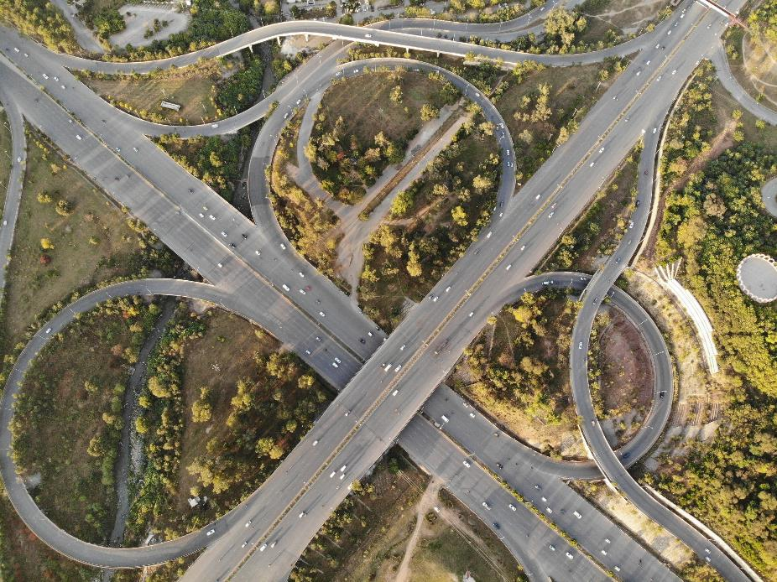
Network dynamics
The two main causes for the production deterioration of overloaded networks are:
the spill-back of queues: traffic that do not need to pass the bottleneck is affected by the queue occurring at the bottleneck
→ The congestion propagates over other links of the network, potentially causing grid-lock effects
the capacity drop: free-flow freeway capacity is considerably larger than the queue discharge rate
Busy motorway - Free image on Pexels

Slide 55
Overview chapter
Vehicle trajectories and microscopic flow variables
Macroscopic flow variables
Microscopic and macroscopic flow characteristics
Developments for the future: connected and automated vehicles
Traffic flow dynamics and self-organisation
Multi-lane traffic flow facilities (motorways)
Microscopic and macroscopic traffic flow models
Network dynamics
Bicycle traffic

Slide 56
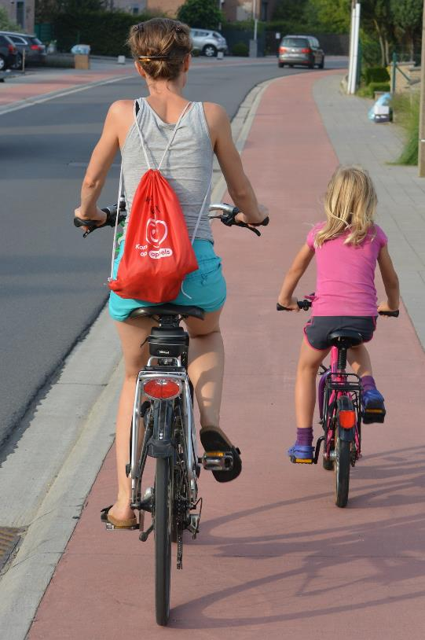
Bicycle traffic
Whereas there are many studies on the choice of travel mode, the actual description of the way people cycle operationally has not taken off until recently.
Theories and modelling tools (on a microscopic level, on a macroscopic level and on a network level) developed for car traffic are – to a certain extent – also applicable for cycling.
The main difference compared to vehicular traffic is the fact that cyclist traffic is not lane bound: cyclists (to some extent) freely choose their lateral position.
Cyclists - Free image on Pixabay

Slide 57
Bicycle traffic
On a microscopic level, Edie’s definitions (equation 10, 12 and 13) can be applied to cyclist traffic, even if it is not lane-bound
On a macroscopic level, parts of the properties of bicycle flows along a road should obey some sort of fundamental diagram, but this has not been fully confirmed with empirical or experimental data
Shockwave theory and queuing theory would be applicable for cyclist traffic:
the capacity increased linearly with the road width
the closer the people are together, the higher the flow of traffic once the traffic light turns green
Regarding the operations on the network scale (macroscopic fundamental diagram), cyclists are smaller than cars and can cross intersections next to each other → a higher fraction of cyclists would increase the maximum flow for a network

Slide 58
Summary
Traffic flow theory is crucial for designing comfortable and safe roads, solving congestion problems, and implementing effective traffic management measures
Microscopic and macroscopic traffic flow variables provide insights into individual driver behaviour and the average state of traffic flow, respectively
The fundamental diagram represents the statistical relation between flow, density, and speed
Current vehicle automation without communication does not enhance road capacity, but future developments with vehicle-to-vehicle communication hold the potential to do so

Slide 59
Summary
Traffic flow models enable simulation and ex-ante evaluation of infrastructure usage. They can be categorized based on the representation of flow (macroscopic), groups of drivers (macroscopic), or individual drivers (microscopic), as well as the underlying behavioural theory
The macroscopic or network fundamental diagram (NFD) captures the overall dynamics of a traffic network. It reveals that network performance deteriorates as the number of vehicles increases
Theories and modelling tools developed for car traffic can be partially applicable to other modes of transportation (such as cycling), extending the understanding of traffic flow beyond automobiles

Slide 60
The Transport System and Transport Policy
Edited by Bert van Wee, Jan Anne Annema, David Banister and Baiba Pudãne
Chapter 7: Traffic flow theory and modelling
Authors: Victor Knoop and Serge Hoogendoorn
Traffic jam - Free image on Unsplash

