Slide 1


The Transport System and Transport Policy
Edited by Bert van Wee, Jan Anne Annema, David Banister and Baiba Pudãne
Chapter 8: Transport technology
Author: Jan Anne Annema
Horse riding - Free image on Pexels

Slide 2

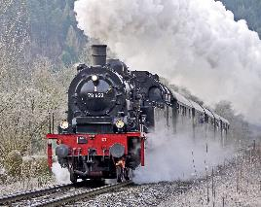
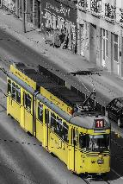
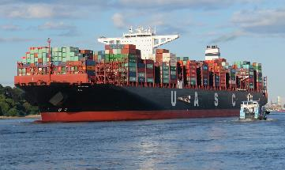
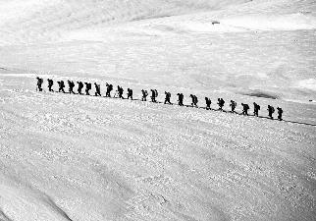
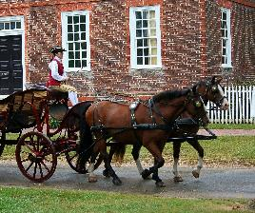
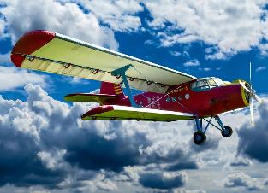

Introduction
Mobility has changed tremendously over history:
Developing new transport technologies
200 years ago
Now
What will the future bring?
Ship, Hiking, Horse carriage, Steam locomotive, Aircraft, Tram, Automobile, Container ship – Free images on Pixabay

Slide 3
Overview chapter
One of the (policy) goals of transport technologies is to reduce the negative external effects, such as environmental damage and safety risks, of the transport system.
After, we focus on three transportation revolutions that are expected (as of 2022) to be most successful in reducing the negative impacts:
1. Transport technology to solve negative impacts: A policy perspective
2. Alternative powertrains and fuels
3. Intelligent transport systems and automated vehicles
4. Sharing and new mobility services such as MaaS

Slide 4
Overview chapter
1. Transport technology to solve negative impacts: A policy perspective
2. Alternative powertrains and fuels
3. Intelligent transport systems and automated vehicles
4. Sharing and new mobility services such as MaaS

Slide 5
External costs of the transport system
Despite progress made over past decades, the transport system is not perfect
Part of table 8.1: Examples of external costs of transport which might be (partly) solved by technological innovations (Taken from Chapter 8, page 156)
Statistics and examples of external costs of the transport system
Traffic jams | Oil dependency | Climate change | Acidification and local air pollution (NOx and PM) | Traffic safety | Noise nuisance
In large cities, car travellers spend more than 100 hours in congestion in a year | Worldwide transportation is responsible for ~60% of oil consumption (McGovern et al., 2020) | In 2019, ~15% of total net anthropogenic Green House Gas (GHG) emissions worldwide came from transport (IPCC, 2022) | In Europe, transport contributes 40-50% to overall nitrogen oxides emissions and 10-15% to Particulate Matter emissions (Hoen et al., 2021) | Worldwide, ~1.35 million people are killed on roads each year (WHO, 2018) | 25% of population in Europe are exposed to road traffic noise exceeding the EU guideline limit of average 55 dB over a day (Sorensen et al., 2020)
McGovern, M., S. Heald and J. Pirie (2020), Oil Dependency in the EU, Cambridge, UK: Cambridge Econometrics.
IPCC (2022), Climate Change 2022. Mitigation of Climate Change, Summary for Policymakers, United Nations (WMO, UNEP): Intergovernmental Panel on Climate Change.
Hoen, A., D. Hilster, J. Király, J. de Vries and S. de Bruyn (2021), Air pollution and transport policies at city level Module 2: policy perspectives, Delft: CE Delft.
WHO (2018), Global Status Report on Road Safety 2018: a summary, Geneva: World Health Organisation.
Sørensen, M., T. Münzel, M. Brink, N. Roswall, J-M. Wunderli, M. Foraster (2020), ‘Chapter four - Transport, noise, and health’, in: Mark J. Nieuwenhuijsen, and H. Khreis (eds), Advances in Transportation and Health, Elsevier, pp 105-131, ISBN 9780128191361.

Slide 6
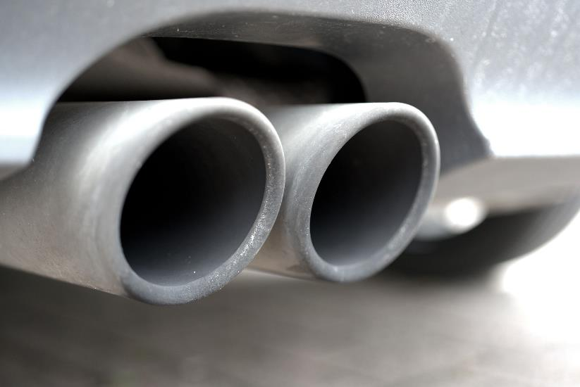
Transport technology to solve negative impacts
Some negative impacts (or: external costs) can be reduced with transport technologies
Climate change and oil dependency:
More efficient engines, hybrid cars, electric vehicles, biofuels, and hydrogen could significantly reduce GHG emissions and oil use
Acidification and local air pollution (NOx and PM): Cleaner fossil fuel-based vehicles and alternative powertrains and fuels can reduce emissions
Exhaust car - Free image on Pixabay

Slide 7
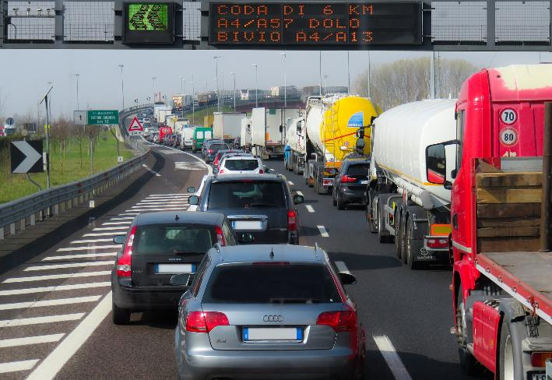
Transport technology to solve negative impacts
But technology is not always the answer:
Traffic jams: without transport policies an increase in traffic jams in urbanized areas is to be expected
Traffic safety: from 2013 to 2016, the number of traffic deaths increased in 104 countries, even given the increased safety of cars with technology like Electronic Stability Control (WHO, 2018)
Noise Nuisance: noise barriers, quieter tires, quieter planes, low-noise road surfaces are not enough to beat the volume growth of air and road traffic
Traffic jam - Free image on Pixabay
WHO (2018), Global Status Report on Road Safety 2018: a summary, Geneva: World Health Organisation.c

Slide 8
Why do we have an imperfect transport system? Evolutionary economics
Gasoline and diesel vehicles turned out to be the ‘fittest’ in the early days of car transport, winning electric-powered vehicles, steam-powered carriages and trains.
According to evolutionary economics:
All actors are assumed to have bounded rationality (Simon, 1957), resulting in heterogeneity in behavioural strategies
Serendipity plays an important role in explaining the innovation process, as a combination of chance, luck, and knowledge can lead to the invention of new solutions
Knowledge waste in the form of trial-and-error and cul-de-sacs is necessary to arrive at "fit" technologies, which are successful and sustainable in the long run
The fitness of a new technological alternative is determined by the processes of innovation and selection working together
Simon, H. A. (1957), Models of Man, New York: John Wiley.

Slide 9
Path dependency, lock-in and co-evolution
Three relevant concepts from evolutionary economics :
Path dependency: economies of scale can lead to dominance of a technology: the more a specific technology is used and produced, the lower its cost. E.g., using large car factories to the full capacity reduces the average cost of a car.
Lock-in: a consequence of path dependency is that the society becomes ‘locked in’ a technology being unable to replace it. This is even if the technology (such as internal combustion engine fuelled by oil products) has negative externalities.
Co-evolution: partial systems (e.g., cars, road and fuel network) develop together resulting in benefits for the users. However, this co-evolution can also reinforce the negative effects.

Slide 10
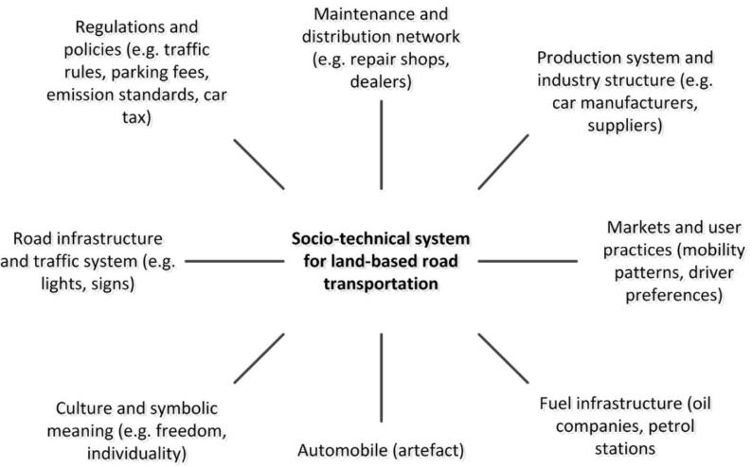

Socio-technical system
Co-evolution leads to interrelated entities and embeddedness of socio-technical system.
Socio-technical system for road transport (Geels, 2005)
(Figure taken from Chapter 8, page 158)
Green leafed plants on gray concrete brick wall photo – Free Japan Image on Unsplash
Geels, F. (2005), Technological Transitions and System Innovations: A Co-Evolutionary and Socio- Technical Analysis, Cheltenham, UK and Northampton, MA, USA: Edward Elgar.

Slide 11
System innovations or transitions: MLP
System innovation is a transition from one socio-technical system to another, potentially characterized by a technological change.
Multi-level perspective (MLP) (Geels, 2002) explains such transitions
changed socio-technical system
existing socio-technical system
Multi-level model of system innovations (Geels, 2002)
(Taken from Chapter 8, page 159)
Geels, F.W. (2002), ‘Technological transitions as evolutionary reconfiguration processes: a multi- level perspective and a case-study’, Research Policy, 31, 1257–1274.

Slide 12
System innovations or transitions: MLP
Three levels of the multi-level model of system innovations:
Landscape developments
These are ‘deep structural trends external to the regime’ (Geels, 2002): economic growth, culture, demographical changes, COVID-19. May help or oppose a technical niche.
Socio-technical regimes
This level is stable, and innovations will not happen here, socio-technical systems are locked-in
Technological niches
Niches (small arrows) ‘act as incubation rooms for radical innovations nurturing their early development’ (Geels, 2002): R&D projects, pilot programmes, etc.
Multi-level model of system innovations (Geels, 2002)
(Taken from Chapter 8, page 159)
Geels, F.W. (2002), ‘Technological transitions as evolutionary reconfiguration processes: a multi- level perspective and a case-study’, Research Policy, 31, 1257–1274.

Slide 13
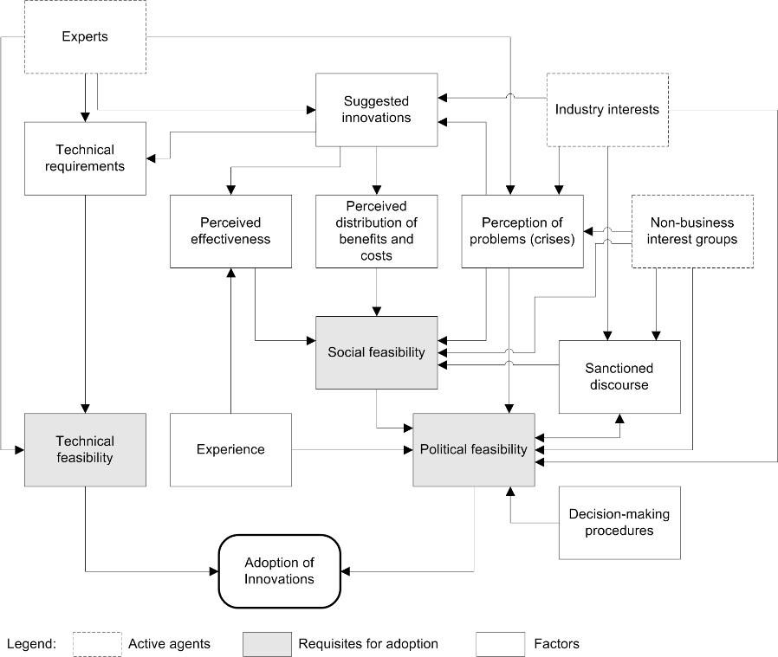
A political-economy model
What is the role of public authorities in (transport) system innovations?
Political-economy framework by Feitelson and Salomon (2004) →
The perception of problems is an important factor in the successful adoption of new technology: oil crises, traffic casualties have spurred technical changes in transport.
Experts such as scientists, advisers and consultants suggest technical innovations and the means to implement them.
A political-economy model for explaining the adoption of innovations (Feitelson and Salomon, 2004)
(Taken from Chapter 8, page 12)
Feitelson, E. and I. Salomon (2004), ‘The political economy of transport innovations’, in M. Beuthe, V. Himanen, A. Reggiani and L. Zamparini (eds), Transport Developments and Innovations in an Evolving World, Berlin: Springer

Slide 14
A political-economy model
Most important: adoption of innovations is predicated on the economic, social, political and technical feasibility
Only a combination of these feasibility factors will result in successful innovation
Strong position for the defenders of the current socio-technical regime.
E.g., European automobile industry accounts for 8.5% of EU manufacturing employment.
A political-economy model for explaining the adoption of innovations (Feitelson and Salomon, 2004)
(Taken from Chapter 8, page 12)
Feitelson, E. and I. Salomon (2004), ‘The political economy of transport innovations’, in M. Beuthe, V. Himanen, A. Reggiani and L. Zamparini (eds), Transport Developments and Innovations in an Evolving World, Berlin: Springer

Slide 15
Overview chapter
1. Transport technology to solve negative impacts: A policy perspective
2. Alternative powertrains and fuels
3. Intelligent transport systems and automated vehicles
4. Sharing and new mobility services such as MaaS

Slide 16
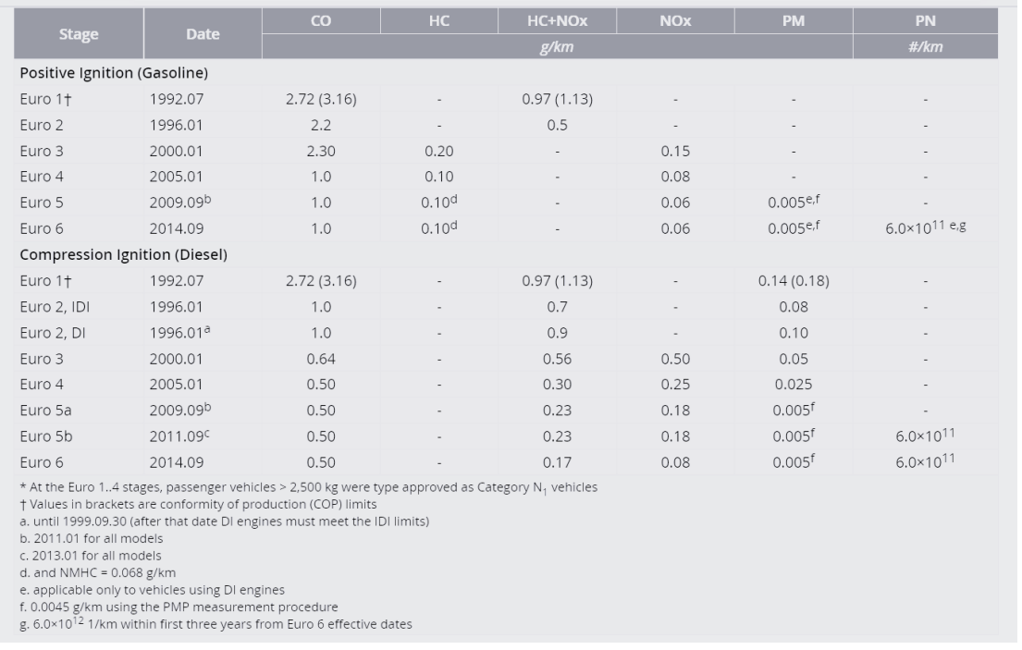
Alternative powertrains and fuels
Table 8.2 EU air pollutant emission standards for passengers cars (Taken from Chapter 8, page 207)
CO = carbon monoxide; HC = hydrocarbons; NOx = nitrogen oxides; PM = particulate matter (in weight); PN = particulate matter in number of particles
Emissions from fossil fuel-based vehicles have decreased considerably in the past, thanks to ever stricter regulations →

Slide 17
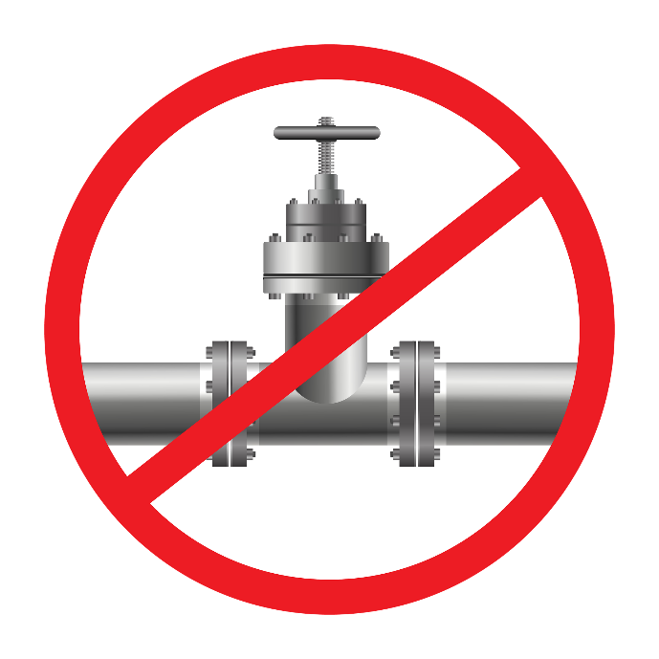
Alternative powertrains and fuels
But, fossil-free technologies are still considered the way forward (IPCC, 2022), despite the achieved reductions.
Stop ban gas pipeline - Free image on Pixabay
IPCC (2022), Climate Change 2022. Mitigation of Climate Change, Summary for Policymakers, United Nations (WMO, UNEP): Intergovernmental Panel on Climate Change

Slide 18
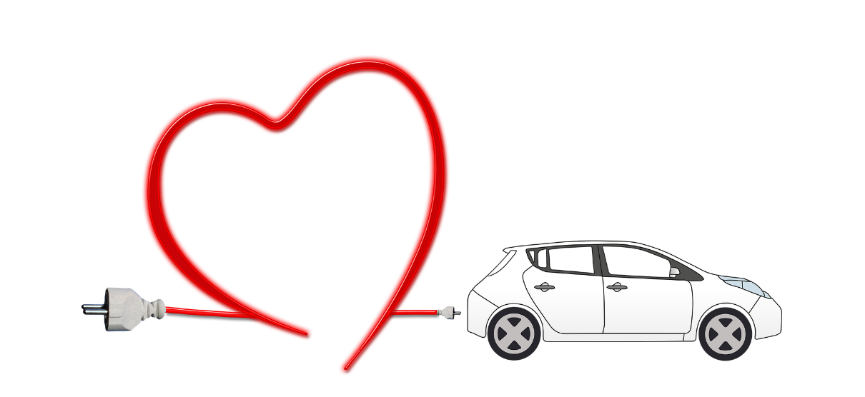
Alternative powertrains and fuels: Cars and vans
Electrification of cars = instead of burning fossil fuel products in an Internal Combustion Engine (ICE) to produce the propulsion energy for the vehicles, electricity is used in an electromotor
No direct emissions take place in that way
Production of electricity and electric vehicle components still create emissions (see Life Cycle Analysis further)
Electric-car-heart-environment - Free image on Pixabay

Slide 19


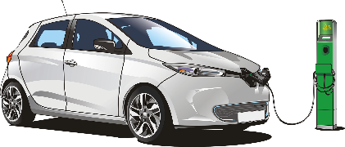
Alternative powertrains and fuels: Cars and vans
There are different types of electric vehicles:
Battery Electric Vehicles contain a battery that has to be charged using an outside electricity source
(Plug-in) Hybrid electric vehicles use an electromotor that is combined with an ICE
Fuel Cell Electric Vehicles generate electricity in a fuel cell by using compressed hydrogen and oxygen from the air
Electric car - Free image on Pixabay
Hybrid electricity + fuel - Free image on Pixabay
Hydrogen - Free image on Pixabay

Slide 20
Alternative powertrains and fuels: Cars and vans
The sales of electric vehicles is mainly policy driven because consumers:
cannot afford electric vehicles because they are more expensive,
have range anxiety because there is a lack in charging infrastructure
have more intangible barriers related to emotions: e.g., ‘lack of fun’ , ‘no cool noise’
Without government support, this technology would probably be adopted very slowly
Governments are interested and committed to decreasing CO2 emissions largely due to international agreements.

Slide 21
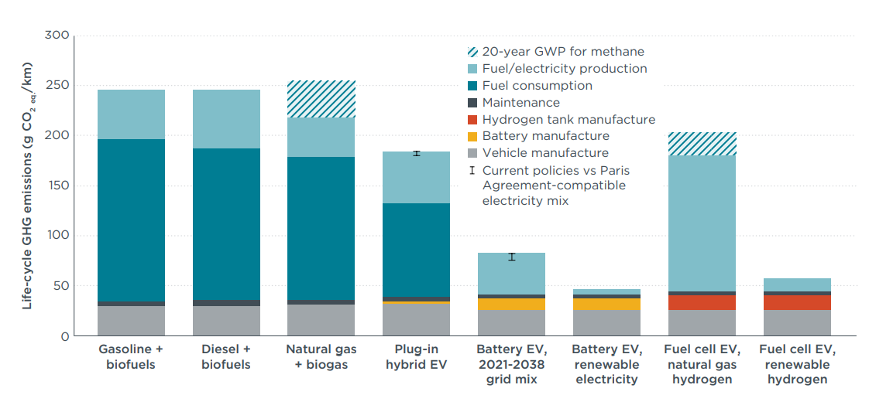
Alternative powertrains and fuels: Cars and vans
Life Cycle Analysis (LCA) of emissions needed to motivate transition to new technologies:
CO₂ during use + CO₂ production of vehicles and fuel + CO₂ end-of-life treatment of vehicles (not considered ↓) + …
Plug-in hybrids, EVs, and fuel cell EVs perform better, but improvement strongly depends on how electricity and hydrogen are produced
Conventional vehicles have highest life-cycle emissions
Life-cycle GHG emissions of lower medium segment cars (e.g., Ford Focus) with different technologies registered in Europe in 2021
(Taken from Chapter 8, page 165)
Bieker, G. (2021), A Global Comparison of the Life-Cycle Greenhouse Gas Emissions of Combustion Engine and Electric Passenger Cars, Berlin: ICCT – International Council on Clean Transportation Europe

Slide 22
Alternative powertrains and fuels: HDV
For Heavy Duty Vehicles (HDVs: trucks and lorries), many alternative fuels are studied (Kluschke et al., 2019):
Liquid petroleum gas
Liquid natural gas
Compressed natural gas
Electric methane
Electric Synfuel
Biofuels
Also, different electrified powertrains are considered:
Catenary
Battery-electric
Hybrid
Fuel-cell electricity
→ Which one (or several) will break through in the sociotechnical regime of HDVs is unknown.
Kluschke, P., T. Gnann, P. Plötz and M. Wietschel (2019), ‘Market diffusion of alternative fuels and powertrains in heavy-duty vehicles: A literature review’, Energy Reports, 5, 1010-1024.

Slide 23
Overview chapter
1. Transport technology to solve negative impacts: A policy perspective
2. Alternative powertrains and fuels
3. Intelligent transport systems and automated vehicles
4. Sharing and new mobility services such as MaaS

Slide 24
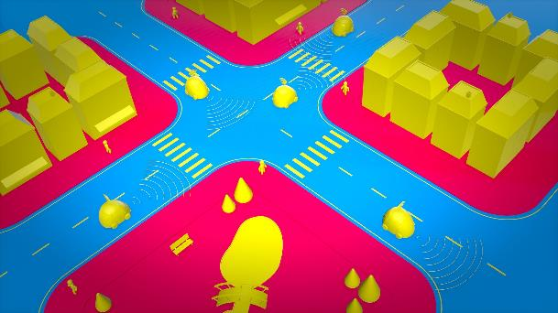
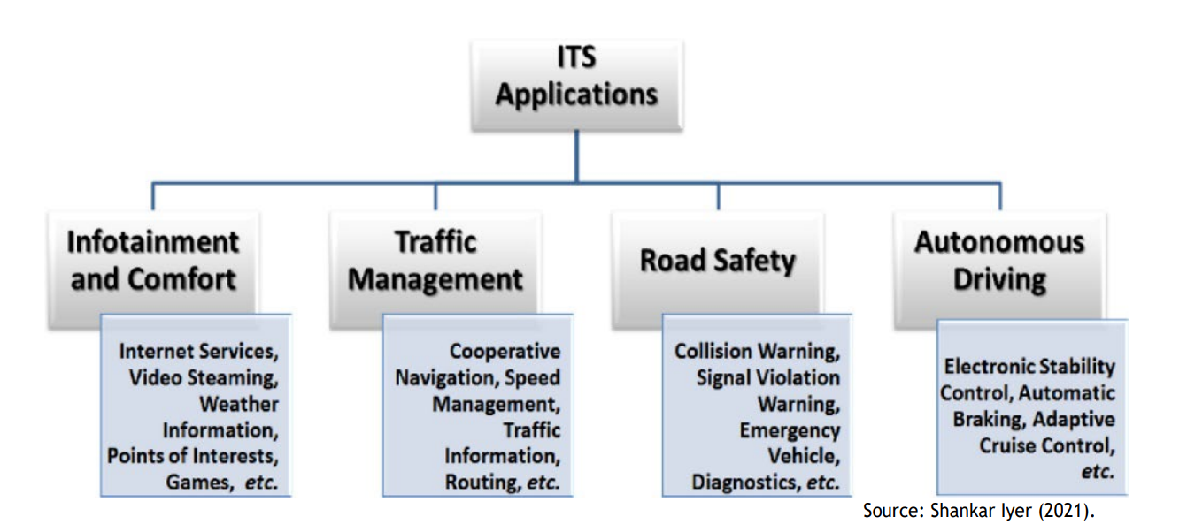
Intelligent Transport Systems (ITS)
Intelligent Transport Systems (ITS) generate a large amount of data from users and infrastructure
Their implementation aims not only to reduce transport externalities (in, e.g., environment and safety) but also to make driving accessible and comfortable for all.
Automobile 3d self-driving - Free image on Pixabay
An overview of ITS application
(Taken from Chapter 8, page 215)
Shankar Iyer, L. (2021), ‘AI enabled applications towards intelligent transportation’, Transportation Engineering, 5, 100083

Slide 25
ITS: Road safety
Advanced driver assistance systems (ADAS) are one category of ITS that promote traffic safety
This includes:
Lane departure warning systems
Automatic and adaptive cruise control systems
Monitoring and warning systems for driver vigilance
Night vision
Intelligent Speed
Assistance (ISA)
An overview of ITS application
(Taken from Chapter 8, page 169)
Shankar Iyer, L. (2021), ‘AI enabled applications towards intelligent transportation’, Transportation Engineering, 5, 100083

Slide 26
ITS: Road safety and Intelligent Speed Adaptation
From May 2022, Intelligent Speed Adaptation (ISA) needs to be fitted on all new vehicles in the EU.
The ISA-equipped vehicle has information on the speed limits for the road along which it is travelling → if the driver exceeds the maximum speed, the system intervenes.
The intervention can have different forms of which actively preventing drivers from exceeding the speed limit is the strongest intervention.
The European Commission has adopted a weaker intervention: ‘Cascade Auditory Warning System’, which only warns if the vehicle is well over the speed limit. It has ~25% of life- and injury-saving potential (Carsten, 2021).
Cartsen, O. (2021), Vehicle safety – technical rules & test procedures for intelligent speed assistance, Feedback from: University of Leeds (europa.eu), https://ec.europa.eu/info/law/better-regulation/have-your-say/initiatives/12222-Vehicle-safety-technical-rules-&-test-procedures-for-intelligent-speed-assistance/F2256609_en (site accessed January 2022)

Slide 27
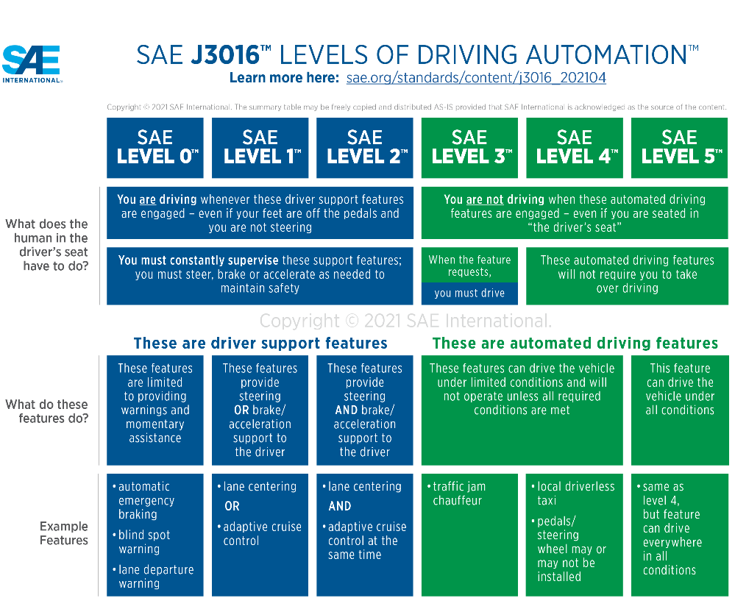
ITS: Autonomous driving
Fully automated driving (SAE Level 5) would transform the transportation socio-technical system
Automation is already extensively used in modern marine vessels and aeroplanes (i.e., autopilot) and in train travel (CBTB: communications-based train control).
Implementation on the road (in ‘mixed traffic’) is much more challenging.
Source: https://www.sae.org/blog/sae-j3016-update
Shankar Iyer, L. (2021), ‘AI enabled applications towards intelligent transportation’, Transportation Engineering, 5, 100083

Slide 28
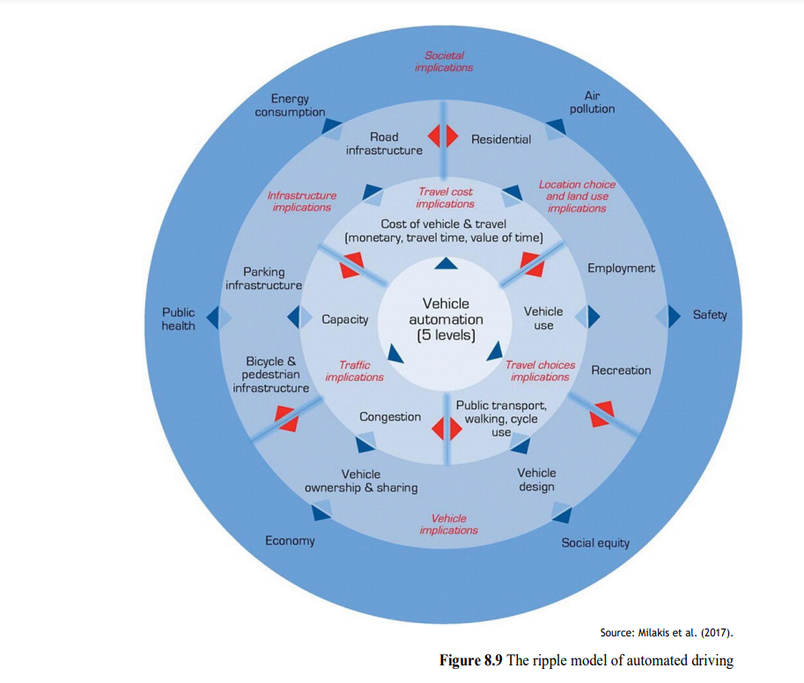
ITS: Autonomous driving
Vehicle automation would have wide policy and society-related implications, starting from more immediate to further ‘ripples’ (Milakis et al., 2017)→
First-order impacts: travel resistance, road capacity, and travel choices
Second-order impacts: vehicle ownership and sharing, locations choices and land use, and transport infrastructure
Third-order impacts on society: economy, public health, etc.
It it is not known if in the long-term automated
driving will increase or decrease transport externalities.
Main concern: automated driving may increase travel demand.
Milakis, D., B. van Arem and B. van Wee, B (2017), ‘Policy and society related implications of automated driving: A review of literature and directions for future research’, Journal of Intelligent Transportation Systems, 21(4), 324-348
The ripple model of automated driving
(Taken from Chapter 8, page 171)

Slide 29
Overview chapter
1. Transport technology to solve negative impacts: A policy perspective
2. Alternative powertrains and fuels
3. Intelligent transport systems and automated vehicles
4. Sharing and new mobility services such as MaaS

Slide 30

Sharing & new mobility services
Increasing vehicle sharing is an important change in the transport socio-technical regime where private ownership has been dominant
Various vehicle sharing systems are (being) developed: (e-)car-sharing, bike sharing, (kick) scooter sharing, … (Ataç et al., 2021)
ICT plays an important role in sharing services → software or apps are needed for ticketing and reservations, opening the car, ‘geofencing’.
Sharing systems not only decrease externalities, but also can be profitable for entrepreneurs and can improve accessibility for its users
Car sharing - Free image on Pexels
Ataç, S., N. Obrenović and M. Bierlaire (2021), ‘Vehicle sharing systems: A review and a holistic management framework’, EURO Journal on Transportation and Logistics, 10, 100033.

Slide 31
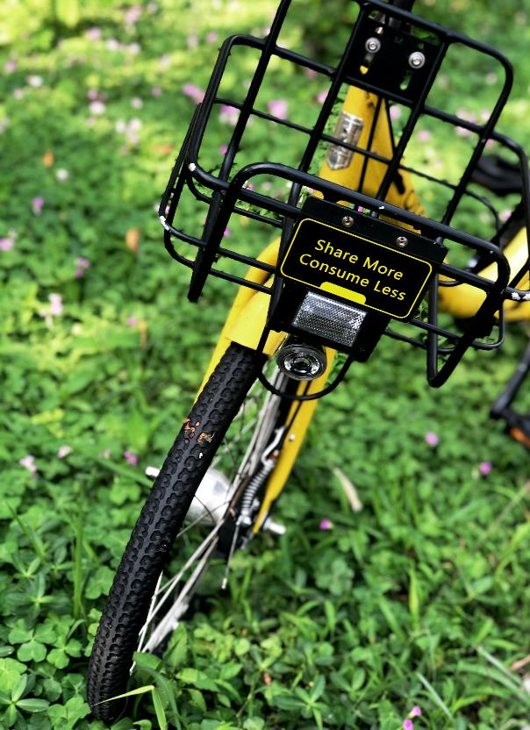
Sharing & new mobility services
Car-sharing has some potential to decrease car use and ownership externalities such as emission and use of public space
But, bike sharing tends to replace other sustainable modes like public transport and walking
→ New trips generated by bike sharing might have positive health impacts (Teixeira et al., 2021)
Bike sharing - Free image on Unsplash
Teixeira, J.P., C. Silva and e Sá, F/.Moura (2021), ‘Empirical evidence on the impacts of bikesharing: a literature review’, Transport Reviews, 41(3), 329-351.

Slide 32
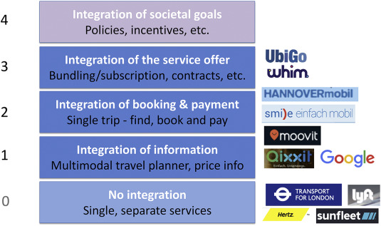
Sharing & new mobility services: MaaS
Mobility as a Service (MaaS) is an integrated system that allows travellers to plan, book, and pay for complete tips through a single online interface as opposed to organising the trip in stages (e.g., first buy a train ticket, then rent a bike, etc.).
Like with vehicle automation, there are different levels of MaaS:
MaaS could promote sustainable transportation modes and reduce transport externalities.
However, MaaS could also replace current public transport and active trips with less sustainable vehicle sharing options.
Sochor, J. Arby, H., Karlsson, M., Sarasini, S. (2017), A topological approach to Mobility as a Service: A proposed tool for understanding requirements and effects, and for aiding the integration of societal goals, 1st International Conference on Mobility as a Service (ICOMaaS), Tampere, Finland, November 28-29, 2017,

Slide 33
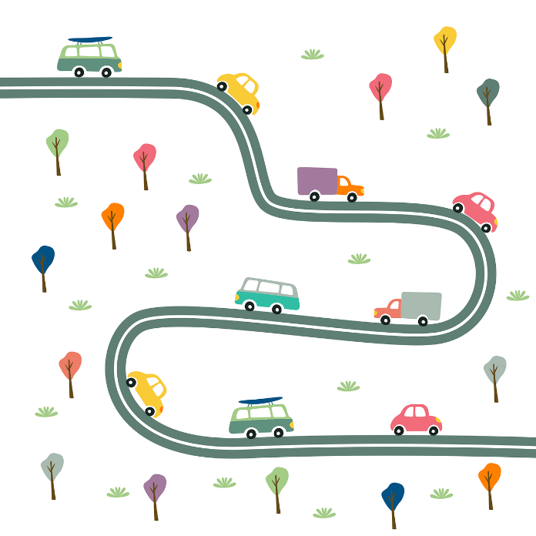
Conclusions
Changing the dominant transportation technology is challenging due to ‘lock-in’ and embeddedness of transport technology in society in terms of physical infrastructure, institutions, markets, and culture.
Innovations that may change socio-technical systems of transport are alternative powertrains and fuels, automated driving, and sharing.
Their success is uncertain, and active government policies are needed to achieve sustainability goals.
Cars-road-street-transportation - Free image on Pixabay

Slide 34
Conclusions
For alternative powertrains and fuels, life cycle analysis gives the full CO₂ impacts.
For automated driving on the road, the long-term societal impacts are not known because it is unclear to what extent these vehicles will increase transport volumes.
Vehicle sharing systems might have positive societal impacts but can also substitute active modes and public transport
Cars-road-street-transportation - Free image on Pixabay

Slide 35
The Transport System and Transport Policy
Edited by Bert van Wee, Jan Anne Annema, David Banister and Baiba Pudãne
Chapter 8: Transport technology
Author: Jan Anne Annema
Horse riding - Free image on Pexels

