Slide 1
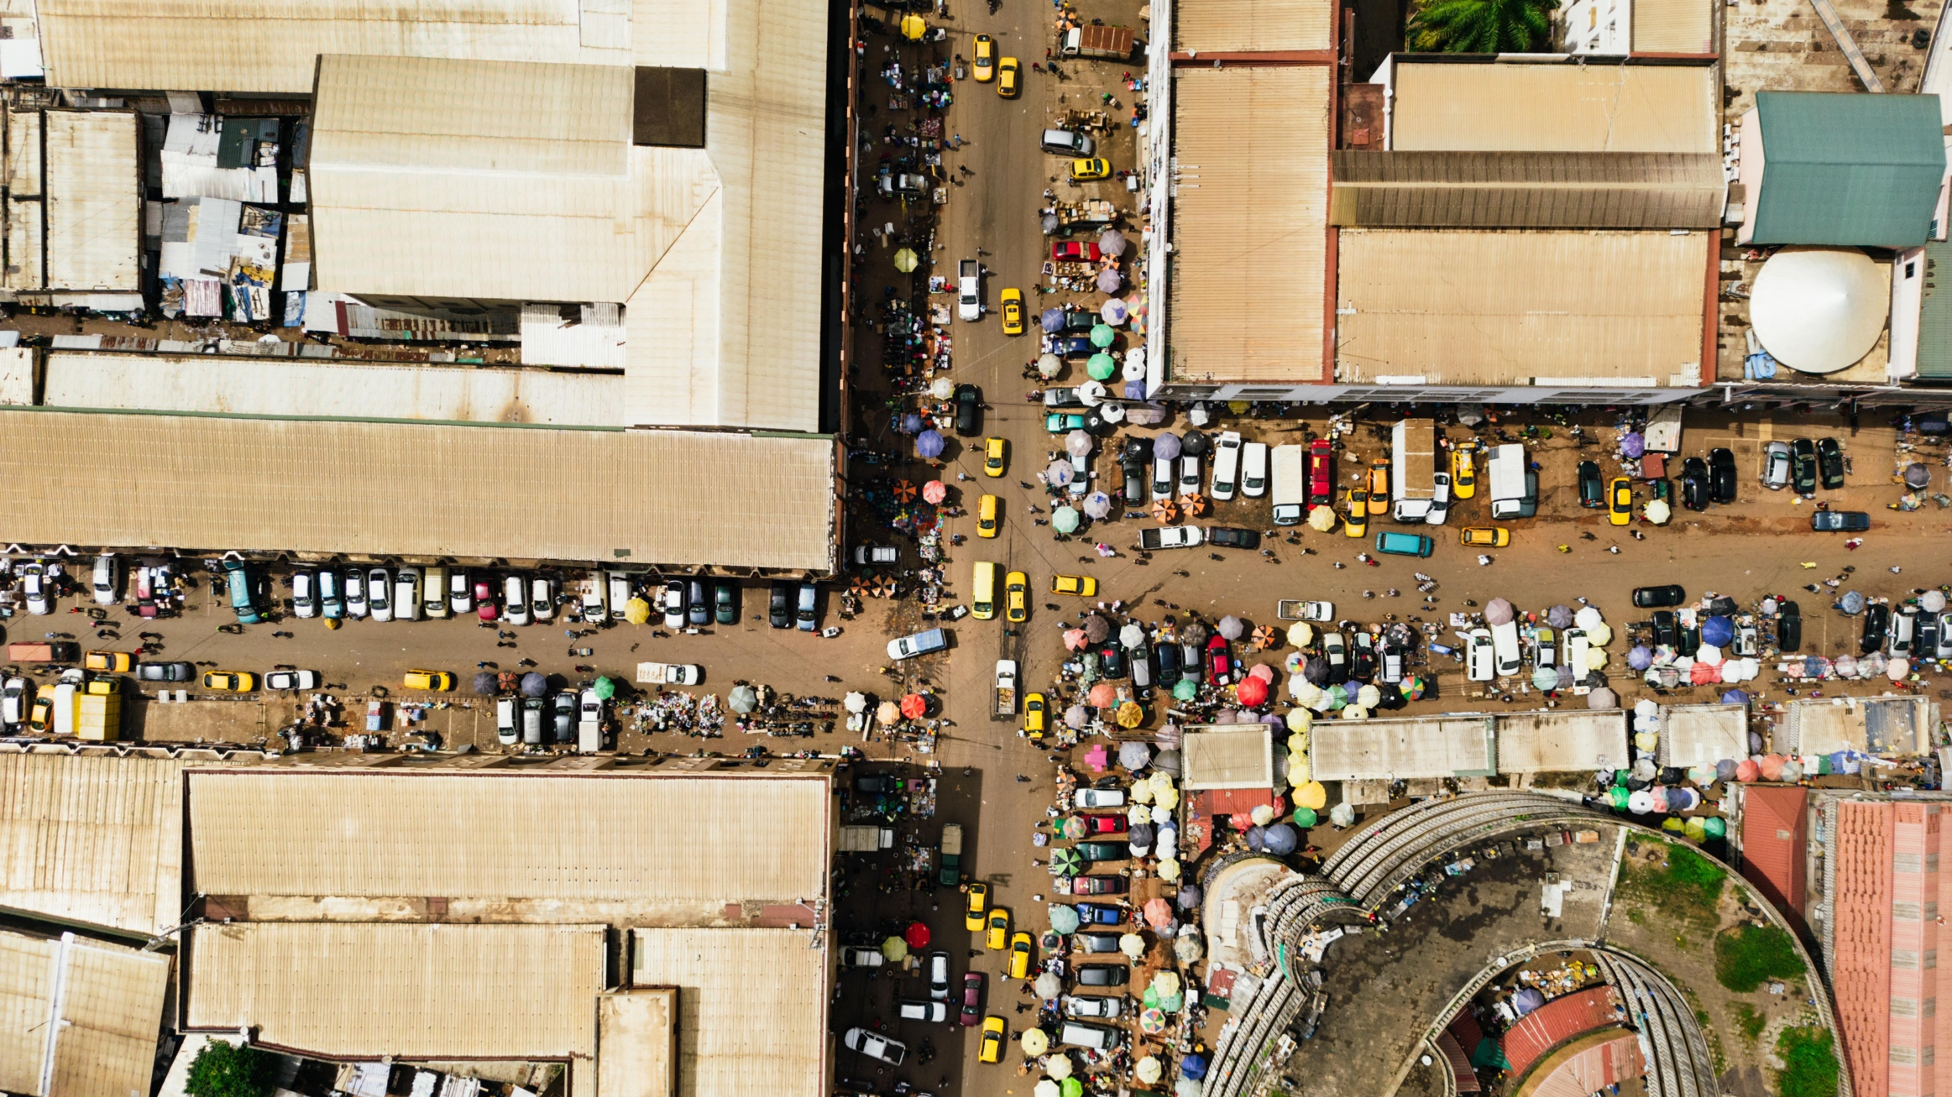
The Transport System and Transport Policy
Edited by Bert van Wee, Jan Anne Annema, David Banister and Baiba Pudãne
Chapter 11: Traffic safety
Authors: Fred Wegman and Paul Schepers
Busy crossover - Free image on Pexels

Slide 2
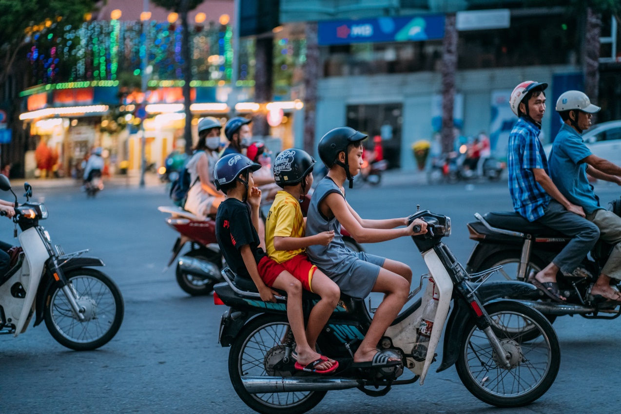
Introduction
The number of road crashes, fatalities and injuries is considered unacceptably high in many countries.
Road traffic injury is the leading cause of death for children and young adults aged 5 – 29 years (WHO, 2018).
Risks with other transport modes – train, plane, ferry – are far lower, although these attract more public attention when accidents happen.
This chapter introduces basic concepts in road safety, discusses recent traffic safety developments and options to further reduce the number of crashes and injuries.
World Health Organization (2018), Global Status Report on Road Safety 2018, Geneva: WHO
Man in yellow shirt riding motorcycle with woman in yellow shirt photo – Free Saigon Image on Unsplash

Slide 3
Overview chapter
Risk factors in traffic
‘Unintentional errors’ or ‘intentional violations’?
Risks for transport modes, age groups and road types
Measuring safety and danger
Developments in improving road safety
Shifts in road safety paradigms
Vulnerable road users
Promising options for further improving road safety
Conclusions

Slide 4
Overview chapter
Risk factors in traffic
‘Unintentional errors’ or ‘intentional violations’?
Risks for transport modes, age groups and road types
Measuring safety and danger
Developments in improving road safety
Shifts in road safety paradigms
Vulnerable road users
Promising options for further improving road safety
Conclusions

Slide 5
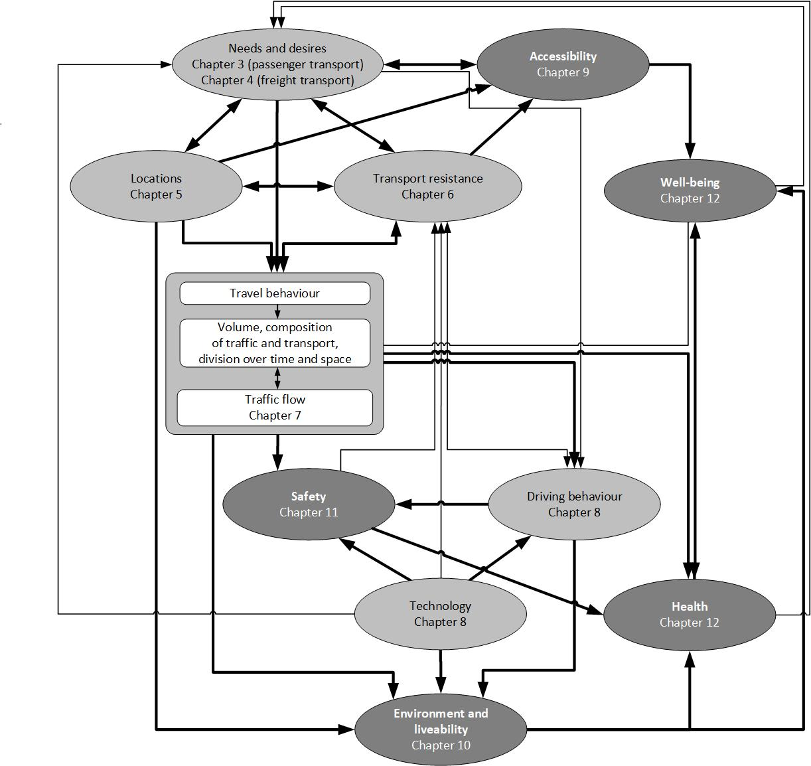
Risk factors in traffic
Three major sources of risks (see →):
Volume, modal split, and composition of traffic: high traffic volume, mix of passenger and goods vehicles, influence of traffic jams, distribution over different road types
Driving behaviour: speed, acceleration and deceleration behaviour, and reaction time
Technology: vehicle design and safety-enhancing technologies (see also ch. 8), use of other technology (such as mobile devices) during travel

Slide 6
Fundamental risk factors
Fundamental risks are inherent to road traffic. → it is unavoidable that road traffic involves combination of vulnerable bodies, high speed and large masses (of vehicles). This combination is inherently dangerous.
Speed (Elvik et al., 2019):
Higher speeds increase the risk and severity of crashes:
Speed increase by 1% increases the number of fatalities by 5.6% and the number of injury accidents by 3.9%
Both exponential and power models well describe the relationship:
Exponential: $Y_{1}/Y_{0}=\exp\left(β\left(v_{1}−v_{0}\right)\right)$ (absolute difference between speeds matter)
Power: $Y_{1}/Y_{0}={\left(v_{1}/v_{0}\right)}^{α}−1$ (relative difference between speeds matter)
$Y$ – number of (fatal/injury) accidents before ($Y_{0}$) and after ($Y_{1}$) speed change
$v$ – speeds before ($v_{0}$) and after ($v_{1}$)
$α, β$ – constants that are estimated based on data
Elvik, R., A. Vadeby, T.Hels and I. van Schagen (2019), ‘Updated estimates of the relationship between speed and road safety at the aggregate and individual levels’, Accident Analysis and Prevention, 123, 114-122

Slide 7
Fundamental risk factors
Speed variance:
Driving at a different speed than other traffic participants increases the risk
Risk of speeding drivers is much greater than the risk decrease of slow drivers
Mass differences:
Unequal mass between colliding parties is a fundamental risk factor
Lighter parties (smaller cars, cyclists, pedestrians) are at a disadvantage, as they absorb more kinetic energy and have less protection
Heavier vehicles generally offer better protection to their occupants
Mass ratio between colliding objects can be as high as 300 (for a pedestrian and heavy goods vehicle)

Slide 8
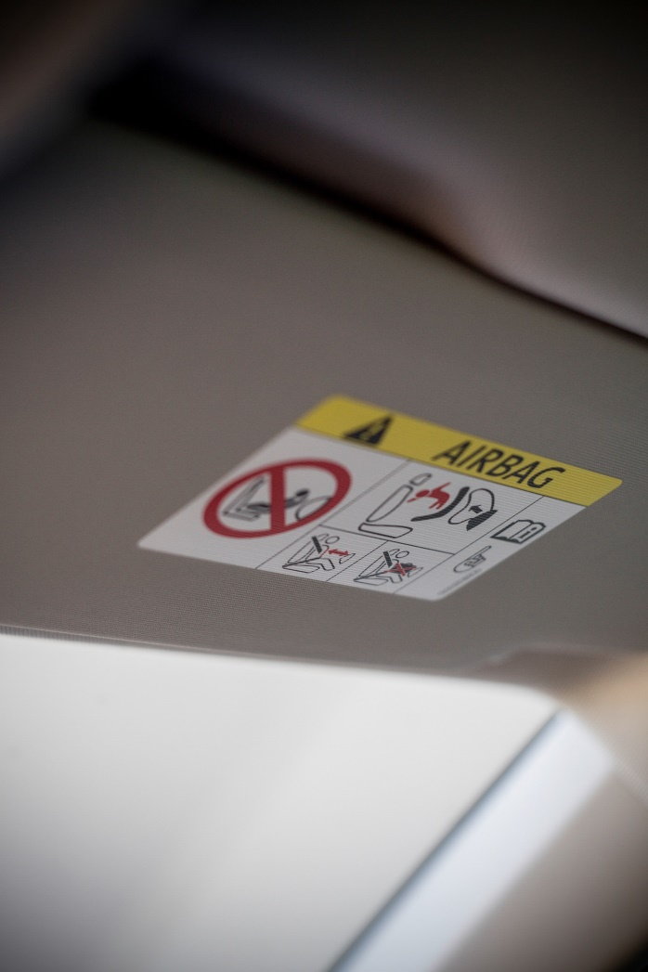
Fundamental risk factors
Vulnerability:
Human bodies are vulnerable.*
Crashworthiness improvements in vehicle design have been made to protect car occupants
Seat belts and air bags reduce the risk of fatalities and injuries by >50% (Glassbrenner and Starnes, 2009)
Vulnerable road users (VRU)* have almost no means to protect themselves from injury in a crash
Modern car designs aim to incorporate safety features to make them safer for VRU in crash
*Pedestrians, cyclists, moped riders, motorcyclists, e-scooter users, etc. are called Vulnerable Road Users (VRU)
Airbag car - Free image on Pexels
Glassbrenner, D. and M. Starnes (2009), Lives Saved Calculations for Seat Belts and Frontal Airbags, Washington, DC: National Highway Traffic Safety Administration.

Slide 9
Risk increasing factors
In addition to the fundamental risk factors, risk-increasing factors are
Lack of driving experience:
Driving experience is correlated with age ➔ difficult to separate the effects
Male novice drivers have ~10 times higher risk; female - ~2.5 times higher risk than experienced drivers (both male and female)
Psycho-active substances (alcohol and drugs):
Blood alcohol content exponentially increases the crash risk in traffic
Combined use of alcohol and drugs can lead to risk increases by factor of 200
Roadside surveys show a reduction of drunk driving, while use of non-alcohol drugs increases

Slide 10
Risk increasing factors
Fatigue:
Fatigue affects the general ability to drive (e.g., keeping course), reaction time and motivation to comply with traffic rules
Distraction:
Talking and texting on the mobile phone while driving or cycling are common causes
Risk increases the most if eyes are directed away from the road
Crash risk impacts of fatigue and distraction are both likely underestimated in police reports
Man holding black smartphone photo – Free Car Image on Unsplash

Slide 11
Overview chapter
Risk factors in traffic
‘Unintentional errors’ or ‘intentional violations’?
Risks for transport modes, age groups and road types
Measuring safety and danger
Developments in improving road safety
Shifts in road safety paradigms
Vulnerable road users
Promising options for further improving road safety
Conclusions

Slide 12
‘Unintentional errors’ or ‘intentional violations’?
Knowing the true cause could help to identify the countermeasure.
However: the significance of unintentional errors vs intentional violations in causing crashes remain unclear.
A Canadian study found a strong association between violations and crash involvement (Redelmeier et al., 2003):
Drivers convicted of causing fatal crashes had a lower chance of being involved in a fatal crash in the first month after the penalty, attributed to reduced violations during that period
This effect diminished over time and disappeared after three to four months
The findings do not establish causality between the two phenomena
Error - Free image on Pixabay
Redelmeier, D.A., R.J. Tibshirani and L. Evans (2003), ‘Traffic-law enforcement and risk of death from motor-vehicle crashes: case-crossover study’, The Lancet, 361 (9376), 2177–2182.

Slide 13
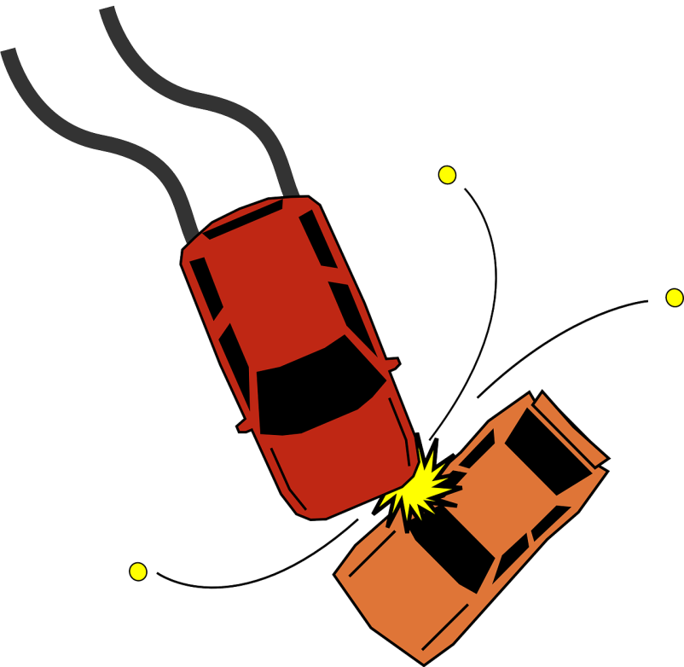
‘Unintentional errors’ or ‘intentional violations’?
Challenges in determining crash causation:
Police registration forms are not reliable: aim to identify the guilty party not to precisely identify the cause of crash
(who would tell the police that cigarette fell on the floor and the driver was trying to retrieve it?)
Intentional violations increase the risk of unintentional errors
Intentional violations are dangerous also because other road users can fail to react appropriately
Crash is usually a result of a combination of factors
Role of unintentional error seems to be the more important one
Accident collision crash - Free image on Pixabay
Both errors and violations should be considered in road safety policies

Slide 14
Overview chapter
Risk factors in traffic
‘Unintentional errors’ or ‘intentional violations’?
Risks for transport modes, age groups and road types
Measuring safety and danger
Developments in improving road safety
Shifts in road safety paradigms
Vulnerable road users
Promising options for further improving road safety
Conclusions

Slide 15
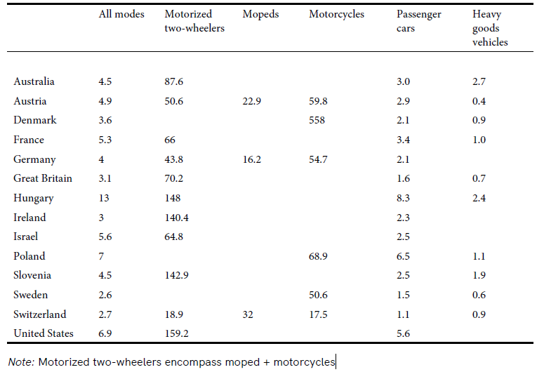
Risks for transport modes
Highest fatality & injury rates due to
Fundamental risk factors: high speed, low mass, poor crash protection
Risk-increasing factors: often young age & lack of driving/riding experience, risky driving behaviour
Table 11.1 Road fatalities per one billion vehicle kilometres (2019) (Taken from Chapter 11, page 234)
Motorcycle car crash - Free image on Pixabay

Slide 16
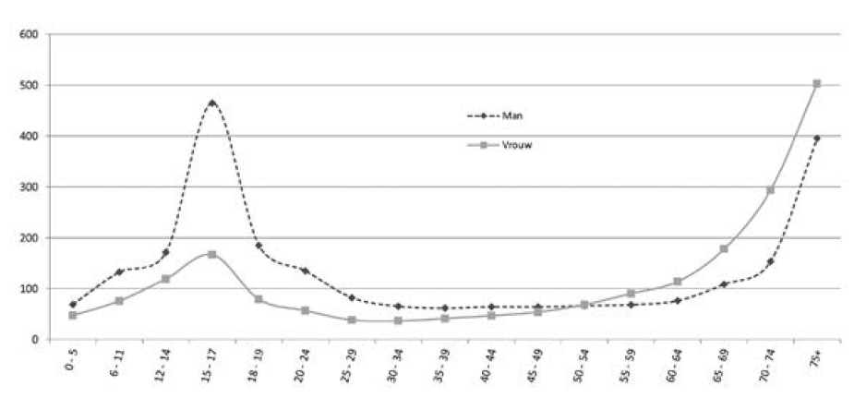
Risks for age groups
Young people (and especially male) are a high-risk group because of lack of driving/riding experience, risky driving behaviour
Male
Elderly road users are a high-risk group because of their physical frailty
Female
Figure 11.1 Number of severely injured people in traffic per 1 billion kilometres travelled of age group and gender for the Netherlands 1999-2009 (Taken from Chapter 11, page 236)

Slide 17
Risks for road types
Different road types exhibit varying risks:
Rural roads are prone to single-vehicle crashes caused by inappropriate speeds, alcohol consumption, distraction, fatigue, and non-forgiving roadside conditions
Urban roads see transverse conflicts (side impacts) as the dominant crash type, influenced by mass differentials, vulnerability of road users, high speeds, and vulnerability of vehicles
Motorways are the safest roads due to high-quality design, absence of slow-moving traffic, and effective management of high speeds

Slide 18
Overview chapter
Risk factors in traffic
‘Unintentional errors’ or ‘intentional violations’?
Risks for transport modes, age groups and road types
Measuring safety and danger
Developments in improving road safety
Shifts in road safety paradigms
Vulnerable road users
Promising options for further improving road safety
Conclusions

Slide 19
Measuring safety and danger: Common measures
The number of road crashes
Definition. A road traffic crash is a collision or incident on a public road involving at least one moving vehicle, resulting in damage or injury
The number of casualties (road deaths)
Definition. Road death is counted when a person dies immediately or within 30 days as a result of a road crash, excluding suicides
Maximum Abbreviated Injury Scale (MAIS): medical classification of injury severity. MAIS 1-2: slight injurites: MAIS 3-6: serious injuries
Sometimes included: damage to objects and fears of being involved in a crash

Slide 20
Measuring safety and danger: Normalisation
The longer the time period or the larger the area, the more crashes ➔ normalisation is needed.
Two main normalisation methods:
Number of fatalities or injuries divided by number of inhabitants: mortality (fatality) and morbidity (injury) rate, expressed per 100,000 inhabitants This measure is a public health indicator – used to compare road injuries with other threats or diseases.
Number of fatalities or injuries divided by (motorised) kilometres travelled (i.e., exposure to traffic risks). This measure allows to compare different travel modes, age groups, etc. (see before)
Caution - Free image on Pixabay

Slide 21
Measuring safety and danger: Challenges
Different definitions
Data quality
Data completeness
Data availability
Typically underreported:
non-motorized crashes (involving pedestrians and cyclists)
alcohol-related crashes
less severe injuries
Dead end sign - Free image on Pixabay

Slide 22
Measuring safety and danger: Costs
Two reasons why road crash costs are important for policy makers:
To compare economic consequences of roads crashes with other transport externalities (e.g., environmental impacts and congestion)
To compare road crash costs with costs of other public health issues → measures ‘DALY’ (disability adjusted life years) or ‘QALY’ (quality adjusted life years) are used
Economic cost categories:
medical costs,
production loss,
human costs (see VOSL next),
property damage,
settlement costs,
sometimes: costs related to congestion or replacement of transport
Measure - Free image on Pixabay

Slide 23
Measuring safety and danger: VOSL
Human costs (category 3 of economic costs, see before) are based on people's willingness to pay for lower risks or willingness to accept rewards for higher risks → The value of a statistical life (VOSL) is derived from the relationship between risk changes and willingness to pay:
The average VOSL in Belgium, France, Germany and the Netherlands was estimated at 6.2 million euros and the Value of a Statistical Serious Injury (VOSI) – at 950,000 euros (Schoeters et al., 2021). The ratio VOSL:VOSI = 7:1.
Example: if someone drives on a road with a risk of 2.5/1 000 000 of death, but is willing to pay 6 minutes by taking a detour to drive on a road with a lower risk of 2/1 000 000, this driver is valuing his or her ‘statistical life’ at 2 million euros. Assuming a value of time of 10 euros/hour, which equals 1 euro/6 minutes the VOSL is 2 million Euro. →
(1)
Schoeters, A., M. Large, M. Koning, L. Carnis, S. Daniels, D. Mignot, R. Urmeew, W. Wijnen, F. Bijleveld and M. van der Horst (2021), Monetary valuation of the prevention of road fatalities and serious road injuries. Results of the VALOR project, Brussels: VIAS Institute

Slide 24
Overview chapter
Risk factors in traffic
‘Unintentional errors’ or ‘intentional violations’?
Risks for transport modes, age groups and road types
Measuring safety and danger
Developments in improving road safety
Shifts in road safety paradigms
Vulnerable road users
Promising options for further improving road safety
Conclusions

Slide 25
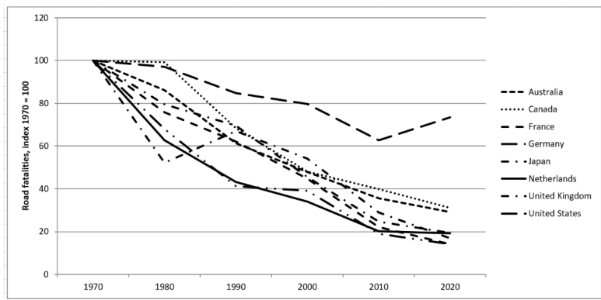
Developments in improving road safety
Table 11.3 Road traffic injury mortality rates (per 100,000 population) by WHO regions for 2019 (Taken from Chapter 11, page 239)
By far most of all crashes, deaths and injuries occur in low- and middle-income countries: 93% of road traffic deaths. →
High-income countries have significantly reduced road fatalities since 1970, but the progress has slowed down in recent years.
←
Figure 11.2 Long-term trends in road fatalities 1970 – 2020 (index 1970 = 100) for a selected number of countries that made data available to the IRTAD-database from International Transport Forum (Taken from Chapter 11, page 239)

Slide 26
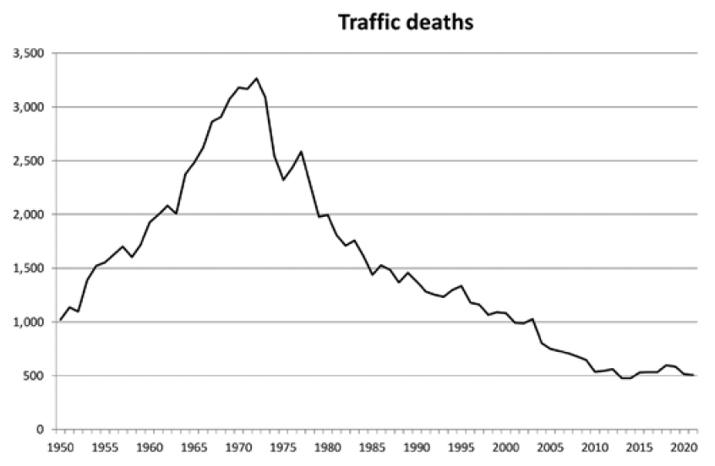
Developments in improving road safety
The Netherlands reduced the mortality rate from 1995 to 2007 by 50%, Great Britain and Sweden – by >20%. This reduction, despite increased mobility, is attributed to various factors:
Infrastructure improvements, such as the construction of safer motorways, separation of modes with safer bicycle facilities
Safety measures in vehicles
Primary safety systems to prevent crashes: e.g., anti-lock braking, daytime running lights
Secondary safety systems to mitigate crash consequences: e.g., crumple zones
Safety legislation and enforcement, targeting risk factors like alcohol consumption, seat belt and helmet use
Increase in average driving experience
Less drinking and driving, car travellers wearing safety belts and motoroized two-wheelers wearing helmets
In the Netherlands, speed limits have been lowered, although many road users exceed the limit
‘The summit conquered’ (SWOV, 2007)
Figure 11.3 Number of traffic deaths in the Netherlands 1950-2020 (Taken from Chapter 11, page 240)

Slide 27
Overview chapter
Risk factors in traffic
‘Unintentional errors’ or ‘intentional violations’?
Risks for transport modes, age groups and road types
Measuring safety and danger
Developments in improving road safety
Shifts in road safety paradigms
Vulnerable road users
Promising options for further improving road safety
Conclusions

Slide 28
Shifts in road safety paradigms
Different countries are at varying stages of development in road safety and policy maturity (see before).
Road safety paradigms in the OECD countries have evolved over time:
1900-1920: Crashes seen as chance occurrences
1920-1950: Crashes attributed to crash-prone individuals
1940-1960: Mono-causal model for crash causation
1950-1980: Multi-causal/system approach to crashes
1980-2000: The person is the weak link: more behavioural influence
2000-: Better implementation of existing policies Safe System Approach: Sustainably Safety (NL) and Vision Zero (S)
Increased sophistication

Slide 29
The Safe System approach
A new line of thinking in the traffic safety discipline since 2000:
Instead, the Safe System approach
focuses on long-term and wider economic, human and environmental goals rather than traditional measures
acknowledges that crashes will continue occurring due to the fallibility of road users
stresses that those involved in the design of the road transport system need to accept and share responsibility
recognizes that investments in traditional interventions are becoming less efficient over time
Two types of problems in road safety: specific and generic
Specific: concentrated on specific locations, road user groups, specific behaviour or vehicles. These ‘peaks in distributions’ have been ‘smoothened’ in the past decades in high-income countries
Generic: caused by road traffic being inherently unsafe. Reducing these problems should be the focus.
An example of the approach is setting a maximum speed limit of 30 km/h in urban areas unless strong evidence supports higher speeds as safe, with vulnerable road users separated from high-speed motorized traffic.
Current traffic system is inherently dangerous.
Intensifying current efforts will not substantially improve safety.

Slide 30
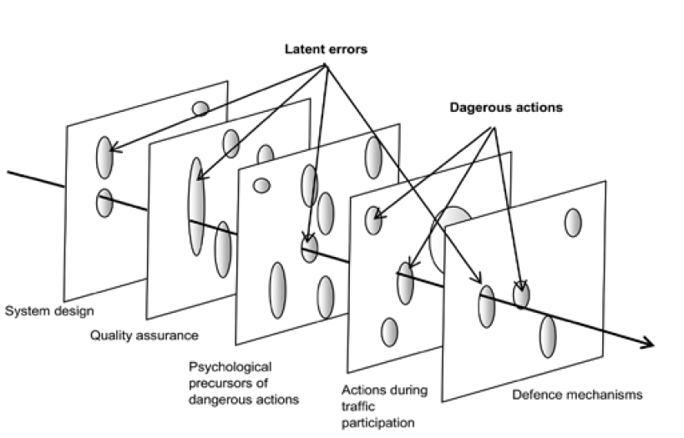
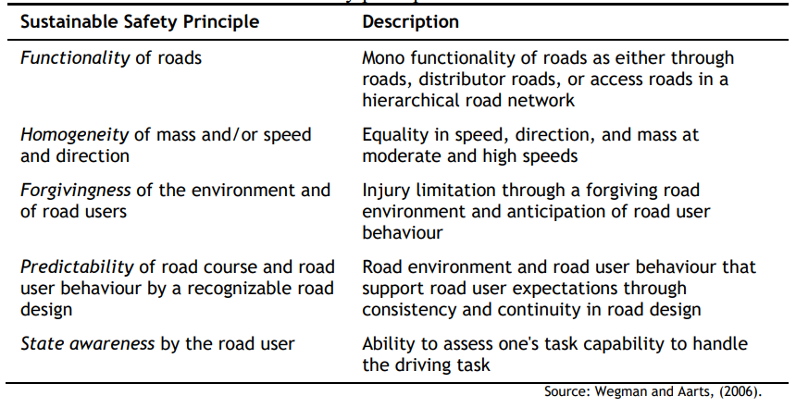
Sustainable Safety: Dutch version of a Safe System approach
The Sustainable Safety approach starts with the idea that the present traffic system is inherently hazardous and that all possible solutions are considered in an integral and rational manner.
The vision aims to eliminate latent errors from traffic and make the road traffic system forgiving towards unsafe actions by road users.
Table 11.5 The five Sustainable Safety principles (Taken from Chapter 11, page 310)
Figure 11.5 The development of a crash (bold arrow) as a result of latent errors and dangeour road user actions: ‘Swiss Cheese model’ (Taken from Chapter 11, page 247)
Wegman, F.C.M. and L.T. Aarts (eds) (2006), Advancing Sustainable Safety: National Road Safety Outlook for 2005–2020, Leidschendam: SWOV.

Slide 31
Overview chapter
Risk factors in traffic
‘Unintentional errors’ or ‘intentional violations’?
Risks for transport modes, age groups and road types
Measuring safety and danger
Developments in improving road safety
Shifts in road safety paradigms
Vulnerable road users
Promising options for further improving road safety
Conclusions

Slide 32
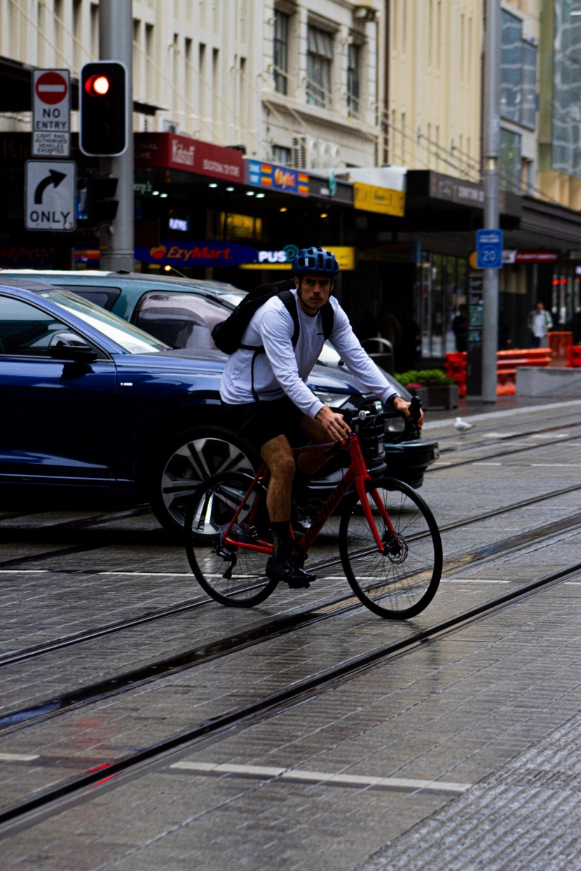
Vulnerable road users
Definition. Pedestrians, cyclists, moped riders, motorcyclists, and users of light electric vehicles (LEVs) are vulnerable road users (VRUs).
These transport modes are promoted by governments due to their lower air pollution and physical activity benefits.
However, VRUs are less protected than car occupants. They account for 54% of all road deaths worldwide (WHO, 2018), with children, youngsters, and the elderly being particularly vulnerable
Most fatal VRU crashes involve collisions with motor vehicles, while serious injury crashes often result from single vehicle incidents such as falls and collisions with obstacles
A man riding a bike down a street next to a traffic light photo – Free Cyclist Image on Unsplash
World Health Organization (2018), Global Status Report on Road Safety 2018, Geneva: WHO.

Slide 33
Vulnerable road users: how to protect them?
Speed management is crucial: area-wide urban traffic-calming schemes reduce injury crashes, especially among cyclists and pedestrians
Road and roadside design: to achieve compliance with reduced speed limits, separation of VRUs by cycle tracks and sidewalks improves road safety
Technology: Advanced Driver Support Systems (ADAS), such as Autonomous Emergency Braking (AEB) and Intelligent Speed Assistance (ISA), can assist in speed management

Slide 34
Vulnerable road users: single-vehicle crashes
Non-fatal crashes with bicycles and e-bikes are often single-bicycle crashes, with infrastructure (e.g., narrow paths, tram tracks), road surface conditions (e.g., potholes), and braking mistakes being contributing factors
Light electric vehicles, including standing e-scooters, are also prone to single vehicle crashes, but more research is needed to compare risks with other travel modes
E-bikes on average travel only slightly faster than conventional bicycles, resulting in similar crash likelihood and severity.

Slide 35
Overview chapter
Risk factors in traffic
‘Unintentional errors’ or ‘intentional violations’?
Risks for transport modes, age groups and road types
Measuring safety and danger
Developments in improving road safety
Shifts in road safety paradigms
Vulnerable road users
Promising options for further improving road safety
Conclusions

Slide 36
How to further improve road safety?
Lower urban speed limits
Increased separation of vulnerable road users from motorized traffic
Advanced Driver Assistance Systems (ADAS) and autonomous driving,
Could significantly reduce traffic deaths but also introduces new challenges: human-driver intervention (during ‘take-over’ in Level 3 Automated driving; see chapter 8) and cybersecurity
A contribution of businesses and enterprises. E.g.:
Via procurement of fleet vehicles and transport services, businesses can specify vehicle safety levels, training of drivers and scheduling and planning of driving operations
Via workplace road safety risk management, companies can address the time pressure due to delivery deadlines that contributes to stress, fatigue and more risky driving or riding
Integrating road safety into a broader approach to improve health, climate, equity, and prosperity goals
Woman in black jacket riding bicycle on pedestrian lane during night time photo – Free Cyclist Image on Unsplash

Slide 37
Overview chapter
Risk factors in traffic
‘Unintentional errors’ or ‘intentional violations’?
Risks for transport modes, age groups and road types
Measuring safety and danger
Developments in improving road safety
Shifts in road safety paradigms
Vulnerable road users
Promising options for further improving road safety
Conclusions

Slide 38
Conclusions
Speed, vulnerability, and mass differences are fundamental risk factors for road crashes
Impaired driving, fatigue, and distraction are risk-increasing factors for road crashes
Both human errors and violations significantly contribute to road crashes.
Measuring road safety is challenging due to data issues and lack of harmonized definitions
Highly motorized and developed countries have made progress in road safety through various measures
Shifting to a Safe System approach is necessary to address generic risks comprehensively
Protecting vulnerable road users requires separating them from high-speed traffic and reducing speeds
Automation shows promise in improving road safety, but its full impact is uncertain
Road safety should be linked to broader goals such as health, green mobility, and sustainable cities in the Sustainable Development Agenda

Slide 39
The Transport System and Transport Policy
Edited by Bert van Wee, Jan Anne Annema, David Banister and Baiba Pudãne
Chapter 11: Traffic safety
Authors: Fred Wegman and Paul Schepers
Busy crossover - Free image on Pexels

