Slide 1
The Transport System and Transport Policy
Edited by Bert van Wee, Jan Anne Annema, David Banister and Baiba Pudãne
Chapter 9: Accessibility: perspectives, measures and applications
Authors: Karst Geurs and Bert van Wee
Travel around the world - Free image on Pexels

Slide 2
Introduction
A principal goal of transport policy is to improve accessibility in the transport system
This goal is achieved when
people can travel and participate in activities
firms can transport goods between locations
A core challenge in accessibility studies – how to measure accessibility?
differences between scientific disciplines
differences between academic literature and practical applications

Slide 3
Overview chapter
Definition and components of accessibility
Operationalisation and choosing the accessibility measures
Digital and physical accessibility
Equity of accessibility
Application: two examples of accessibility measures
Conclusions

Slide 4
Overview chapter
Definition and components of accessibility
Operationalisation and choosing the accessibility measures
Digital and physical accessibility
Equity of accessibility
Application: two examples of accessibility measures
Conclusions

Slide 5
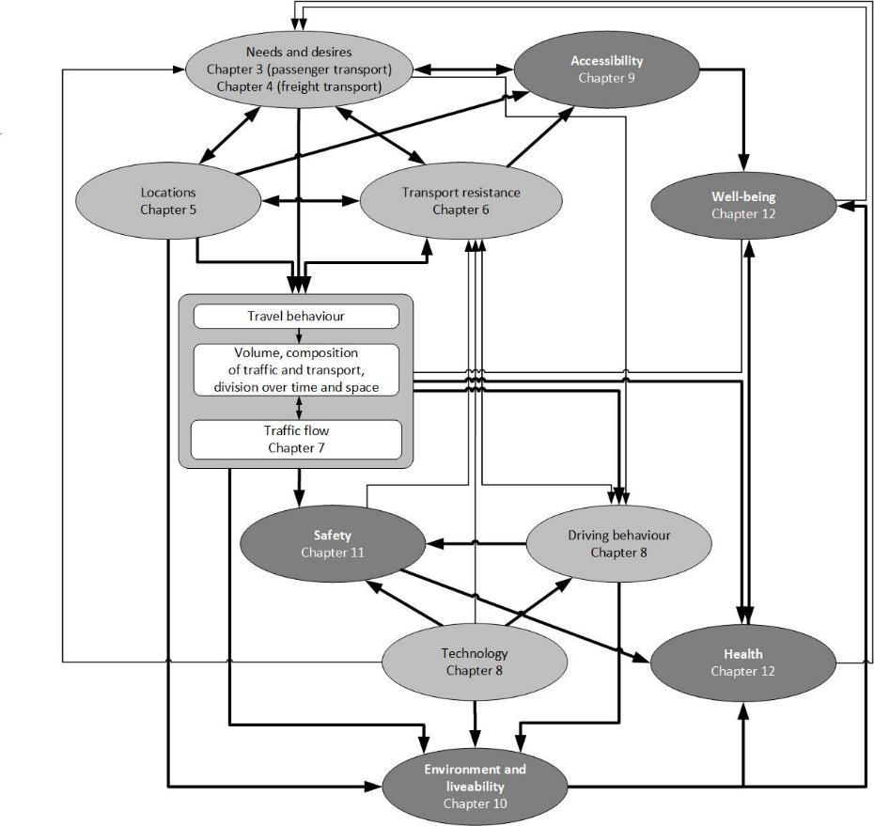
Defining accessibility
3 core determinants of accessibility
The first definition of accessibility is: the potential of opportunities for interaction (Hansen, 1959: 73)
After this, accessibility has taken on a variety of meanings, but in this book the definition of accessibility is defined following the conceptual framework from Chapter 2:
Definition: “Accessibility is the extent to which land-use and transport systems enable (groups of) individuals to reach activities or destinations by means of a (combination of) transport mode(s) at various times of the day (perspective of persons), and the extent to which land-use and transport systems enable companies, facilities and other activity places to receive people, goods and information at various times of the day (perspective of locations of activities).”
Hansen, W.G. (1959), ‘How accessibility shapes land use’, Journal of the American Institute of Planners, 25, 73–76.

Slide 6
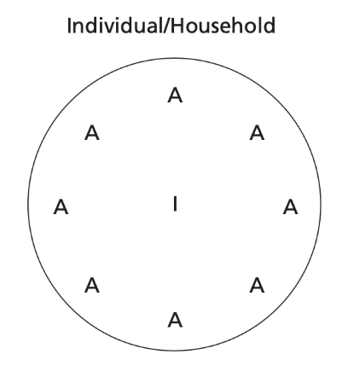
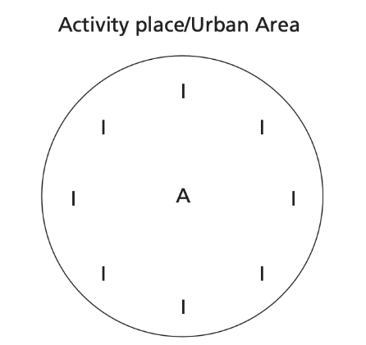
Defining accessibility
Access: the area that a person can reach from his or her origin location to participate in activities
Accessibility: the catchment area from which people, goods and information from different locations can reach a specific origin location
Dijst, M. J., Jayet, H., & Thomas, I. (2002). Transportation and urban performance: Accessibility, daily mobility and location of households and facilities.

Slide 7
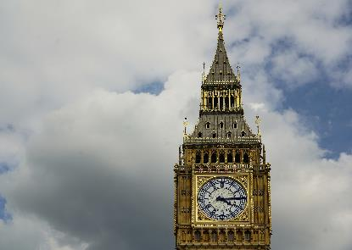
Four components of accessibility (Geurs & van Wee, 2004)
1
Land-use component
3
Temporal component
(a) The amount, quality and spatial distribution of opportunities, (b) the demand for these opportunities at origin locations, (c) the confrontation of supply and demand (e.g., job vacancies)
Availability of opportunities at different times of the day and the time available for individuals to participate in them
2
Transportation component
4
Individual component
Disutility for an individual to travel between an origin and a destination using a specific transport mode. The disutility consists of time, cost and effort components (see transport resistance, ch. 6)
Activities in which individuals want/need to participate and their options to fulfil those needs and wishes(see NOA model, ch. 3)
World map with pins photo – Free Travel Image on Unsplash
People near train station photo – Free Grey Image on Unsplash
The big ben clock tower towering over the city of london photo – Free London Image on Unsplash
Two boy riding on red step-through bicycle during daytime photo – Free Bicycle Image on Unsplash
Geurs, K.T. and B. van Wee (2004), ‘Accessibility evaluation of land-use and transport strategies: review and research directions’, Journal of Transport Geography, 12, 127–140.

Slide 8
Overview chapter
Definition and components of accessibility
Operationalisation and choosing the accessibility measures
Digital and physical accessibility
Equity of accessibility
Application: two examples of accessibility measures
Conclusions

Slide 9
Operationalisation of accessibility measures
Accessibility measures should ideally take all components into account → in practice, applied accessibility measures focuses on one or more components of accessibility, depending on the perspective taken
There are four main types of accessibility measures:
Infrastructure-based accessibility measures analyse the performance or service level of transport infrastructure, such as the length of infrastructure networks
Location-based accessibility measures analyse the level of accessibility to spatially distributed activities, such as the number of jobs within 30 min travel time
Person-based accessibility measures analyse accessibility at the individual level, such as the activities in which an individual can participate at a given time → founded in time geography (Hägerstrand, 1970) (See Chapter 3)
Utility-based accessibility measures analyse the (economic) benefits that people derive from access to the spatially distributes activities
Hägerstrand, T. (1970), ‘What about people in regional science?’, Papers of the Regional Science Association, 24, 7–21.

Slide 10
Operationalisation of accessibility measures
In operationalising the measures, first the type of measure is chosen (1), and then various elements are determined (2).
An example of operationalising the utility-based measure:
In determining the time costs, the analyst can choose whether to differently weigh waiting, in-vehicle, access and egress times.
In determining the monetary costs, the analyst can consider only fuel costs for car or the total variable costs, including, e.g., parking and fixed costs (i.e., depreciation of the car)
Table 9.2 Types of accessibility measures and components (Taken from Chapter 9, page 184)
2
Treated implicitly / aggregated
Not included
1
Geurs, K.T. and B. van Wee (2004), ‘Accessibility evaluation of land-use and transport strategies: review and research directions’, Journal of Transport Geography, 12, 127–140.

Slide 11
Choosing and using accessibility measures
The choice is typically guided by several criteria:
Purpose of the study: What is the main reason for analysing accessibility: to obtain the accessibility impacts of a transport project or analyze social equity effects, or economic effects?
Scientific quality: Does the measure take the individual needs, abilities and opportunities into account? Is the measure sensitive to the changes in the transport and land-use systems and the temporal constraints of opportunities?
Operationalisation: Availability of the data and tools (e.g., WebGIS) to develop the measures
Interpretability and communicability: Are the comprehensive approaches to measure accessibility made practical enough to understand and interpret the measure by researchers, planners and policy makers?

Slide 12
Overview chapter
Definition and components of accessibility
Operationalisation and choosing the accessibility measures
Digital and physical accessibility
Equity of accessibility
Application: two examples of accessibility measures
Conclusions

Slide 13
Digital and physical accessibility
Information and communications technologies (ICTs) are permeating modern lifestyles, shaping and colouring the undertaking of activities and travel (Lyons, 2014)
ICT can have complex impacts on accessibility as it affects all four of its components:
Transport component: ICTs can affect travel resistance → e.g., travel information, multitasking during travel affects the VoT
Land use component: ICTs influence which persons carry out which activities at which locations → e.g., working at home using ICT, online shopping leads to emptying of physical shops
Temporal component: ICTs affect the availability of opportunities at different times of the day → e.g., working at non-traditional times of a day
Individual component: ICT can have an impact on the needs of people → e.g., finding out about a concert online, individual access to digital technologies determine their access to some transport options
Laptop and smartphone - Free image on Pixabay
Lyons, G. (2014), ‘Transport’s Digital Age Transition’, Journal of Transport and Land Use, 8, 1-19.

Slide 14
Overview chapter
Definition and components of accessibility
Operationalisation and choosing the accessibility measures
Digital and physical accessibility
Equity of accessibility
Application: two examples of accessibility measures
Conclusions

Slide 15
Equity of accessibility
People, groups of people and regions do not have the same level of access to destinations, such as shops, jobs, or medical services.
Di Ciommo and Shiftan (2017) argue that transportation equity has three key components:
1. The benefits and costs that are being distributed
2. The population groups over which the benefits and costs are distributed
3. The distributive principle that determines whether a particular distribution is ‘morally proper’ and ‘socially acceptable’
Equity of accessibility is the most assessed aspect in transport policy.
Equity - Free image on Pixabay
Di Ciommo, F., Y. Shiftan (2017), ‘Transport equity analysis’. Transport Reviews, 37(2), 139-151.

Slide 16
Equity of accessibility
The Capabilities Approach has five key features for assessing a person's freedom (Vecchio and Martens, 2021):
Resources: commodities and intangible goods available to achieve goals
Capabilities: freedoms available for a person to do and be in various life areas
Functioning's: actual achievements of a person, using available capabilities, with traveling being the basic element
Conversion factors: personal, social, and environmental conditions that shape a person's life experience and ability to convert resources to freedoms
Choice: person's decision to select a particular "state" from within their capability set
Accessibility ≈ Capability in this approach?
Silhouette sunset - Free image on Pixabay
Vecchio, G. and K. Martens (2021), ‘Accessibility and the Capabilities Approach: a review of the literature and proposal for conceptual advancements’, Transport Reviews, 41, 833-854.

Slide 17
Overview chapter
Definition and components of accessibility
Operationalisation and choosing the accessibility measures
Digital and physical accessibility
Equity of accessibility
Application: two examples of accessibility measures
Conclusions

Slide 18
Application
Two commonly used location-based accessibility measures:
Potential accessibility measure (also called gravity-based measure) This measure does not consider the spatial distribution of demand for opportunities
Shen accessibility measure This measure incorporates competition effects by considering the spatial distribution of demand
These examples demonstrate how the choice and operationalization of an accessibility measure can significantly impact conclusions about accessibility

Slide 19
Application: potential accessibility measure
Potential accessibility measures have been widely used in urban and geographical studies since the late 1940s. The measure $A_{i}$ estimates the accessibility of opportunities in zone $i$ to all other zones $n$. Smaller and more distant opportunities have smaller contribution to the accessibility:
Where:
$D_{j}$ – opportunities (e.g., jobs, schools, health facilities) in zone $j$, $cij$ – the impedance or costs of travel between $i$ and $j$; $β$ – the cost sensitivity parameter
The choice of the impedance function, which determines how accessibility decreases with increasing costs, significantly affects the results of the measure → Negative exponential function is the most commonly used impedance function, as it aligns closely with travel behaviour theory
(1)

Slide 20
Application: potential accessibility measure
The standard potential accessibility index calculates the geographic distribution of accessibility between zones without accounting for the number of people accessing the opportunities:
To compare potential accessibility measures across different areas with varying volumes of opportunities, population weighting can be applied to estimate person-average accessibility (2).
Advantage: * can be computed using available land-use and transport data, making them practical for analysis and as input for infrastructure-based measures.
Disadvantages: * can be challenging to interpret due to the combination of land-use and transport elements and the weighing of opportunities based on the impedance function, * standard measures do not account for competition effects (see next)
$A_{i person}=\frac{A_{i} }{P_{i}}$
(2)

Slide 21
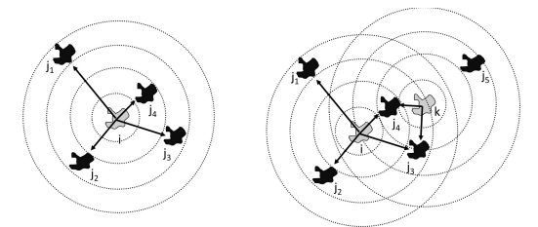
Application: Shen accessibility measure
Standard potential accessibility measures often overlook competition effects in the spatial distribution of opportunities
Ignoring competition effects can lead to misleading conclusions about accessibility:
Conclusion: jobs in $j_{2}$ are more accessible from $i$, because opportunities in $j_{3}$ and $j_{4}$ are within reach for competitors from $k$.
Conclusion: jobs in $j_{4}$ are most accessible from $i$.
Figure 9.2 Visualisation of potential accessibility (left) and Shen measure (right)
(Taken from Chapter 9, page 193)

Slide 22
Application: Shen accessibility measure
The Shen index $S_{i}$ (Shen, 1998) accounts for competition by considering both the supply of jobs and the demand potential within reach of a specific zone:
$S_{i}$– the accessibility in zone 𝑖 (by mode) while considering competition from other zones 𝑘; $O_{j}$ – opportunities in zone $j$; $P_{k}$ – the population in location 𝑘; $f(t_{kj}$) – the impedance as a function of the travel time $t_{kj}$ between 𝑘 and 𝑗 using a specific mode
Simplification: only a single travel mode is used. More advanced approaches exist.
$S_{i}= \sum_{j}{\frac{O_{j}∗f(t_{ij})}{D_{j}}}$ ,
(3)
where $D_{j}= \sum_{k}{P_{k}∗f(t_{kj})}$
Shen, Q. (1998). Location characteristics of inner-city neighborhoods and employment accessibility of low-wage workers. Environment and planning B: Planning and Design, 25(3), 345-365.

Slide 23
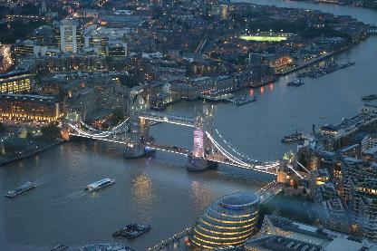
Application: Shen accessibility measure (Pritchard et al., 2019)
Table 9.3 Job accessibility in the Randstad area, Greater London and São Paulo
(Taken from Chapter 9, page 195)
 |  |  | Car | Public transport
São Paulo | Potential accessibility | Standard | 2,166,153 | 638,993
 |  | Person-Averaged | 409 | 144
 | Shen Accessibility | Mode-Specific | 0,62 | 0,58
 |  | Best-Alternative | 0,62 | 0,18
London | Potential accessibility | Standard | 786,490 | 179,334
 |  | Person-Averaged | 477 | 116
 | Shen Accessibility | Mode-Specific | 0,70 | 0,71
 |  | Best-Alternative | 0,70 | 0,15
Randstad | Potential accessibility | Standard | 1,585,952 | 202,858
 |  | Person-Averaged | 355 | 37
 | Shen Accessibility | Mode-Specific | 0,81 | 0,76
 |  | Best-Alternative | 0,81 | 0,09
Which of these cities / areas has the best accessibility to jobs?
Sào Paulo - Free image on Pexels
Tower Bridge of London · Free Stock Photo (pexels.com)
High Rise Buildings of Hague · Free Stock Photo (pexels.com)
Conclusion: choice and operationalization of accessibility measures affects the rankings and conclusions of accessibility studies.
Pritchard, J.P., D. Tomasiello, M. Giannotti, K.T Geurs (2019), ‘An international comparison of temporal and spatial inequalities in job accessibility – London, Sao Paulo and the Netherlands Randstad Area’. Transport Findings, 1-12, 10.32866/7412

Slide 24
Overview chapter
Definition and components of accessibility
Operationalisation and choosing the accessibility measures
Digital and physical accessibility
Equity of accessibility
Application: two examples of accessibility measures
Conclusions

Slide 25
Conclusions
Careful decision-making is crucial for defining and operationalizing accessibility as it affects the output. Four criteria to base decisions on are: study purpose, scientific quality, operationalization, and interpretation
Often, the used accessibility measures are easy to operationalize and interpret. Different approaches are required for different situations and study purposes, but ignoring these criteria has implications
Location- and utility-based measures can be used for evaluations with land-use and transport data. They overcome shortcomings of infrastructure-based measures and can be easily computed
Transport planning now requires equity analysis of accessibility, which is complex due to various types of equity, categorization methods, impacts, and measurement techniques. Traditional approaches fall short in dealing with fairness and justice in transportation
Information and communications technologies (ICTs) have impacted all components of accessibility and their interactions

Slide 26
The Transport System and Transport Policy
Edited by Bert van Wee, Jan Anne Annema, David Banister and Baiba Pudãne
Chapter 9: Accessibility: perspectives, measures and applications
Authors: Karst Geurs and Bert van Wee
Travel around the world - Free image on Pexels

