Slide 1
The Transport System and Transport Policy
Edited by Bert van Wee, Jan Anne Annema, David Banister and Baiba Pudãne
Chapter 14: Transport futures research
Authors: Vincent Marchau, Warren Walker and Jan Anne Annema
Bookshelves - Free image on Pexels

Slide 2
Introduction
"To govern means to foresee"
Governments need to know about possible future transport expectations to be able to implement new policies in time.
For example, policies for dealing with negative impacts of transport (recall Chapters 9 to 13).
Ultimately, the question is how to explore the future impacts of candidate transport policy options?

Slide 3
Introduction
Can you tell the future?
Futures research in transport policy analysis is carried out for two reasons:
to identify the types and magnitudes of future transport problems (and/or opportunities), and
to identify ways to reduce these transport problems (and/or take advantage of these opportunities) their effects, and their costs and benefits.
This chapter specifies research approaches to the study of transport futures, and explains the role of futures research related to transport policy analysis
Glass sphere - Free image on Pixabay

Slide 4
Overview chapter
A framework for policy analysis
Different levels of uncertainty
Forward-looking scenarios
Backcasting
Level 4 approaches
Dynamic Adaptive Policymaking
Conclusions

Slide 5
Overview chapter
A framework for policy analysis
Different levels of uncertainty
Forward-looking scenarios
Backcasting
Level 4 approaches
Dynamic Adaptive Policymaking
Conclusions

Slide 6
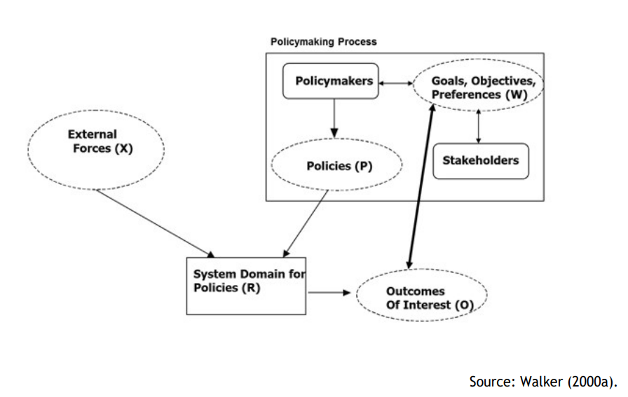
A framework for policy analysis
A rational-style policy analysis typically starts with a model of the transport system that defines the boundaries of the system and describes its structure and operations.
Figure 14.1 illustrates the framework:
External forces (X) influence transport demand and supply, beyond the control of the problem owner.
Transport system (R) include all transport-related elements and interactions.
Outcomes of interest (O) are policy-relevant results from the transport system.
Policies (P) are interventions in the system whose outcomes align with policy goals or preferences.
Valuation of outcomes or weights (W) are subjective importance given to outcomes of interest by crucial stakeholders.
Figure 14.1: A framework for policy analysis (Taken from Chapter 14, page 295)
Walker, W.E. (2000a), ‘Policy Analysis: A Systematic Approach to Supporting Policymaking in the Public Sector’, Journal of Multicriteria Decision Analysis, 9 (1–3), 11–27.

Slide 7
Policy analysis steps
The four main steps in performing a policy analysis:
Note that this will generally not be a linear process, and there will often be feedback between the steps, particularly from step 3 to step 1
2) Estimate the future impacts: e.g., outcomes of interest (O) of the various policy options for different futures using transport system models and scenarios
3) Compare options supported through quantitative, analytical tools (e.g. cost–benefit analysis, multi-criteria analysis)
4) Choose and implement the chosen option
1) Formulate the transport problem: Problem definition, setting goals, specifying

Slide 8
Overview chapter
A framework for policy analysis
Different levels of uncertainty
Forward-looking scenarios
Backcasting
Level 4 approaches
Dynamic Adaptive Policymaking
Conclusions

Slide 9
Different levels of uncertainty
The methodological approach to estimate the future impacts of policies and external forces (using e.g., scenarios) on the transport system depends on how uncertain the future is assumed to be.
Uncertainty is defined as ‘any departure from the (unachievable) ideal of complete determinism’ (Walker et al., 2003, p. 8)
Or, in mathematical terms:
Let Y be some event. If Probability(Y) ≠ 0 or 1, then the event Y is uncertain
Road beginning - Free image on Pixabay
Walker, W.E., P. Harremoës, J. Rotmans, J.P. van der Sluijs, M.B.A. van Asselt, P. Janssen and M.P. Krayer von Krauss (2003), ‘Defining uncertainty: a conceptual basis for uncertainty management in model-based decision support’, Integrated Assessment, 4 (1), 5–17.

Slide 10
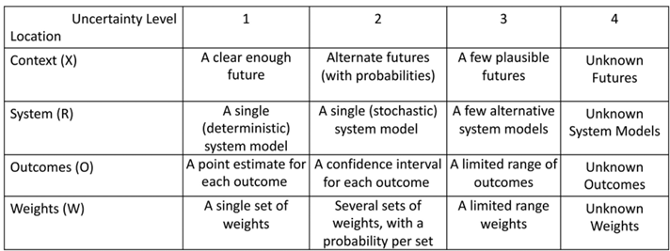
Different levels of uncertainty
A way of representing different levels of uncertainty is shown in Figure 14.2 (Marchau et al., 2019)
Figure 14.2 The progressive transition of levels of uncertainty (Taken from Chapter 14, page 297)
Marchau, V.A.W.J., W.E. Walker, P.J.T.M. Bloemen and S.W. Popper (eds.) (2019), Decision Making Under Deep Uncertainty: From Theory to Practice, New York: Springer.

Slide 11
Different levels of uncertainty
Level 1 Uncertainty: Often addressed through sensitivity analysis of transport model parameters, where small changes in input parameters are examined for their impact on model outcomes.
Level 2 Uncertainty: Refers to uncertainty that can be adequately described using statistical terms.
Levels 3 and 4 Uncertainties: They cannot be handled using probabilities or mitigated by collecting more data; they are fundamentally unknowable and unpredictable at present.
Long-term transport policy analysis typically involves higher levels of uncertainty (Levels 3 and 4).
Many negative outcomes from past policy decisions resulted from approaches that didn't consider the challenges posed by Levels 3 and 4 uncertainty (e.g., Cruz and Sarmento, 2020; Flyvbjerg et al. 2003, 2006).
Cruz, C.O. and J.M. Sarmento, (2020), ‘Traffic forecast inaccuracy in transportation: a literature review of roads and railways projects’, Transportation, 47 (4), 1571–606, DOI: 10.1007/s11116–019–09972-y Flyvbjerg, B., N. Bruzelius and W. Rothengatter, (2003), Megaprojects and Risk: An Anatomy of Ambition, Cambridge: Cambridge University Press. Flyvbjerg, B., M.K. Skamris Holm and S.L. Buhl (2006), ‘Inaccuracy in Traffic Forecasts’, Transport Reviews, 26 (1), 1–24.

Slide 12
Overview chapter
A framework for policy analysis
Different levels of uncertainty
Forward-looking scenarios
Backcasting
Level 4 approaches
Dynamic Adaptive Policymaking
Conclusions

Slide 13
Level 3 approaches
Forward-looking scenarios
Backcasting

Slide 14
Level 3 approaches: Forward-looking scenarios
Forward-looking scenarios
Backcasting

Slide 15
Level 3 approaches: Forward-looking scenarios
When faced with Level 3 uncertainties, transport policy analysts use scenarios.
Assumption is that the future can be specified well enough to identify policies that will produce favourable outcomes in one or more specific plausible future worlds.
Scenarios are "explorative" and different from "predictive" and "normative" scenarios (Börjeson et al., 2006)
Different routes - Free image on Unsplash
Börjeson, L., M. Höjera, K-H. Dreborg, T. Ekvall and G. Finnvedena (2006), ‘Scenario types and techniques: Towards a user’s guide’, Futures, 38 (7), 723–39.

Slide 16
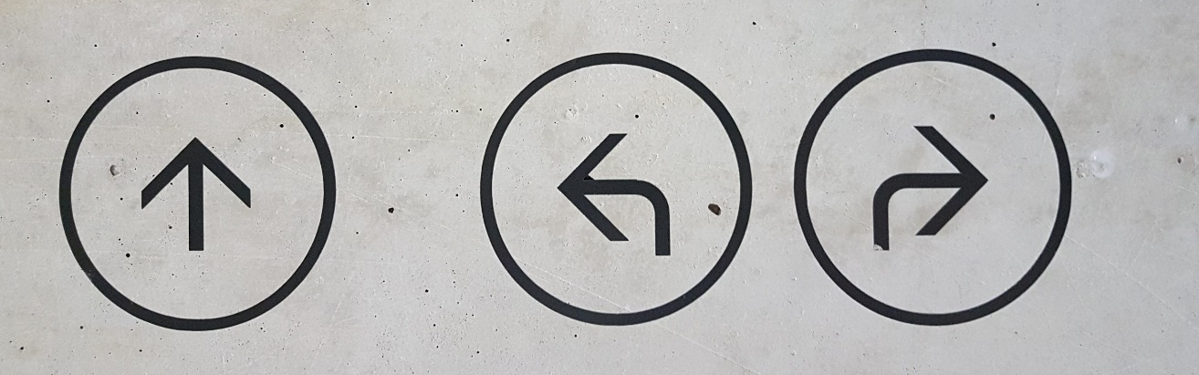
Level 3 approaches: Forward-looking scenarios
Scenarios are logical, consistent sets of assumptions that create stories of possible futures with sufficient detail to provide context for engaging planners and stakeholders.
They include assumptions about system developments and external factors, but exclude the policy options to be examined.
Scenarios span a range of developments and a range of futures of interest without any assigned probabilities.
They identify possible future problems and robust policies for dealing with them.
Different directions - Free image on Unsplash

Slide 17
Level 3 approaches: Forward-looking scenarios
Scenario adequacy or quality cannot be assessed by a general theory, but there are several important criteria (Schwarz, 1988):
Consistency: the assumptions made are not self-contradictory; a sequence of events could be constructed, leading from the present world to the future world.
Plausibility: the posited chain of events can happen
Credibility: each change in the chain can be explained (causality)
Relevance: changes in the values of each of the scenario variables are likely to have a large effect on at least one outcome of interest
Schwarz, B. (1988), ‘Forecasting and scenarios’, in H.J. Miser and E.S. Quade (eds.), Handbook of Systems Analysis: Craft Issues and Procedural Choices, New York: Elsevier Science, 327–67.

Slide 18
Level 3 approaches: Forward-looking scenarios
Structured process for forward-looking scenario development:
Steps 3 and 4 lead to identifying candidates for scenarios (red box)
Step 1: Specify the system, outcomes of interest, and relevant time horizon
Step 2: Identify external forces driving changes in the system and outcomes of interest
Step 3: Categorize forces and resulting system changes as fairly certain or uncertain
Step 4: Assess the relevance of uncertain forces/system changes based on their impacts
Step 5: Design multiple future scenarios based on different combinations of driving forces
Table 14.1 Selecting relevant forces for system changes for forward-looking scenarios (Taken from Chapter 14, page 372)

Slide 19
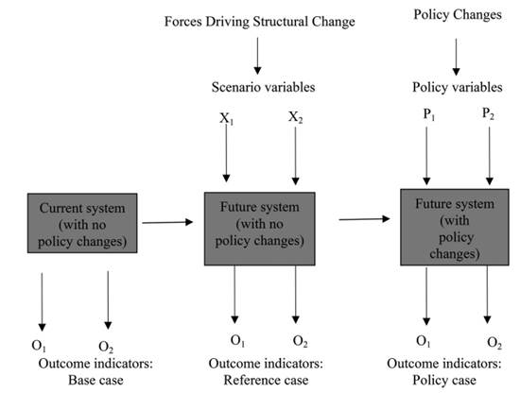
Level 3 approaches: Forward-looking scenarios
Model-based evaluation:
The Base case is used to validate the model
The same models are used to produce the outcomes of the Reference and Policy cases.
The outcomes of the Reference case and the Policy case are evaluated by policymakers using different methods (e.g., multi-criteria analysis, cost-effectiveness analysis, cost-benefit analysis)
O’₁
O’₂
O’’₁
O’’₂
Figure 14.4 Evaluating policy options using scenarios (Taken from Chapter 14, page 301)

Slide 20
Forward-looking scenarios: pros and cons
Pros | Cons
Scenarios help analysts and policymakers address situations with multiple sources of uncertainty | Deciding which assumptions about future external developments to include is challenging in the face of uncertainty
Scenarios allow examination of potential changes in the system and implications of external uncertainties | It is difficult to determine if the range of futures provided by scenarios covers all or a certain percentage of possibilities
Scenarios identify future problems and enable the identification of robust policies to address them | Scenarios generate many performance estimates, making it challenging for policymakers to navigate
 | Policymakers may fall back on a single "most likely" scenario or choose to take no action due to insufficient information, which can lead to unfavourable outcomes in the face of high uncertainty and potential consequences

Slide 21
Overview chapter
A framework for policy analysis
Different levels of uncertainty
Forward-looking scenarios
Backcasting
Level 4 approaches
Dynamic Adaptive Policymaking
Conclusions

Slide 22
Level 3 approaches: Backcasting approach
Forward-looking scenarios
Backcasting

Slide 23
Level 3 approaches: Backcasting approach
In backcasting, a normative target in the future is chosen, then appropriate paths towards this desired outcome are searched for.
Four steps in the backcasting process:
Define future target(s) (e.g., zero CO2 emissions in 2050 for international aviation)
Construct a reference (forward-looking) scenario to determine the required scale of change
Design "images of the future" that meet the targets and cover a range of possibilities
Specify potential policies and analyse trajectories from future images back to the present state
Weak points of backcasting methods:
Assuming the future to be as forecast by the reference scenario (Step 2) gives a false feeling about predictability.
Step 4 incorrectly assumes that specified policies will lead to the desired future.

Slide 24
Overview chapter
A framework for policy analysis
Different levels of uncertainty
Forward-looking scenarios
Backcasting
Level 4 approaches
Dynamic Adaptive Policymaking
Conclusions

Slide 25
Level 4 approaches: flexible and adaptive approaches
Level 4 uncertainty, also known as deep uncertainty, is characterized by unknown models, probability distributions, and value judgments
Unlike most policy analysis studies, the implementation step of policy analysis is explicitly addressed by the researcher – focusing on potential failures and ways to prevent failure.
Three (overlapping, not mutually exclusive) ways of dealing with deep uncertainty in making policies (see, for example, Leusink and Zanting, 2009):
Resistance: plan for the worst conceivable case or future situation (e.g., over- dimensioning of infrastructure)
Resilience: whatever happens in the future, make sure to have a policy that will result in the system recovering quickly (e.g. floating roads, traffic incident management)
Adaptive robustness: prepare a policy that is flexible and adaptable, which will perform well across the full range of plausible futures (including surprises), i.e. Assumption Based Planning (ABP)
Leusink, A. and H.A. Zanting (2009), Naar een afwegingskader voor een klimaatbestendig Nederland, met ervaringen uit 4 case studies: samenvatting voor bestuurders [Towards a trade-off framework for climate-proofing the Netherlands, with experiences from 4 case studies: executive summary], accessed August 2011 at http://edepot.wur.nl/15219.

Slide 26
Level 4 approaches
Robust Decision Making (RDM):
Utilises Exploratory Modelling (EM) to run system models and identify futures relevant to plan success; employs Scenario Discovery (SD) to analyse data and understand key characteristics of success and failure using Assumption Based Planning (ABP) (Lempert, 2019)
Dynamic Adaptive Policymaking (DAP): Focuses on implementing an initial policy and adapting it over time based on new knowledge; explicit adaptation from the beginning with a designed monitoring program and trigger-based responses (Walker et al., 2019)
Dynamic Adaptive Policy Pathways (DAPP): Considers timing of actions and alternative routes into the future, based on Adaptation Tipping Points (ATPs) to identify conditions under which a plan might fail (Haasnoot et al., 2019)
Engineering Options Analysis (EOA): Assigns economic value to technical flexibility through Real Options Analysis, calculating the value of options for taking actions over time (de Neufville and Smet, 2019)
1) Lempert, R.J. (2019), ‘Robust Decision Making (RDM)’, Chapter 2, in: V.A.W.J. Marchau, W.E. Walker, P.J.T.M. Bloemen and S.W. Popper (eds.), Decision Making Under Deep Uncertainty: From Theory to Practice, New York: Springer.
2) Walker, W.E., V.A.W.J. Marchau, and J.H. Kwakkel (2019), ‘Dynamic Adaptive Planning (DAP)’, in: V.A.W.J. Marchau, W.E. Walker, P.J.T.M. Bloemen and S.W. Popper (eds), (2019), Decision Making Under Deep Uncertainty: From Theory to Practice. New York: Springer.
3) Haasnoot, M., A. Warren, and J.H. Kwakkel, (2019). ‘Dynamic Adaptive Policy Pathways (DAPP)’, in: V.A.W.J. Marchau, W.E. Walker, P.J.T.M. Bloemen and S.W. Popper (eds.), Decision Making Under Deep Uncertainty: From Theory to Practice. New York: Springer.
4) de Neufville, R. and K. Smet (2019), Engineering options analysis, Chapter 6, in: V.A.W.J. Marchau, W.E. Walker, P.J. Bloemen and S.W. Popper (eds.), Decision Making Under Deep Uncertainty: From Theory to Practice. New York: Springer.

Slide 27
Level 4 approaches
Robust Decision Making (RDM):
Utilizes Exploratory Modelling (EM) to run system models and identify futures relevant to plan success; employs Scenario Discovery (SD) to analyze data and understand key characteristics of success and failure, and robust success. (Lempert, 2019)
Dynamic Adaptive Policymaking (DAP): Focuses on implementing an initial policy and adapting it over time based on new knowledge; explicit adaptation from the beginning with a designed monitoring program and trigger-based responses (Walker et al., 2019)
Dynamic Adaptive Policy Pathways (DAPP): Considers timing of actions and alternative routes into the future, based on Adaptation Tipping Points to identify conditions under which a plan might fail (Haasnoot et al., 2019)
Engineering Options Analysis (EOA): Assigns economic value to technical flexibility through Real Options Analysis, calculating the value of options for taking actions over time (de Neufville and Smet, 2019)
1) Lempert, R.J. (2019), ‘Robust Decision Making (RDM)’, Chapter 2, in: V.A.W.J. Marchau, W.E. Walker, P.J.T.M. Bloemen and S.W. Popper (eds.), Decision Making Under Deep Uncertainty: From Theory to Practice, New York: Springer.
2) Walker, W.E., V.A.W.J. Marchau, and J.H. Kwakkel (2019), ‘Dynamic Adaptive Planning (DAP)’, in: V.A.W.J. Marchau, W.E. Walker, P.J.T.M. Bloemen and S.W. Popper (eds), (2019), Decision Making Under Deep Uncertainty: From Theory to Practice. New York: Springer.
3) Haasnoot, M., A. Warren, and J.H. Kwakkel, (2019). ‘Dynamic Adaptive Policy Pathways (DAPP)’, in: V.A.W.J. Marchau, W.E. Walker, P.J.T.M. Bloemen and S.W. Popper (eds.), Decision Making Under Deep Uncertainty: From Theory to Practice. New York: Springer.
4) de Neufville, R. and K. Smet (2019), Engineering options analysis, Chapter 6, in: V.A.W.J. Marchau, W.E. Walker, P.J. Bloemen and S.W. Popper (eds.), Decision Making Under Deep Uncertainty: From Theory to Practice. New York: Springer.

Slide 28
Overview chapter
A framework for policy analysis
Different levels of uncertainty
Forward-looking scenarios
Backcasting
Level 4 approaches
Dynamic Adaptive Policymaking
Conclusions

Slide 29
Dynamic Adaptive Policymaking
Definition of DAP: An adaptive policy that adjusts over time to changing circumstances while achieving the prespecified targets
DAP studies in the transport domain have been undertaken to address challenges and uncertainties
DAP is incremental, adaptive, and conditional (Walker, 2000b):
Systematic method: Monitoring the environment, gathering information, implementing policy actions, and adjusting to new circumstances
Unchanged targets ensure consistency
New targets require a new plan, but previous knowledge accelerates the process

Slide 30
Dynamic Adaptive Policymaking
Example: Strategic planning for an airport close to a built-up area (Kwakkel et al. 2010c)
Step 1: Specification of problem, objectives, success definition, and constraints
Step 3: Identifying vulnerabilities of the basic policy and anticipatory actions
Objective: Improve airport capacity to handle increased demand
Success: Match future capacity to future demand, considering constraints like costs, safety, etc.
Step 2: Specification of basic policy and conditions for success
Basic policy: Expand physical capacity of the airport (add a runway)
Conditions for success: Continued demand growth and minimal protests against aircraft noise
Anticipatory actions: Preparing for potential vulnerabilities that could lead to policy failure
Scenarios used to explore ways in which the basic policy could fail
Step 4: Setting up a monitoring system and preparing to adapt the policy
Monitoring changes in the world and policy performance
Specifying triggers and signposts to initiate responsive actions if needed
Kwakkel, J.H., W.E. Walker and V.A.W.J. Marchau (2010b), ‘Assessing the efficacy of adaptive airport strategic planning: results from computational experiments’, Environment and Planning B: Planning and Design, 39, 533–50.

Slide 31
Overview chapter
A framework for policy analysis
Different levels of uncertainty
Forward-looking scenarios
Backcasting
Level 4 approaches
Dynamic Adaptive Policymaking
Conclusions

Slide 32
Conclusions
Futures research plays an essential role in transport policymaking, but outcomes are inherently uncertain due to the unknown nature of the future
Policymakers often acknowledge uncertainty, but there is limited understanding of its various dimensions, magnitudes, and approaches to address them
Forward-looking scenarios are used in transport policy planning to explore implications of uncertainty, identify future problems, and identify potential policies
A drawback of scenarios is their misuse as certain predictions instead of 'what if' estimates for plausible futures, leaving the actual future unknown
Backcasting method sets a normative target as the desired outcome and designs diverse future images meeting these targets, showcasing the range of possible futures
Policies that embrace uncertainty avoid prescribing an 'optimal' policy for a single future and instead focus on robust and adaptable policies
Different directions - Free image on Unsplash

Slide 33
The Transport System and Transport Policy
Edited by Bert van Wee, Jan Anne Annema, David Banister and Baiba Pudãne
Chapter 14: Transport futures research
Authors: Vincent Marchau, Warren Walker and Jan Anne Annema
Bookshelves - Free image on Pexels

